Slide 1
Budget and Performance Subcommittee
Committee on Information Technology
03/01/24

Slide 2
Agenda
Call to Order by Chair
Roll Call
General Public Comment
Department Updates and Announcements
Approval of Meeting Minutes from February 2, 2024 (Action Item)
FY 2024- 2025 & FY 2025- 2026 Budget Presentations
Review the remaining schedule for Department presentations (March- April)
Adjournment

Slide 3
Item Number 3
General Public Comment
Discussion

Slide 4
Item Number 4
Department Updates and Announcements
Discussion

Slide 5
Item Number 5
Approval of Minutes from February 2, 2024
Action item

Slide 6
Item Number 6
FY 2024- 2025 & FY 2025- 2026 Budget Presentations
Discussion

Slide 7
Order of Presentations
Employee Access to their City (Intranet/Employee Portal) (10:10AM - 10:30AM)
IVR Enhancement (10:30AM - 10:50AM)
Lightweight CRM (10:50AM - 11:10AM)
JUSTIS Program (11:10AM - 11:30AM)
Generative AI Center of Excellence (11:30AM-11:50AM)

Slide 8
Digital HR Service Delivery
Onboarding & Electronic Personnel Records
-and-
Employee Access to their City (Intranet / SF|My Portal)
Committee on Information Technology
FY 2024-2025

Slide 9
Understanding projects in context
Workforce Structures
Sourcing Recruiting Assessing Vetting
Onboarding
Employee Relationships
Compliance Leaves
Benefits and Payroll
Performance
Succession Planning
Learning and Development
Offboarding
Alumni Relations
HR Service Modules
Records
Digital Personnel Record
Support
Hiring Support HR Support Center
Analytics & Reporting
Hiring Data People Analytics
Comms & Presentation
SF Careers
Intranet
Hiring Modules
People Analytics Portal

Slide 10
Past projects: Hiring – New ATS & online exams
Workforce Structures
Sourcing Recruiting Assessing Vetting
Onboarding
Employee Relationships
Compliance Leaves
Benefits and Payroll
Performance
Succession Planning
Learning and Develop
ment
Offboarding
Alumni Relations
HR Service Modules
Records
Digital Personnel Record
Support
Hiring Support
HR Support Center
Analytics & Reporting
 | Hiring Data | People Analytics
Comms & Presentation
SF Careers
Intranet
 | Hiring Modules | People Analytics Portal

Slide 11
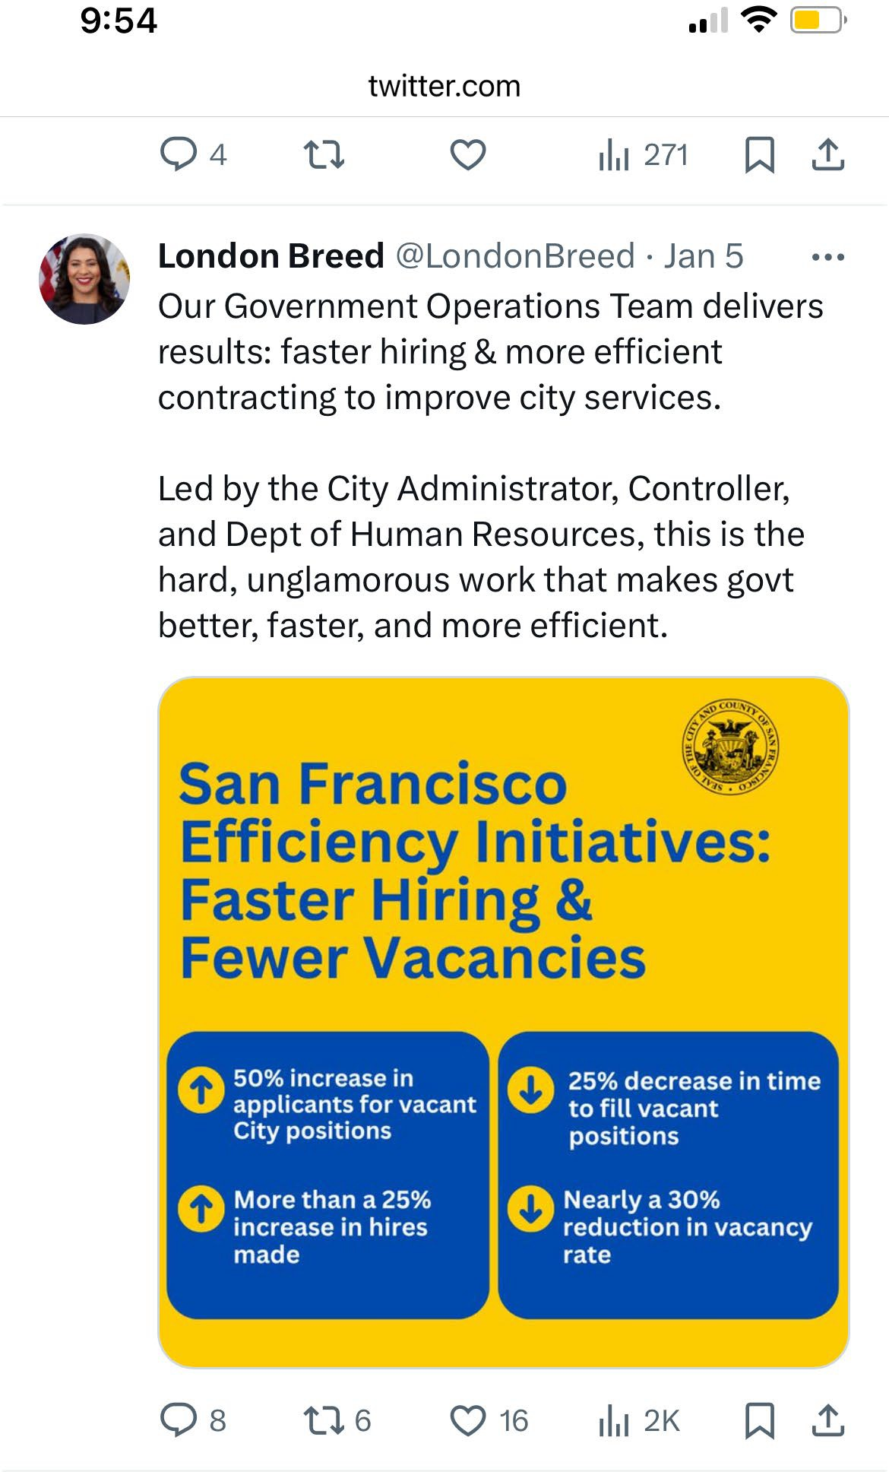
Our work is translating into meaningful impact
Application volume
Hiring totals
Vacancy rate
Time-to-fill
46%
year-over-year increase
26%
year-over-year increase
33%
decrease since Oct. '22
23%
decrease compared to Oct. '22
4

Slide 12
On path to reimagining exams
Launched six continuous testing processes for high vacancy classes:
Processed 10,000+ applicants so far through online on-demand vendor (Vervoe)
Processed scores and established eligible lists
Piloted online on-demand vendor's functionality on 14 recruitments for behavioral consistency questionnaires, oral and multiple choice assessments for various departments
The shortest recruitment timeline was 22 days from receiving the request to set up and administer the exam to posting of the eligible list (9221 Airport Operations Supervisor and Core A administration for PUC)
Current median timeline is ~70 days
Using lessons learned to inform procurement of additional online on-demand exam platforms which we hope to launch with new approach to assessments altogether

Slide 13
Current projects: Employee journey
Workforce Structures
Sourcing Recruiting Assessing Vetting
Onboarding
Employee Relationships
Compliance Leaves
Benefits and Payroll
Performance
Succession Planning
Learning and Development
Offboarding
Alumni Relations
HR Service Modules
Records
Digital Personnel Record
Support
Hiring Support HR Support Center
Analytics & Reporting
Hiring Data | Starting on Workforce Data | People Analytics
SF Careers
Intranet
Comms & Presentation
SF Careers
Hiring Modules People Analytics Portal

Slide 14
Problem and opportunity

Slide 15
Problem descriptions
Onboarding & Electronic Records
SF|My Portal – Intranet
Personnel files are paper:
During COVID, files were inaccessible
Searching the files of long-time employees is difficult
Records are not reportable and the lack of structured data prevents us from using that information to enhance the employee experience
Onboarding experience is inconsistent
Employees in different departments are given early access to information and services in an inconsistent way
First part of the employee’s journey with the City and the lack of consistency often prevents them from hitting the ground running on Day One
No one-stop shop to access everything you need as an employee
Current employee portal is not extensible to address all use cases
Employees access services
differently depending on department
Inconsistent access to HR services creates inequities between employees
The costs associated with maintaining paper records and siloed service delivery are expensive.

Slide 16
Potential cost savings
Item | FY 23-24 Savings | Savings Type
CON-Systems Infrastructure Reduction | $ 20,596 | Ongoing
CON-Systems Upgrade Project Reduction | $ 209,800 | Ongoing
CON-Ongoing Platform Support | $ 13,650 | Ongoing
 | $ 244,046
Improved efficiencies
Reduced redundancy when updating employee-facing documentation
Emergency response and management information sharing

Slide 17
Three modules supporting one goal
Electronic Records
Onboarding
Portal
The base of any employee’s journey with the City
Where an employee’s journey with the City begins
How an employee accesses services and manages their own persona.

Slide 18
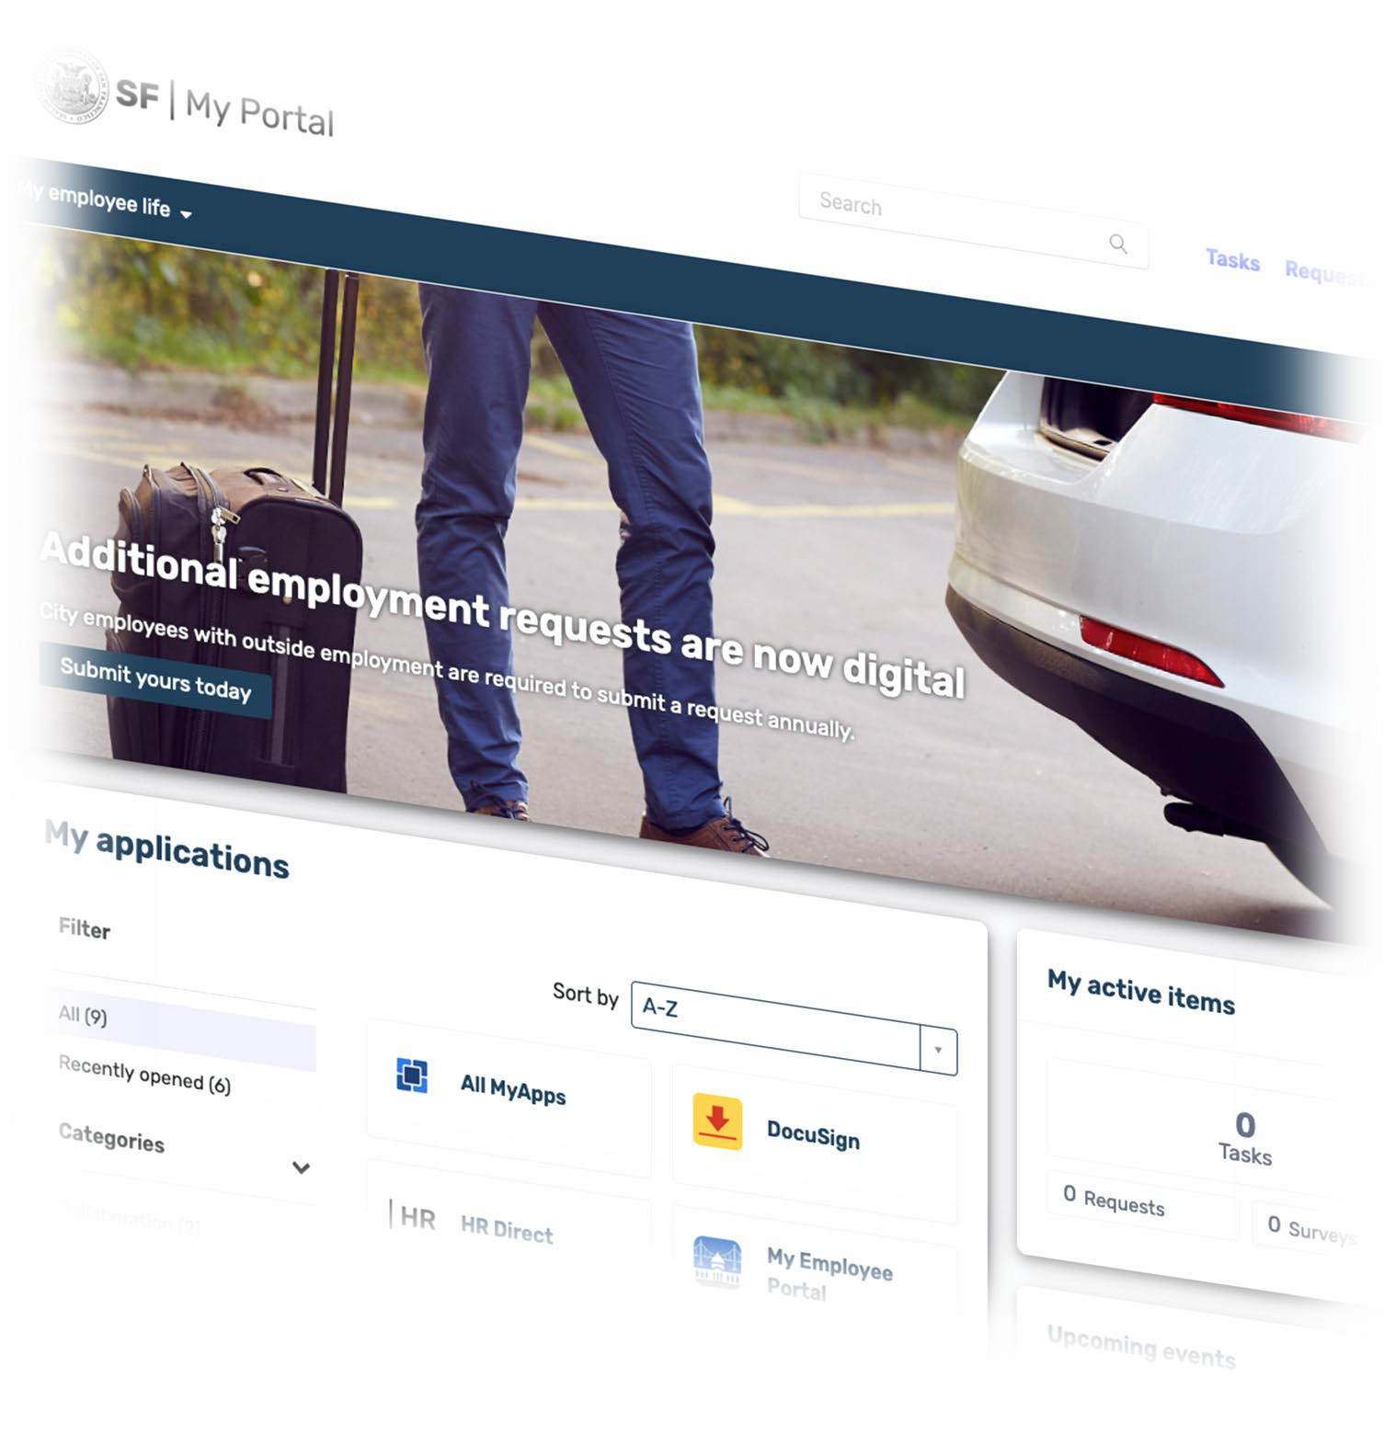
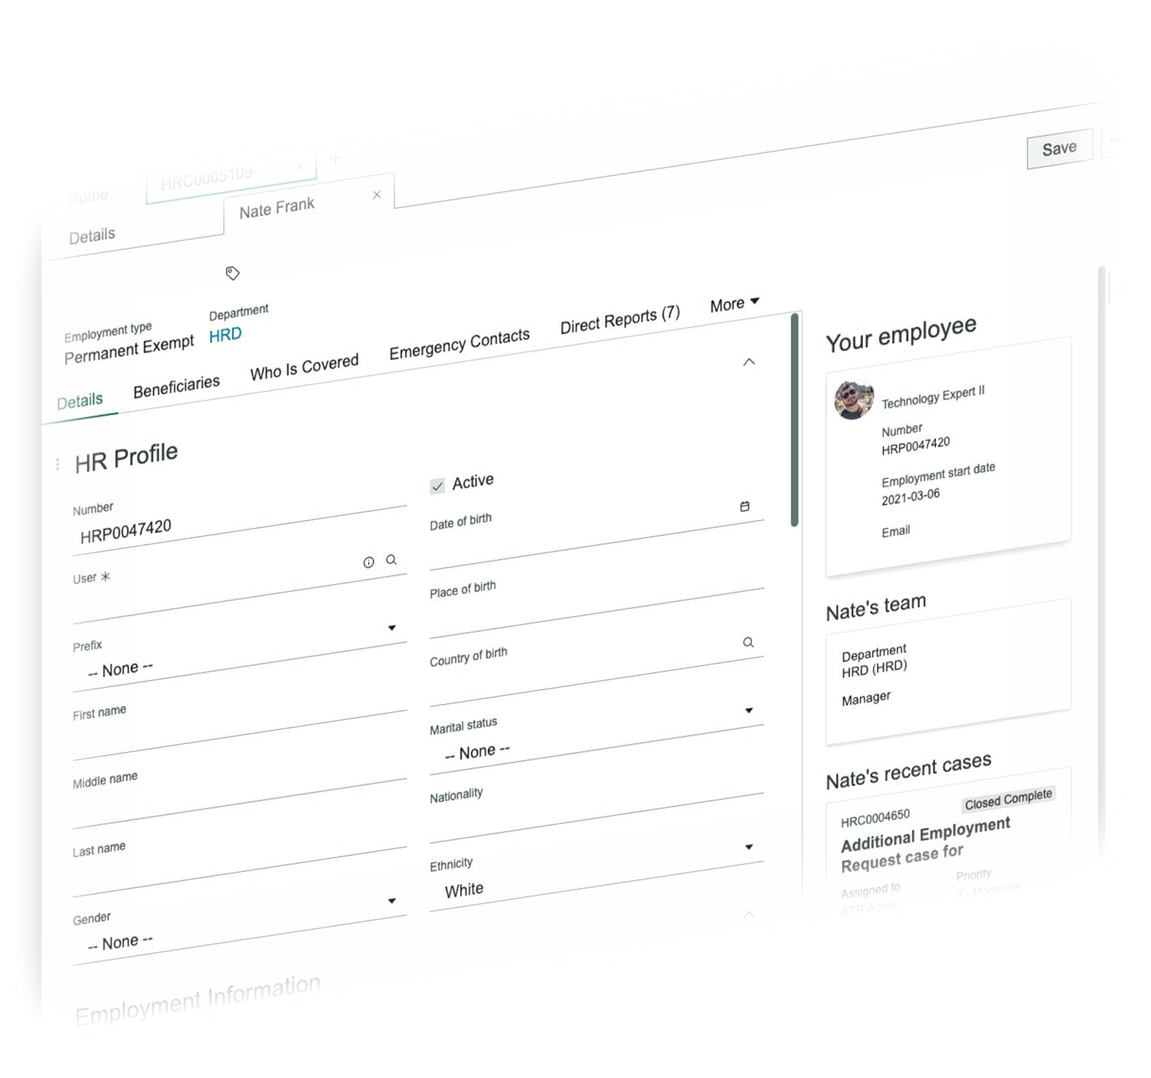
Joint portal for a unified experience
HR
Services
More
Payroll
My Portal
Procurement Requests
Agent Workspace
IT
Services
Information Sharing

Slide 19
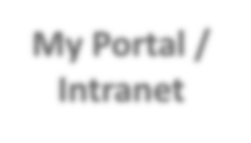
Project components and status
FY 22-23 23-24
24-25
Electronic Personnel Records
Employee Profile Foundation
Record Producer Workflow Design
Iterative Delivery
Digitization of Paper Records
Iteration
Employee Onboarding
System Integration
Research
Design
Pilot
Iteration
My Portal / Intranet
UI
Development
Knowledge Population
Employee Portal Migration
Multi- Department Expansion
Additional Integration
Completed
In-progress
Iterating on

Slide 20
What has this translated into so far?

Slide 21
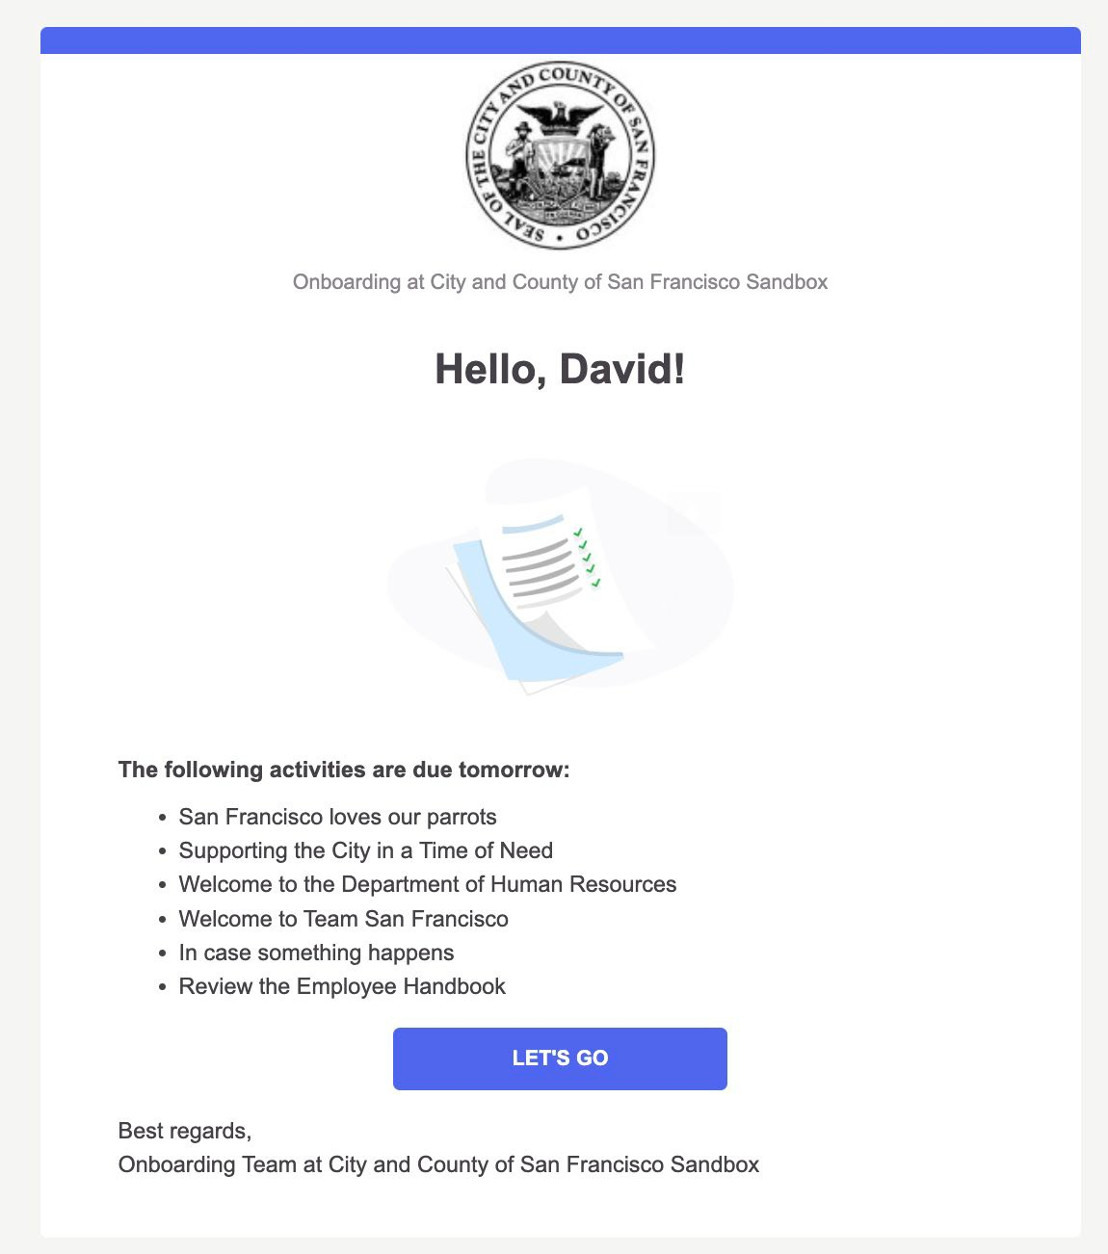
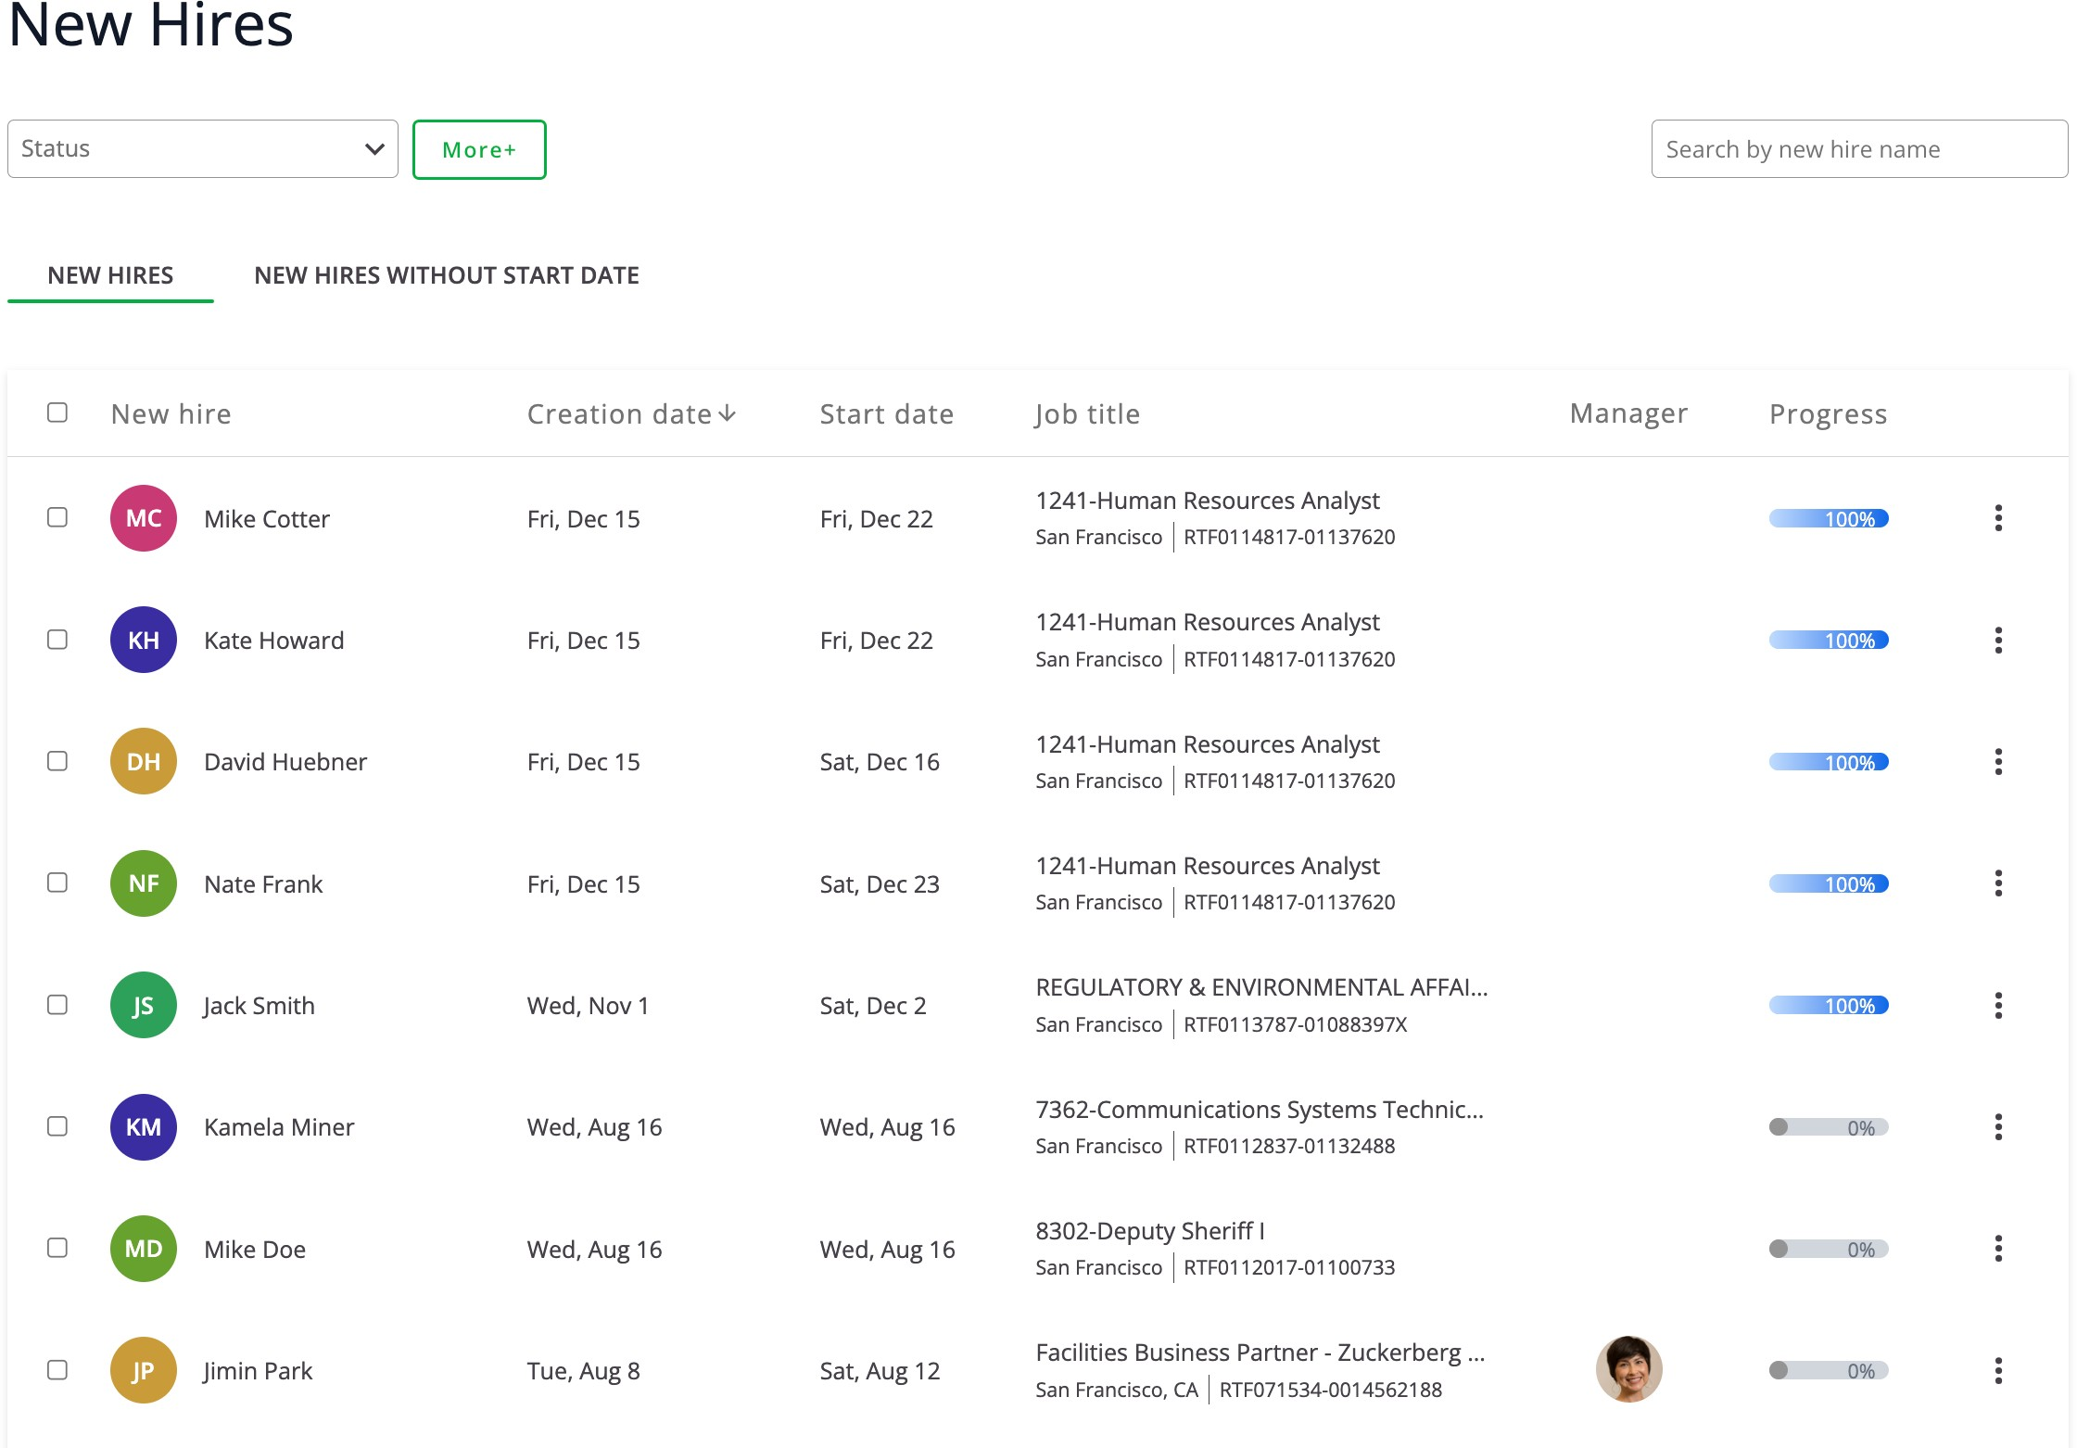
Onboarding pilot coming later this quarter

Slide 22
Resourcing for delivery

Slide 23
Total funding request
Portal/Intranet: New Ask FY24-25: +$1.3M, Total $2.0M
Onboarding/Personnel Records: New Ask FY24-25: +$1.3M, Total $1.3M

Slide 24
Non-staff funding requests
Licensing
Professional Services
$900k in additional licensing costs to support Employee Journeys within ServiceNow
Includes: ServiceNow Enterprise Upgrade for 35k Users
Includes: Employee Document Management for 35k Users
$750k in professional services to support rapid development and deployment of onboarding features with internal team to support management and enhancement of tools into the future.

Slide 25
Non-staff funding to support delivery in a year
Enterprise licenses allow for:
Document management
Department flexibility with more agency given to managers
Dedicated workflows pre- and post-hire
Pathway to handle offboarding as well
Alumni (Retiree) access to systems
Professional services allow for:
Expedited development of all workflows pre- and post-hire
Without these two pieces, we would likely only deliver a very rudimentary solution especially in a world where we would need to develop other solutions for document management in the digital personnel record

Slide 26
IVR Enhancement
DEPARTMENT of Building Inspection
Presentation to COIT Budget & Performance Subcommittee
3/1/2024

Slide 27
Project Overview

Slide 28
Project Overview
Problem Statement
Provide an automated inspection scheduling solution for all permit applicants.
With the current IVR system, permit applicants can only schedule inspections via a phone call.
Project Objective
Implement inspection scheduling function via web and SMS with current IVR system.

Slide 29
Project 5-Year Financial Forecast
 | FY24-25 | FY25-26 | FY26-27 | FY27-28 | FY28-29
COIT Allocation
Other Sources | $300,000 | $60,000 | $63,000 | $66,000 | $69,000
Total Project Funding | $300,000 | $60,000 | $63,000 | $66,000 | $69,000

Slide 30
High-Level Project Plan
List key project activities in left-hand column, known dates of key milestones in second column, and adjust length/position of blue bars and diamonds to indicate time period/duration for listed activities.
Quarter/FY | Dates of Key Milestones | FY24 | FY24 | FY24 | FY25 | FY25 | FY25 | FY25 | FY26 | FY27 | FY28
 |  | Q2 | Q3 | Q4 | Q1 | Q2 | Q3 | Q4
Project Initiation
Contracting
Project Kick-off
Implementation
Requirements gathering
System configuration
UAT
Go-live

Slide 31
Measuring Project Success
Key Performance Indicator(s)
Current inspections scheduling stats
DBI Staff 50%
IVR 50%
Within 1 year of system Go-Live, inspections scheduling stats will be
DBI Staff 25%
IVR 25%
Web/SMS 50%

Slide 32
Risk Mitigation Strategies
[For remaining slides, complete either a set for each project or one set addressing all of Department’s projects collectively]

Slide 33
Project Risk Management Plan
COIT considers a thoughtful list of potential risks and plan to address them to be a strength. For a helpful reference on types of project risk, see this this resource.
Below, please discuss the risks this project might face. What could fail and why? How would you prepare for these risks? Some common risks are pre-populated below, but feel free to change these as appropriate for your project.
Potential Risk #1: Budget Overrun and/or Vendor Delays | Your Plan to Prepare for/Mitigate this Risk Factor in 20% as a budget buffer. Rigorous reference check on potential vendor during RFP phase.
Potential Risk #2: Project Scope Creep (project deliverables expand beyond original plan and exceed available resources) | Your Plan to Prepare for/Mitigate this Risk Adopt PMI scope management methodology. Focus on scope control which align defined scope against requirements collected.
Potential Risk #3: Staffing/Capacity for Implementation, Deployment, Training | Your Plan to Prepare for/Mitigate this Risk Resource planning during project initiation. Identify business SMEs and project participants, prioritize project tasks over operational tasks for all project SMEs and resources.

Slide 34
Project Risk Management Plan, Continued
Below, please answer two questions related to a scenario in which your project does not receive funding.
Consequences of Not Funding | One of DBI’s strategic goal is to improve inspection turnaround time. The consequence for not implementing this system will prevent DBI meeting this strategic objective.
Alternate Plans | If project is not funded, DBI will explore the feasibility of developing an interim scheduling system by internal IT team. DBI will hire additional staff to provide scheduling service over current phone system.

Slide 35
Change Impact Assessment
Purpose: This template can help you determine the degree and complexity of change your project entails. It also brings focus to who and what is impacted, which can sharpen your plans for communication and training.
Impact Analysis
Dimension of Change
Description of the change
Operational Impact
There will be minimal impact to operation since this project will not change current inspection processes and workflows.
Policy & Management Impact
There will be minimal impact to DBI policy and management since this project will not require new surveillance or cybersecurity technology.
Impact to Specific Roles/Teams,
Departments,
Residents
This project will have minimal impact on DBI employees. It will provide an additional service to local property owner and permit applicants with the intent of improving overall inspection turnaround time.

Slide 36
Questions?

Slide 37
Lightweight CRM
DEPARTMENT of Building Inspection
Presentation to COIT Budget & Performance Subcommittee
3/1/2024

Slide 38
Project Overview

Slide 39
Project Overview
Problem Statement
DBI is the execution department for many local legislations related to building safety and in many cases which will require customer to register and provide their contact information as part of the process.
Project Objective
Implement a lightweight CRM system for DBI to store and track customer contact information.

Slide 40
Project 5-Year Financial Forecast
 | FY24-25 | FY25-26 | FY26-27 | FY27-28 | FY28-29
COIT Allocation
Other Sources | $300,000 | $60,000 | $63,000 | $66,000 | $69,000
Total Project Funding | $300,000 | $60,000 | $63,000 | $66,000 | $69,000

Slide 41
High-Level Project Plan
List key project activities in left-hand column, known dates of key milestones in second column, and adjust length/position of blue bars and diamonds to indicate time period/duration for listed activities.
Quarter/FY | Dates of Key Milestones | FY24 | FY24 | FY24 | FY25 | FY25 | FY25 | FY25 | FY26 | FY27 | FY28
 |  | Q2 | Q3 | Q4 | Q1 | Q2 | Q3 | Q4
Project Initiation
Contracting
Project Kick-off
Implementation
Requirements gathering
System configuration
UAT
Go-live

Slide 42
Measuring Project Success
Key Performance Indicator(s)
Current state:
Lack of customer contact information tracking mechanism.
Expected future state:
Self-service register and contact information tool can be provisioned and configured within 30 days of an legislation adoption.

Slide 43
Questions?

Slide 44
JUSTIS Program

Slide 45
JUSTIS Program: Project Objective
Emergency
Mgmt.
CAL DOJ
JUSTIS Data Hub
Police Department
Sheriff’s Office
Superior Court
District Attorney
Public Defender
Adult Probation
Juvenile Probation
Modernizing the JUSTIS Hub to Improve Delivery of Services and Reduce Long-Term Technical Debt
Deploying the JUSTIS API to integrate with partner agencies
Converting Oracle SOA Suite to Python to reduce costly Oracle licenses
JUSTIS Migration Cloud
DR in the Cloud
Establish the Data Center of Excellence (DCoE) - Operating Model and Governance and Reporting and Analytics
Expanding the Data Integration Hub and establish the Data Sharing Capabilities
Finalizing Operating Agreement and Service Levels
Provide consultative support to agencies developing queries and reports on inter-agency data
Prepare and maintain the JUSTIS Data Taxonomy
Provide centralized Data Quality Assessments
Prepare periodic assessments of DCoE effectiveness
Notes:
Develop Queries, Reports and Visualizations as prioritized by Data Governance
Administer the Enterprise Reporting Tool

Slide 46
JUSTIS Program: Performance Measures
Completed FY23/24:
Completed development of a JUSTIS hub that connects eight departmental case management systems and shares data across these systems.
Completed the new JUSTIS / Courts system integration.
Daily Average of 17,000 Messages Received From the Courts & 2,000 Messages Sent to the Courts
Business applications for querying the data Hub and producing alerts and notifications have been developed.
Submitted Workplans for Performance & Strategy, Data & Architecture, Systems & Large Projects, Operations & Maintenance
Planned FY24/25:
Build JUSTIS API to Integrate With New Systems at The Sheriff's Office and District Attorney's Office
Disaster Recovery on Azure - Proof of Concept
Database Migration from CMS14 to Data Lake, allowing JUSTIS to support additional data and features
Convert old Oracle SOA Suite to Python
Notes:
- Highlight any challenges we are facing.
- We might be asked about swapping out funding

Slide 47
JUSTIS Program: Business Benefits & Impact
Business Benefits:
Reducing Technical Debt: Focusing on technical goals which will allow us to retire legacy software & hardware that is costly to maintain. Goal is to reduce operating costs long-term
Governance: Continue maturing JUSTIS governance initiatives
Data in the format that each agency needs
Easy to maintain, Less points of failures
Major Stakeholders: Public Safety & Criminal Justice
Primary Users: Public Safety & Criminal Justice

Slide 48
JUSTIS Program: Funding Request
 |  | FY2024-25 | FY2025-26 | FY2026-27 | FY2027-28 | FY2028-29 | FY2029-2030
Total Project Costs | High | Upcoming Need = $1.64M Carry Over = $2.1M Net Ask = $0 | $1.70M | $1.47M | $925K | $300K | $0
 | Low | Upcoming Need = $1.41M Carry Over = $2.1M Net Ask = $0 | $1.45M | $1.22M | $675K | $300K | $0
Funding requested from COIT |  | $0 | $1.70M | $1.47M | $925K | $300K | $0
Breakdown of Funding Ask: | FY2024-25 | FY2025-26
Data Center of Excellence:
Business Analyst Contractor (1) | $230,000 | $230,000
Lead Business Data Coordinator 1054-O | $250,000 | $250,000
Project Manager 5502-T | $257,000 | $257,000
Data Lake/Data Warehouse subscription/licensing | $50,000 | $75,000
Data Catalog | $30,000 | $50,000
JUSTIS Hub Enhancements:
APEX Developer / API Developer (Contractor) | $220,000 | $220,000
Oracle Licenses | $400,000 | $400,000
Python Developer TEX 1063-T01 | $200,000 | $220,000
Test Agency DR recovery | Existing Staff | Existing Staff
Engineer cloud back-up environment | Existing Staff | Existing Staff
Total: | $1,637,000 | $1,702,000
Notes:
APEX Developer Contractor- Currently Ravi, contracts to end in December. Need someone to help Vanessa for Apex.
$2.1M Carryover for 2024
- APEX
- 5502
- Oracle licenses
= $1,223,000
$460K differential between carryover and FY24-25 ask.
LOW cost budget adjusted for if the DCOE Business Analyst Contractor position does not move forward
How do we fully operationalize on JUSTIS and detach from COIT long-term?
Can we set up a fund for JUSTIS which DT maintains and carries over?
The hub enhancements is about re-platforming JUSTIS to the Cloud.
Plan: We do 3 year projection

Slide 49
Gen AI Center of Excellence

Slide 50
Gen AI Center of Excellence: Problem Statement
Gen AI is a term used to describe the next generation of artificial intelligence technologies, characterized by advancements in learning, adaptation, and problem-solving abilities, potentially rivaling or surpassing human intelligence. It is capable of generating text, images or other data using generative models, often in response to prompts.
Background:
Generative Artificial Intelligence (Gen AI) has great potential to provide public benefits. When used appropriately, the Gen AI tools have the potential to expand the City’s toolkit for public service.
The Gen AI Center of Excellence will provide guidance, set best practices, and coordinate with all City departments to be aligned use of Gen AI so that it can use be used effectively.
It will help advance a unified Gen AI vision within the City and a standard framework for Gen AI adoption to ensure there is an appreciation of Gen AI benefits, risks and limitations.
Problem Statement:
CCSF is in early stage of Gen AI Evaluation, the Gen AI Center of Excellence will help in effectively adoption of Gen AI technologies across various departments so that it can be used effectively.

Slide 51
Gen AI of Excellence: Objectives
Facilitate collaboration and adoption of Gen AI technologies
Build Generative AI expertise and encourage adoption of best practices
Create a platform for innovation and experimentation
Encourage Depts’ investment in pilot projects to demonstrate Generative AI value
Advance the responsible and secure use of Generative AI.
Provide recommendations related to generative AI policy, development, procurement and deployment
Guide further integration of the technology into the City daily operations to improve productivity
Foster knowledge sharing to take advantage of industry advancements
Develop training and educational resources for Generative AI literacy to IT and City Staff.
Create Community of Practice across the city
Gen AI can benefit city governments by optimizing infrastructure, improving citizen services, enhancing public health and safety, managing traffic, facilitating emergency response, and informing policy development through advanced data analysis and smart technologies.
Notes:
Add copilot for M365 in the scope

Slide 52
Gen AI of Excellence: Key Metrics
Adoption of Gen AI Technologies
Adoption rate of Gen AI solutions across the organization
Cross-Functional Collaboration
Level of collaboration between different departments
Impact on Operations:
Evaluate how Gen AI solutions enhance operational efficiency, reduce costs, and improve productivity across various city government functions.
Success Metrics
Percentage of successful Pilot projects
Number of Departments/City Staff trained
Notes:
Key metrics for a Gen AI Center of Excellence include AI performance, impact on operations, citizen satisfaction, data quality and security, innovation and adoption, risk management, ROI, talent development, ethical and regulatory compliance, and alignment with long-term strategic goals. These metrics help measure the effectiveness, efficiency, and ethical implementation of AI initiatives in city governments.

Slide 53
Gen AI of Excellence: Key Business Benefits and Impact
Benefit - Innovation Acceleration
Impact - Fostering a culture of continuous improvement
Benefit - Cost Savings Opportunities
Impact - Reduces operational costs through greater automation
Impact - Shared platform for AI across the city, leverage DT Contract for cost savings.
Benefit - Cross Functional Cooperation
Impact - encouraging knowledge sharing and holistic problem-solving
Notes:
Implementing Gen AI in city governments yields efficiency gains, data-driven decision-making, improved services, resource optimization, enhanced public safety, citizen engagement, innovation stimulation, enhanced brand reputation, risk mitigation, and long-term sustainability, fostering economic growth and societal well-being.

Slide 54
Gen AI of Excellence: Potential Risks and Mitigation
Establishing a Center of Excellence (CoE) for Gen AI in city governments involves various risks, which can be mitigated through several strategies
S. No | Potential Risks | Mitigation Strategies
1 | Cost Overruns | Develop detailed budget plans and monitor expenses closely.
2 | Skill Shortages | Invest in training programs and offer competitive compensation packages.
3 | Ethical Concerns | Establish clear ethical guidelines and involve diverse stakeholders in decision-making.
4 | Resistance to Change | Communicate benefits of AI, involve employees, and provide support.
5 | Security Vulnerabilities | Implement robust cybersecurity measures and regular assessments.
6 | Misuse of AI | Implement strict governance frameworks and prioritize ethical considerations.
By proactively identifying and addressing these risks, city governments can enhance the effectiveness and sustainability of their CoE for Gen AI, ensuring that it contributes positively to urban governance and development.
Notes:
By proactively identifying and addressing these risks, city governments can enhance the effectiveness and sustainability of their CoE for Gen AI, ensuring that it contributes positively to urban governance and development.

Slide 55
Gen AI Center of Excellence Funding Request
 |  | FY2024-25 | FY2025-26 | FY2026-27 | FY2027-28 | FY2029-30
Total Project Costs | High | $1,536,000 | $1,636,000 | $1,496,000 | $0 | $0
 | Low |  |  | $0 | $0 | $0
Funds requested from COIT |  | $1,536,000 | $1,636,000 | $1,496,000 | Operational | Operational
Breakdown of Funding Ask: | FY 2024-25 | FY 2025-26 | FY 2026-27
Platform Cost for Azure AI, Open AI, M365 Co-Pilot | $400,000 | $500,000 | $600,000
2 AI Engineers (1043 & 1044) - AI ($248K per position) | $496,000 | $496,000 | $496,000
1 Lead (0932) for projects, collaboration, policies and training | $240,000 | $240,000 | $240,000
External Consulting Services: costs for hiring external experts and consultants. | $240,000 | $240,000
MSFT Unified Support for AI | $160,000 | $160,000 | $160,000
Total: | $1,536,000 | $1,636,000 | $1,496,000
Existing DT employee will be the Technical lead in the AI Center of Excellence and will be funded through DT’s operations budget.
Not building a Center of Excellence for Gen AI in city governments can lead to challenges such as lack of expertise, inefficient resource use, biases in decision-making, missed innovation opportunities, scalability issues, difficulties in monitoring progress, and competitive disadvantage, ultimately hindering effective governance and development.
Notes:
100 CoPilot license for 1 year commitment
Open AI license.
Ask for 3 years
Lead can be 1071 resources
1041 can be technical resources

Slide 56
Item Number 7
Review the remaining schedule for Department presentations (March- April)
Discussion

Slide 59
Adjournment

