Slide 1
Shelter Monitoring Committee
Annual Report to the
Homelessness Oversight Commission
Fiscal year 2022 - 2023

Slide 4
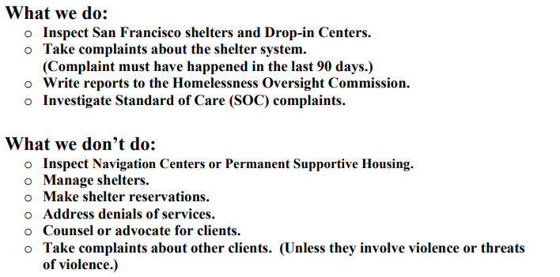

Slide 5
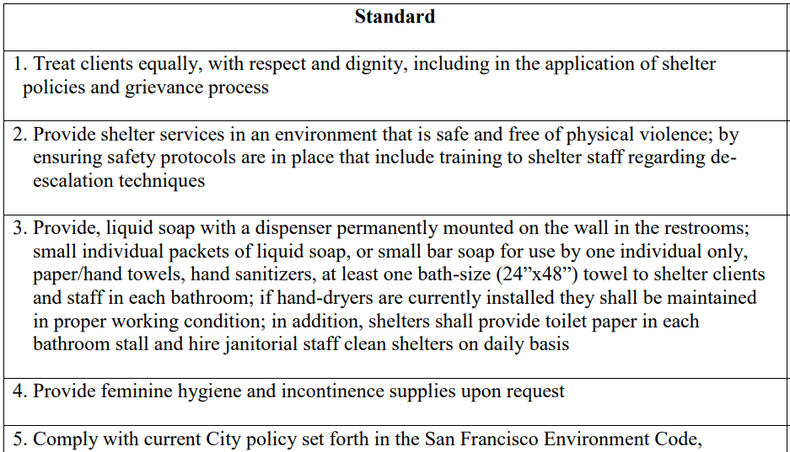
https://sf.gov/sites/default/files/2022-12/Standard%20of%20Care%20List%202019.pdf

Slide 6
Complaints
Phone (415) 255-3642
Email shelter.monitoring@sfgov.org
On-line form ↓
Shelter Monitoring Committee | San Francisco (sf.gov)
In-person 440 Turk St. Monday, Wednesday

Slide 8
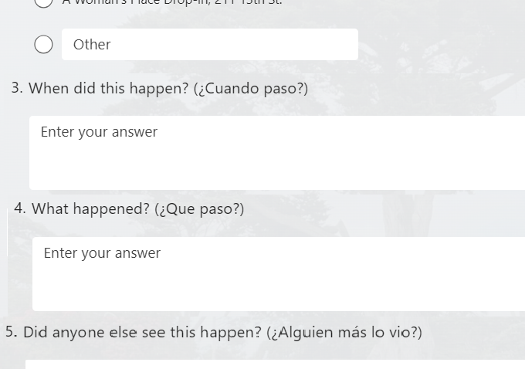

Slide 9
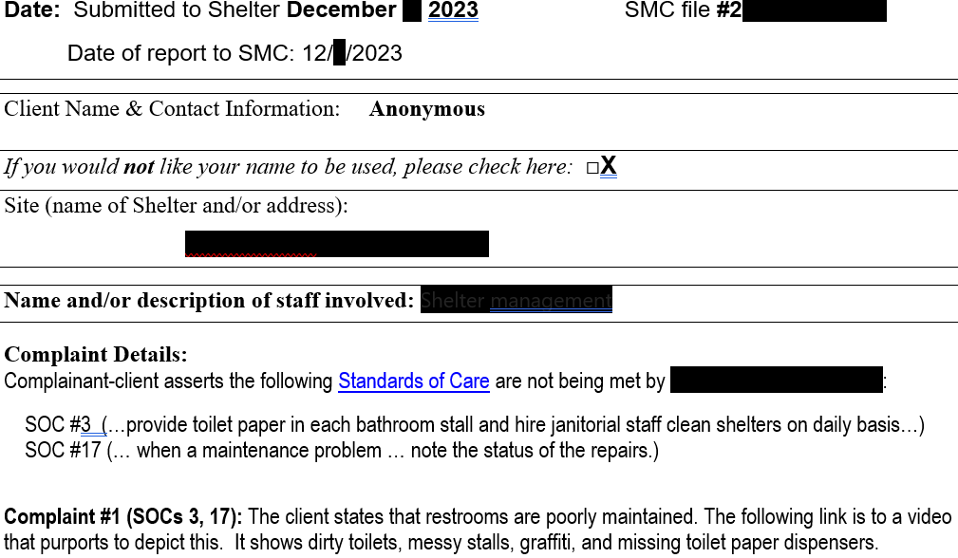

Slide 12
Number of allegations by Standard of Care (FY22-23):

Slide 13
Complaints by site - Fiscal year 2022 – 2023
Shelter | Total | Navigation Center | Total
A Woman’s Place | 1 | Bayview Nav | 1
AWP Drop-in | 6* | Central Waterfront Nav | 1
Adante | 1 | Division Circle | 1
Hamilton Family | 1 | Lower Polk TAY | 1
Monarch | 2 | Taimon Booton | 1
MSC-South | 5*
Next Door | 4
Sanctuary (ECS) | 12*
Total | 37* | * Includes non-unique | complainants

Slide 14
Site Visits (Inspections)

Slide 15
Central Waterfront Navigation Center

Slide 16
Members look at restrooms and showers:

Slide 17
Are vents dirty? Rust is okay; heavy dust is not:

Slide 18
Do guests have lockable storage? Water?

Slide 19
Is there adequate bedding? Electrical outlets?

Slide 20
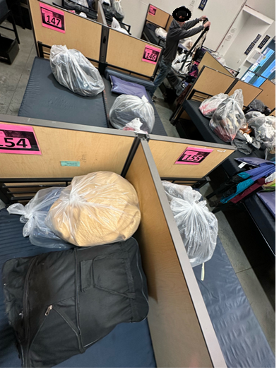
Are beds too close together?

Slide 21
Are services offered in a safe environment?

Slide 22
Is the shelter clean?

Slide 23
Are staff properly trained?

Slide 24
Is the shelter welcoming?

Slide 25
Other SMC Activities at the Shelters
Participation in Town Hall Meetings
Surveys of client satisfaction
Investigation of complaints that are not resolved to the satisfaction of the complainant
Standard-of-Care Training for Staff

Slide 26
So far in Fiscal Year 2023 - 2024

Slide 27
Near-term Outlook
Member Concerns
Training of shelter staff should be given more focus
There are still two vacancies (Seats 1 and 5)
New Officers
Britt Creech was elected Vice Chair
Angie David was elected Secretary
Diana Almanza was elected to another term as Chair
Site Visit Schedule has been disseminated to Members
A second staffer should be hired early in the new year
The Hot-line phone number will be changed to an HSH number

