Slide 1

Homelessness Gross Receipts Tax
Fall 2023 Update
CITY & COUNTY OF SAN FRANCISCO
Office of the Controller
12.08.2023

Slide 2
2
Overview
San Francisco business taxes are volatile, and budgets are based on forecasts at a moment in time. We update those projections throughout the year to help policy-makers manage budgets to a changing reality.
We’re projecting a significant loss in business tax revenue versus budgeted levels, in both the current and future fiscal years. Our November forecast projects approximately $40M up to $55M in annual losses in the current and future fiscal years from the prior projection. This revision is in addition to the downward revision of a similar magnitude made in the prior years.
Some downside risk remains. While the forecast assumes little or no growth in the City’s underlying tax base, it is not a recession scenario.
Current and future year plans may need to be revised. We will have another forecast in Spring 2024, in time for the annual budget cycle.

Slide 3
3
Basics of Homelessness Gross Receipts Tax (HGR)
November 2018 Proposition C imposed a tax on gross receipts in excess of $50M, in addition to the existing gross receipts business tax. (i.e., if a business earned $150M, it pays taxes on $100M)
Rate: HGR tax rates differ by industry
Base: Homelessness gross receipts tax (HGR) payors include the largest payors of the existing gross receipts (GR) tax. In tax year 2022, there were 358 payors of HGR versus 10,492 payors of GR.

Slide 4
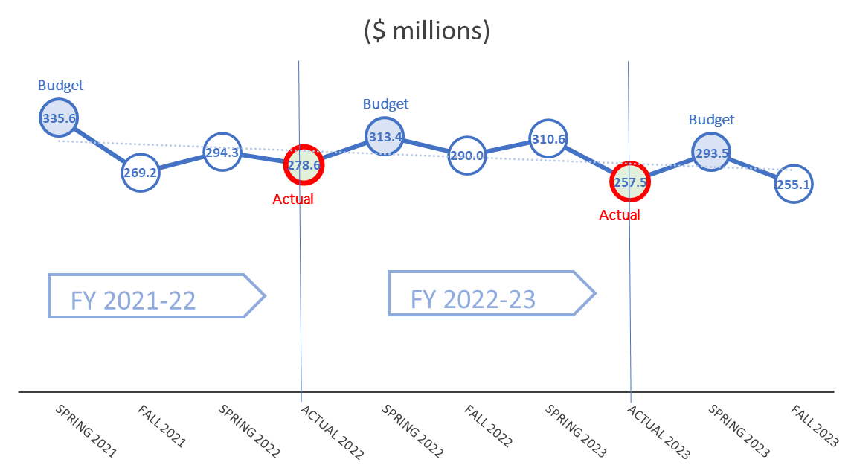
4
Volatile and Unpredictable Revenue Source
HGR Tax revenue came in significantly below budget in the last 2 years (by $57M in FY22 and $65M in FY23).
These variances are primarily due to (1) the taxpayer basis being highly concentrated so changes at a few large firms have an outsized effect on revenue (2) high levels of active business tax litigation that can affect prior year payments.
247.5
247.5

Slide 5
5
FY 24 through FY 28 Preliminary Forecast
Based on the volume of recent tax refund claims, the forecast was lowered from our previous assumption.
Key assumptions:
Slow or no growth of tax base in earlier years of forecast to reflect slowing of the economy, and back to inflation in future years.
Current levels of remote work continue.
Lower tax base to reflect ongoing litigation risk.

Slide 6
6
Next Steps
January 2024, Controller, Mayor’s Office and Board of Supervisors issue the Five-Year Financial Plan
February 2024, Controller’s Six-Month Budget Update for FY 2023-24
March 2024, Controller, Mayor’s Office and Board of Supervisors issue an update to the Five-Year Financial Plan
May 2024, Controller’s Nine-Month Budget Update for FY 2023-24

Slide 7
7
Closing
Current year forecast. As in the last two fiscal years, departments will need to ensure expenditure budgets align with forecasted revenue amounts in FY 2023-24.
Spending plans in the upcoming budget years will need to be revisited. The Controller’s Office will update our future fiscal year forecasts in February and March of 2024 with the most recent information.
There’s significant risk to this forecast.

