Slide 1
San Francisco VA Health Care System Updates
Kathleen Mink, LCSW
Outreach Specialist/Health Systems Specialist
Office of Strategic Planning

Slide 2
PACT Act Outreach Efforts Suicide Prevention Santa Rosa Clinic Expansion Virtual Services

Slide 3
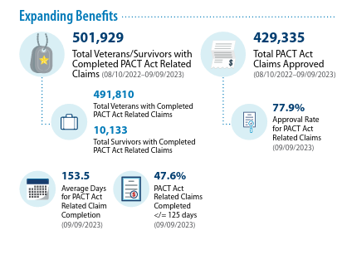
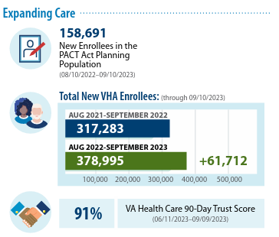
PACT Act
Largest health care and benefits expansion in VA history
4.5 million toxic exposure screenings performed
Over 1 million PACT Act-related claims submitted
Processed more than 551,000 claims, granting 77.9%
Awarded more than $2.2 billion in earned benefits to Veterans and survivors

Slide 4
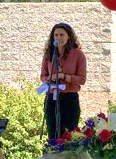
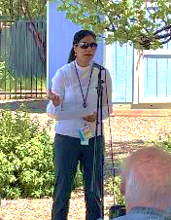
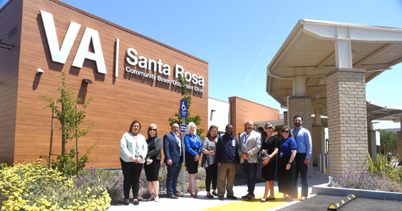
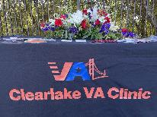
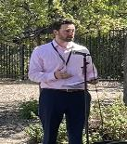
PACT Act Awareness Events
Clearlake VA Clinic
PACT Act Awareness Event
April 27, 2023
South Santa Rosa VA Clinic
PACT Act Awareness Event
Friday, June 16

Slide 5
Ft. Miley PACT Act Resource Fair
Saturday, September 30, 2023 10:00 a.m. - 1:00 p.m.
Outreach event to aid in connecting all Veterans with the new health care and benefits they’ve earned
Event Offerings
VHA Enrollment/Eligibility
Toxic Exposure Screenings
Claims Assistance (Partnership with Regional Office VBA Oakland)
Flu Vaccinations
Blood Pressure Screenings
Million Veteran Program
Whole Health Service Overview & Resources
Outreach Support
Social Work Services
VA Scheduling for Primary Care, Mental Health, and Direct Schedule Specialties

Slide 6
Outreach Efforts
PACT Act specific
Direct outreach calls to 8G combat Veterans (~59 enrolled and ~12 pending review)- collaboration with SFVA member services
PACT Act outreach emails to community partners Vet Force, SF Federal Executive Board, Vets In Tech, Salesforce, SF and SM County Veterans Commission, OneVet OneVoice, SF Giants, Swords to Plowshares, Heart and Armor, SFVA SVHP, CVSO offices, SFPL, CalVet, SF POA, etc.
PACT Act townhalls in Santa Rosa and SF with Congressional Representatives

Slide 7
Additional Outreach Efforts
Presentations/Tabling/Meetings:
San Mateo County CVSO/SAVES presentation
CalVet webinars: re: VA health care and PACT Act and ChampVA
National Guard outreach with Oakland VBA outreach staff
SF Fire Department: meeting with SFFD regarding SFVA health care, PACT Act and tabling at SFFD health care open enrollment event- Presentation was a collaboration with member services and Dr. Jenny Cohen
Coast Guard attended Coast guard family day and webinar with Coast Guard service members. Collaboration with member services, SP, CVSO and Dr. Cohen.
America Works- Employment fair (tabling) – Collaboration with Chris Waltrous and Bridget Leach (Student Veteran Health Program)
Presentation at San Mateo County Veterans Commission (re: MH/VA health care)
Meeting with Swords to Plowshares, CDCE VSO stakeholders, VSO post meetings and community events such as National Night out in Daly City
Meeting with SF Giants regarding employment fair. Currently in contact with SF Giants Community Relations Director
Presentation regarding VA health care/ PACT Act given to SF Federal Executive Board
Lunch and Learn for VBA Oakland employees
Homeless Project Connect- collaboration with SWer Jamie Jensen and Jaime Nugent
Fleet Week
Upcoming Veterans Appreciation Celebration (Oakland Probation Office)

Slide 8
SFVA Internal Efforts
Survey/suspense to better understand outreach done at SFVA
Communication, collaboration and support to individuals who do outreach
Connecting staff who do outreach, combining enrollment with employment and homeless outreach
Updating resource sheets used by Member Services/outreach teams to include new patient appt scheduling number, modernize handouts
Work with Member Services to identify additional methods of assisting Veterans rather than referring them to HEC or to the online application
Direct connection created between outreach teams, Member Services, M2VA to call center staff to schedule appt following enrollment or connecting with Veteran
Beginning to collaborate ED, primary care regarding Veterans who are not assigned to PACT teams

Slide 9
Creating and Updating New Outreach Materials

Slide 10
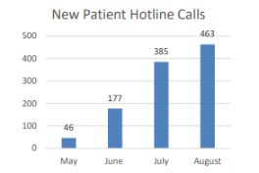
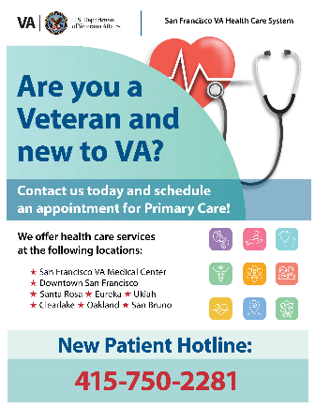
SFVAHCS New Patient Hotline
Outreach
Launched in May 2023
Operated Monday-Friday from 7:30 a.m. - 6:00 p.m.
Direct Pathway to coordinate patient care for both New and Re-establishing Veterans
Resource for SFVA Outreach team to connect patient with services at point of care while at outreach events in the community
Promotional Flyer in development and will be shared widely internally and externally to VA

Slide 11
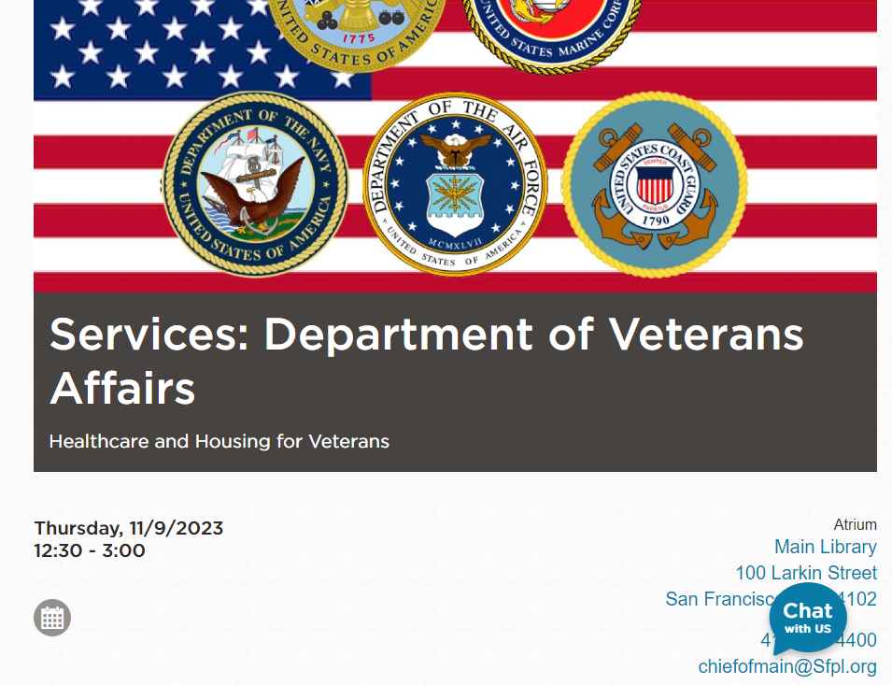
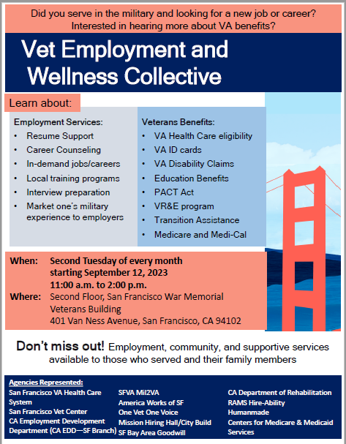
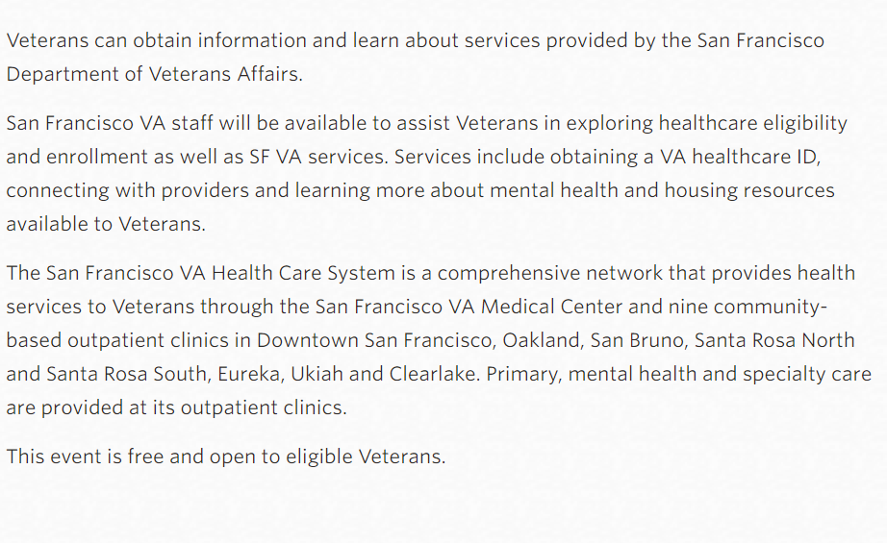
Community Outreach

Slide 12
Raising Awareness of Veteran Suicide Prevention

Slide 13
Suicide Prevention Awareness Month Events
Trainings:
Lethal Means Safety Counseling (for community partners)
Lock Box Distribution (for Veterans & community partners)
Assessment and Management of Suicide Risk (for clinicians)
Acute Suicide Interventions (for clinicians)
Events:
Sonoma County Veterans Art Day (Petaluma)
Connection is Prevention at the Old Courthouse Square (Santa Rosa)
Out of the Darkness Community Walk (SF & Humboldt)
Research:
Clinician Response to Postvention: A Retrospective Analysis of Response Effects on Clinician Practice & Retention
Social Media:
PSAs on SFVAHCS’ Facebook & Twitter pages
Notes:
Trainings:
1. Lethal Means Safety Counseling and Lock Box Distribution on September 26th from 12pm-2pm at Finley Center and offering 2 CEs. In collaboration with the local Veterans Affairs office, we are offering a free two hour course on Lethal Means Safety Counseling (LMSC) which is an evidence-based intervention intended to promote the safety of a person in suicidal crisis or in anticipation of a crisis. LMSC facilitates collaborative discussion to assist a person with increasing time and distance between their suicidal intent and their ability to access lethal means. This training will explain the importance of addressing means safety as part of suicide prevention and how the implementation of LMSC can enhance suicide prevention efforts in your own community. We will distribute fee lock boxes following the presentation, and the lock boxes (see image below), which can store medications or a hand gun, can be a vital part of safety planning.
2. Suicide Prevention 3CEUs: This training will help to build necessary clinical skills during interventions and increase use of motivational interviewing. The purpose of this live virtual training is to increase knowledge of national suicide trends, gender and ethnic differences, and trends in Veterans. This training will discuss suicide prevention efforts, suicide risk assessment, safety planning, and VA suicide prevention tools/procedures. It will highlight successful interventions, such as recognizing warning signs, proper assessment of risk, and ensuring appropriate and timely care are given. (Tentative date: Sept. 21, 2023, for MH and SW providers)
3. Lethal Means Safety and Acute Suicide Interventions 3 CEUs: The purpose of this live virtual training is to support clinicians in becoming effective lethal means safety counselors and to provide clinically appropriate acute interventions for suicide risk. Research shows that access to lethal means matters and can significantly reduce suicide risk if proper training is provided. The discussion on lethal means and acute suicide interventions will promote safety, ways to approach complex clinical populations and situations, and identify risk and protective factors. ((Tentative date: Sept 28, 2024, for MH and SW clinicians)
Tabling events:
1. Life On Earth Art (LOEA) is a non-profit organization in Petaluma that connects with veterans struggling with emotional, mental, social and isolation challenges. They offer the opportunity for artistic and emotional self-expression, and for the vets to be in community with other veterans in a safe, uplifting environment. LOEA is producing their first annual Sonoma County Veterans Art Day on September 23rd at their Petaluma studio and workshop. The event will focus on exhibiting the art of veteran artists. It will be an afternoon of art exhibits, presentations, a drum circle, veteran storytelling, artmaking, veteran service organizations' information tables, music, food, drink and more. (Sponsored by MH Services Oversight and Accountability Committee, funded by CA Prop. 63)
2. September 10th: Sonoma County Life Worth Living: Suicide Prevention Alliance in collaboration with West County Community Services are planning a community event, called Connection is Prevention at the Old Courthouse Square. At this free event there will be activities, presentations, and resources from a wide variety of diverse groups. The event schedule is below, Mayor Natalie Rogers and Jan Cobaleda-Kegler will be speaking at the event.
3. American Foundation for Suicide Prevention, SF Out of the Darkness Community Walk, Sept. 9., 2023: The Community Walks, held in hundreds of cities across the country, are the core of the Out of the Darkness movement, which began in 2004. These events give people the courage to open up about their own connections to the cause, and a platform to create a culture that’s smarter about mental health. Friends, family members, neighbors and coworkers walk side-by-side, supporting each other and in memory of those we’ve lost.
Research:
1. Postvention and Clinician Response: A Retrospective Analysis, September 14: The SFVA Suicide Prevention Team conducted a 2 year nationwide survey of VA mental health clinicians who have lost patients to suicide. They examined the impacts upon clinicians of such loss and the resultant VA system responses, with particular attention to the association between formal retrospective reviews like peer reviews and RCAs and clinician retention, as well as changes in clinician clinical practice after the review (both negative and positive). Findings and recommendations for VA HCS were presented to the field in honor of Suicide Prevention Awareness month.

Slide 14
Don’t Wait. Reach Out.
Downloadable materials for both VA internal and external audiences will be available at https://www.va.gov/REACH/spread-the-word.
Notes:
The U.S. Department of Veterans Affairs (VA) Office of Mental Health and Suicide Prevention (OMHSP) uses Suicide Prevention Month in September to raise awareness & increase understanding about Veteran suicide prevention and the programs and resources available.
In October 2021, as part of their ongoing efforts to address this public health issue, VA launched a national campaign: “Don’t Wait. Reach Out.” The public service advertisements (PSAs) encourage Veterans to reach out for help before their challenges become overwhelming.
The campaign directs both those seeking and providing, support to VA.gov/REACH, a website that makes it easier to find guidance and support services from across the full breadth of the VA’s offerings. The user-friendly experience invites Veterans to identify the specific life challenges they may be struggling with—like trouble sleeping or financial stress—then serves up the appropriate resources for their unique needs.
* Resources can be found at the “Spread the Word” digital toolkit landing page on VA.gov/REACH, which serves as the hub for shareable content for use by a broad network of colleagues, stakeholders, and supporters.

Slide 15
COMPACT Act Campaign Expansion
Approximately 30,000 Veterans accessed COMPACT Act benefits to date
A post implementation gap analysis completed this spring
Highlighted the complexity of care delivery afforded by COMPACT Act
Need for a singular point of contact at each facility
By September 30, 2023 all VA HCS across the enterprise:
Will have a dedicated COMPACT Act Coordinator to ensure all care is received
Transitions are safe and comprehensive
Veterans are not billed for COMPACT related care
SFVAHCS appointed Mental Health Service as lead on the initiative
Notes:
Compact ACT: provide, pay for, or reimburse for treatment of eligible Veterans' emergency suicide care, transportation costs, and follow-up care at any VA or community health care center for up to 30 days of inpatient care and 90 days of outpatient care 
Why do facilities need a COMPACT Act Coordinator?
On January 17, 2023, VHA implemented COMPACT Act. This spring, a post implementation gap analysis was completed and highlighted the complexity of care delivery afforded by COMPACT Act and the need for a singular point of contact at each facility to ensure all care is received, transitions are safe and comprehensive, and Veterans are not billed for COMPACT related care.

What roles and responsibilities will a facility COMPACT Care Coordinator have?
This is a developing role that will evolve over time. We have developed the following list with preliminary functions of a facility COMPACT Act Coordinator:
Navigation between varying levels of care
Coordination between health care providers and care managers in direct care and community care
Comprehensive transition planning
Outreach to community providers and healthcare systems providing COMPACT care
Advocacy for Veterans, ensuring they do not receive bills for COMPACT related care
A singular point of contact for Veterans, families and caregivers during COMPACT episodes of care
Facility subject matter expert for COMPACT Act
Coordinate with local Patient Advocate Tracking System – Replacement (PATS-R) COMPACT clinical review teams
Collaborate with their local facility revenue and finance departments
Coordinate with their local facility Office of Integrated Veteran Care (IVC) Coordinators

Slide 16
Expansion of Medical and Specialty Services – South and North Santa Rosa VA Clinics

Slide 17
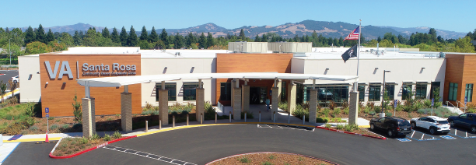
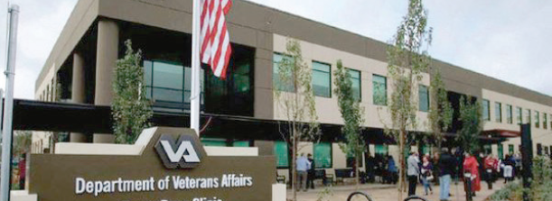
Expanded Medical and Specialty Services – Santa Rosa VA Clinics
South Santa Rosa VA Clinic 2285 Challenger Way Santa Rosa, CA 95407 (707) 569-2300
North Santa Rosa VA Clinic 3841 Brickway Blvd Santa Rosa, CA 95403 (707) 569-2300

Slide 18
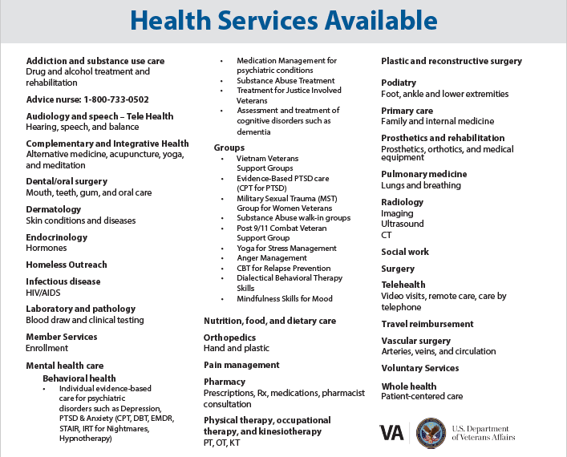
South Santa Rosa VA Clinic

Slide 19
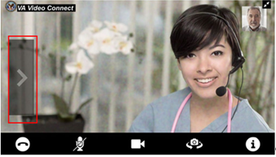
Services Offered Virtually – Video to Home
Primary Care
Mental Health
Rehabilitation
Almost all medical and surgical specialties at the San Francisco VA Medical Center have providers who can provide video to home visits when visits are appropriate for a virtual platform

Slide 20
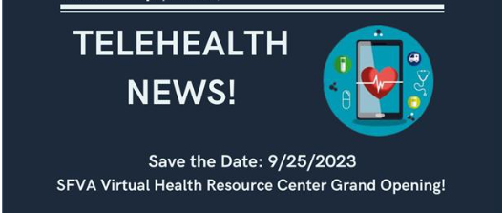
SFVAHCS Virtual Health Resource Center
SFVAHCS Virtual Health Resource Center (VHRC)
Launching on 9/25/2023
Staffed with health technology experts who provide in-person, phone, and/or virtual guidance, hands-on support, training, troubleshooting, and information regarding virtual care tools such as VA Video Connect, MyHealtheVet, health apps, and devices
VHRC staff provide these services for Veterans, caregivers, and VA Staff
Operating Monday - Friday from 8:00 a.m. - 4:00 p.m.
Telephone: 415-379-5661

Slide 21
Questions

