Slide 1
OCOH Meeting: HSH Updates
Oct 26th, 2023

Slide 2
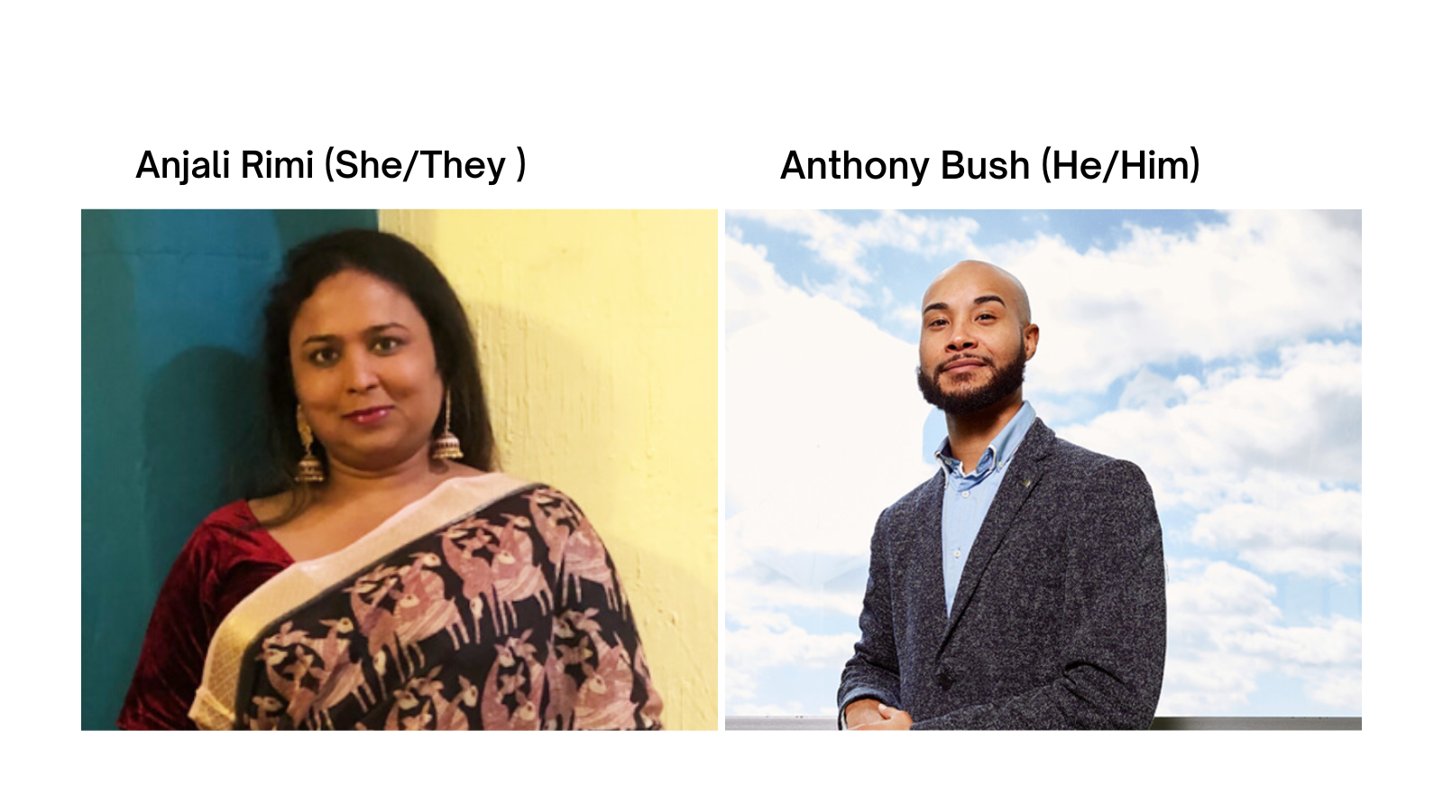

Equity Office
Andrew Tse(He/Him)
Notes:
Add Anthony and Anjali Photo. Elaborate. Introduce yourselves. Once we get through some housekeeping.

Slide 3
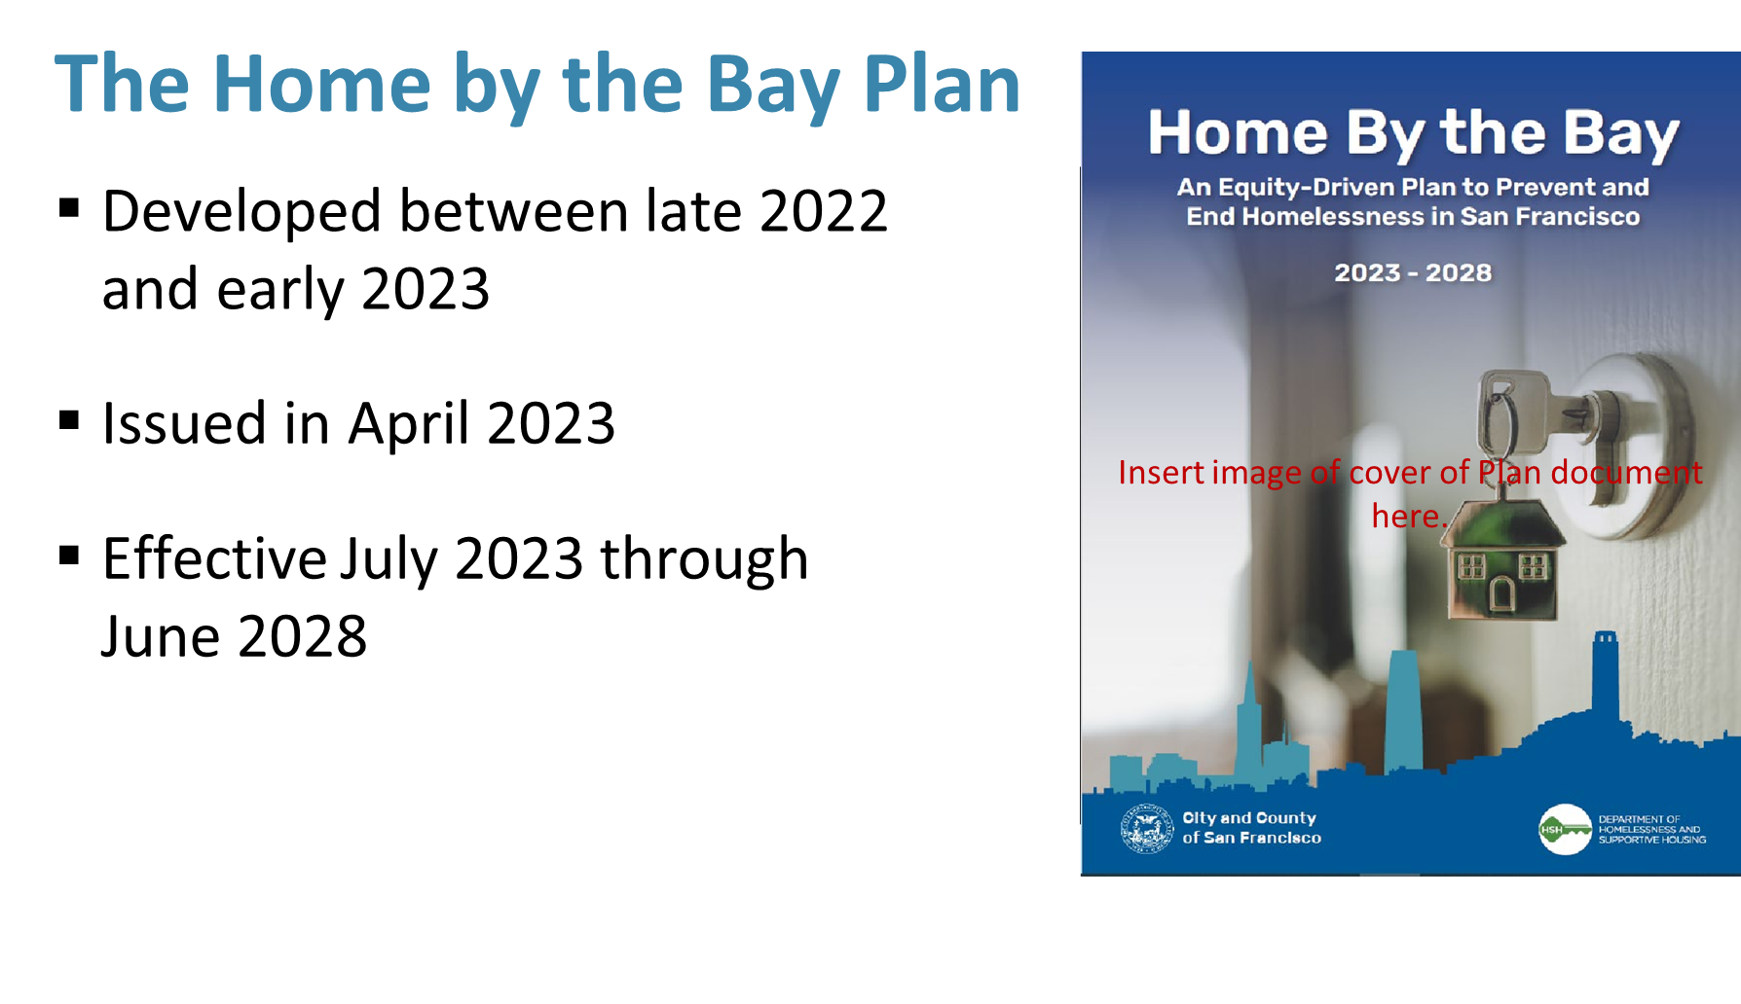

Slide 4
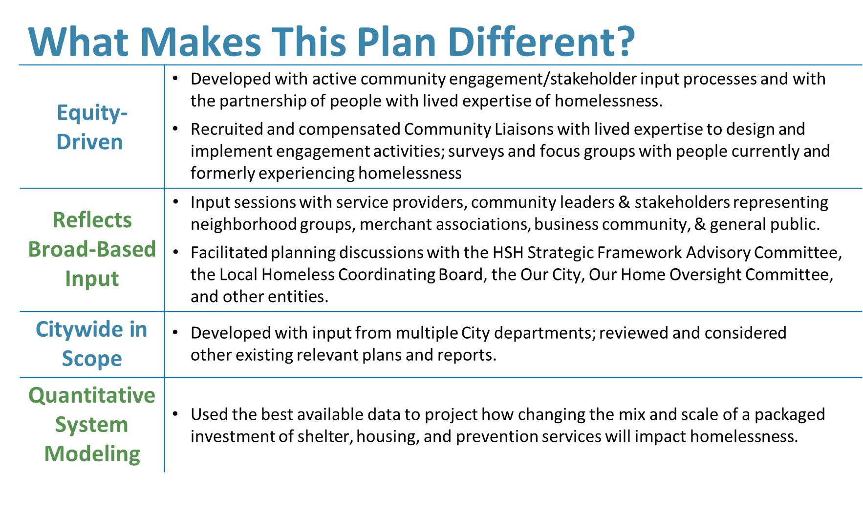

Slide 5
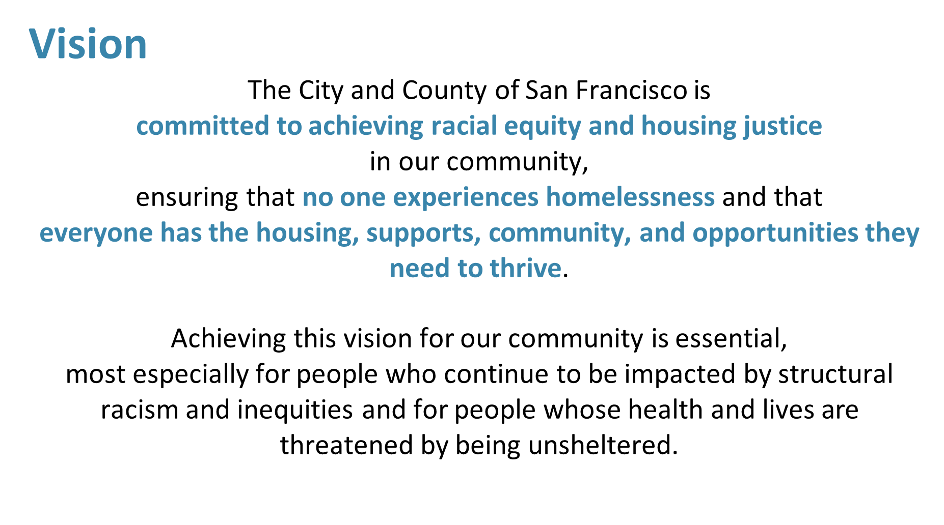

Slide 6
Why Equity Matters
BIPOC (Black, Indigenous, People of Color) populations are overrepresented in the homeless population.
The US Census estimates non-Hispanic White and Asian populations make up 75% of the population of San Francisco.
Data from the Coordinated Entry system shows White and Asian populations make up 32.1% of enrollments into our Homeless Response System.
BIPOC populations make up nearly 68% of the HRS while accounting for under 25% of San Francisco’s total population.
San Francisco Population Source: https://www.census.gov/quickfacts/fact/table/sanfranciscocountycalifornia/PST045222#qf-headnote-b
Coordinated Entry Source: https://hsh.sfgov.org/about/research-and-reports/hrs-data/coordinated-entry-demographics/
Notes:
HUD standards have evolved to combine Race and Ethnicity fields. This has muddied available data from ONE – Latine was originally captured as Ethnicity, now merged into a single field. This has led to a massive spike in the Multiracial population – i.e., somebody with a response in the Race field (e.g. Indigenous) and a Hispanic/Latino response in the Ethnicity field has been automatically merged as Multiracial.
Statistics here are from FY21-2022: BIPOC (Black, Latine, Middle Eastern, Multiracial, Native American, and Native Hawaiian or Pacific Islander) total 8,461 enrollments in CE. White/Asian alone total 4,009 enrollments.

Slide 7
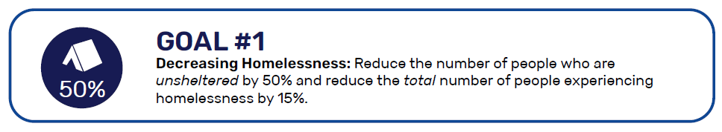


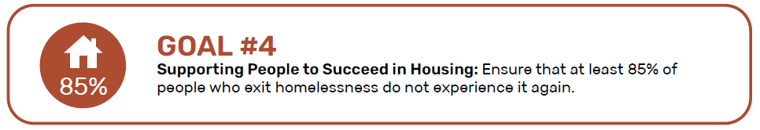

Strategic Plan System Goals: HOMEBYTHEBAY
Notes:
Anjali
Among the survey’s questions, people were asked, based upon their lived expertise, what the City’s top priorities for addressing homelessness should be over the next five years.
The top five priorities identified were:
Improving housing options
Making it easier or faster to get housing
More housing options
Improved shelter system
Improved case management services

Slide 8
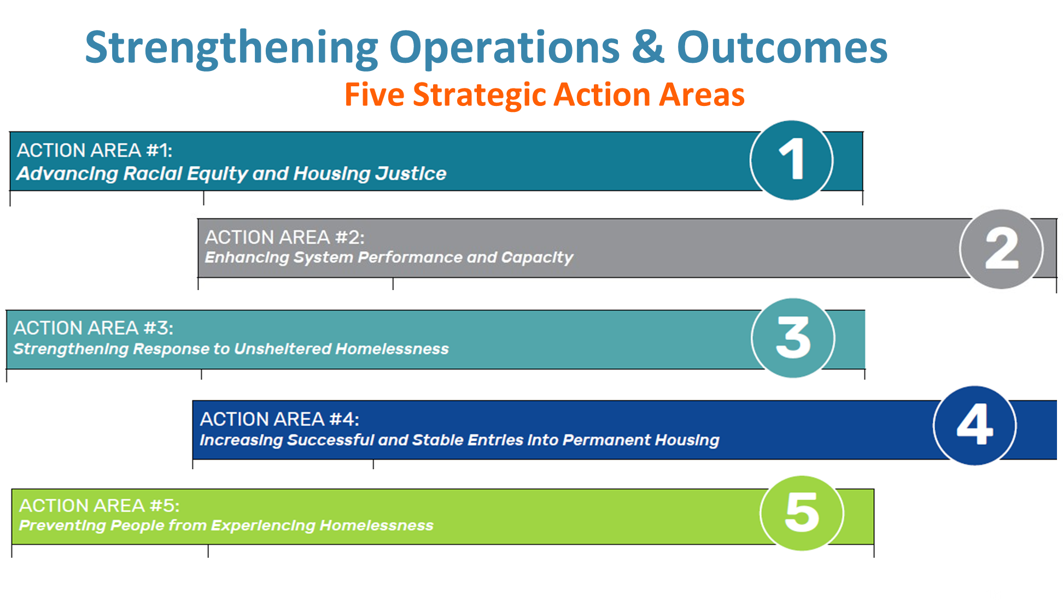
Notes:
Anjali
Among the survey’s questions, people were asked, based upon their lived expertise, what the City’s top priorities for addressing homelessness should be over the next five years.
The top five priorities identified were:
Improving housing options
Making it easier or faster to get housing
More housing options
Improved shelter system
Improved case management services

Slide 9

Focus Areas for FY 23-24
CCSF- Overall
O.R.E Training Curriculum development by HSH
HSH- Overall
Embedding Equity in Programs- Latinx Homelessness, End Trans Homelessness & BIPOC Capacity building
HSH People
The Equity Office in Partnership with the DEI Committee hold monthly HSH community convenings where we center a cultural community impacted by housing injustice and invite subject matter experts to increase staff cultural humility/cultural competency around these issues.
The Programs Team, Strategy and Performance Team, and the Equity Office in partnership with the DEI Committee have developed an equity strategy to address the rise in Latinx homelessness and will collaborate with external partners to set metrics to target this issue.
Notes:
O.R.E Training Curriculum development by HSH EO
Embedding Equity in Programs- Latinx Homelessness, End Trans Homelessness & BIPOC Capacity building

Slide 10
HSH’s Racial Equity Training
In October of 2022 HSH’s Equity Office led the first training in a 4 part series that focused on how racism to equip all HSH staff with a foundational knowledge of how systemic racism informs the current landscape of homelessness.
The framework for the training focuses on 4 parts: Structural/Institutional Racism in Housing, Interpersonal Racism-Internal (staff), Interpersonal Racism External (CBOs), and Individual Racism (clients).
The series is wrapping in January of 2024 and will inform how we train our Community Based Organizations on the issues of racism and housing discrimination in the U.S.

Slide 11
What is an equity practice that your department has implemented in the last year and can share with other departments?
Developed a 4 part racial equity training series for all staff addressing racism: Systemic; Institutional, Interpersonal (internal), interpersonal (external) and internalized levels.
  Why: Major priority for R.E.A.P as HSH staff to do not have a shared language/understanding of how systemic oppression manifests in our organization, partnership with community based organizations, and clients we serve.
  How: Empowered our Equity Office to curate and facilitate all staff meetings to deepen staff's cultural competency and fluency on these issues.
  Outcome: After our initial training 70% of staff identified that their understanding and fluency on these topics significantly increased or generally increase by the end of the sessions. We used end of session surveys and community listening sessions to gather data.
  Follow up: We will continue the first year of training by the end of the quarter and develop a similar curriculum on a different 'ism for the next year. R.E.A.P1-3 series completed, 4 begins in Feb'24
Notes:
My Identity/My work, Diversity Celebration, HR&; Listening sessions, Community events- coaching circles, Career fair/Utilizing feedback. Employee- ORE, 2517, discpline/seperation: Exit interviews, do intent of employee, HR/Equity seperation. Add 4 slides. Racial equity/measure success.

Slide 12
Coordinated Entry Redesign- Equity Focus
CBOs
-
Equity Office HSH
CE Redesign Steering Committee & HSH Team
Equity office Engagements
- Community listening sessions
- Monthly shelter meetings
- Site visits- Individual conversations
- Data dashboarding to highlight disparities

Slide 13

HSH- Equity Office Initiatives
EXTERNAL
CBO-centering BIPOC Equity fund
  Project Management
  Capacity Building
End Trans Homelessness
  Project Management
  HSH Workstreams
Equity Interventions
  CBO- Community Liasoning
  CE redesign program
  Building resources- CBOs
“Home by the Bay” Strategic plan integration to External Equity measures and requirements.
CBO & Client Engagements
  Community Listening Sessions
  Intersectional data dashboarding
  Transgender ETH Advisory Council
  Diversity Celebrations- External Speakers/Artists
INTERNAL
R.E.A.P- NIS Implementation
  Racial Equity Training Series 1-4
  Leading PLC with ORE on cultural humility.
Create a sense of belonging
  Coaching circles cohorts
  Supervisor coaching circles(Feb 2024)
  Diversity Celebrations- My Identity My Work
  New Employee Equity Onboarding
  “Equity Matters” Monthly Newsletter
Internal stakeholder Equity Accountability
  Equity Dashboarding- Intersectional Benchmarking
  HSH Leadership-Team dynamics and interventions
  DEI and Social Committee partnerships and spaces

Slide 14
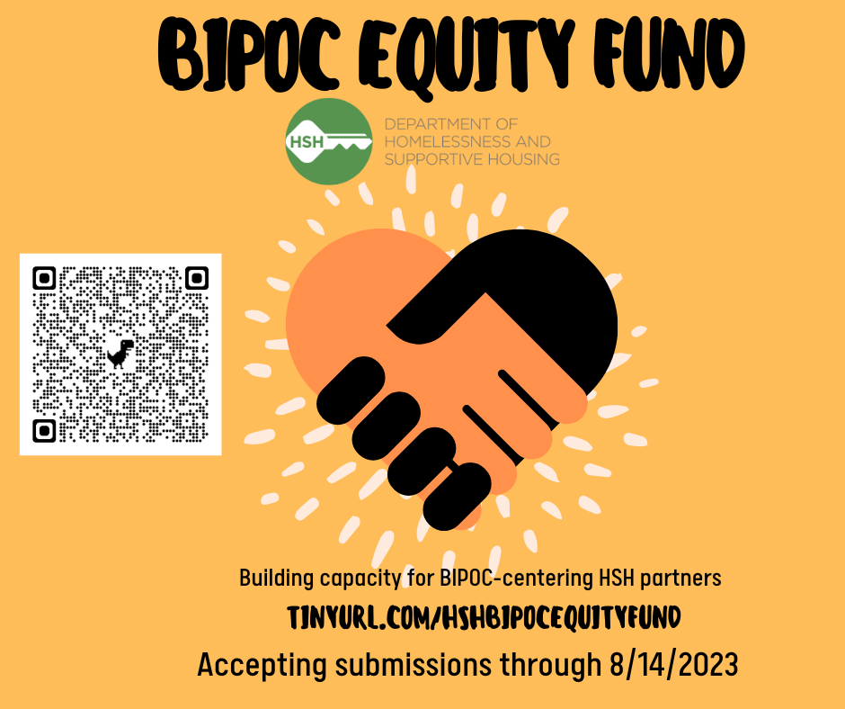
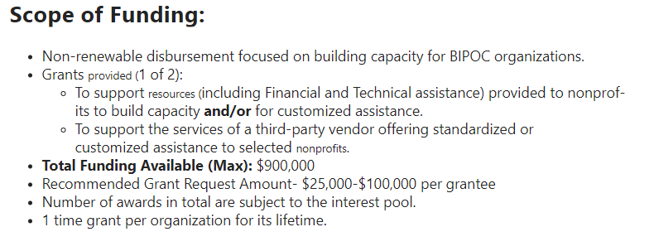
BIPOC Equity Fund-HSH: FY23-24
Organizational priorities :
Financial Management/Grants Management: fundraising, budgeting, and/or grant management
Talent/Leadership development, executive coaching support, and/or staff recruitment
Board and governance
DEI- Diversity, Equity & Inclusion Engagement Plan
Program design and service delivery
Operations infrastructure
Performance management
14
Notes:
Andrew

Slide 15
BIPOC Equity Fund-HSH: FY23-24
Accept Submissions
17 applications submitted
$1.48 million requested
Complete
Review Submissions
Team of 5 panelists reviewed each application
Complete
Video Conversations
9 applicants scheduled to attend video conversations
In Progress
Awardee Selection
Intent to Award
Fund Disbursement
Ranking finalists, Leadership approval
Target: 10/16
Inform selected organizations, review contract/supplier status
Target: 10/23
Add contract/supplier, deliver funds
Target: 11/01
Notes:
Andrew

Slide 16
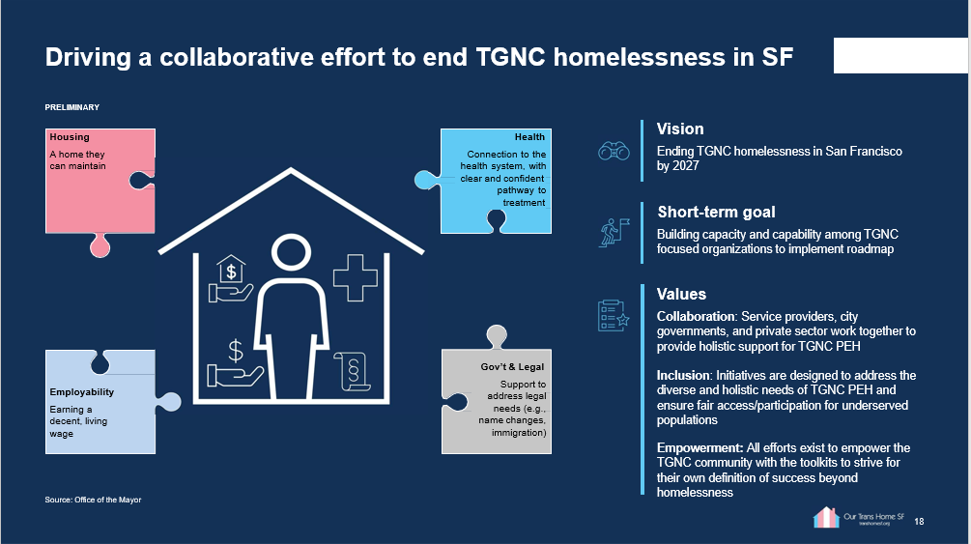
Notes:
Provide Context for the commission to better understand the overall initiative?
Are the commissioners on the same page in understanding ETH?
This initiative was brought about by the mayor and the commission in 2018-2019 with the purpose of Ending TGNCI by 2027. The overall goal is to ensure this community seeks stable housing and wrap around services, access to support them in attaining stable and sustainable housing.
Ensuring the PEH (Physical and Emotional Health) are part and parcel to this initiative the TGNCI community can thrive.
The Equity Office tasked with overseeing the ETH, after deliberation from several departments and collaboration between OTI, MOHCD, DPH, and HSH. The Equity Office will be driving the larger initative and updates from this point forward.

Slide 17
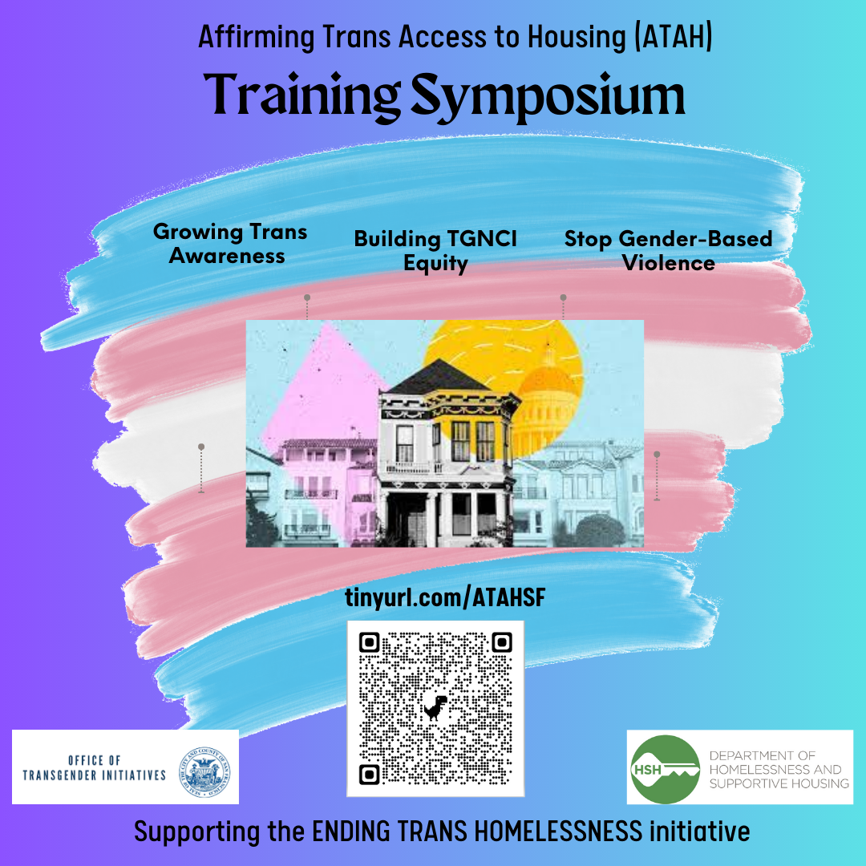
Top 10- ETH-HSH Priorities
ATAH (Affirming Trans Access to Housing) CBO specific training symposiums are 60% (254 individual signups) through March 2024. First session on 11/20/2023.

Slide 18
End Trans Homelessness Progress
Affirming Trans Access to Housing Symposium: Trans inclusion training for providers across the homelessness response system to improve service delivery for TGNCI people experiencing, or at-risk of, homelessness, led by OTI
Professional pathways for TGNCI Leaders: Professional development program for a cohort of 35 TGNCI service providers to complete the City College of San Francisco Community Health Worker Certificate Program

Slide 19
So far…
Trainings
Beginning 11/20
HSH- CBO
Professional Pathways
City College led
TAY PSH
RFP in progress
Flex Pool
Project Mgmt
Cultural Humility
TGNCI cohorts
Increasing competency
Budget approval in progress
Early 2024 timeline
Grantees selected
112 vouchers
Racial Equity
Equity Office takes the lead
Strategic Plan integration
Dedicated project leads for each work stream.

Slide 20
FY23-24 Guidance
Community Needs
Priorities
Increased placements to shelter and housing and other assistance for TGNCI people (HSH)
Remove barriers and strengthen cultural responsiveness across system(HSH)
TGNCI-inclusive programs that can address increased safety issues(MOHCD)
Data Equity to support system improvements that accommodates for TGNCI client needs(HSH)
Coordinated implementation of strategies to improve outcomes for TGNCI people and strengthen organizational infrastructure(HSH)
Support for people with lived experience who will support the City’s goals to end TGNCI homelessness (HSH)
Financial Barriers
Service coordination
Cultural Humility
Data Tracking Equity
Organizational infrastructure of TGNCI-focused organizations
Professional pathways for TGNCI leaders
Notes:
First year the grant began late, but the overall goal of the projects seek to address these community needs by prioritizing these areas. .
Y1 [FY22-23] Progress Highlights:
Housing for TGNCI youth:
OTI and HSH interviewed 6 youth-serving organizations, and held 1 focus group with TGNCI youth, to identify necessary features of a site dedicated to TGNCI youth exiting homelessness;
HSH identified a site based on input from providers and youth, and currently is in the process of purchasing a 40-unit building;
Housing for TGNCI adults:
City and community providers coordinated to continue implementation of housing and health care programs, helping over 300 TGNCI people access shelter and stabilize in housing across our systems;
MOHCD encumbered $3M in grants to TGNCI-focused housing providers to fund rental subsidies and staff for program expansions (these grants were encumbered in Q4 of FY22-23, so will be leveraged throughout FY23-24);
HSH issued a competitive bid for a Flexible Housing Subsidy Pool program serving 50+ TGNCI adults with permanent subsidies, and is currently in process of selecting a provider to run the program;
Behavioral health for TGNCI youth and adults:
DPH hired 3 behavioral health clinicians to expand mental health services at the TGNCI youth-focused Dimensions Clinic;
DPH completed a community input process to determine the highest behavioral health needs, and will soon be releasing a competitive bid to expand outreach and access to behavioral health services for TGNCI adults and youth experiencing homelessness, and to deliver trainings on trans inclusion to behavioral health clinicians serving TGNCI people experiencing homelessness;
Development and coordination of ETH initiative:
OTI, St James Infirmary and Mayor’s Office of Innovation partners developed a landscape analysis of TGNCI homelessness in San Francisco, with input from 15 TGNCI-serving community-based organizations (see summary of report in attachment “Homelessness & TGNCI People”);
OTI hosted multiple meetings with TGNCI-focused community-based organizations to gather input and update stakeholders on progress to date;
OTI hosts bimonthly meetings with HSH, MOHCD, DPH, Mayor’s Office and Mayor’s Office of Innovation to increase coordination and cohesion across various components of ETH initiative.

Slide 21
End Trans Homelessness
Homelessness deeply impacts TGNCI people​
It is estimated that about 800 TGNCI people experience homelessness over the course of the year.
TGNCI people are 18 times more likely to be homeless than the non-TGNCI population, and more likely to be unsheltered.
Precipitating events leading to homelessness among the TGNCI communities include: migration to the City (as a sanctuary City), inability to afford rent, family disputes, gender-based violence, and incarceration.
Unique needs of TGNCI people
Safety from violence and harassment.
Housing and Shelter that allows for privacy and enforces inclusive practices.
Gender-affirming health and behavioral health care
Employment that supports upskilling and allows people to address their health needs while sustaining employment.
Government and legal services that support migration and identification needs

Slide 22
End Trans Homelessness
System Needs
Addressing
Increased placements to shelter and housing and other assistance for TGNCI people.
Remove barriers and strengthen cultural responsiveness across system
TGNCI-inclusive programs that can address increased safety issues
Data Equity to support system improvements that accommodates for TGNCI client needs
Coordinated implementation of strategies to improve outcomes for TGNCI people and strengthen organizational infrastructure
Support for people with lived experience who will support the City’s goals to end TRANS homelessness
Financial Barriers
Service coordination
Cultural Humility
Data Tracking Equity
Organizational infrastructure of TGNCI-focused organizations
Professional pathways for TGNCI leaders

Slide 23
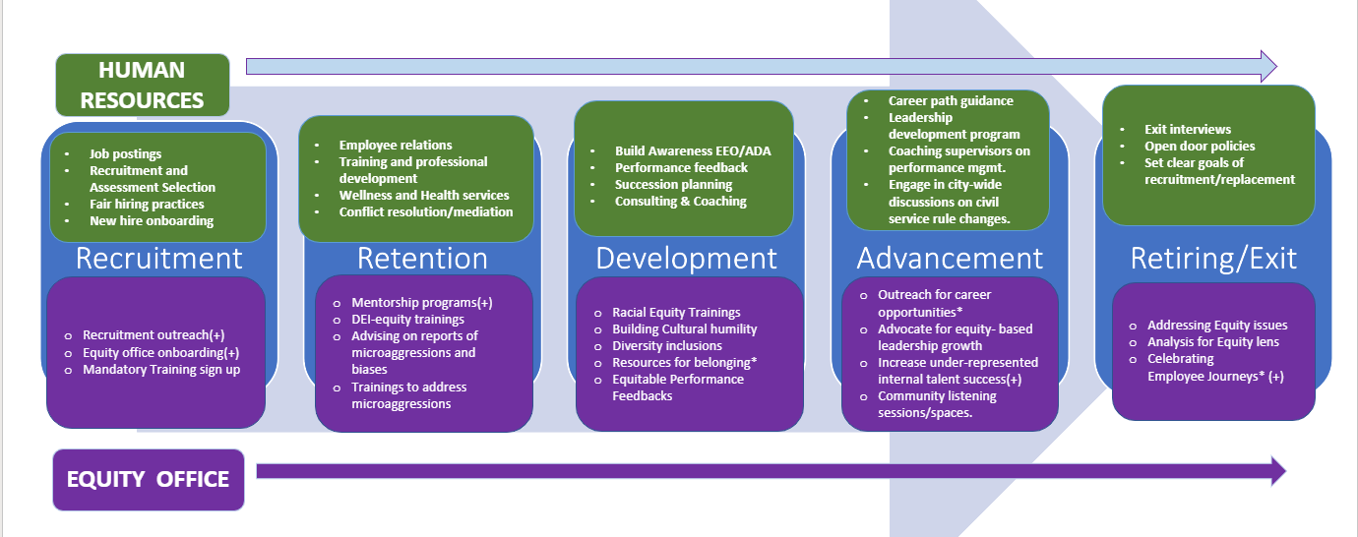
Employee Lifecycle: HR & EO Support

Slide 24
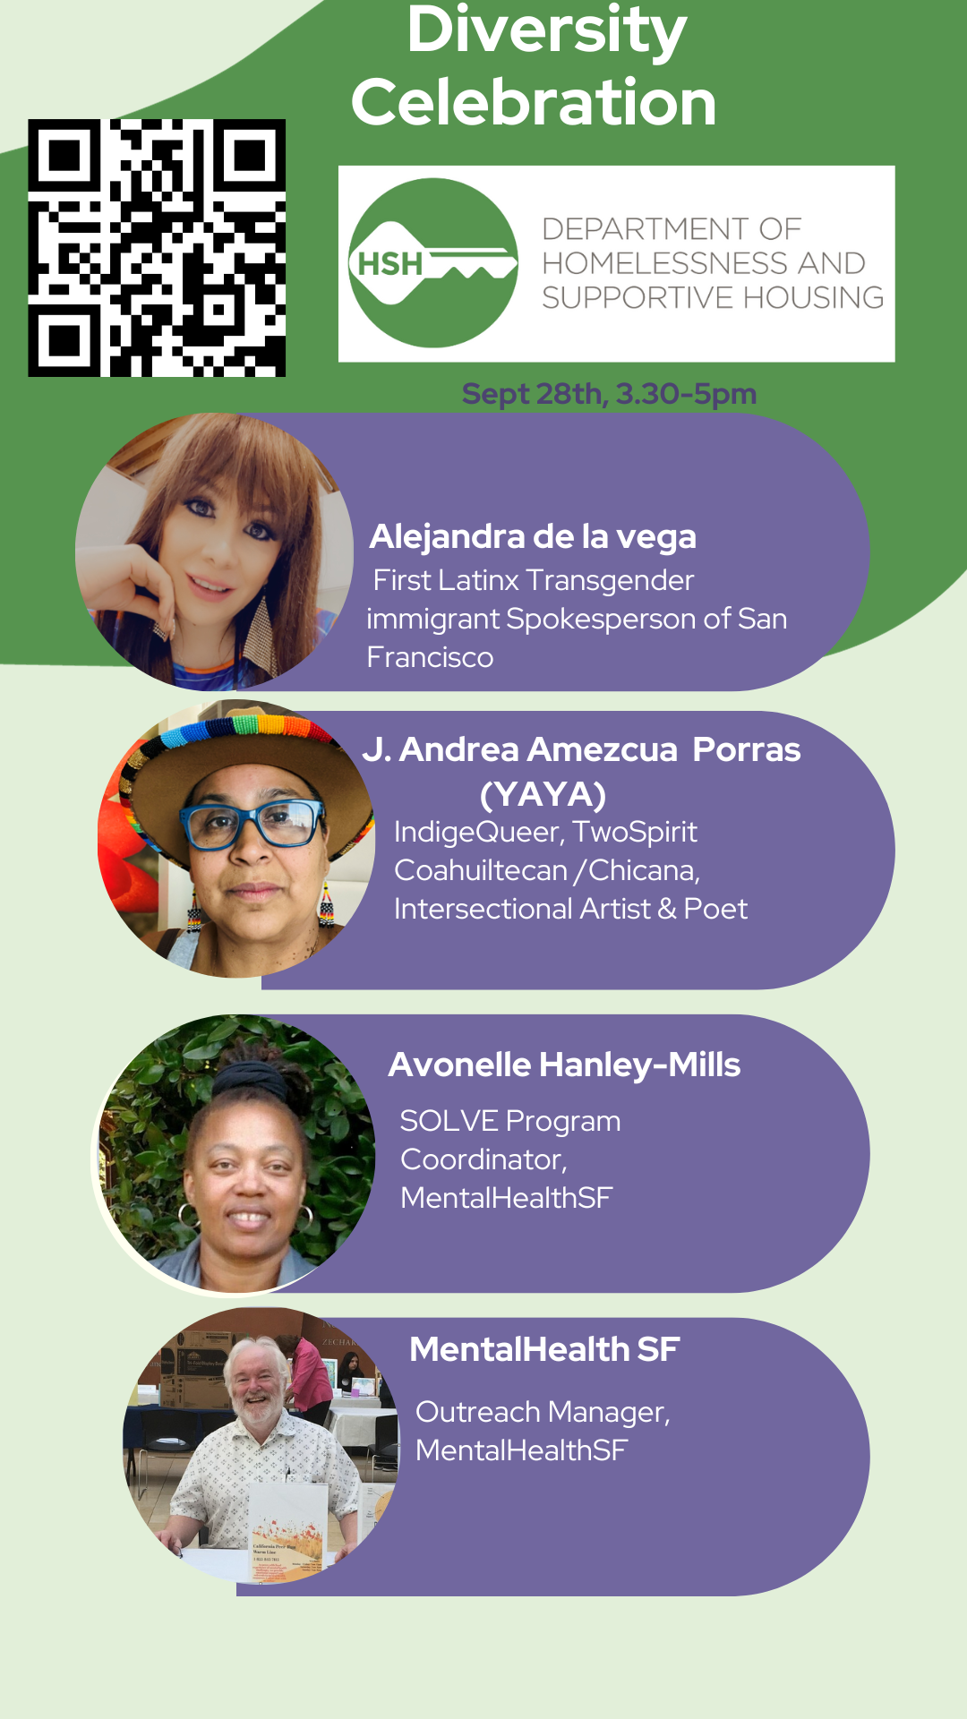

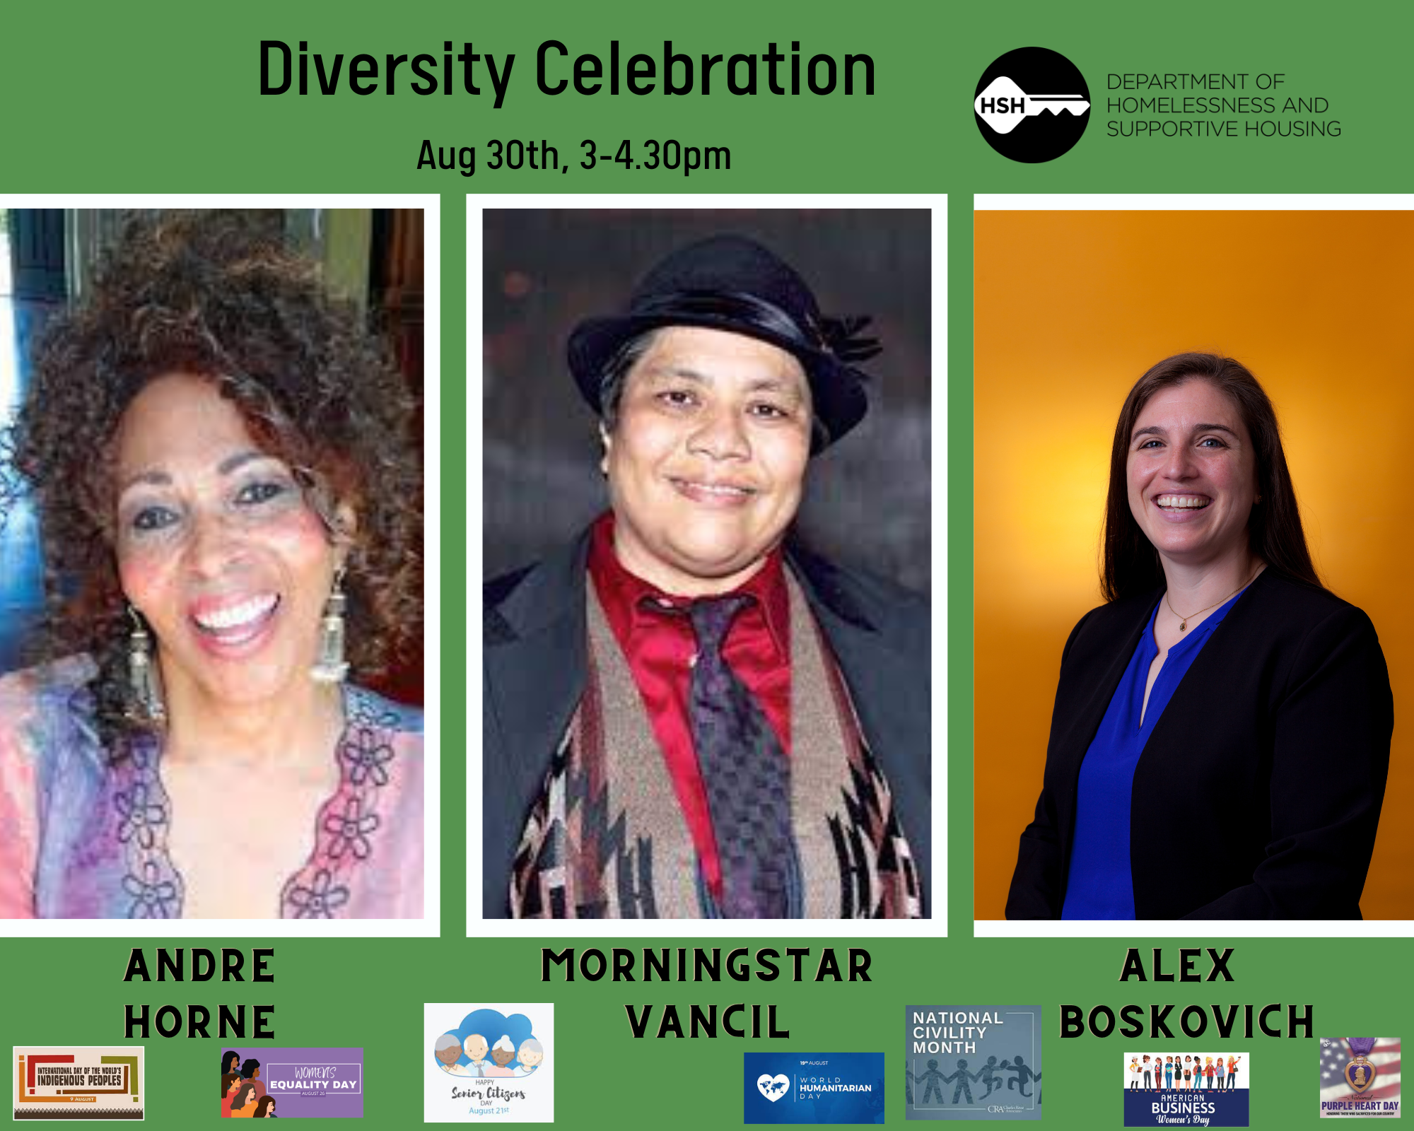
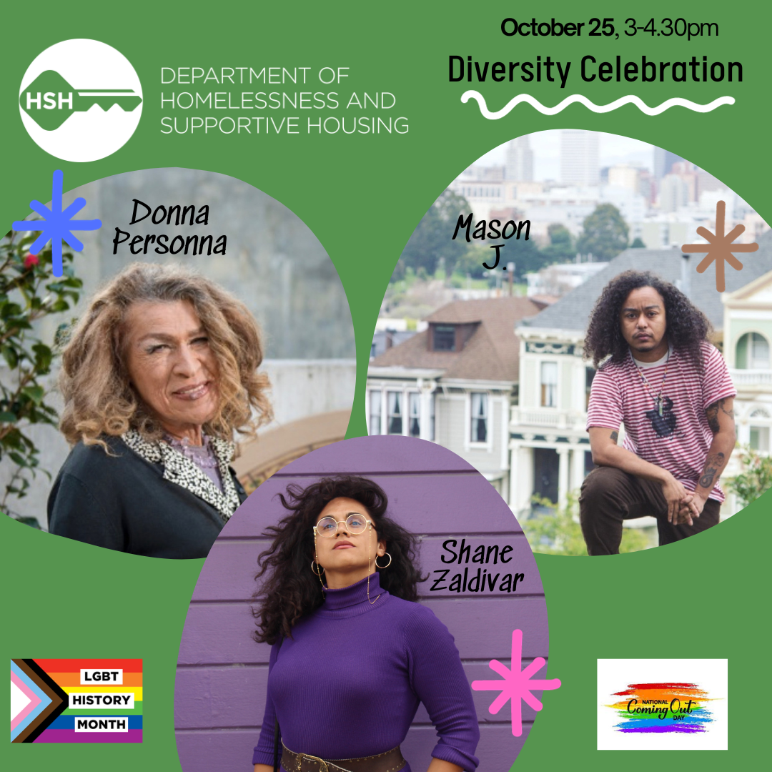

Diversity and Equity Programs
Each month 3-4 community guests and intra-city department members are invited to a diversity celebration tied to the specific month's diversity commemoration.
24

Slide 25
Equity Office R.E.A.P Progress Tracker
Key Initiatives | Status | Details | Section of R.E.A.P Plan
Equity Training Series | On Track | Series#3 Interpersonal Racism(external) scheduled for Sept-Oct 2023 | Diverse and Equitable Leadership
Coaching Circles | On Track | Equity-in-Action Sessions in Progress | Mobility and Professional Development
Capacity Building | On Track | BIPOC Equity Fund Program developed, Phase 3 scheduled! | Organizational Culture of Inclusion and Belonging
Diversity Celebrations | On Track | Monthly Diversity, My Identity/My Work- FY22-23 success!! | Organizational Culture of Inclusion and Belonging
DEI Community Spaces | On Track | Replacing Equity office Hours, Starting in July 2023 | Retention and Promotion
Community Listening Sessions | On Track | Second series with external network beginning in July 2023 | Diverse and Equitable Leadership
Communications | On Track | Newsletter Ongoing(Started) Re-vitalize the DEI intranet page(Launched!) | Organizational Culture of Inclusion and Belonging
Examination and Evaluation process for PET | On Track | Data secured by DEI committee, CEO engaged with HRC, O.R.E | Retention and Promotion
Equity Dashboard | TBD | Developing a Racial Equity Dashboard Capturing Intersectional Data and benchmarks | External: Phase 2
ETH | On track |  | External: Phase 2
Notes:
Anthony

Slide 26
Equity Office R.E.A.P Progress Tracker
Key Initiatives | Status | Details | Section of R.E.A.P Plan
Equity Training Series | On Track | Series#3 Interpersonal Racism(external) in progress; Series#4- content building begins | Diverse and Equitable Leadership
Coaching Circles | On Track | Equity-in-Action Sessions in Progress | Mobility and Professional Development
Capacity Building | On Track | BIPOC Equity Fund Program developed, Phase 3 scheduled! | Organizational Culture of Inclusion and Belonging
Diversity Celebrations | On Track | Monthly Diversity, My Identity/My Work- FY22-23 success!! | Organizational Culture of Inclusion and Belonging
DEI Community Spaces | On Track | Replacing Equity office Hours, | Retention and Promotion
Community Listening Sessions | On Track | Third series with internal/external networks beginning in Fall 2023 being planned. | Diverse and Equitable Leadership
Communications | On Track | Newsletter Ongoing(Started) Updated DEI intranet page | Organizational Culture of Inclusion and Belonging
Program Initiatives | On Track | BIPOC Equity Fund – On Track End Trans Homelessness- OffTrack | Diverse and Equitable Leadership
Notes:
Anthony

