Slide 1
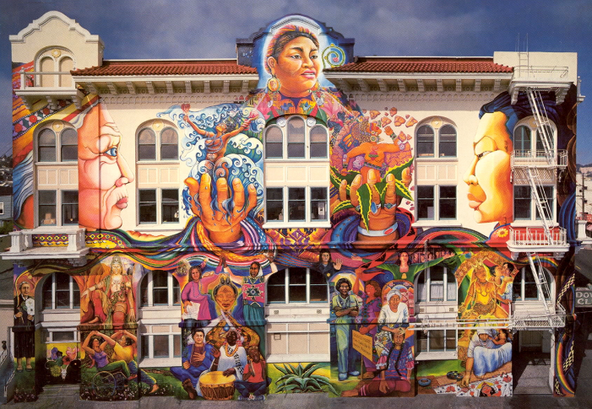
San Francisco Department of Public Health Division of Behavioral Health Services
A presentation to Our City, Our Home October 26, 2023
Jessica Brown, MPH Director of the Office of Justice, Equity, Diversity and Inclusion/Mental Health Services Act San Francisco Department of Public Health

Slide 2
San Francisco Landscape
Extremely diverse, with persons of color making up 59.8% of the total population.
Faces severe crises of mental illness, overdose, homelessness, and housing insecurity—each factor exacerbated by the high cost of living and the compounding effects of trauma and systematic racism.
In 2020, there were 711 overdose deaths, 61% more than the 441 overdose deaths recorded in 2019 and 220% more than the 222 recorded in 2017.
Black/African Americans have four times the rate of overdose deaths than white San Franciscans. One-third of overdose deaths.
SF saw a 33% citywide increase in client suicide attempts and a 13% increase in deaths among adult and older adult clients.
SF saw a 76% increase in the number of people who are unsheltered and experiencing homelessness between 2010 and 2020, compared to a statewide increase of 31%. ng people who are unhoused

Slide 3
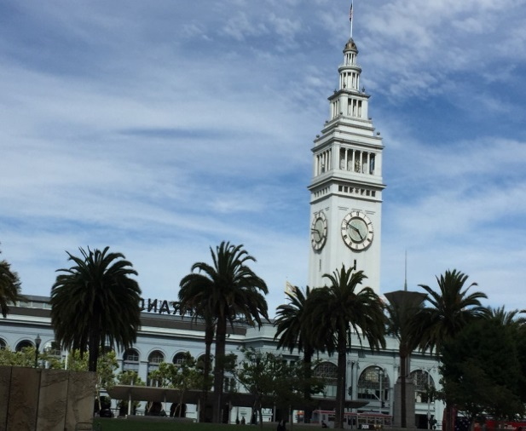
Behavioral Health Services (BHS)
BHS offers a full range of specialty behavioral health services provided by a culturally diverse network of community behavioral health programs and private psychiatrists, psychologists and therapists.
Mental Health and Substance Use Services include outpatient treatment, inpatient treatment, medication management, linkage services and a large array of more specialized treatment services.
Services are available to residents of San Francisco who receive Medi-Cal benefits, San Francisco Health Plan benefits and to residents with limited resources.
SF-MHSA is integrated all throughout BHS.

Slide 4
Behavioral Health Services Mission & Vision
Goals
System Transformation
CalAIM
Mission
Improve access to and effectiveness of mental health and substance use treatment and recovery services
Increase public awareness of where and how to get help for mental health and substance use challenges.
Expand proactive and low threshold interventions that reduce risky behaviors.
To provide equitable, effective substance use and mental health care and promote behavioral health and wellness among all San Franciscans.
EPIC
Mental Health SF / Prop C Funding
Vision
For all San Franciscans to experience mental and emotional well-being and participate meaningfully in the community across lifespans and generations.

Slide 5
Mental Health Services Act (MHSA) 5 Funding Components: San Francisco’s 7 Service Categories
Recovery-Oriented Treatment
Mental Health Promotion
Peer-to-Peer Support Services
Vocational Services
Housing for FSP Clients
Workforce Development
Capital Facilities and Information Technology
Community Services & Supports (CSS)
Innovation (INN)
Prevention and Early Intervention (PEI)
Workforce Education and Training (WET)
Capital Facilities and Technology Needs (CF/TN)
Notes:
Community Services & Supports (CSS)
Supports Full Service Partnership (FSP) Programs and other programs improving the mental health service delivery system for all clients
- Recovery-Oriented Treatment
- Peer-to-Peer Support Services
- Vocational Services
- Housing for FSP Clients
Innovation (INN)
To test novel, creative mental health practices/ approaches that contribute to learning
Prevention and Early Intervention (PEI)
Identify risks early on; prevent worsening of mental illness and promote positive outlook
Funded activities include outreach, identification and linkage
Workforce Education and Training (WET)
Identify gaps in workforce; increase workforce’s cultural and linguistic capacities; educate consumers
Capital Facilities and Technology Needs (CF/TN)
Renovation of admin and service facilities owned by City; modernize information systems and provide access to health records to consumers and family members

Slide 6
Integration of JEDI and SF-MHSA
Our Office of Justice, Equity, Diversity, and Inclusion (JEDI), formally known as the Office of Equity and Workforce Development, is committed to "leading with race and prioritizing Intersectionality, including sex, gender, sexual orientation, age, class, nationality, language, and ability, the SFDPH BHS OEWD strives to move forward on the Continuum of Becoming an Anti-Racist Multicultural Institution through Dismantling Racism, interrogating White Supremacy Culture, building solidarity between racial groups, and working towards becoming a healing organization in partnership with staff, clients, and communities."

Slide 7
San Francisco MHSA Programs
SF MHSA funded 83 programs in FY20-21which served 46,355 unduplicated individuals. Highlights include:
15
Population-focused
Programs
9
Vocational
Programs
12
Full Service
Partnership Programs
6
Recovery-Oriented
Treatment Programs
Capital Facilities & Information
Technology
Programs
4
7
14
Mental Health Promotion &
Early Intervention Programs
Peer
Programs
8
BH Workforce
Development Programs
4
Supporting Housing
Programs (~200 units)
4
Innovation
Programs

Slide 8
BHS/JEDI Commitments
Operating from an intersectional lens that centers on dismantling white supremacy in our system
Incorporating an anti-racist stance throughout our programs with a focus on addressing anti-Blackness equitably
Treating our peers, colleagues, and communities members with respect and integrity, while honoring each of our individualities and intersectionality.
Honoring the cultural and linguistic diversity and needs of our staff and consumers
Reducing and addressing disparities amongst disenfranchised staff and consumers
Empowering our communities by incorporating their voices, needs, and ideas into our programs
Supporting staff via ongoing cultural humility/anti-oppression training
Working towards being a healing informed system for staff and consumers

Slide 9
JEDI Team and Accomplishments
Our JEDI Team comprises the Mental Health Services Act, Trauma-Informed Systems, Equity, Staff Wellness, and Workforce Development & Training. This JEDI Structure allows us to expand our responsibilities in ensuring that equity is embedded throughout all of our systems of care. JEDI is responsible for training, staff wellness, language services, community engagement, workforce development, and inter/intradepartmental partnerships and coordinates normalizing, organizing, and operationalizing racial equity across all of BHS. Since merging our efforts have expanded. We have accomplished the following:
Continuing Support for Existing PEI Programs
Implementing Culturally Congregant Innovation Project
Expanding Behavioral Health Services for Black/African Americans and Birthing People
Supporting Overdose Prevention Efforts
Increasing Diversity of Our Workforce
Equity Capacity Building with Leadership
Integrating equity principles throughout all of BHS
Increasing support for our internships, peer support and vocational programs.
Expanding FSP/ICM Services

Slide 10
Key BHS/JEDI Equity Initiatives

Slide 11
Culturally Congruent Initiatives to Address Racial Disparities
May 2023
16-Week Equity Executive Fellowship
Training on understanding the roots of racism and bias for BHS leadership team with NY Times Best Seller, Robin DeAngelo, and Assistant Professor at Mayo Clinic School of Medicine, Dante King.
June 2023
Mental Health Services Act (MHSA) Innovation Intervention
Developing and evaluating culturally responsive behavioral health interventions for Black/African American clients at four civil service clinics (OMI, SOMA, TAY, Mission Mental Health: Alternatives Program)
Nov. 2023
Equity-Based Maternal Health RFP Awarded
$6M/per year RFP in partnership with Maternal Child and Adolescent Health (MCAH) to fund four community-based organizations to support Black/African American pregnant, perinatal, and postpartum people through mental health care screenings, linkages, and more.
Awarded funding: RAMS, Rafiki, Homeless Childrens Network, and UCSF Embrace Program.
Jan. 2024
Universal Talk Therapy
Partnership and collaboration with the Human Rights Commission on providing a universal talk therapy program for Black/African Americans via the UCSF Embrace Program
Notes:
Met 100% of 26 key components
Addressed 100% of recommendations for improvement
Three consumer focus groups were held with a total of 17 consumers/family members.

Slide 12
Culturally Congruent Initiatives to Address Racial Disparities
Lifting and Empowering Generations of Adults, Children, and Youth (LEGACY)
Ajani Program Westside Community Services
Black/African American Community Health and Wellness Initiative
Homeless Children’s Network Ma’at Program
Transitional Age Youth Engagement and Treatment – Black/African American Third Street Youth Center
Kuumba Peer Fellowship
RAMS-API Collaborative
Native American Health Center
Gender Health SF
IFR
Curry Senior Center
Fuerte
Notes:
Black African American Community Wellness Health Initiative
CHEP has allocated a total of $1,403,955 to be divided equally among the 3 contractors (Bayview YMCA, Booker T. Washington, and Rafiki) to support wellness in B/AA populations (across age, gender, sexual orientation, geographic, etc. spectrum) using a culturally-responsive, holistic (mind/body) approach.
Support B/AAs to reach their optimal physical and mental health.
Identify and work toward systemic changes that create sustainable change that enables B/AA wellness.
Linkages to local primary and mental health care/community health clinic(s) so they can cross-refer community members/patients to respective services.
Assess community needs and use assessment to shape programs/services offered
Build capacity and increase network of organizations serving B/AAs

Slide 13
Culturally Congruent Initiatives to Address Overdose Racial Disparities
Our goal is to reduce racial disparities in
fatal overdoses among Black/African Americans by 30% by 2025. The overdose death rate among Black/African Americans is more than 5-times higher than the citywide rate. Black/African Americans represent just 6% of the population in SF, but 28% of the preliminary overdose deaths in 2023.
BHS partners with Whole Person Integrated Care programs (Post Overdose Engagement Team, Street Medicine, health care services in shelters and Permanent Supportive Housing) on overdose prevention initiatives for people experiencing homelessness.
Seven Completed & Planned Overdose Prevention Trainings & Education
Ella Hill Hutch Community Center; Success Centers; San Francisco State University; Bayview YMCA; Faith-Based Coalition; IT Bookman Center; Booker T Washington
Notes:
Met 100% of 26 key components
Addressed 100% of recommendations for improvement
Three consumer focus groups were held with a total of 17 consumers/family members.

Slide 14
Other Workforce Initiatives Addressing Equity
Racial Equity Affinity Groups
JEDI launched affinity groups for staff who identify as Black/African Americans; Latinx; White; or Asian Pacific Islander to help staff build their capacity on racial equity concepts and practices
Started with the curriculum of Unlearning Racism to help build the capacity for understanding racism.
30+ attendees have joined us so far. Expanding to LGBTQIA and Multiracial groups later this year.
Recruitment and Hiring Equity Interventions
Prioritizes top 5 classifications with lowest representation of Black/African and Latinx staff e.g., clinicians and managers/directors.
Includes lived experience desired qualifications, interview questions, response guidelines, and ratings.
Includes equity partners in all phases of the hiring process including interview preparation and interview panels.
Includes onboarding warm welcome video and best practices.
DPH HR hiring efficiencies to include several BHS equity interventions.

Slide 15
Questions?
Jessica Brown, MPH
Director, Office of Justice, Equity, Diversity and Inclusion /Mental Health Services Act
1380 Howard Street
San Francisco, CA 94103
415-255-3963
jessica.n.brown@sfdph.org

