Slide 1
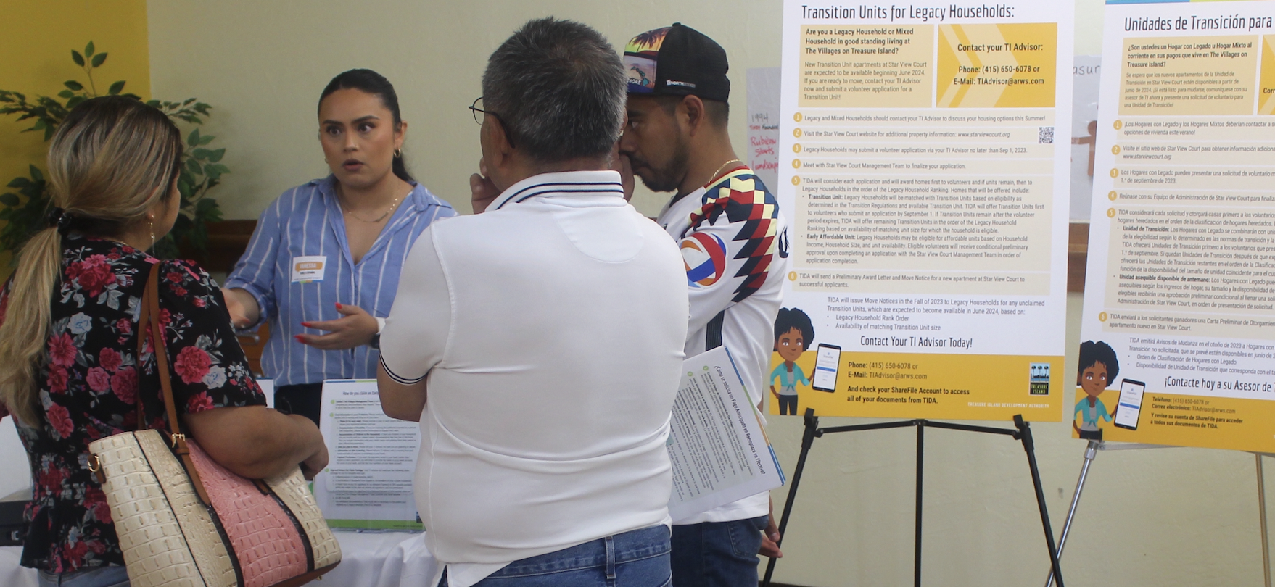
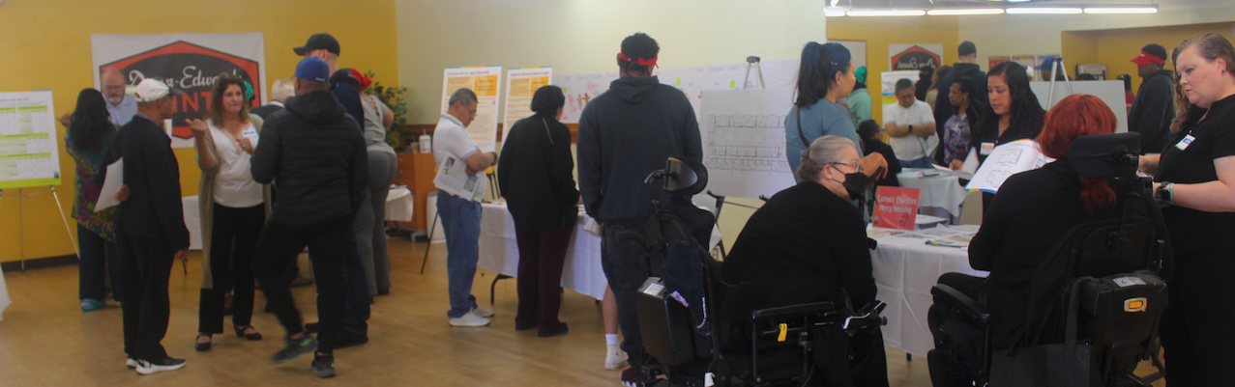
TI Advisor Board Report
September 13, 2023
Presented By
Vanessa Zamora
TI Advisor
InterEthnica
Notes:
]

Slide 2
Agenda
Island Households: The Numbers
Star View Court (SVC) Early Volunteer Period
TI Advisor's Engagement Efforts and Directors Support
Timeline and Opportunities through 2024
How to contact a TI Advisor

Slide 3
Island Households: The Numbers
Island Households
250 | One Treasure Island Partner Households
317 | The Villages at Treasure Island
92 | Legacy Households
64 | Mixed Households (with Legacy, Vested and/or Post Vested Residents)
137 | Vested Households
24 | Post Vested Households with No Legacy or Vested Residents
Current Transition Units Needed: 156

Slide 4
Star View Court Early Volunteer Period
What is Star View Court?
A pivotal component of Phase 1 development.
Mercy Housing will be the management agent for the property
Catholic Charities will be the lead supportive service provider for their units
23 units designated for Legacy Households
43 Affordable Units via DAHLIA Lottery; qualifying Legacy Residents and Vested Residents receive preference
Located at 78 Johnson Street on Treasure Island

Slide 5
Star View Court Early Volunteer Period Engagement Strategy
Planned and participated in key events with Director's Support
Star View Court Open House Events on July 13th and 15th.
National Night Out Table on August 1st.
TI Advisors Partnered with:
MOHCD.
One Treasure Island.
Catholic Charities.
Mercy Housing.
Goals: Ensure that Legacy Residents can volunteer and select a unit at SVC.
Distribute Information Pages for Star View Court.
Promote Inclusionary Housing with Information
Provide an Online Resource Folder
Promote the Star View Court Early Volunteer Applications.

Slide 6
Star View Court Early Volunteer Period
Outcomes
Volunteer Applications Received
Received a total of 21 volunteer applications.
In Lieu Payments Processed
Successfully processed 5 additional in lieu payments
TIR Numbers Shared
Shared TIR numbers with Legacy and Vested members

Slide 7
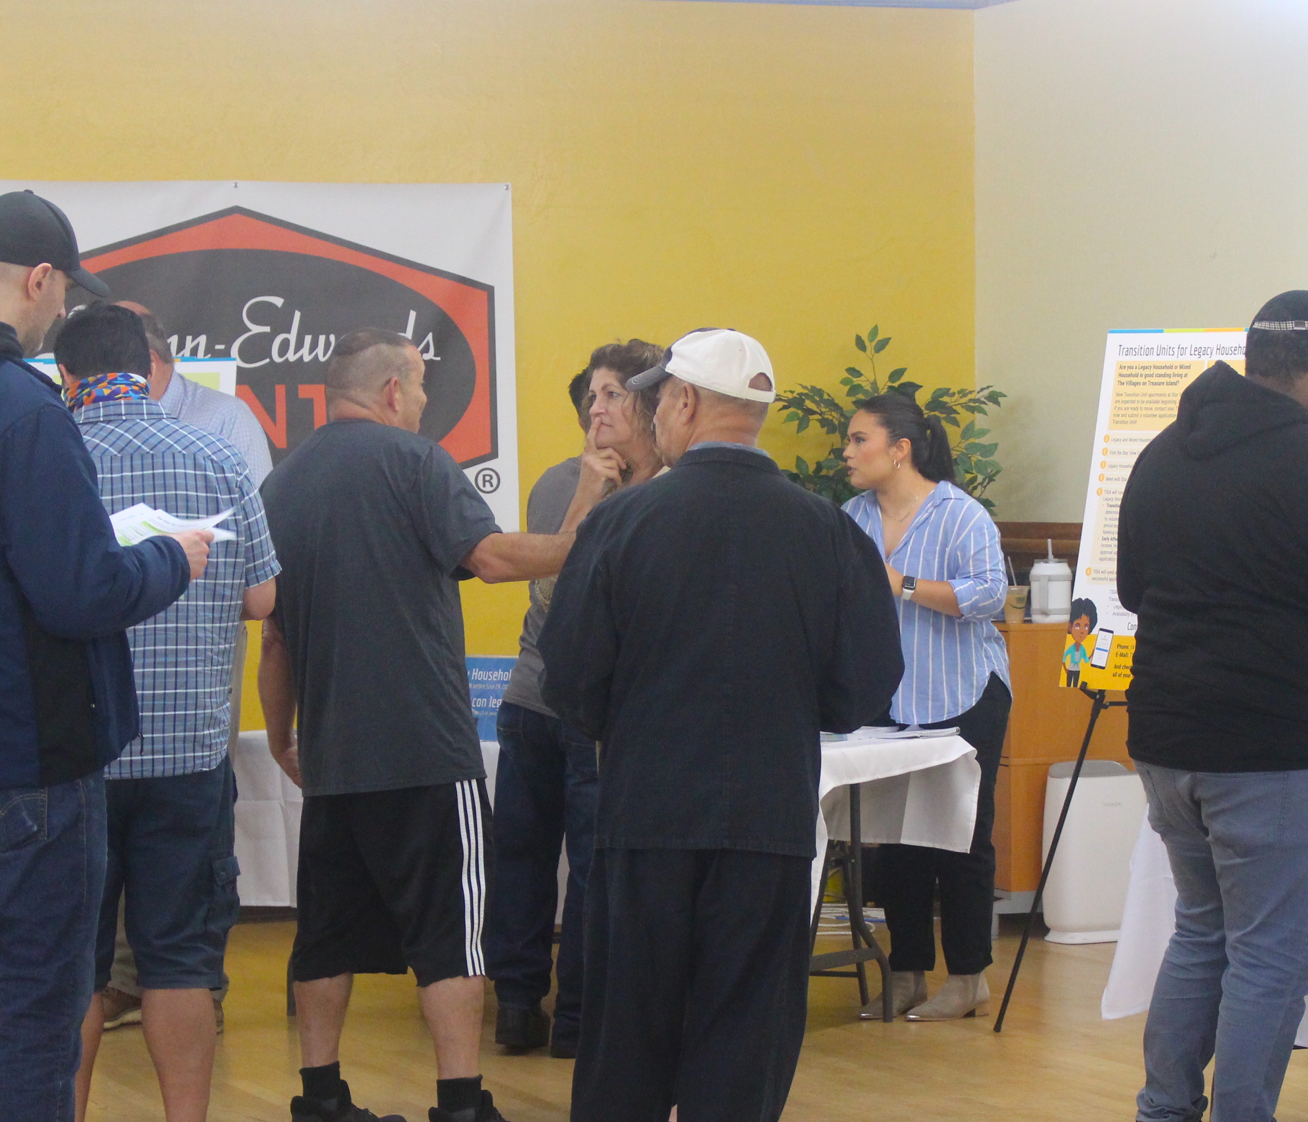
TI Advisor's Engagement Efforts: Key Events
(July - September 1, 2023)
National Night Out Event
  Tuesday August 1st 5:00 p.m. to 7:30 p.m.
Two Star View Court Open House Events at Ship Shape
  Thursday July 13th 5:00 p.m. to 8:00 p.m.
  Saturday July 15th 10:00 a.m. to 1:00 p.m.
On Island Office Hours August 4th
  Residents scheduled a 1-1 session or had the option to walk in to Aracely Café from 9:30am-3:00pm

Slide 8


TI Advisor's Engagement Efforts: Outreach Materials
(July - September 1, 2023)
  Invitations: 750 emails to Legacy and Vested Residents on July 7th (44% opened)
  Door Hangers: Distributed 300 Door Hangers to all households at The Villages on July 10th
  Letter from Director Beck: 156 Letters to Legacy and Mixed Household doors on July 11th
  Follow-Up: Sent 750 follow-up emails with housing document links on July 24th (59% opened)
  Portal Upload: Continued uploading Future Housing Information to the TI Advisor Portal.
  Ongoing Support: Conducted calls, meetings, and emails to assist with Future Housing Opportunities, volunteer applications, and resident inquiries related to housing.

Slide 9
TI Advisor's Engagement Efforts: 1-1 Sessions
(July - September 1, 2023)
Individual Meetings with Residents:
  Opportunity for 1-1 sessions with a TI Advisor.
  40+ virtual and in-person meetings with Island Residents.
Responsive Support:
  Answering daily phone calls to address questions and concerns.
  Monitoring TI Advisor email account for timely resident responses.
Scheduling Convenience:
  Introduced a simple meeting request system via Calendly Link.
Bilingual Support:
  Increased awareness through communication in Spanish.
  Provided bilingual voicemail messages.
  Scheduling system was made available in both English and Spanish

Slide 10
TI Advisor's Engagement Efforts: Resources
(July - September 1, 2023)
TI Advisors and Director Collaborated to:
Create clear and helpful materials for Island Residents about Future Housing Opportunities on Treasure Island.
Resource Handouts:
Star View Court Affordable Unit Handout for all Island Residents.
Star View Court Transition Unit Handout for Legacy Residents.
Handouts for Resident Access to Other Affordable Housing in Market Rate Buildings in 2024.
First-Time Homebuyer Information.
All materials available in an online resource folder:
Legacy Resident English: https://tinyurl.com/5fy2hym3 Legacy Resident Spanish: https://tinyurl.com/22dj3dkh
Vested Resident English: https://tinyurl.com/43bpjc5y Vested Resident Spanish: https://tinyurl.com/2yjv3vua

Slide 11

Timeline to June 2024
July 17 to September 1, 2023: Star View Court Early Volunteer Period for Legacy and Mixed Households
September 2023: Hand off Volunteer list to the SVC Management Team Volunteers will meet with the Star View Court Management Team for initial meeting and unit choice selection
October 2023
Star View Court Management Team Issues Preliminary Award to Star View Court Early Applicants
Begin to Assign Matched Legacy Households with Transition Units in order of Legacy Household Ranking
Move Out Notices: TIDA issues Initial Move Notices for Star View Court
Remaining Transition Unit Assessment: TI Advisors assess unclaimed Transition Units
Matching Transition Units: TI Advisors match Legacy Households and unclaimed Transition Units
November 2023 – January 2024
TI Advisors will get the word out to Legacy and Vested Residents about Affordable Units
TI Advisors will help residents register for DAHLIA
DAHLIA lottery for Affordable Units in early 2024
TI Advisors will share TIR Numbers will all Vested and Legacy Residents
February 2024
Remaining Affordable Units Application Period for all via DAHLIA
Spring 2024
Final Applications and Resident/Manager Lease Coordination Meetings
June 2024
Residents Move into Star View Court

Slide 12
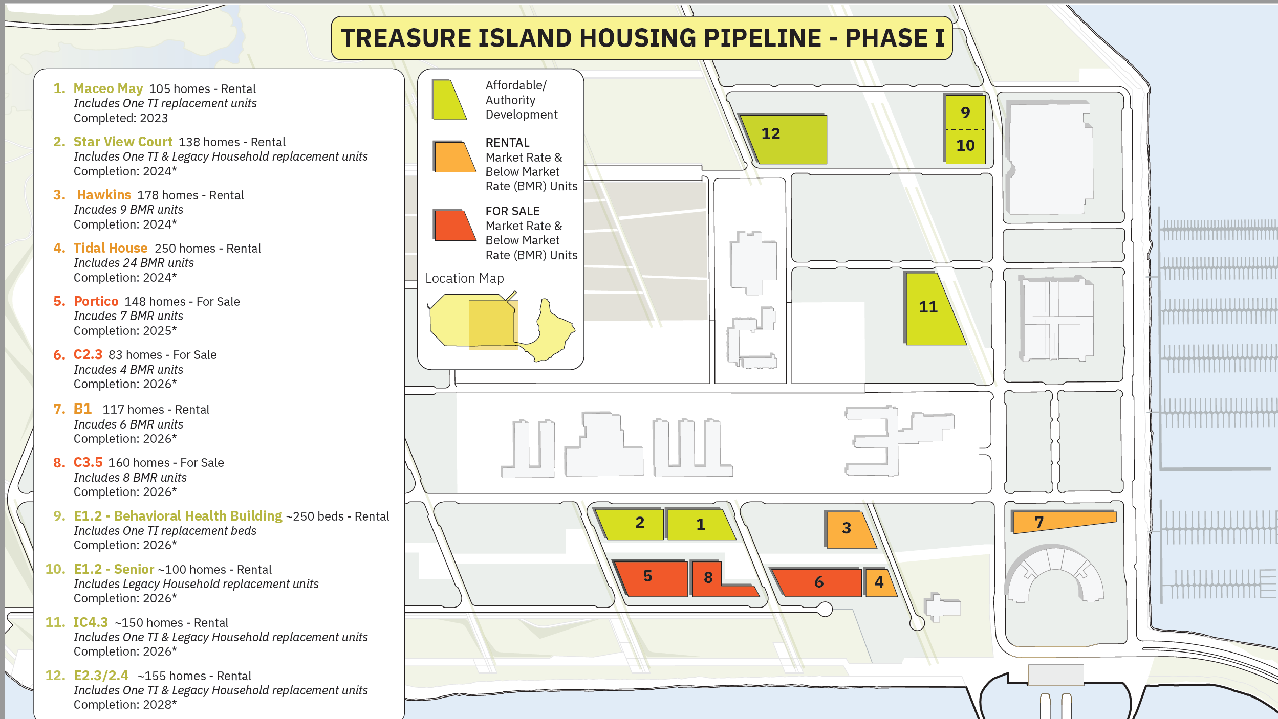

Slide 13
Other Opportunities on the Island: Summary
Parcel | Estimated Availability | Total Units | Transition Units | Affordable Units | One TI Units | Inclusionary For Rent | Inclusionary For Sale
Star View Court | 2024 | 137* | 23 | 43 | 71
Hawkins | 2024 | 177* |  |  |  | 9
Tidal House | 2024 | 249* |  |  |  | 24
Portico | 2025 | 143 |  |  |  |  | 7
B1.2 | 2026 | 116* |  |  |  | 6
C2.3 | 2026 | 83 |  |  |  |  | 4
C3.5 | 2026 | 160 |  |  |  |  | 8
E1.2 Senior |  | 100 | ~10 | ~90
E1.2 Behavioral Health |  | Will Transition HealthRight 360 Programs
*Plus an additional manager unit

Slide 14
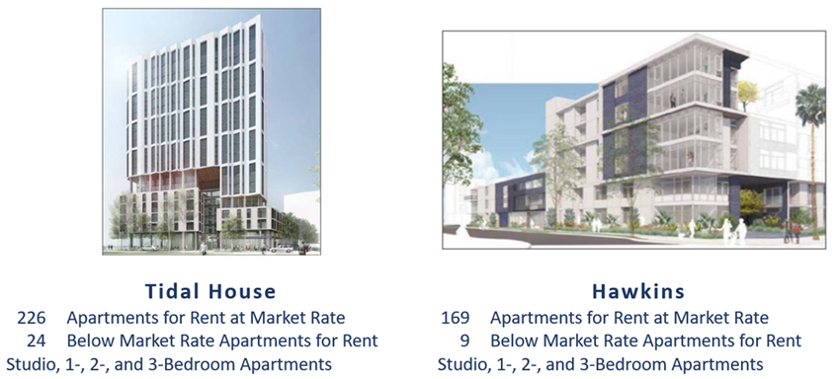
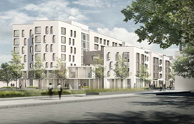
Other Opportunities on the Island: Rent
Rent a Market Rate or Below Market Rate Apartment in 2024!
Star View Court Apartments for Rent 2024 Up to 42 Affordable Apts. | Tidal House Apartments for Rent 226 Market Rate Apts. 24 Below Market Rate Apts. | Hawkins Apartments for Rent 169 Market Rate Apts. 9 Below Market Rate Apts.

Slide 15
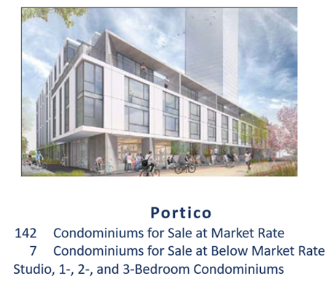
Other Opportunities on the Island: Purchase
Purchase a Market Rate or Below Market Rate Condominium!
First Time Homebuyer Education Available
Downpayment Assistance for Legacy Residents
Treasure Island Resident (TIR) Preference Certificate Number for Legacy and Vested Residents

Slide 16

Thank you for your time this afternoon.

