Slide 1
SF Domestic Violence Consortium Our City, Our Home September 28, 2023
Beverly Upton , Executive Director
Orchid Pusey, Executive Director, Asian Women’s Shelter

Slide 2
There are lots of great resources for Gender-Based Violence in San Francisco!
San Francisco Domestic Violence Consortium
Asian Pacific Islander Legal Outreach • APA Family Support Services • Asian Women’s Shelter •
Bay Area Legal Aid • Black Women Revolt Against Domestic Violence •
Community United Against Violence • Cooperative Restraining Order Clinic • Donaldina Cameron House •
Futures Without Violence • Glide’s Women’s Center • Justice & Diversity Center of the SF Bar Association •
LYRIC • Riley Center of St. Vincent de Paul • Shalom Bayit •
Survivor Empowerment Project of the Sheriff’s Department • Victim Services Division of the District Attorney’s Office •
W.O.M.A.N., Inc.

Slide 3
Let’s Look at the Data from SF Homeless Self-Identified Women & domestic Violence
38% of San Francisco’s Unhoused Population are self-identified women
Approximately 3,000
80% say that they are escaping violence and abuse
5% of homeless beds/resources are earmarked for women
According to the Women’s Housing Coalition

Slide 4
System Response
Incidents Reported: 3,379 incidents were responded to the Police Department.
Prosecutions: 543 of 1,587 total cases received by the District Attorney’s Office (34%) were prosecuted.
Convictions: 7 of 8 cases resulted in a conviction by trial.
Restraining Orders: The Family Law Division of the San Francisco Superior Court received 825 requests for domestic violence restraining orders and granted 74% of requests (292).

Slide 5
From the ACLU on DV & Homelessness
When women flee domestic abuse, they are often forced to leave their homes, with nowhere else to turn. Landlords also sometimes turn victims of domestic violence out of their homes because of the violence against them. For years, advocates have known that domestic violence is a primary cause of homeless-ness for women and families. Studies from across the country confirm the connection between domestic violence and homelessness and suggest ways to end the cycle in which violence against women leads to life on the streets.

Slide 6
What Can Be Done?
Train!
Support Services and Advocates!
Support Survivors Who Present as Unhoused!
Ensure Sufficient Housing for Non-Violent Parents and their Children!
May Ending Domestic Violence a Priority!

Slide 7
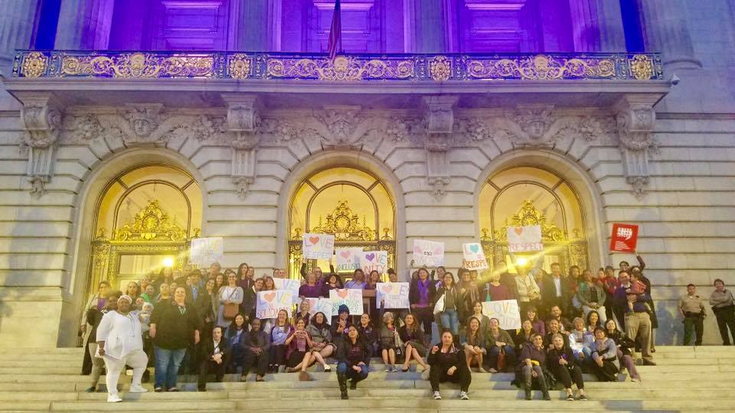
We thank you for your work!

