Slide 1
Police Response to Dolores Park Event 07.08.23
SAN FRANCISCO POLICE DEPARTMENT
CITY & COUNTY OF SAN FRANCISCO
July 19, 2023

Slide 2
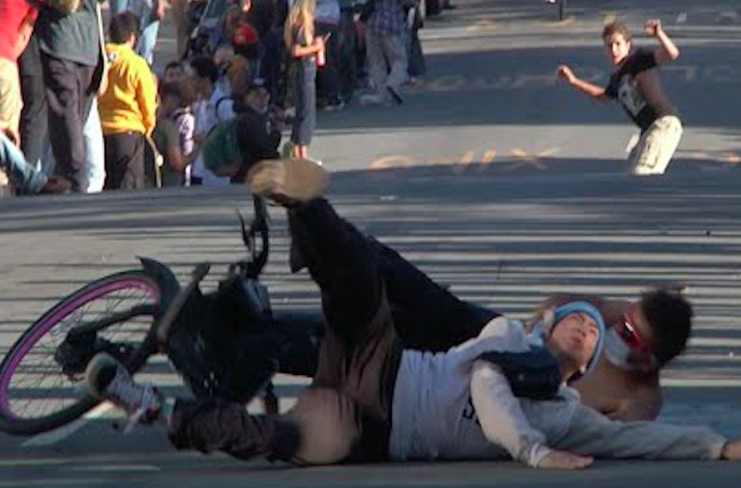
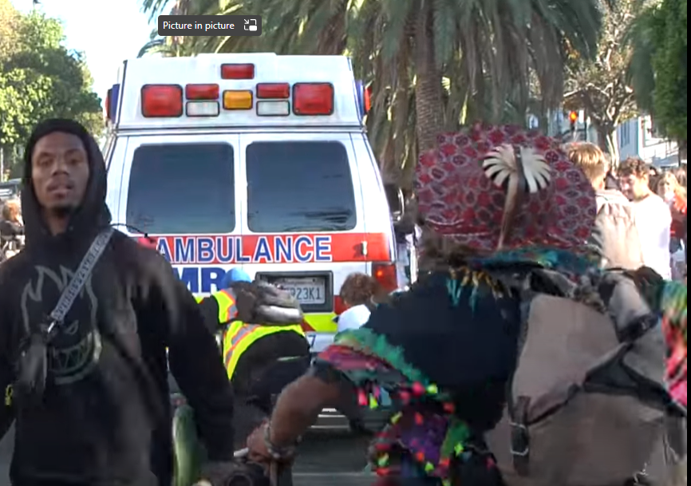
Safety factors considered before deployment
PREVIOUS DOLORES HILL BOMB EVENTS HAVE LED TO INJURY AND DEATH
Multiple injuries every year ranging from minor to severe
People treated for broken bones and head injuries
Paramedics blocked from accessing injured people
2020 – cyclist killed after colliding with skateboarder
2022 – sideshow and stabbing
Safety with Respect

Slide 3
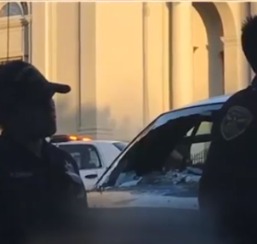
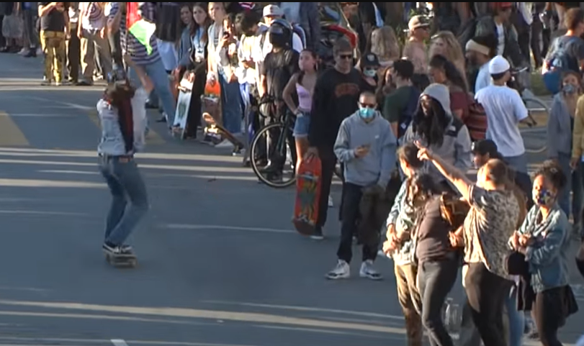
Safety factors considered before deployment
HILL BOMB EVENTS ARE DISRUPTIVE TO NEIGHBORHOOD
Event is unpermitted with no organized leadership
Vehicles, pedestrians, cyclists at risk crossing street
Escalating violence and property damage in recent years (assaults, graffiti, etc.)
Neighborhood residents have demanded SFPD intervene
Safety with Respect

Slide 4
STAFFING
SFPD STAFFING DECISIONS
July 2020 – SFPD had less staffing. Additional personnel requested following injuries, death, property damage
July 2022 – SFPD had lower staffing with contingency plans, but plan was insufficient. Officers and paramedics were assaulted, and property was damaged
October 2022 – More officers deployed as safety concerns grew
JULY 8, 2023
11 on-duty officers from Mission Station
40 already on-duty officers from Tactical, Specialized Units, and motorcycle officers.
30 officers deployed on overtime

Slide 5
VIDEO
LINK TO VIDEO OF PREVIOUS TROUBLE

Slide 6
TIMELINE OF EVENTS
TIMELINE OF JULY 8, 2023
4 p.m. – Barricades set up along Dolores between 18th and 20th streets
Officers were wearing standard uniforms and engaging with public, including giving out “junior officer” stickers to youth
5:30 p.m. – Firefighters and park rangers managed problems in Dolores Park
6:15 p.m. – An estimated 200 people in Dolores park. People gathered behind barricades
Fireworks going off. Department of Parking and Traffic property vandalized
Officers began putting on helmets with face shields due to assaults from bottles, cans and fireworks

Slide 7
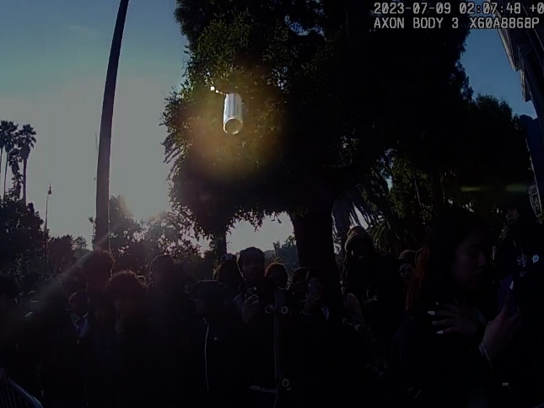
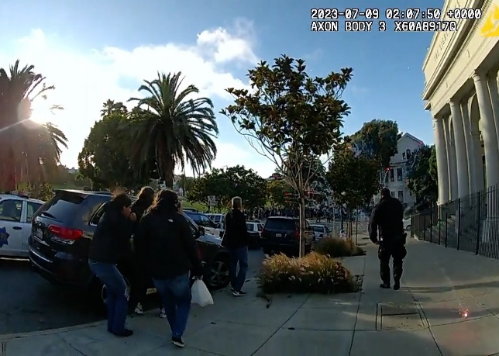
TIMELINE OF EVENTS
7:07 p.m. – Male juvenile spat in a sergeant’s face at Dolores and Cumberland streets
Female juvenile struck sergeant with a nail, causing laceration to his left temple
BWC showed both assaults on sergeant were unprovoked
Officers arrested both juveniles
Physical force was used during both arrests
Officers hit with cans and bottles
Officer struck in the helmet with can full of liquid
Mortar-style aerial firework exploded near officers and innocent bystanders

Slide 8
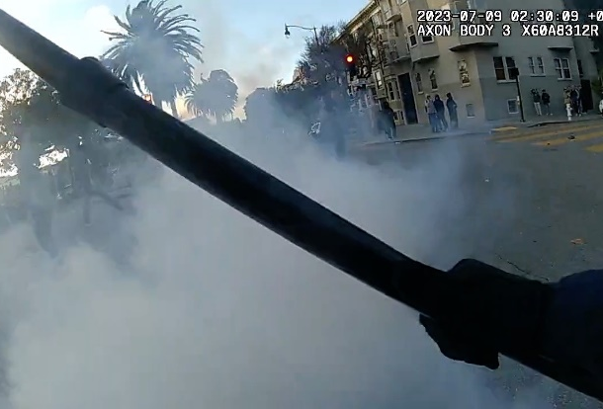
TIMELINE OF EVENTS
7:09 p.m. – SFPD declared unlawful assembly
Event commander read first dispersal order
At least 12 dispersal orders read by megaphone and long-range acoustic device over 1 hr. and 20-minute period.
Multiple other orders to leave area given throughout event
Crowd dismantled barricades along Dolores Street
Officers formed skirmish lines on Dolores Street to disperse crowd
Officers hit with cans, bottles and fireworks, including M-80-type explosive

Slide 9
TIMELINE OF EVENTS
7:35 p.m. – Reports of gunshot at 18th and Church streets
People climbed on occupied Muni LRV and sprayed graffiti
Stunt driving “sideshow” occurred at 20th and Church streets
Other occupied Muni vehicles vandalized:
A second J-line LRV covered in graffiti
An F-line heritage streetcar had broken window, covered in graffiti
Muni supervisor’s truck forced to stop and vandalized with graffiti
Several buses vandalized after being forced to stop by crowds

Slide 10
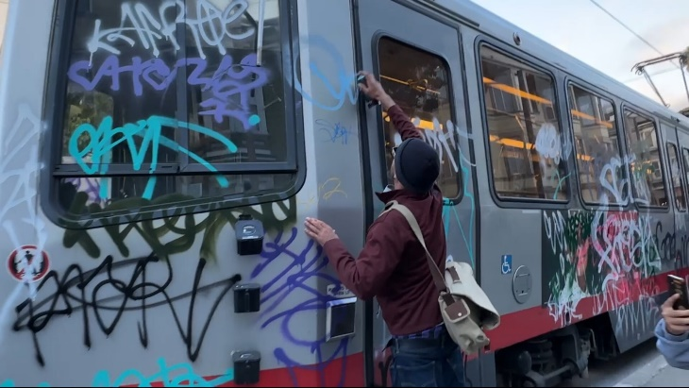
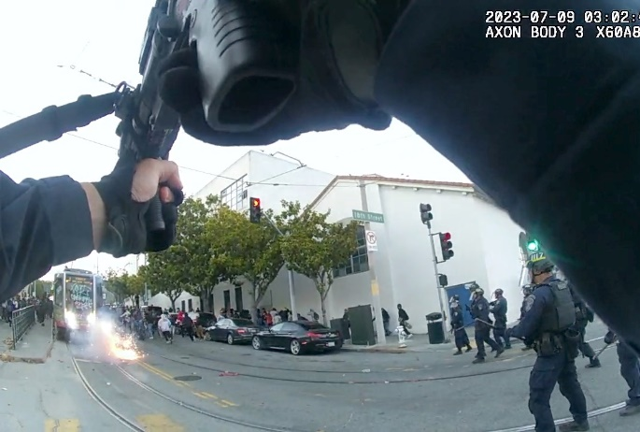
TIMELINE OF EVENTS
8:01 p.m. – SFPD declared incident a riot
8:05 p.m. – Officers deployed ERIW toward suspect launching fireworks at officers at 18th and Church streets
15 ERIWs deployed during event, targeting individuals throwing objects at officers
It is unknown if anyone was injured by ERIW. No one has come forward
8:12 p.m. – More than 100 people gathered at 18th and Dolores and removed barricades
People continued to throw fireworks at officers and did not comply with multiple dispersal orders

Slide 11
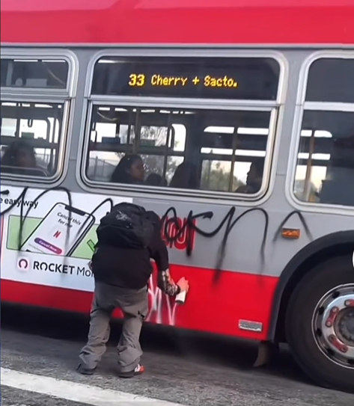
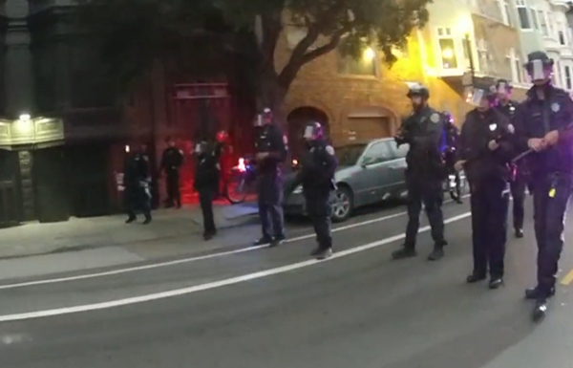
TIMELINE OF EVENTS
8:12 p.m. – Muni bus vandalized at 18th and Church streets
8:16 p.m. – Officers encircled main group that refused to disperse on 17th Street between Dolores and Guerrero streets
8:43 p.m. – SFPD conducted mass arrest to prevent further violence, injuries and property destruction

Slide 12
VIDEO
LINK TO VIDEO OF JULY 8, 2023 INCIDENT

Slide 13
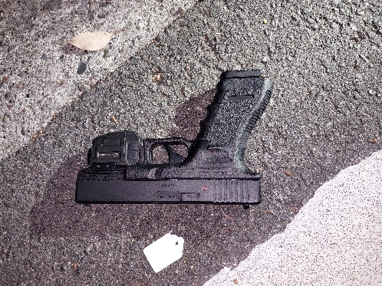
ARRESTS
81 juveniles arrested
32 adults arrested
Weapons and contraband seized
Two firearms
One pellet gun replica firearm
Six knives
9 fireworks
Multiple backpacks containing spray paint
Everyone Mirandized
Processing group took considerable time
Detainees order to sit on ground

Slide 14
ARRESTS
Juveniles separated from adults during encirclement
Juveniles transported to Mission Station one block away
Majority taken by bus
All female juveniles transported separately
Each juvenile given “juvenile know your rights” card
Juveniles cited and released to parent or guardian
Public Defender’s office notified in real-time
No juveniles interrogated

Slide 15
INVESTIGATIONS
The Department of Police Accountability (DPA) is investigating all complaints from members of the public.
Were the arrests lawful?
Were there any unnecessary delays in processing juveniles?
Were the department’s juvenile policies and protocols followed?
How long were parents waiting?
Were juveniles allowed to use the restroom?
Did any juveniles urinate on themselves?
Was anyone injured?

Slide 16
GOING FORWARD
SFPD will continue to enforce the law
SFPD is still investigating crimes associated with this event, including reviewing body-worn camera and social media footage to identify suspects in assaults and vandalism
Parents can reach out to the San Francisco Department of Children, Youth and Their Families (DCYF) for resources like mental health services
www.our415.org

Slide 17
QUESTIONS?

