Slide 1
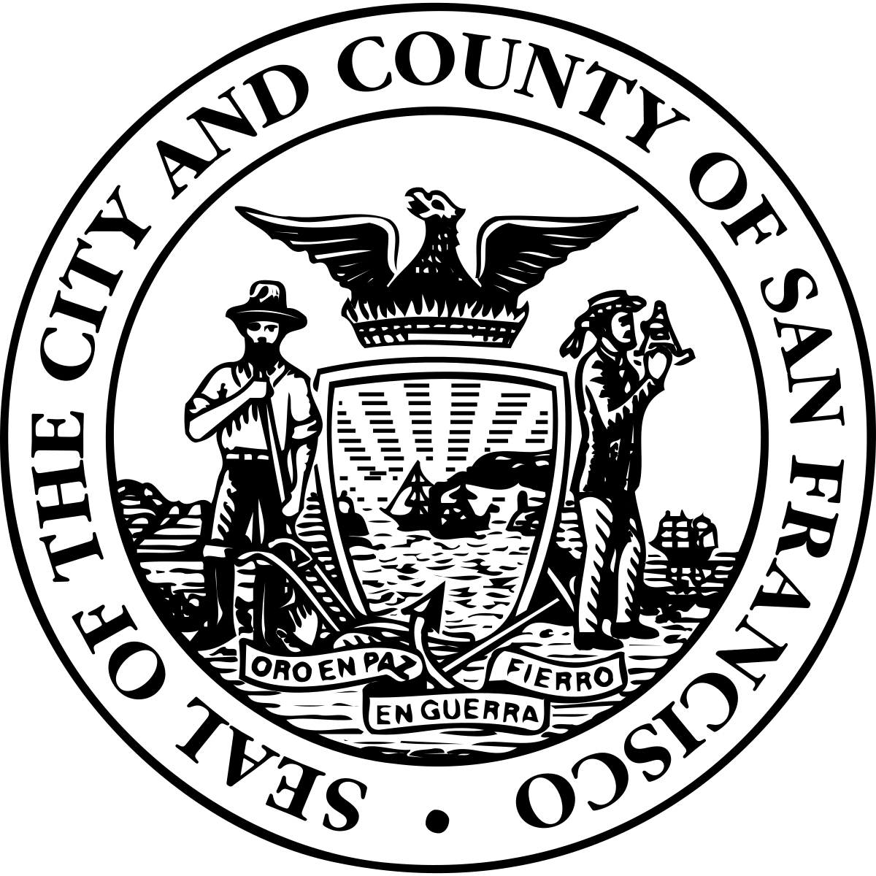
ROADMAP TO DOWNTOWN
SAN FRANCISCO'S FUTURE

Slide 2
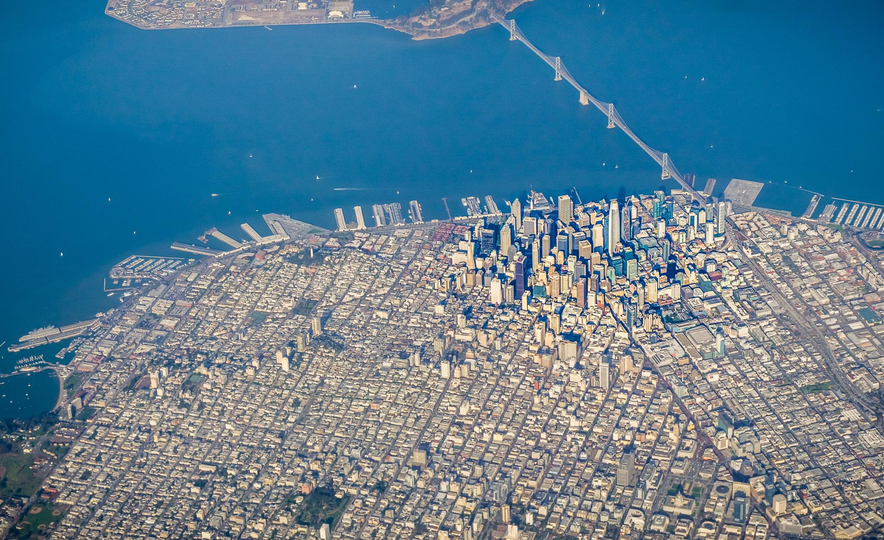
WHY DOWNTOWN SAN FRANCISCO?
Downtown is the engine of San Francisco’s economy
Nearly 80% of San Francisco’s GDP came from Downtown companies in 2021
Downtown and office core was home to 70% of San Francisco jobs pre-pandemic
Nearly half of our sales tax revenue and 95% of business tax revenue comes from Downtown
Downtown offers unique advantages
Downtown’s transportation network makes it more connected to the Bay Area’s high-skilled workforce than anywhere else
Downtown’s built environment features a dynamic public realm, cultural institutions, and millions of square feet of existing space
Notes:
A lot of people have asked, “Why are we focused on just Downtown?”
Downtown is the city’s economic engine, and it has unique infrastructure - including regional transportation connections, public spaces, and millions of sq ft of building space - that make it the foundation of our economic success.
We need to invest in that foundation while also re-imagining what Downtown can be if San Francisco is going to fully recover from the pandemic and continue to grow and sustain itself.

Slide 3
COVID ECONOMIC IMPACTS
Office attendance remains at 40% of pre-pandemic levels, contributing to an office vacancy rate of 26% (vs 6% pre-pandemic)
Downtown BART exits are 36% of pre-pandemic levels, but increasing
Air travel and hotel stays began rebounding in 2022, but remain down
Air travel is at 80% of 2019 levels
Hotel occupancy is at 67% of 2019 levels
These impacts are reflected in the City’s tax base:
Property tax growth is projected to slow and some office property valuations are likely to be reassessed downward
Business tax is down 10% and not projected to recover until 2025
Hotel tax is down 37% and not projected to recover until 2027
Sales tax is down 12% and not projected to recover before 2028
Small businesses are struggling, and business starts inconsistent
Notes:
Message:
COVID-19 has impacted our economy, especially Downtown… remote work, loss of foot traffic for small businesses, less demand for office, tax implications
Notes:
Business tax decline is an understatement bc of outside factors: 1) The 2018 Prop C business tax (extra tax on GRT over $50 million for homeless services) was held up in court until 2020 and began hitting the books on a delay in 2021 that has inflated our business tax revenue and 2) Prop F in 2020 switching from payroll to gross receipts tax included a tax increase so the revenue trend does not reflect the trend in the actual tax base. We don’t have the actual tax base number available at this time.
Hotel and sales tax hit are more reflective of the scale of the impact bc they respond immediately to the loss of tourism and overall spending caused by reduction to foot traffic and visitors.
FYI, out of total General Fund tax revenue, property tax is by far the biggest (35%), and the others listed are the #2, 3, and 4 sources, respectively.
Sources:
Controller, Status of the San Francisco Economy: January 2023 - https://openbook.sfgov.org/webreports/details3.aspx?id=3180
Controller, 2019 Annual Comprehensive Financial Report -
https://openbook.sfgov.org/webreports/details3.aspx?id=2781
Controller, Five Year Financial Plan FY23-24 through FY27-28 (Jan 2023) -
https://openbook.sfgov.org/webreports/details3.aspx?id=3178

Slide 4
Notes:
Message:
COVID-19 has impacted our economy, especially Downtown… remote work, loss of foot traffic for small businesses, less demand for office, tax implications
Notes:
Business tax decline is an understatement bc of outside factors: 1) The 2018 Prop C business tax (extra tax on GRT over $50 million for homeless services) was held up in court until 2020 and began hitting the books on a delay in 2021 that has inflated our business tax revenue and 2) Prop F in 2020 switching from payroll to gross receipts tax included a tax increase so the revenue trend does not reflect the trend in the actual tax base. We don’t have the actual tax base number available at this time.
Hotel and sales tax hit are more reflective of the scale of the impact bc they respond immediately to the loss of tourism and overall spending caused by reduction to foot traffic and visitors.
FYI, out of total General Fund tax revenue, property tax is by far the biggest (35%), and the others listed are the #2, 3, and 4 sources, respectively.
Sources:
Controller, Status of the San Francisco Economy: January 2023 - https://openbook.sfgov.org/webreports/details3.aspx?id=3180
Controller, 2019 Annual Comprehensive Financial Report -
https://openbook.sfgov.org/webreports/details3.aspx?id=2781
Controller, Five Year Financial Plan FY23-24 through FY27-28 (Jan 2023) -
https://openbook.sfgov.org/webreports/details3.aspx?id=3178

Slide 5
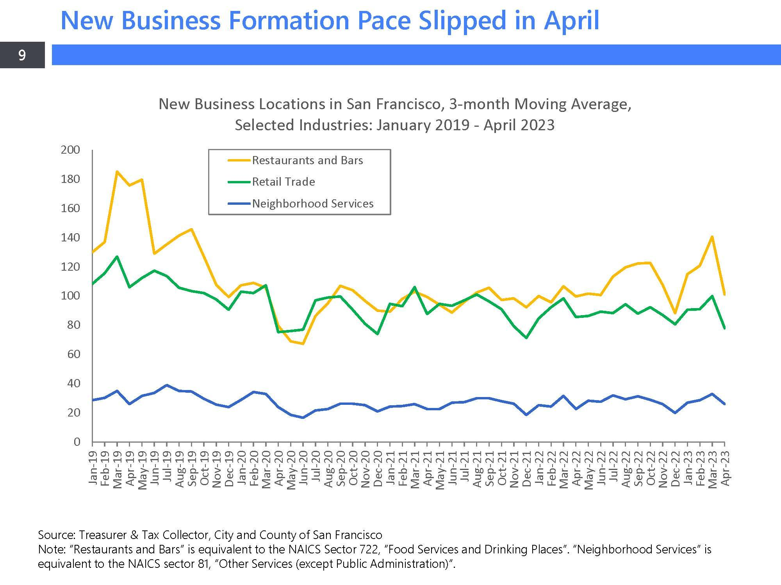
Notes:
Message:
COVID-19 has impacted our economy, especially Downtown… remote work, loss of foot traffic for small businesses, less demand for office, tax implications
Notes:
Business tax decline is an understatement bc of outside factors: 1) The 2018 Prop C business tax (extra tax on GRT over $50 million for homeless services) was held up in court until 2020 and began hitting the books on a delay in 2021 that has inflated our business tax revenue and 2) Prop F in 2020 switching from payroll to gross receipts tax included a tax increase so the revenue trend does not reflect the trend in the actual tax base. We don’t have the actual tax base number available at this time.
Hotel and sales tax hit are more reflective of the scale of the impact bc they respond immediately to the loss of tourism and overall spending caused by reduction to foot traffic and visitors.
FYI, out of total General Fund tax revenue, property tax is by far the biggest (35%), and the others listed are the #2, 3, and 4 sources, respectively.
Sources:
Controller, Status of the San Francisco Economy: January 2023 - https://openbook.sfgov.org/webreports/details3.aspx?id=3180
Controller, 2019 Annual Comprehensive Financial Report -
https://openbook.sfgov.org/webreports/details3.aspx?id=2781
Controller, Five Year Financial Plan FY23-24 through FY27-28 (Jan 2023) -
https://openbook.sfgov.org/webreports/details3.aspx?id=3178

Slide 6
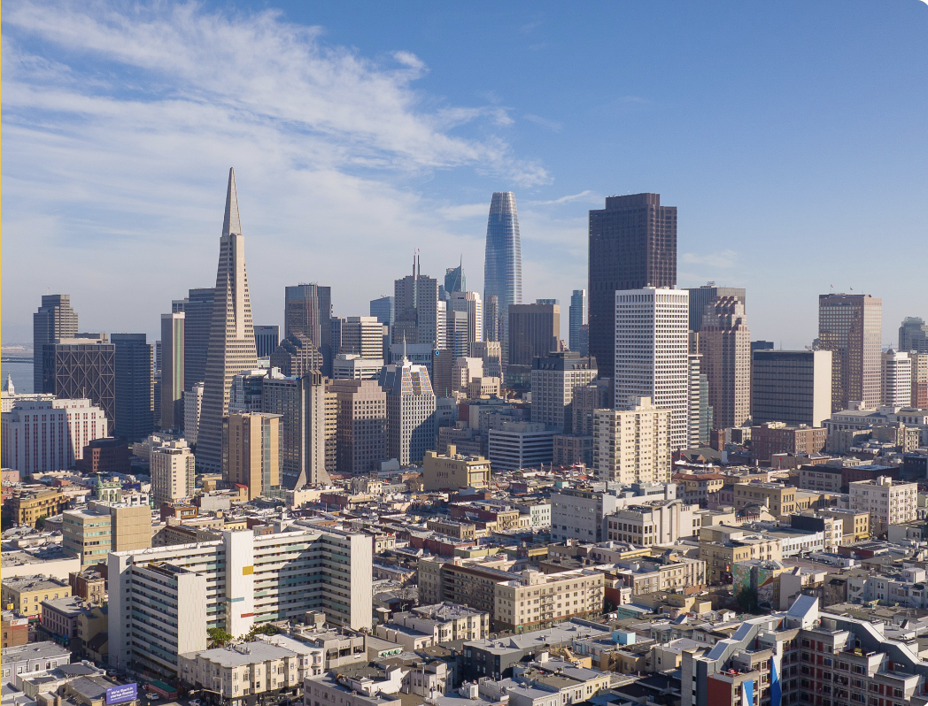
MAYOR BREED’S VISION
Five priorities for Downtown
An economically diverse and resilient job engine
A welcoming, clean, and safe environment
A dynamic destination active at all hours, every day
A world-class transportation experience
An equitable economy that supports full participation by all
Notes:
So, the Mayor put forward her Roadmap to Downtown San Francisco’s Future in her State of the City address that lays out the her overarching vision for the future of Downtown

Slide 7
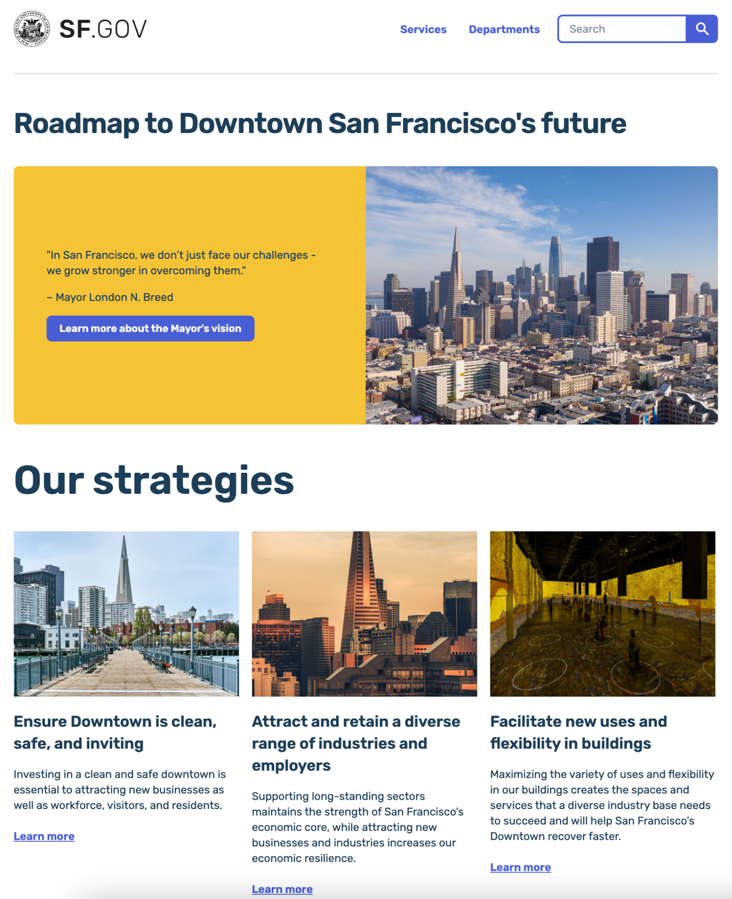
Notes:
This Roadmap isn’t a static report. It’s a living plan that is available on the Roadmap website that will evolve and grow over time and be updated regularly
https://sf.gov/roadmap-downtown-san-franciscos-future

Slide 8
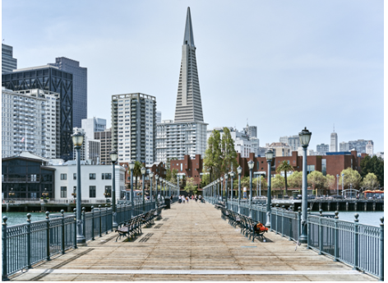
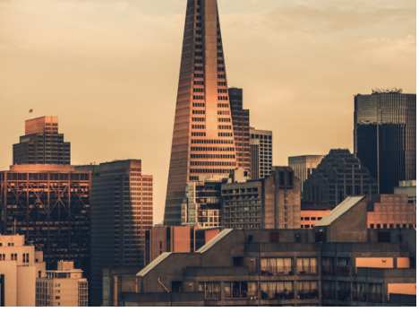
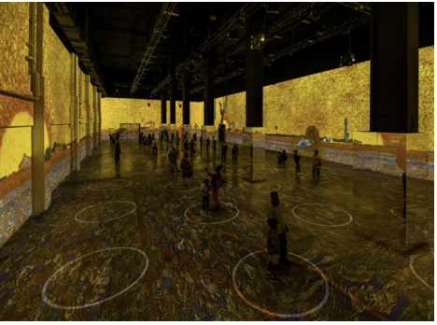
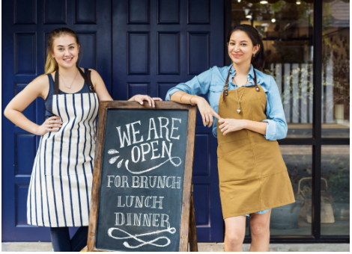
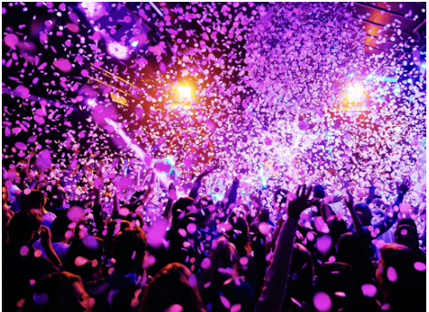
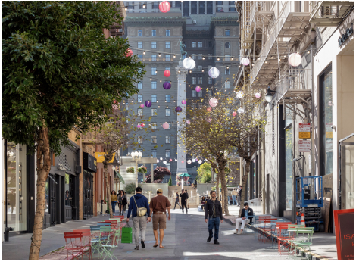
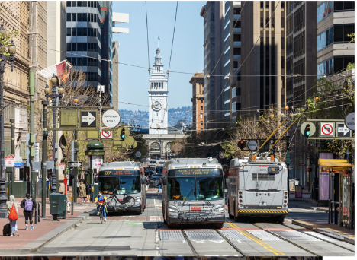
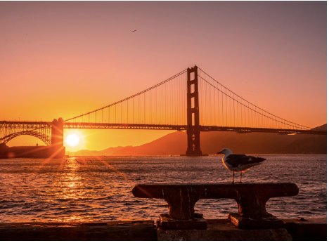
Our Strategies
Notes:
The Roadmap is organized around 9 strategies that include around 50 specific initiatives

Slide 9
ENSURE DOWNTOWN IS CLEAN, SAFE, AND INVITING
Support businesses, residents, and visitors with an enhanced public safety presence.
Continue and grow Healthy Streets coordinated response programs that connect people with services while keeping streets and sidewalks safe for everyone.
Implement street vending regulations to discourage resale of stolen merchandise and keeping sidewalks accessible.
Provide a welcoming gateway to Downtown attractions through increased parking garage security at City garages.
Continue to partner with CBDs to keep sidewalks and plazas clean through the 311 Connected Worker App.
Continue to fund and expand targeted cleaning crews in key areas and hot spots.
Welcome transit riders and visitors Downtown with refurbished transit platforms, and shelters.

Slide 10
ATTRACT AND RETAIN A DIVERSE RANGE OF INDUSTRIES AND EMPLOYERS
Support businesses recovery with ongoing tax relief and incentives in key sectors.
Explore business tax reform to adapt to shifting work patterns and make our tax base more resilient and competitive.
Complete a Competitive Industries Assessment to identify high-potential industries and supporting strategies.
Launch a business attraction campaign to bring new ventures in high-potential industries to San Francisco.
Continue attracting convention and business travel with the Moscone Recovery Fund.
Increase filming in Downtown to promote San Francisco’s image and develop the local film industry.

Slide 11
FACILITATE NEW USES AND FLEXIBILITY IN BUILDINGS
Amend the Planning Code to ensure flexible zoning Downtown to accommodate the widest possible range of activities and uses.
Prepare a housing conversion analysis to identify the feasibility of office-to-residential conversions and recommend supporting policy changes.
Develop a recovery entitlement program that would allow time and flexibility for previously entitled development projects to adjust to market conditions.
Notes:
The flexible zoning and housing conversion legislation was approved by the Planning Commission on Thursday 5/4

Slide 12
MAKE IT EASIER TO START AND GROW A BUSINESS
Provide direct business recovery assistance including grants and loans.
Expanded the First Year Free program to reduce permit costs for new business ventures.
Right-size local employer healthcare contributions under the Health Care Security Ordinance (HCSO).
Connect new ventures to ground floor vacancies and provide support through a new Vacant to Vibrant program.
Build on the Save Our Small Business Initiative and SBRA to deliver smoother business permitting.
Modernize processes and add resources to support businesses at the Permit Center.
Streamline business inspections to reduce delays and unexpected costs for new and existing businesses.

Slide 13
GROW AND PREPARE OUR WORKFORCE
Implement the Mayor’s Housing for All plan to deliver housing for our workforce.
Potrero Power Station IFD approved in March
Site permit reform legislation announced in March
Housing streamlining legislation introduced in April
Provide industry-informed training programs that target resources to employers’ shifting needs.
Expand outreach to grow the workforce through programs that match new job seekers and those outside the labor force with emerging opportunities.
Hospitality & Small Business Job Fair in April
Committee on City Workforce Alignment launched in April

Slide 14
TRANSFORM DOWNTOWN INTO A LEADING
ARTS, CULTURE, AND NIGHTLIFE DESTINATION
Designate an Arts, Culture and Entertainment (ACE) Zone with targeted City programs and incentives to foster new arts and culture establishments.
Continue supporting public space events and activations that showcase local talent, entrepreneurs and culture.
Permitting improvements for community events to support neighborhood festivals and street fairs.
Advocate for and implement state legislation to allow for outdoor alcohol consumption in Entertainment Zones in select areas.
Leverage the Moscone Visitor Center as a point to connect guests to local arts, culture, and entertainment offerings.

Slide 15
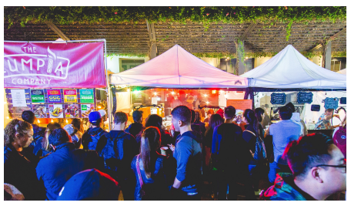
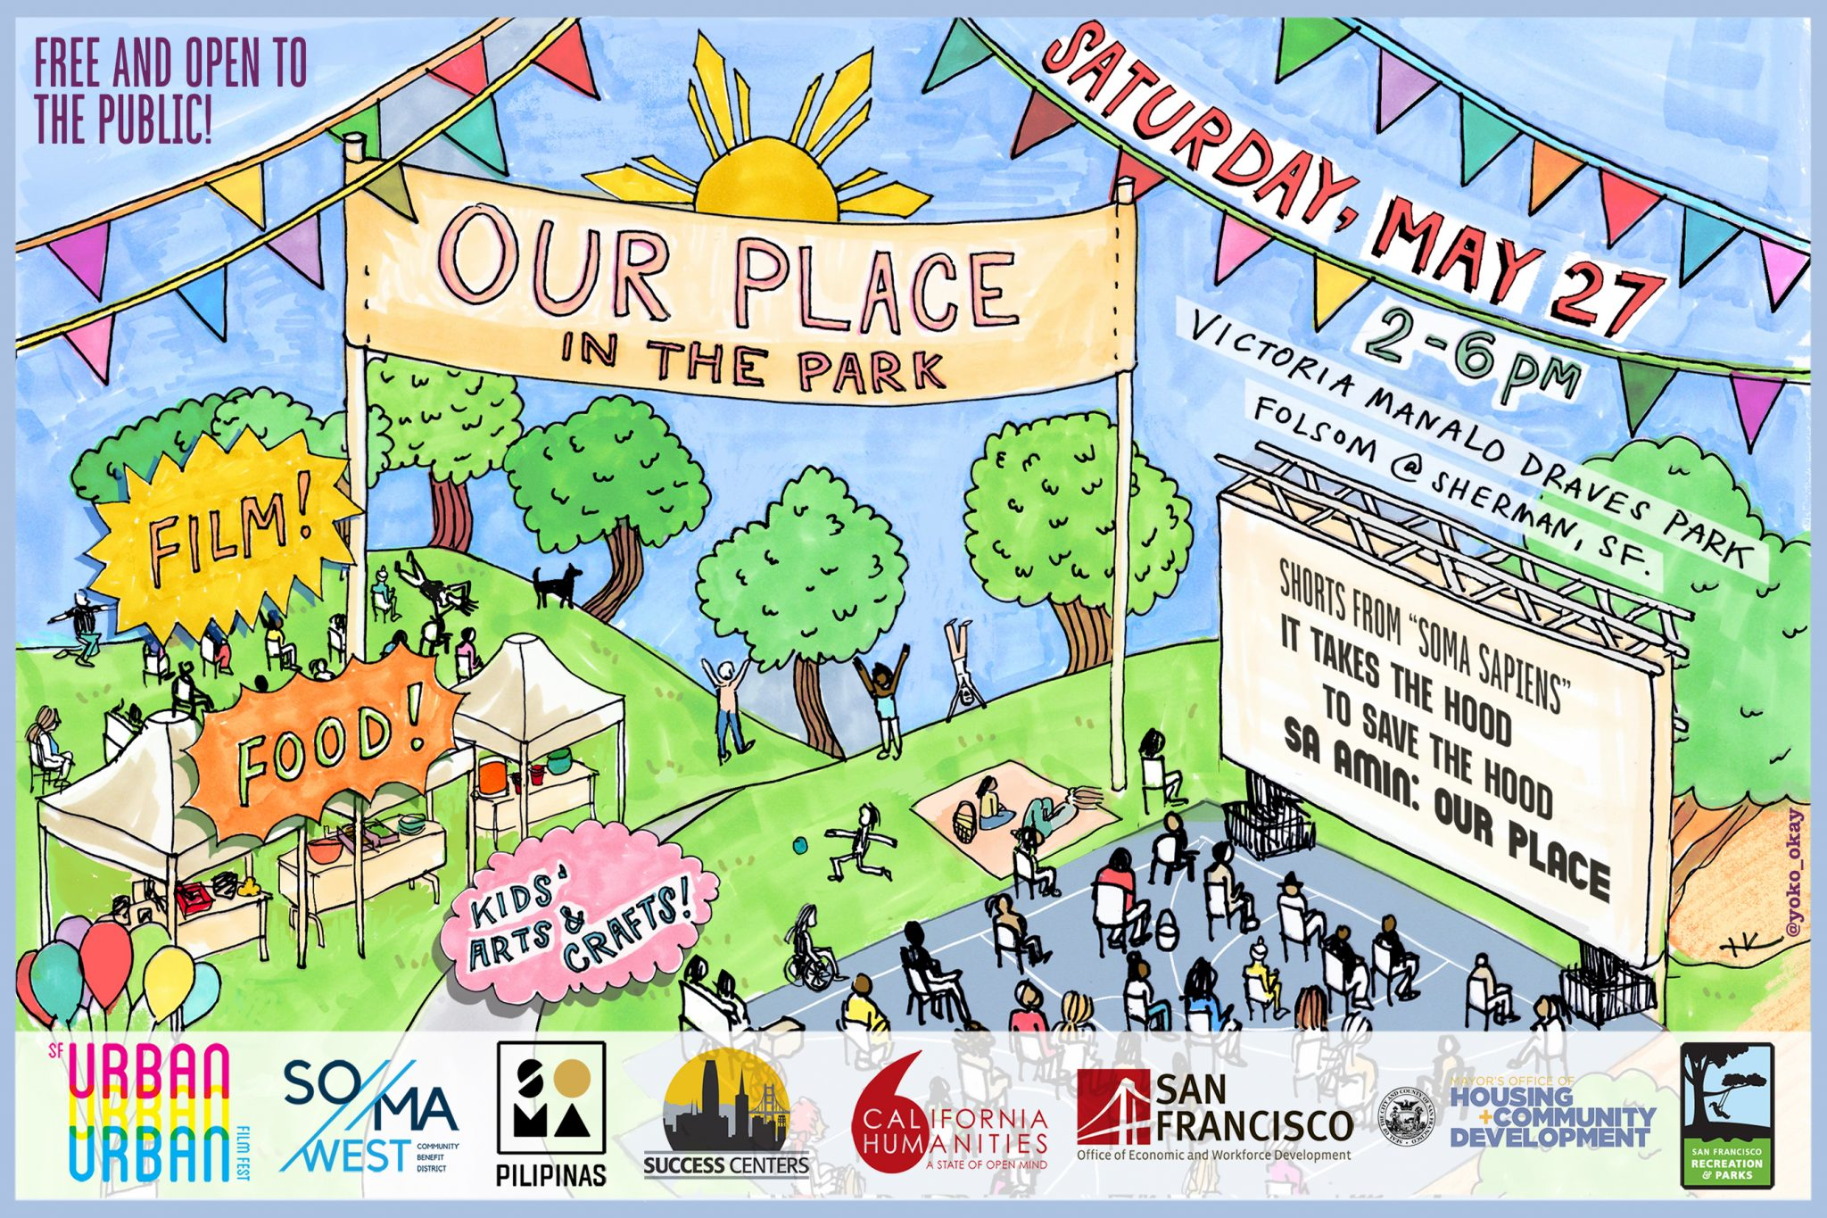
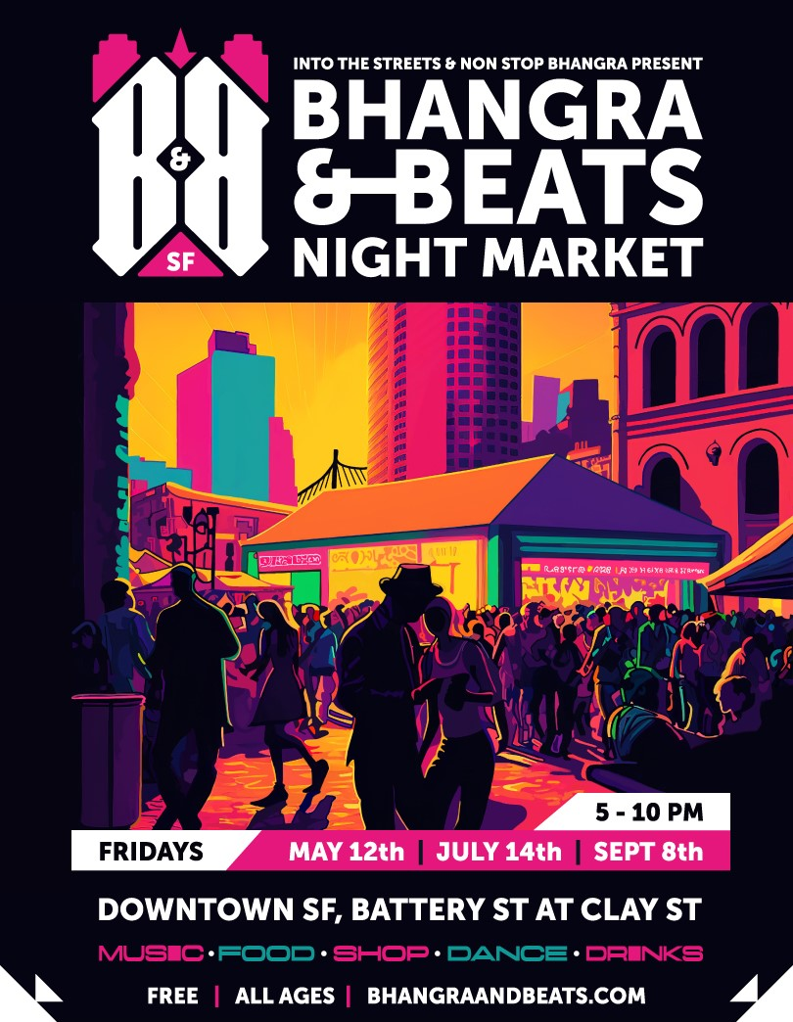
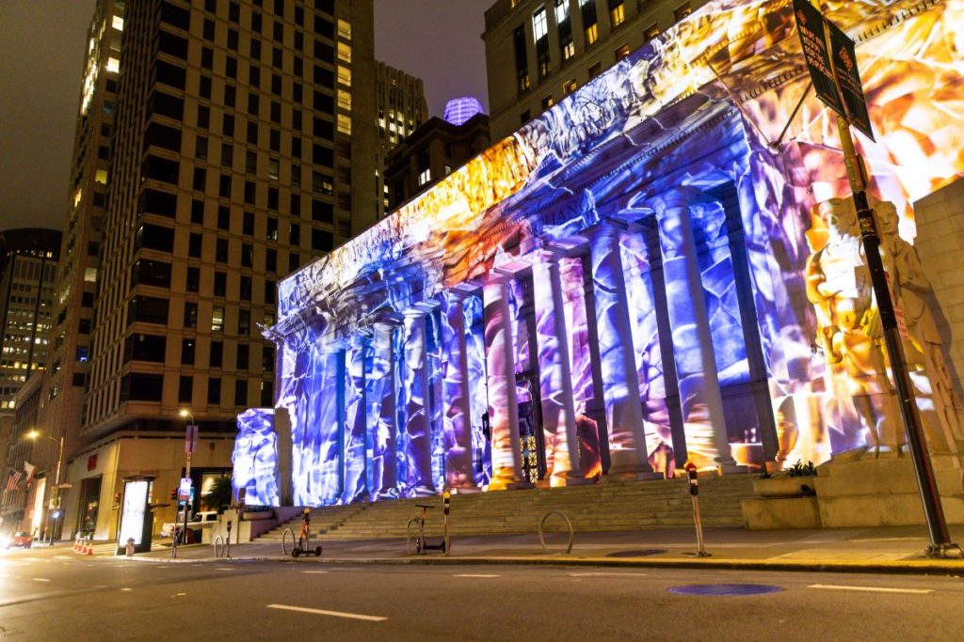
Photo courtesy of Downtown SF
Notes:
San FranDisco
World Cup Village at Civic Center Plaza, Crossing, and Union Square in December
Let’s Glow SF holiday light show in December
Holiday Market in Hallidie Plaza
Farmers Market and Pickle Ball at the Crossing at East Cut
Yerba Buena Art & Makers Market at Yerba Buena Gardens launched in April
Bhangra & Beats Night Market in FiDi launching May 12
Union Square in Bloom
Our Place in the Park AAPI Film Fest (and seasonal Filipino cultural events) May 27 at Victoria Manalo Draves Park in SOMA.

Slide 16
ENHANCE PUBLIC SPACES TO SHOWCASE DOWNTOWN
Complete the transition of Shared Spaces to a permanent program allowing businesses to activate streets, plazas, and sidewalks.
Continue adding new design elements in public spaces to showcase Downtown’s environment and support community activities.
Create new points of interest that attract visitors and encourage gatherings in public spaces like the Landing at Leidesdorff.
Reimagine transit stations as platforms for local art and talent to support local artists and spark interest Downtown.

Slide 17
INVEST IN TRANSPORTATION CONNECTIONS
Make it easy for workers, residents and visitors to travel Downtown with improved Muni connections.
Provide faster trips to Downtown with ongoing Muni Forward improvements on key lines.
Work with City and regional partners to bring high-speed rail to the Salesforce Transit Center.
Pursue new strategies to ensure long-term financial stability for Muni.
Ensure biking is safe and convenient with a more connected and protected Downtown bike network.
Strategically deploy traffic control officers to keep traffic moving Downtown.
Make Muni a more attractive option with cellular service in the Metro.
Launch additional fare pass programs to boost Muni ridership.

Slide 18
TELL OUR STORY
Promote a national visitor attraction campaign in targeted markets to remind potential visitors of San Francisco’s unique allure. Always San Francisco campaign launching late May.
Launched the Heart of SF social media campaign to amplify a cohesive narrative around Downtown’s evolving identity.
Launched the Make Your Future San Francisco campaign with business leaders to inspire entrepreneurs to locate Downtown.
Develop a San Francisco recovery campaign to put forward overall positive stories of San Francisco.
Update this Roadmap as our story evolves at sf.gov/roadmap-downtown-san-franciscos-future

