Slide 1
Research Partnership
Draft Findings from graduate student research
Presented by USF Prof. Rachel Brahinsky, Ph.D
May 8, 2023

Slide 2
Research Partnership
How the partnership developed
Methodology
Results, including quotes from participants

Slide 3
How did this
partnership
develop?
October presentation for AARAC
Students: Desire to support reparations effort
Discussion: AARAC staff & USF’s Urban & Public Affairs research class
January MOU
Jan-April: Weekly meetings
Collaborated on research plan, materials, guest speakers

Slide 4
Research methodology
Aim: Support final AARAC reparations report
Aim: Support AARAC in recording community voices
Aim: Students learn, while contributing to important community effort
Aim: Students practice collaborative – not extractive – model of research

Slide 5
Research methodology
Decision:
90-minute Focus Group Interviews, in multiple locations
Ideally: Create space for meaningful conversations
Ideally: Reach maximum people in a short research cycle

Slide 6
Research methodology
Aim: interview 20-40 African American San Franciscans
Data: Record and transcribe interviews to provide rich source of data representing community voices
Data Ownership: All data gathered belongs to the HRC/ AARAC
The AARAC retains decision-making power around how to use

Slide 7
How did we develop the questions?
Sample Interview Questions (just a few)
How would reparations change your life or the life of your children, your community?
Do you have any concerns about the proposals in the draft plan and if so, what?
What do you think will help bring more African Americans back to San Francisco, and help keep them here for generations to follow?
Students drafted, based on AARAC guidance
AARAC staff & Prof edited
Back and forth a few times
Aim: Forward-looking questions

Slide 8
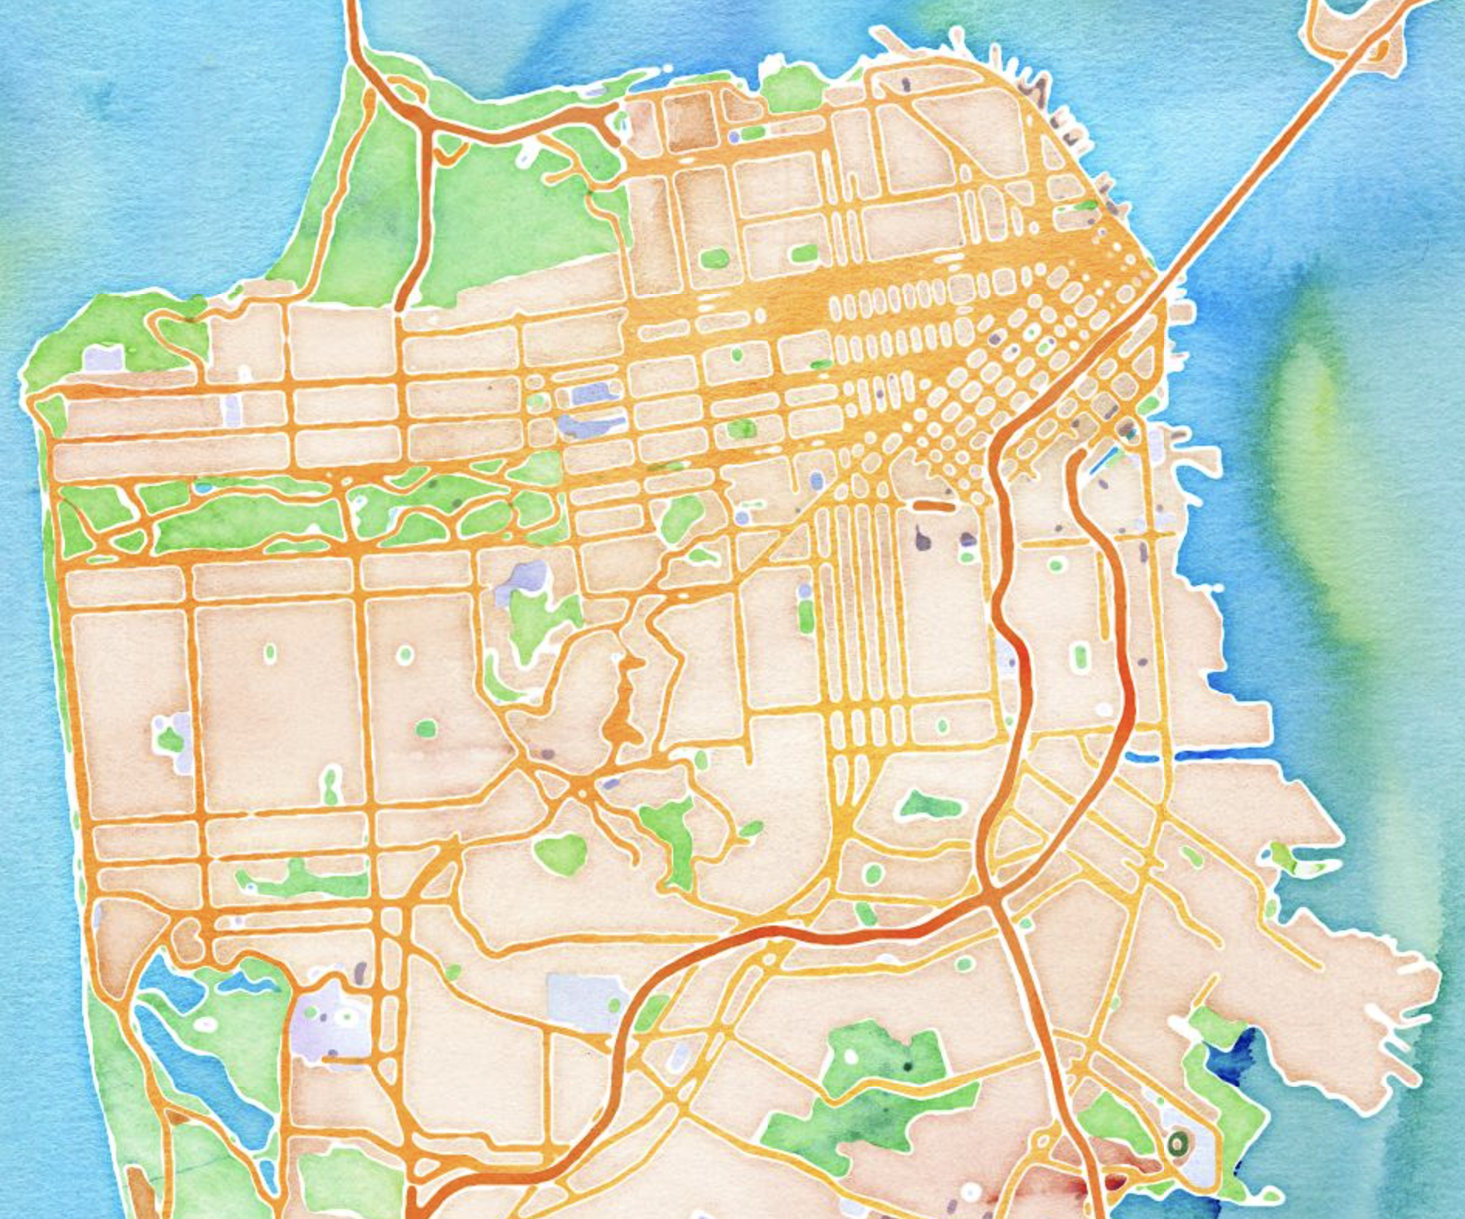
How did we choose locations?
Aim: A mix of locations to create maximum accessibility
Limitations: Some ideal places were not available during our timeline
Decisions:
Public library community rooms in Bayview Hunter’s Point & Fillmore
USF campus
Zoom
Mix of days/ times: evening and weekend

Slide 9
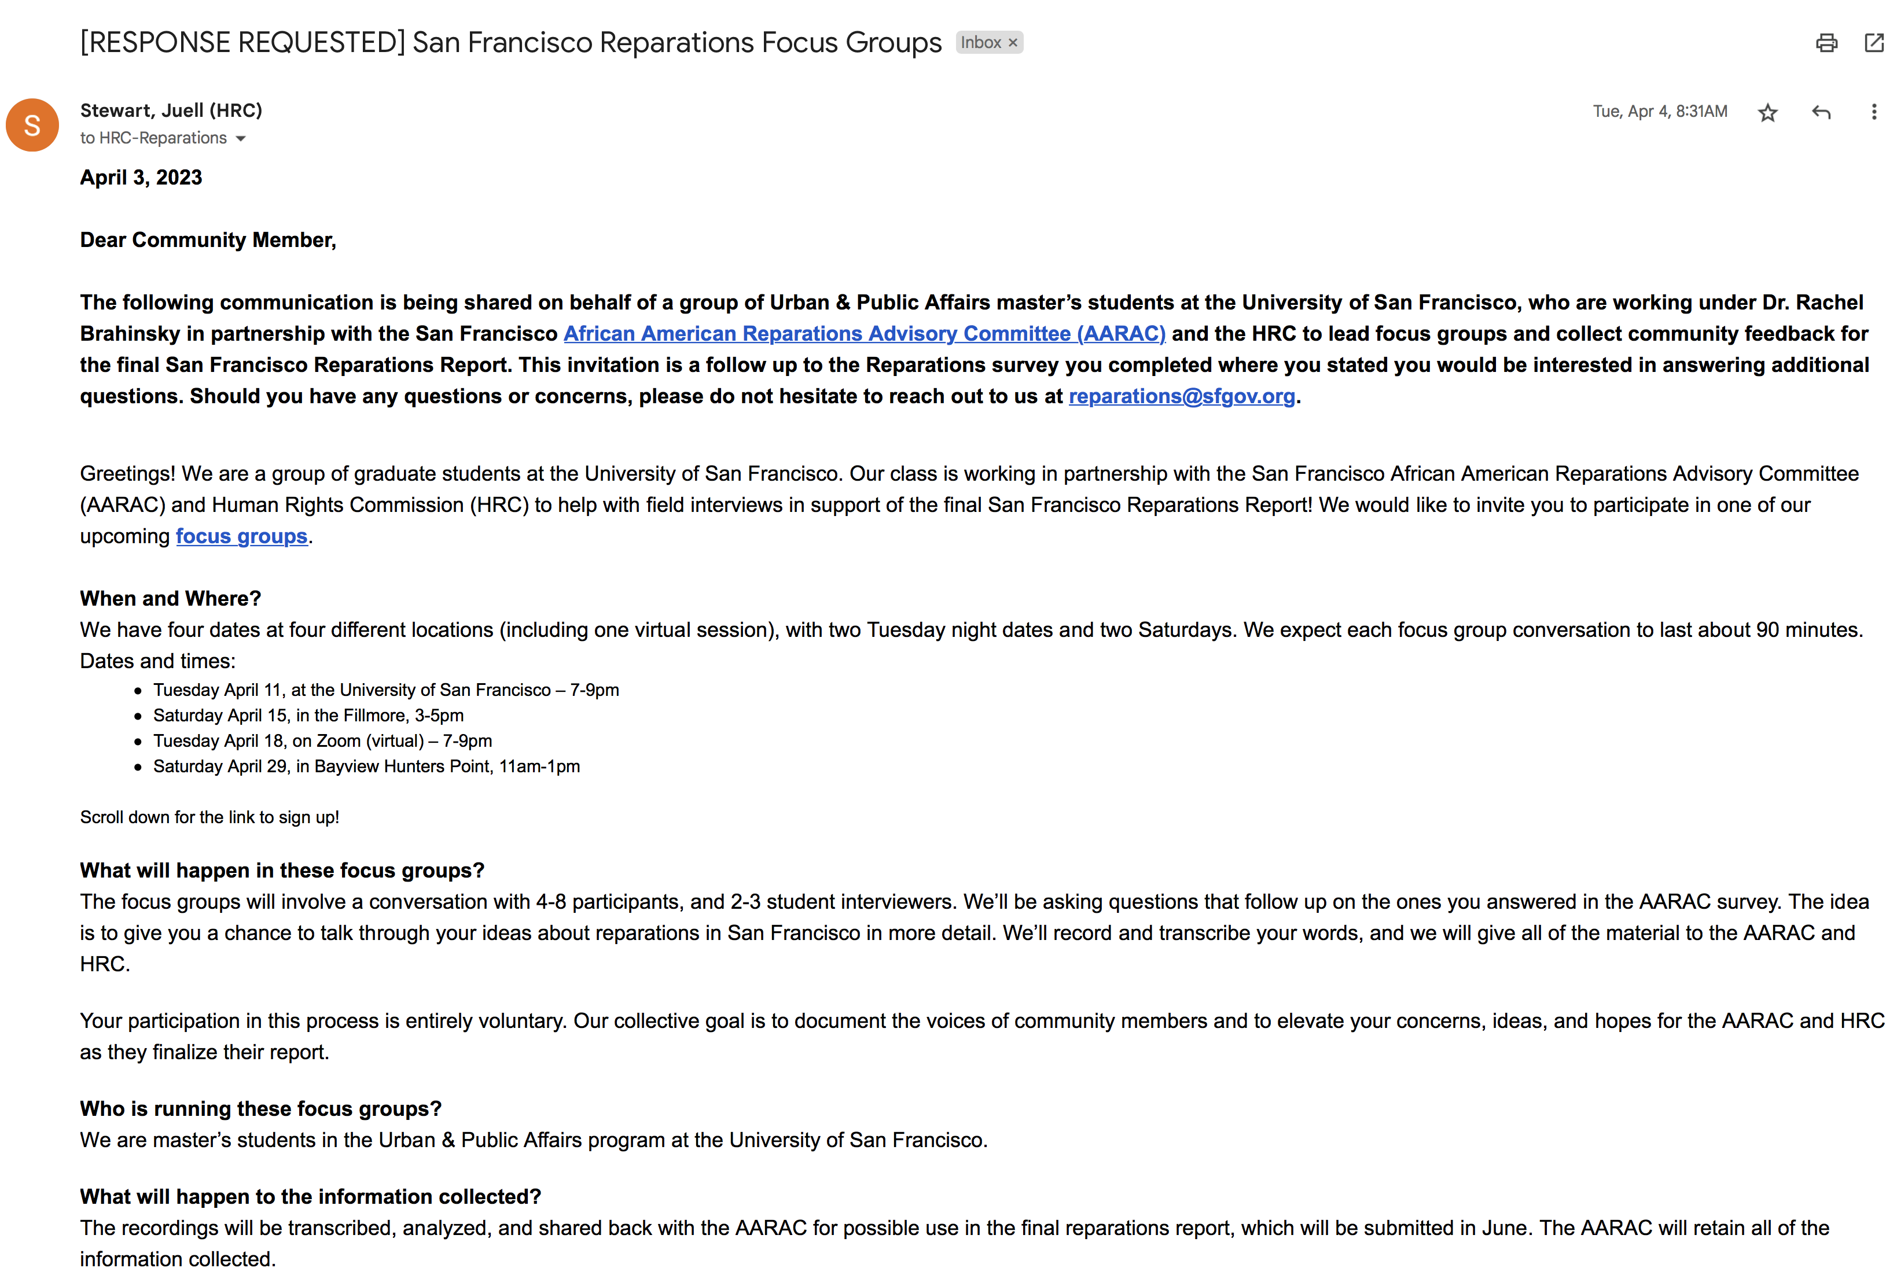
Who did we reach out to?
Students drafted outreach materials
Prof & AARAC staff revised
AARAC staff sent to list from AARAC survey

Slide 10
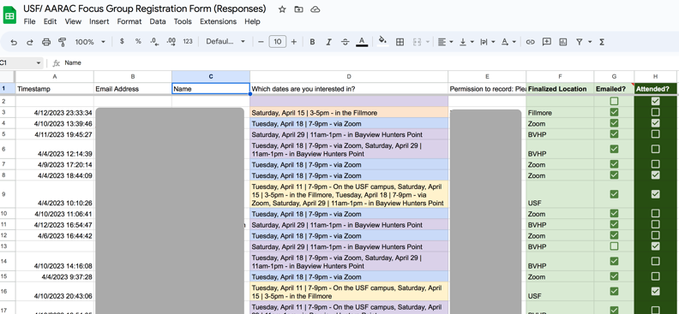
Who did we reach out to?
More than 60 people expressed interest
Students managed RSVPs and scheduling

Slide 11
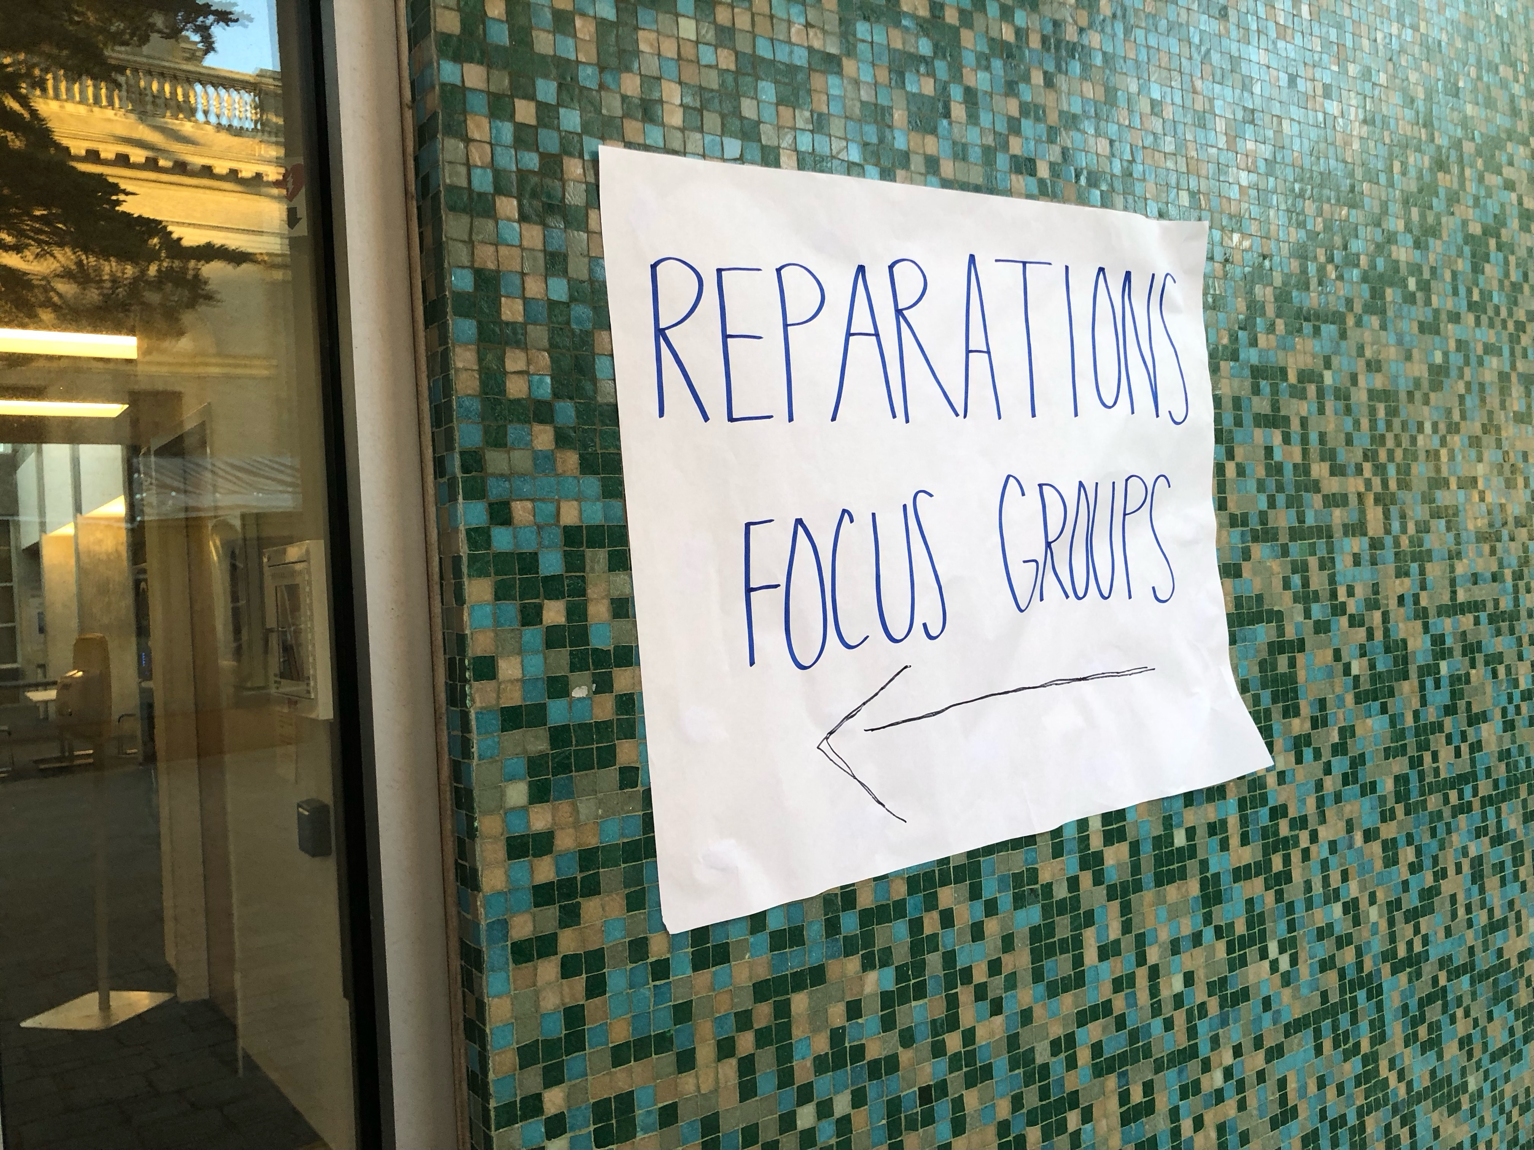
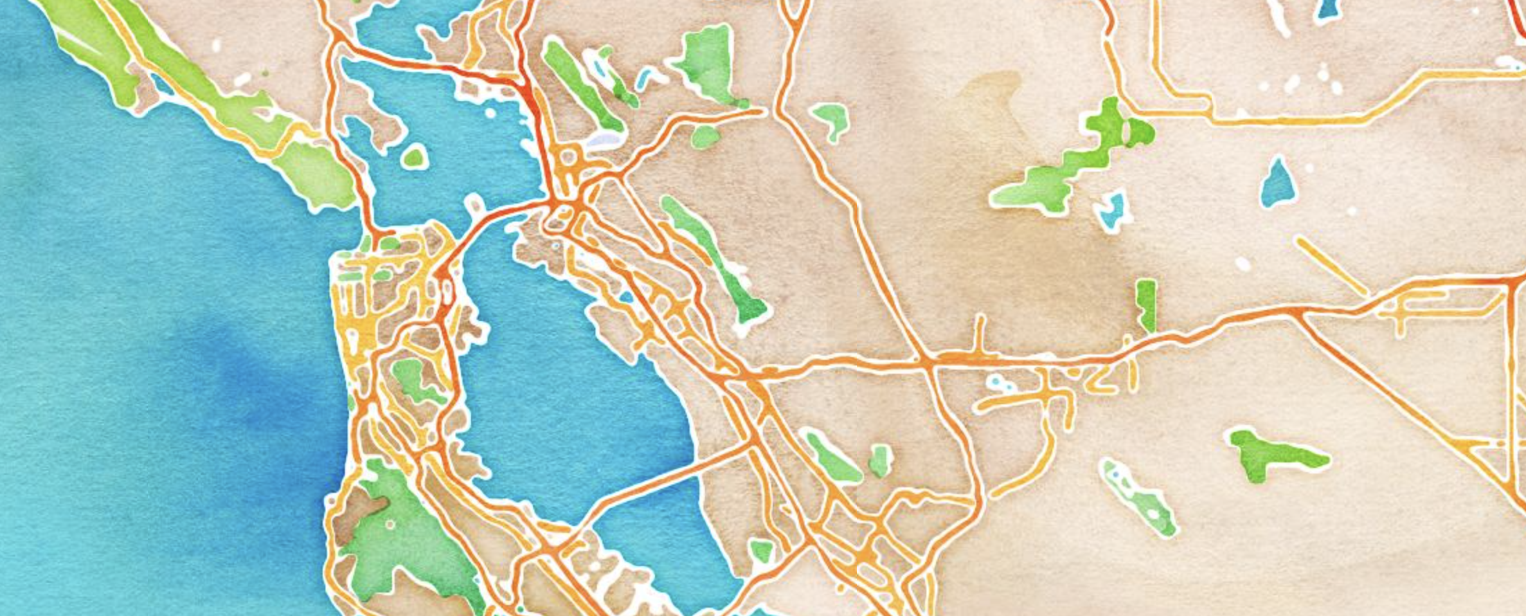
Who participated?
28 participants
From all over the region
Majority identify as Black/ African American
Many from SF; some more recent arrivals

Slide 12
A few notes on process
Interviews were recorded
Students took notes by hand as a back-up
Professional transcriptions; corrected by students
Limited by time: short research cycle
Qualitative research

Slide 13
What did participants tell us?
Richly detailed stories that support reparations claims
Community voices that can be cited or quoted

Slide 14
Key themes:
Longing for Home & Belonging
Long Overdue
Equity
Autonomy
Culturally Relevant &
Accessible Resources
Education
Monetary Compensation

Slide 15
In their own words…

Slide 16
Longing for Home & Belonging
“It's like we want to participate again. We want to be part of this again. It is about repair too, of course, but it's like: We love this city. It's a part of you when you grow up here. It's different than, ‘Everybody feels that way about their hometown,’ or it's not about better or best. It's like it's infectious. It's part of you. It just makes me feel comfortable. I want to feel that again.
Usually, when we come into the city now, those of us who've moved away, it's like, having hope and wanting to build businesses here is like, I don't feel comfortable, how am I going to do this? Why would I give financial resources and the time and the effort into a place I don't feel comfortable? … We want to be part of the positive change, and that's what this means.”

Slide 17
Longing for Home & Belonging
“My parents came here in the '50s. My father had a … business here in the area which was taken through eminent domain, so he lost his business, and we lost the opportunity for generational wealth.
It's very expensive to live here, it's very expensive to get property here, and we had that, but we don't have it anymore. It was taken, and he was not adequately paid for it. It was just a lose-lose situation, and he never opened his own business again.”

Slide 18
Long Overdue / AUTONOMY
“When it comes to the needs of African Americans, specifically, addressing our harms, that sets people off, and it is a political third rail as they say. It's time for that to just stop. It's time for it to stop: Address the harm, or let us take care of business the way we need to. If the state of California does it, awesome too. If it's federal, fine, but address our harm, and leave us alone after that.”

Slide 19
Autonomy
“I don't want programs… I don't want public housing, that's projects. That's what we came from. We're trying to get away from that type of lifestyle or environment, which actually perpetuates more violence within our communities and amongst ourselves because we're too tightly confined to an area. I don't want to see money going for job readiness or job training. I'm 67, I don't need another job. I'm trying to survive and enjoy the rest of my life.”

Slide 20
Culturally Relevant & Accessible Resources
“I think how San Francisco can pay its debt is multi-layered. I think financial is one way, land is another way, health care, mental health care, housing, education for not only Black children, but Black adults who may not have even ever been able to go to school because wages were less than stellar living in San Francisco.”
“I'm 64, we are getting older. There's not a Black nursing home in San Francisco. I know some of us are lucky enough to have a family that can take care of us, but then some people aren't. It would be nice to establish that if possible.”

Slide 21
Education
“We need a diverse group of people creating these curriculums for our children. For all children, really, because like I said, if you do it for my group, it's going to trickle down.”

Slide 22
Monetary Compensation
“We knew what we meant by that: ‘Cut the check.’ Because all of us want to be paid. We want to be paid for our labor and our work that we did, not just being hired in the office, or anything. We want to be paid for what's due to us and our family, so we can start the healing and the repair in our families.”

Slide 23
Reparations
Reparations, “would give us a – I was getting ready to say a leg up. It's beyond a leg up. It is freedom, is what it is, and maybe that's what's so scary.”

Slide 24
What’s next
Your feedback is welcome
Students finalize analysis
AARAC decides how to use this data

Slide 25
Thank you
(on behalf of myself and the students in the UPA program at USF)
To the participants in the focus groups
To the Chair, Vice Chair, and all members of the AARAC
To the staff and interns at the HRC/AARAC
Questions or Follow-ups?
Contact: Dr. Rachel Brahinsky, University of San Francisco: rbrahinsky@usfca.edu

