Slide 1
Our City, Our Home Oversight Committee Special Meeting November 2022
Ann Oliva, CEO
National Alliance to End Homelessness

Slide 2
WHO WE ARE
The National Alliance to End Homelessness is a nonprofit, non-partisan, organization committed to preventing and ending homelessness in the United States.
As a leading voice on the issue of homelessness, the Alliance analyzes policy and develops pragmatic, cost-effective policy solutions; works collaboratively with the public, private, and nonprofit sectors to build state and local capacity; and provides data and research to policymakers and elected officials in order to inform policy debates and educate the public and opinion leaders nationwide.

Slide 3
What We Do
Policy and Programs
Carries out the vital work of educating policymakers and the field about key strategies and policies for ending and preventing homelessness.
Capacity Building
Supports efforts to end homelessness by offering training and technical assistance tailored to communities’ unique needs.
Homelessness Research Institute
Analyzes data to identify homelessness trends on national, local, and Continuum of Care levels.
Keeps federal policymakers and legislators informed of the needs of people experiencing homelessness and the programs serving them.
Leads advocacy efforts on a grassroots level.
Helps design and implement crisis systems, improve systems’ performance, and utilize data to end homelessness, particularly with an equity lens.
Provides online courses, trainings, and webinars to inform the field of best practices to end homelessness.
Publishes research that ensures policymakers, practitioners, the media, and the public have the best information about trends and emerging solutions to the problem.
Uses an equity lens to identify disparities in homelessness data.

Slide 4
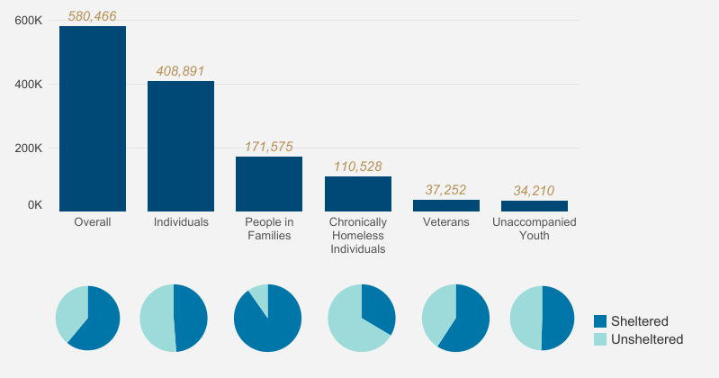
Total People Experiencing Homelessness By Population and Sheltered Status (2020)
Notes:
Even before the pandemic HUD reported an alarming 7% rise in the number of people living unsheltered and a 15% increase in chronic homelessness.
We know that 8 million extremely low-income households pay at least half of their incomes on rent, and that the pandemic has only increased housing instability for many struggling households.
Historically marginalized people – including people of color, people living with disabilities, LGBTQ people and others - bear the brunt of homelessness and housing instability, and we can act now to begin to repair the harm caused by racist practices and disinvestment in housing and communities that brought us to where we are today.

Slide 5
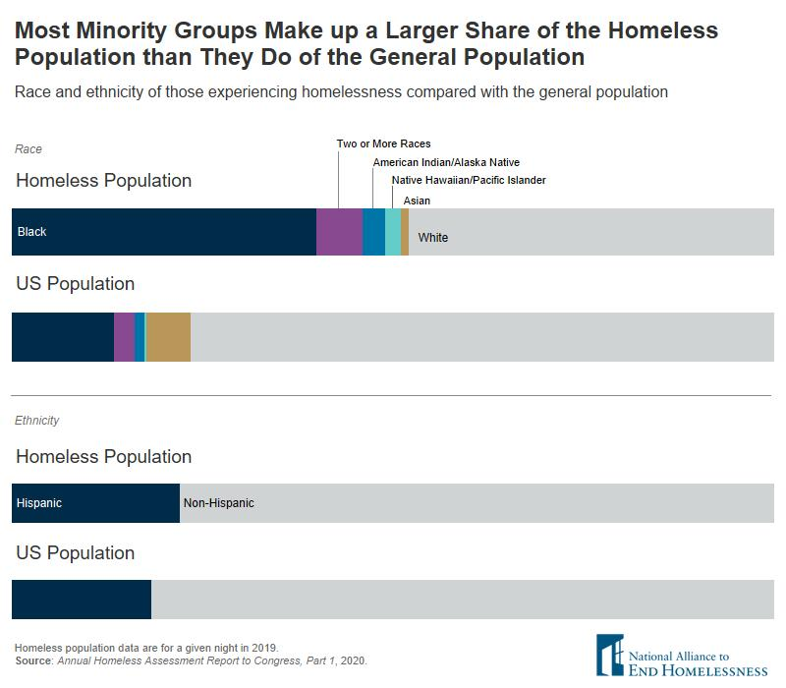
Notes:
Historically marginalized people – including people of color, people living with disabilities, LGBTQ people and others - bear the brunt of homelessness and housing instability, and we can act now to begin to repair the harm caused by racist practices and disinvestment in housing and communities that brought us to where we are today.

Slide 6
What We Are Hearing from People Experiencing Homelessness (Framework)
Adequate affordable housing options and support (e.g. long term rental assistance, affordable housing development, services) must be developed and targeted to those most impacted by structural inequity.
Dignity-based services led by the communities most impacted by homelessness should be designed and supported in a post-COVID environment.
Current congregate emergency shelter options are inadequate and cause harm, both in normal circumstances and in a pandemic.
Because of the trauma created by these activities, communities should end practices that criminalize people experiencing homelessness, and police are not appropriate outreach workers.

Slide 7
What NAEH Listening Sessions Tell Us (So Far)
ARP and CARES Act funding was both challenging and highly beneficial
Flexible funds in Emergency Housing Voucher program for landlord engagement and incentives should be replicated in the HCV program
Some communities used these to fund innovative practices
New opportunities for funding (unsheltered, rural) are appreciated, although timing has not been optimal
Staffing issues and burn-out throughout the system
Skyrocketing rents are causing significant inflow and outflow challenges
Not enough deeply affordable housing stock
Need more and deeper services, or connection to existing services
Criminalization is spreading and hard to combat
https://nlihc.org/housing-first-webinar-recaps

Slide 9
Contact the Alliance
Contact info:
Ann Oliva
aoliva@naeh.org

