Slide 1
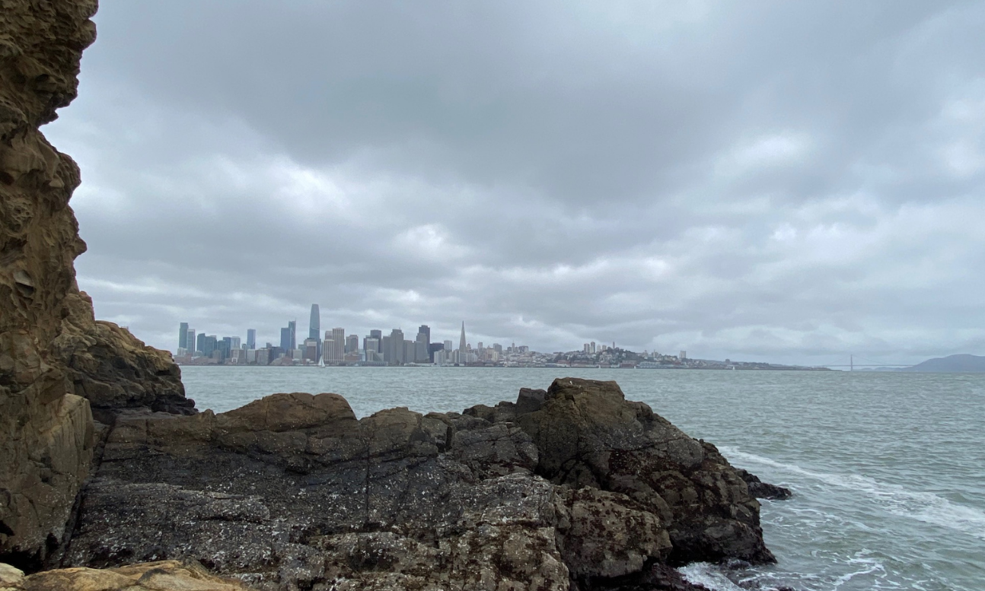
Yerba Buena Island Intertidal and Eelgrass Surveys
Alison Young and Dr. Rebecca Johnson
Center for Biodiversity & Community Science
California Academy of Sciences
Notes:
AY

Slide 2
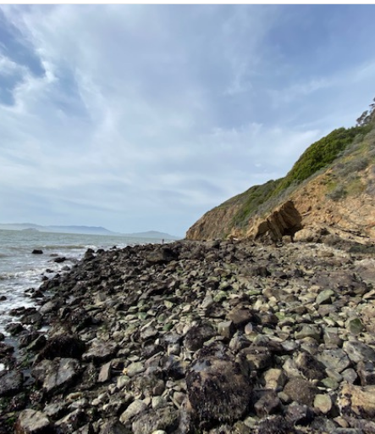
Study objectives
To survey the biodiversity of YBI intertidal areas to develop species lists
To survey the Treasure Island marina fouling community to develop a species list
To understand which intertidal habitats harbor the most native diversity
To survey for eelgrass along the southern edge of Clipper Cove
Based on other studies, to situate the YBI intertidal in the context of San Francisco Bay

Slide 3
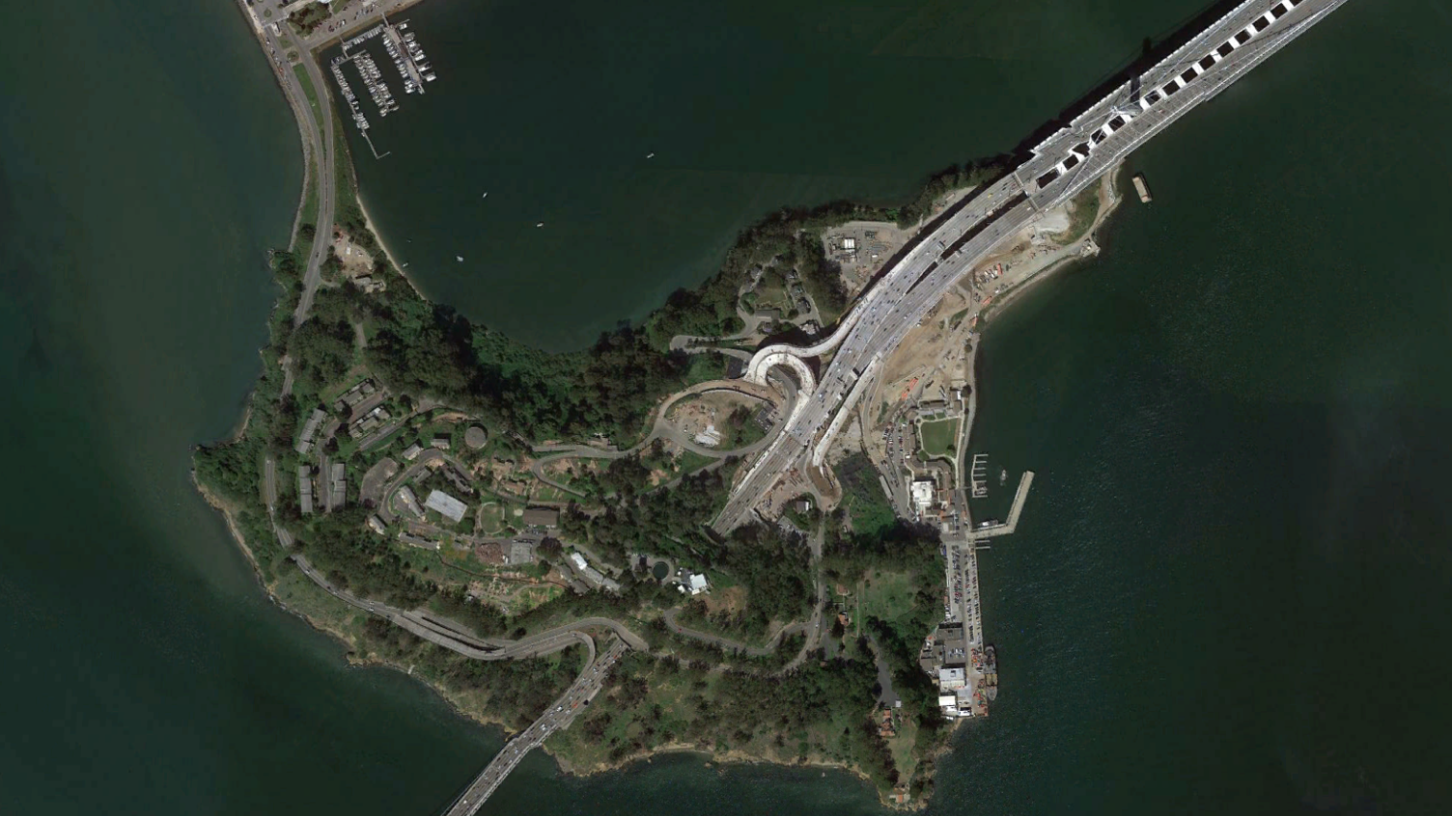
Survey Sites
Treasure Island Marina site
Clipper Cove rocky site
Torpedo Storehouse site
Clipper Cove sandy site
Northwest cove site
Southwest cove site
Intertidal survey sites

Slide 4
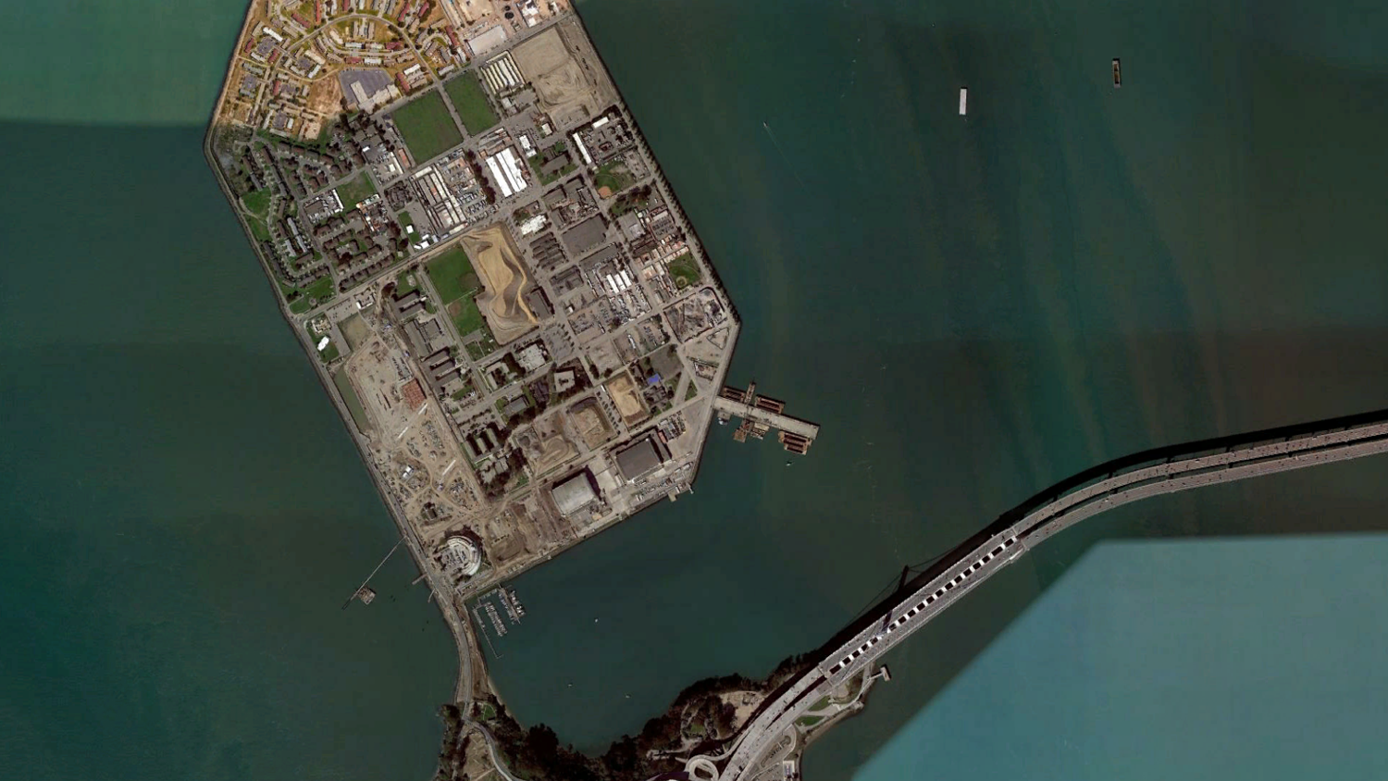
Survey Sites
East Treasure Island eelgrass survey area
Clipper Cove eelgrass survey area
Eelgrass survey sites

Slide 5
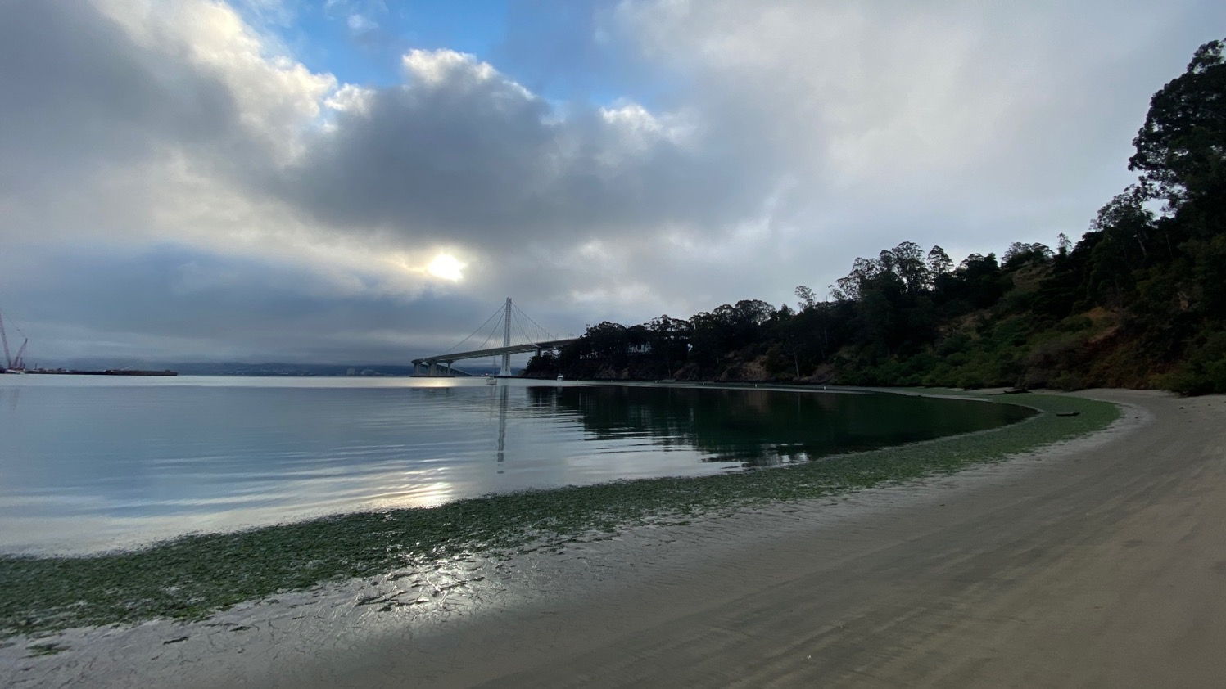
Methods: intertidal surveys
Notes:
RJ

Slide 6
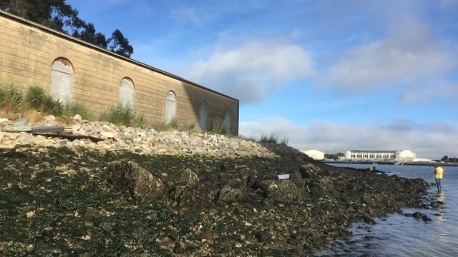
Methods: intertidal surveys

Slide 7
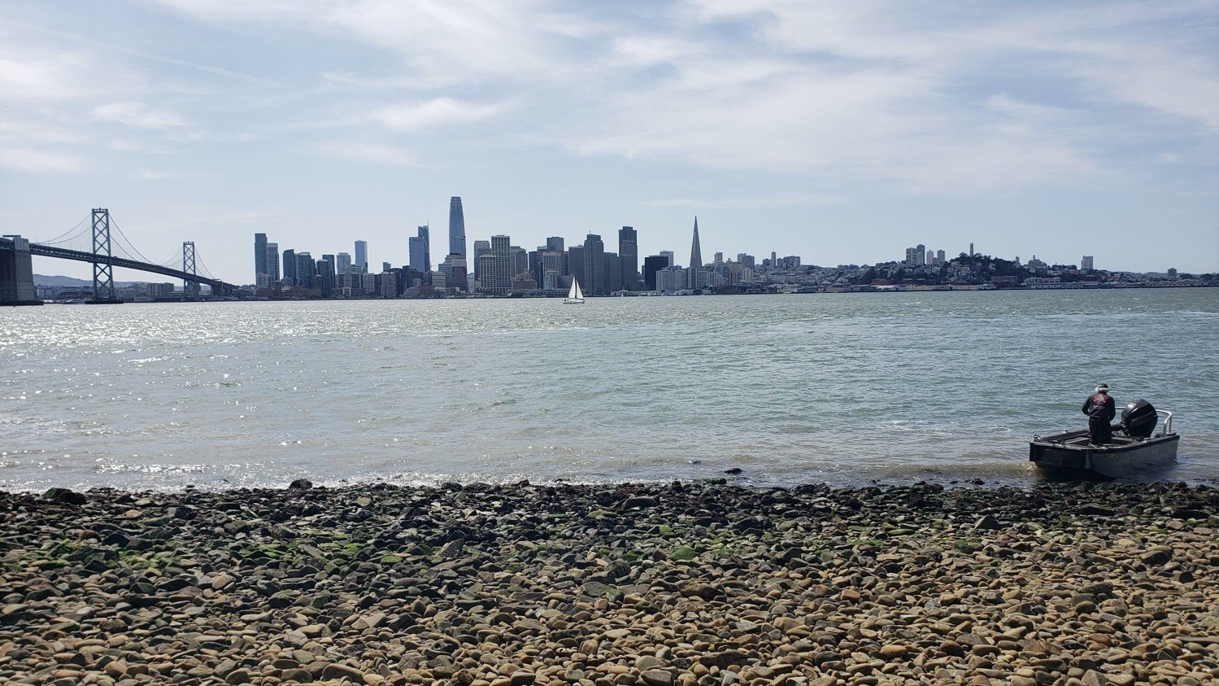
Methods: intertidal surveys

Slide 8
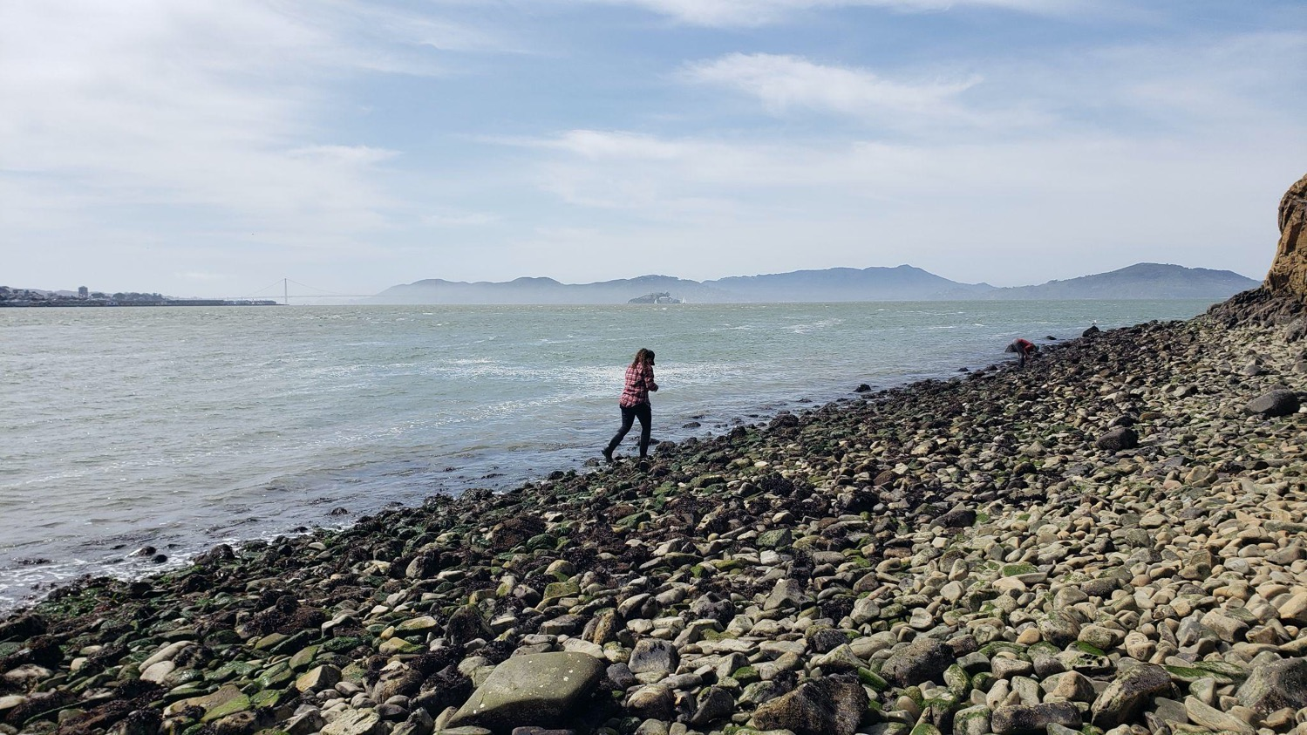
Methods: intertidal surveys

Slide 9
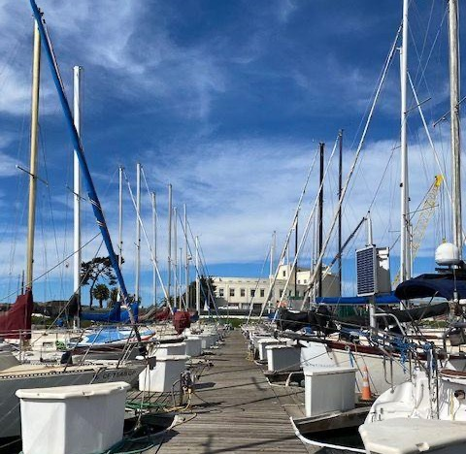
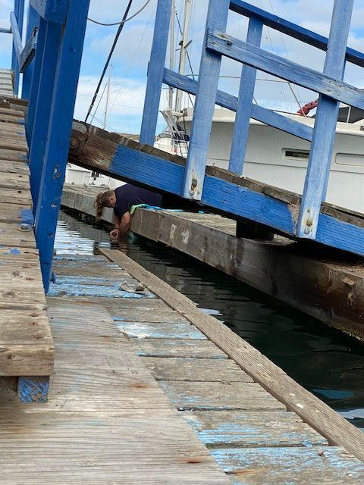
Methods: TI Marina survey

Slide 10
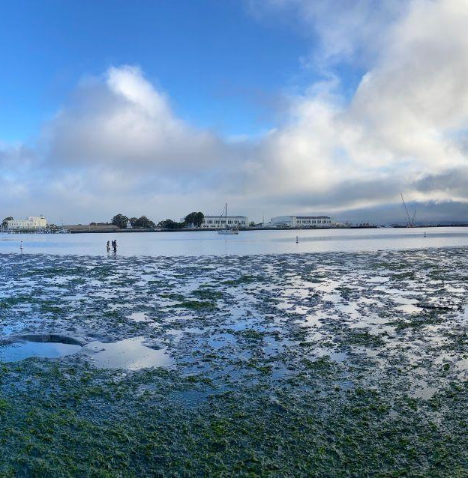
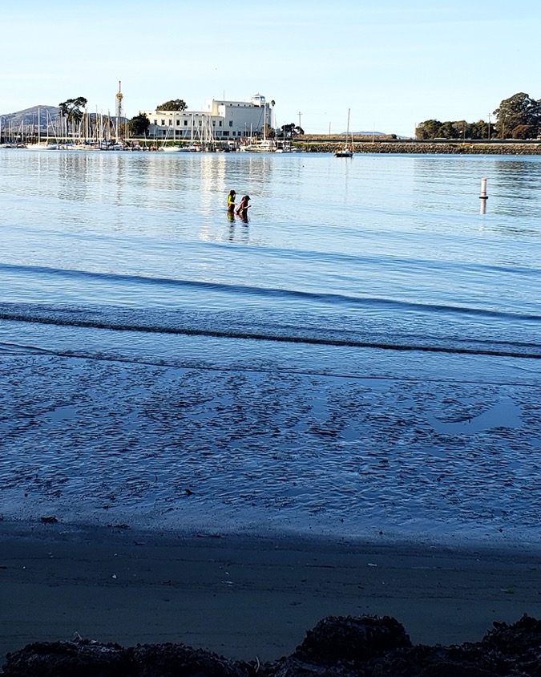
Methods: eelgrass surveys

Slide 11
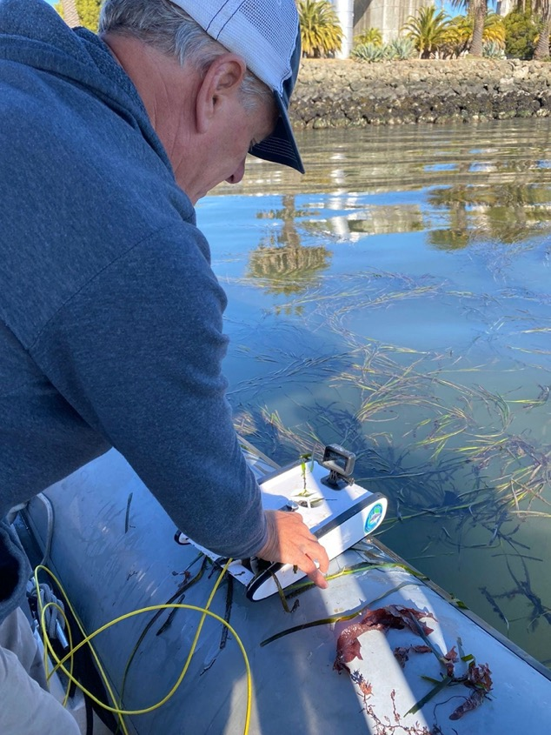
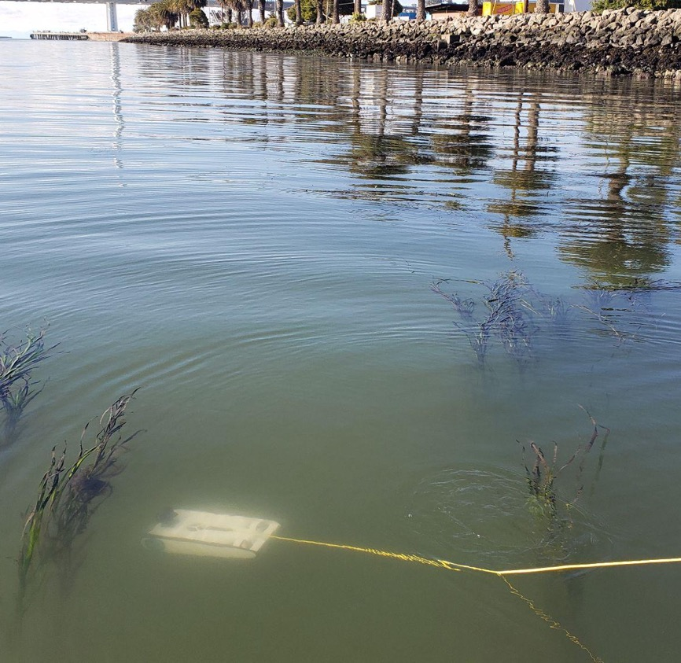
Methods: eelgrass surveys

Slide 12
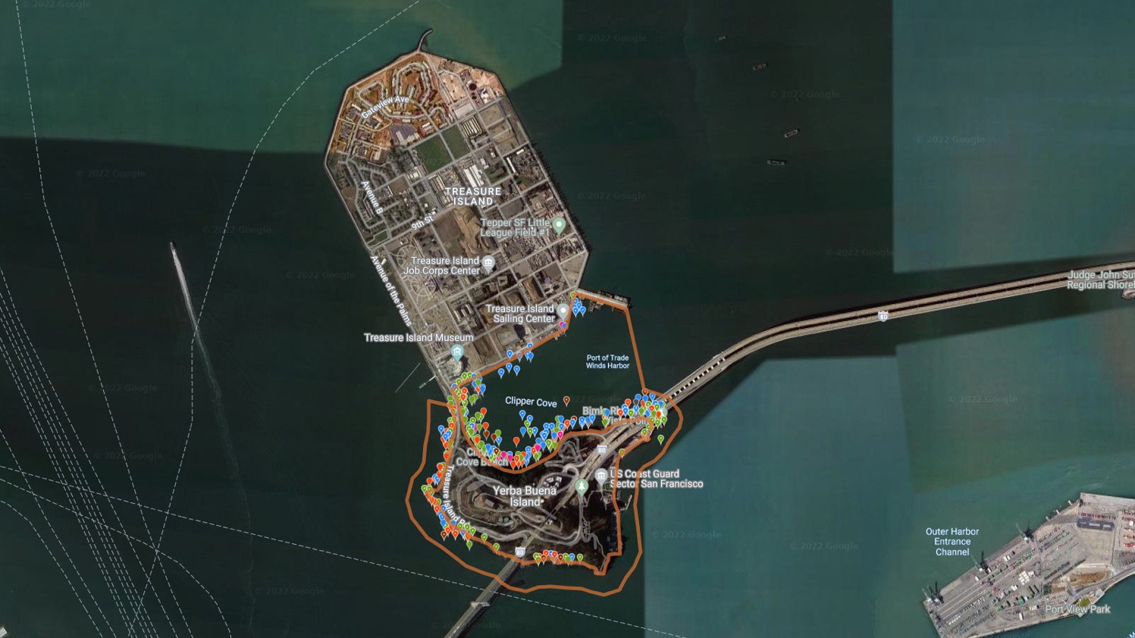
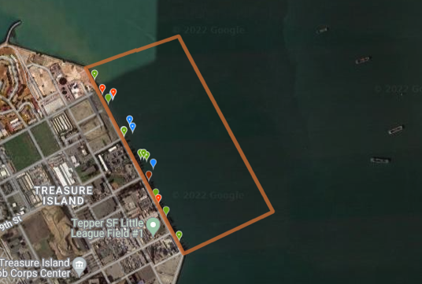
Methods: species documentation

Slide 13
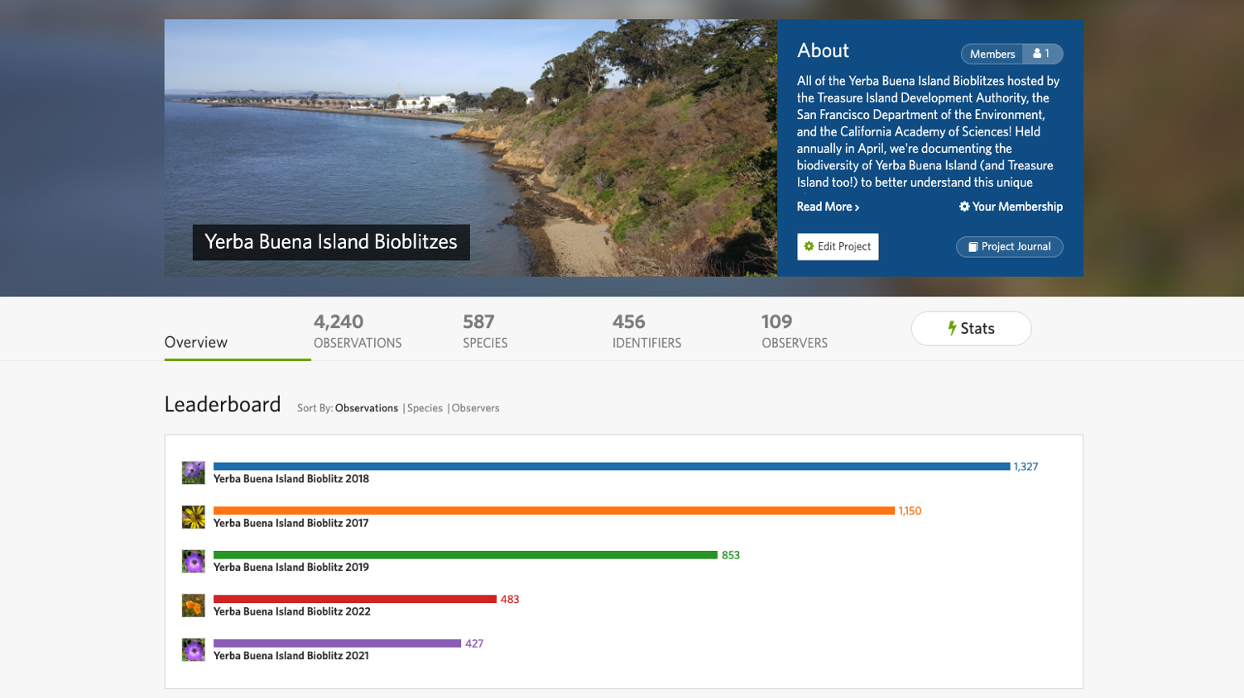
Methods: species documentation

Slide 14
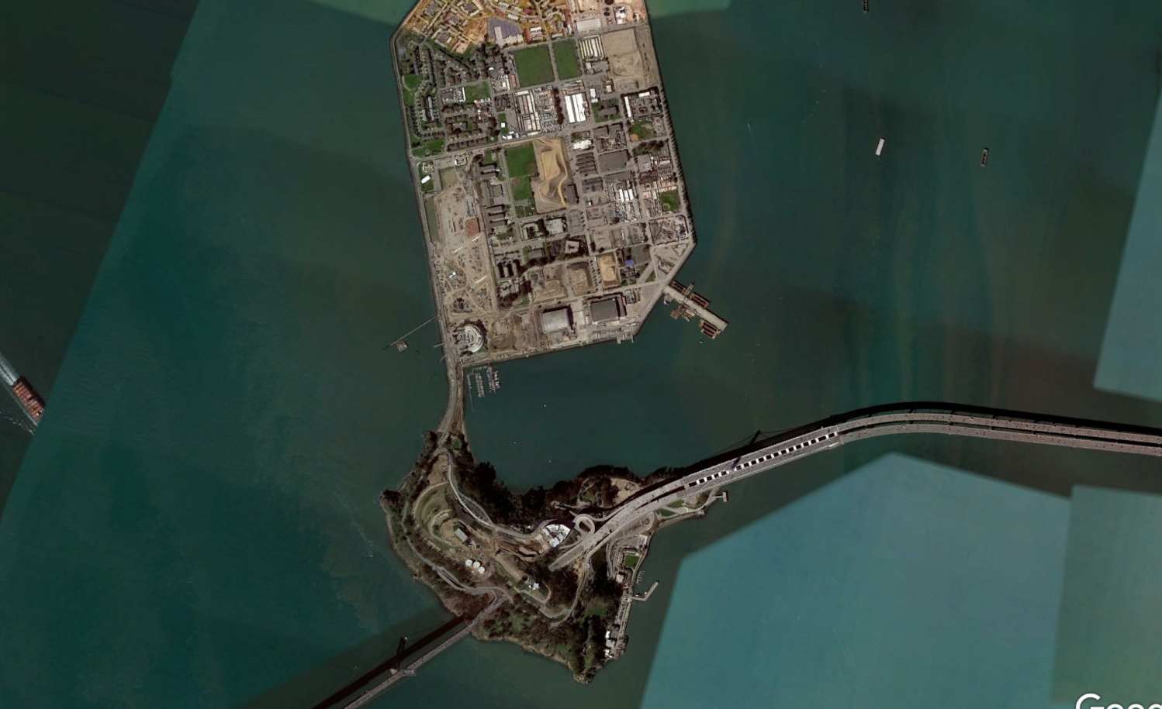
Study Regions
Eastern Treasure Island eelgrass/subtidal
Treasure Island Marina
Clipper Cove & Eastern Yerba Buena Island
Western Yerba Buena Island
Notes:
RJ

Slide 15
198 Species Documented
Eastern Treasure Island eelgrass/subtidal
15 species
42 species
Treasure Island Marina
Clipper Cove & Eastern Yerba Buena Island
Western Yerba Buena Island
108 species
115 species
Notes:
AY

Slide 16
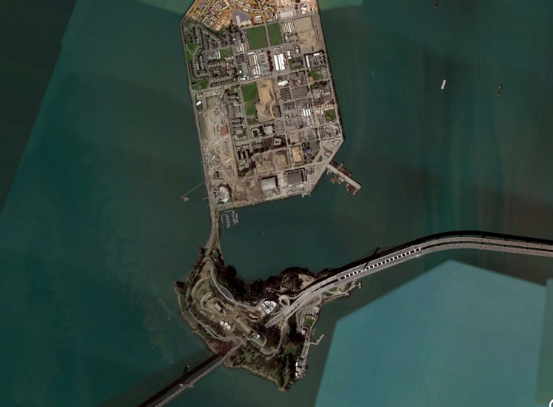
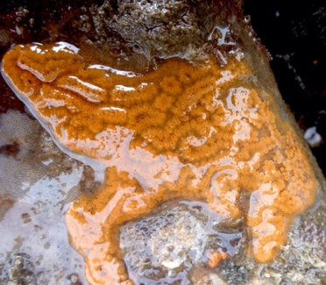
198 Species Documented
Species in Common
Western YBI – Clipper Cove/Eastern YBI: 50 species
Clipper Cove/Eastern YBI – TI Marina: 18 species
Western YBI – Treasure Island Marina: 14 species
1 species found in all 4 regions: introduced Chain Tunicate (Botrylloides violaceus)

Slide 17
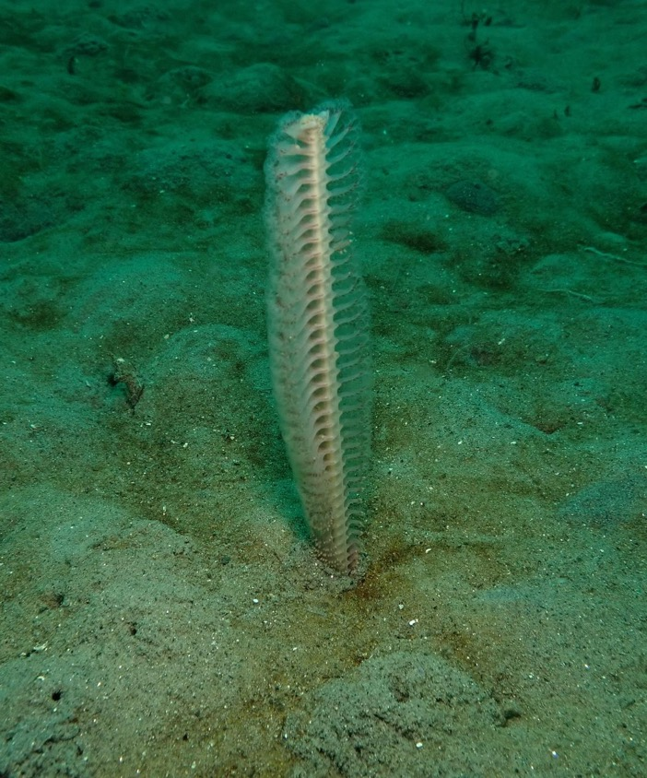
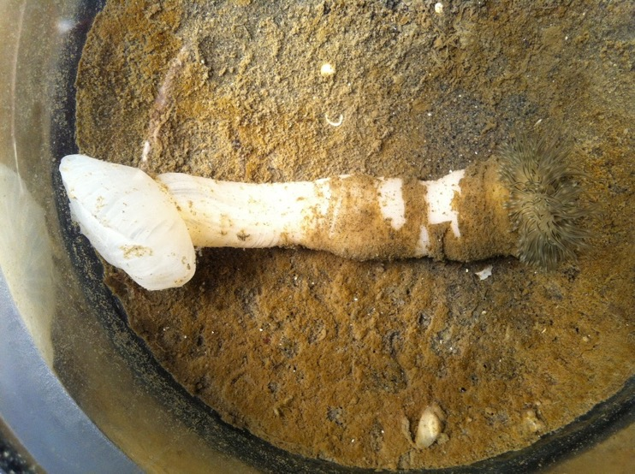
Yerba Buena Island intertidal biodiversity
173 species documented
96 species not previously recorded on/around YBI
108 species found in/on Clipper Cove/Eastern YBI, including 58 species only found there
White Burrowing Anemone
(Flosmaris grandis)
Slender Sea Pen
(Stylatula elongata)
Chris Brown
DW Daniels
Notes:
Clipper Cove/Eastern YBI is sheltered, and the intertidal community there is more similar to those you would find at other inner Bay intertidal sites, with species that do not tolerate much wave exposure
ROV surveys of Clipper Cove turned up some interesting subtidal species. The Slender Sea Pen, Stylatula elongata, has been documented off the east, north, and west shores of Treasure Island, but this is the first record from Clipper Cove. Sea pens are a type of octocoral, serve as a food source for some species of nudibranchs and sea stars, and can live to over 100 years. White Burrowing Anemones (Flosmaris grandis) have only been documented two other times in San Francisco Bay, and are understudied as a whole.

Slide 18
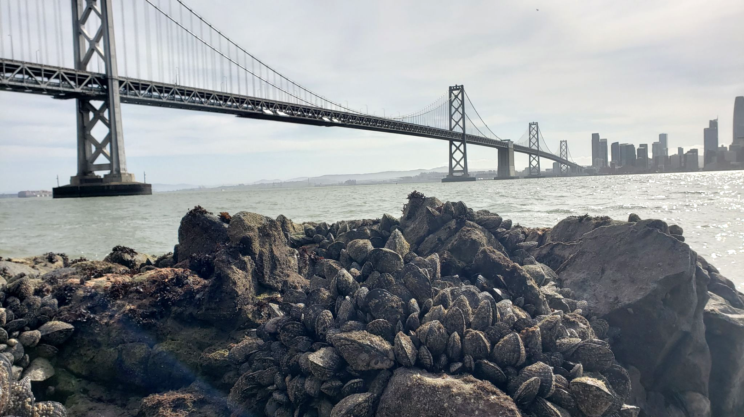
Yerba Buena Island intertidal biodiversity
115 species found on Western YBI, including 65 only found there
7 species never before documented in San Francisco Bay
Notes:
Western YBI is almost directly across from the Golden Gate, approximately six miles from the opening of the Bay, and the intertidal community there very much reflects an open-ocean influence, with many species that more commonly occur on the outer coast and are adapted to wave exposure
Western YBI is likely a hotspot for these new species records due to its inaccessibility (and thus being understudied), combined with it being a site largely under open-ocean conditions thanks to its proximity to and that it directly faces the Golden Gate, making it a somewhat unique site within San Francisco Bay.

Slide 19
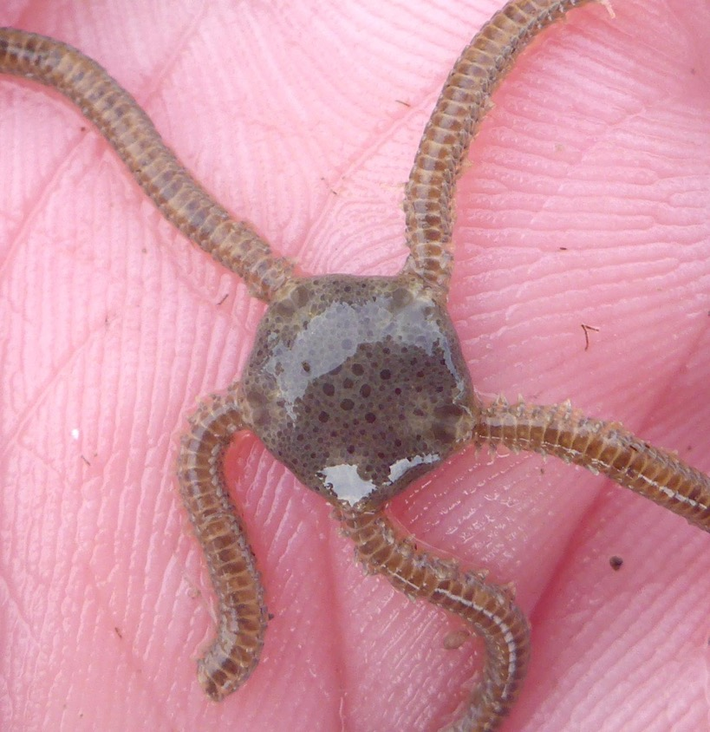
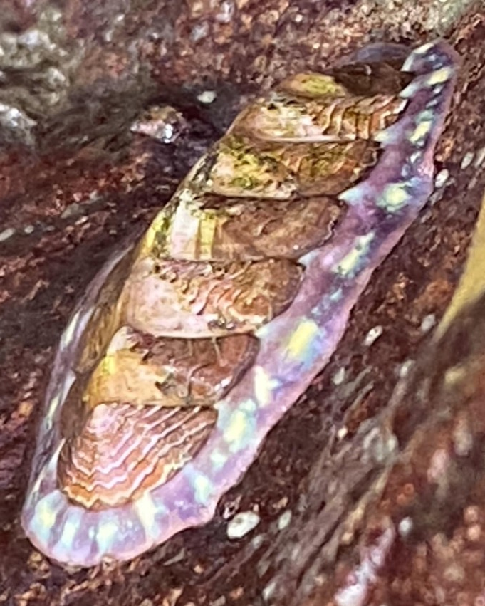
Esmark’s Brittle Star (Ophioplocus esmarki)
Flame Lined Chiton (Tonicella lokii)

Slide 20
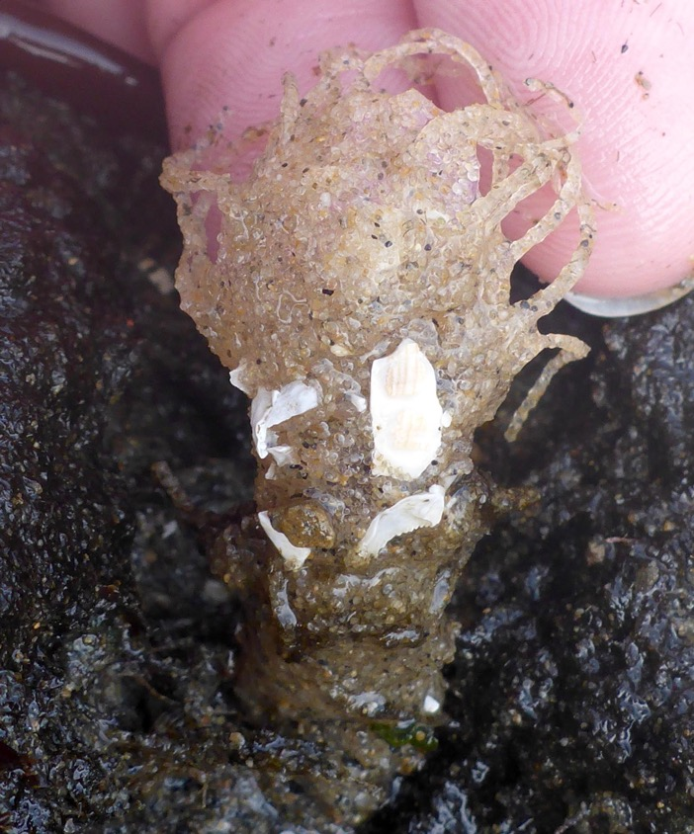
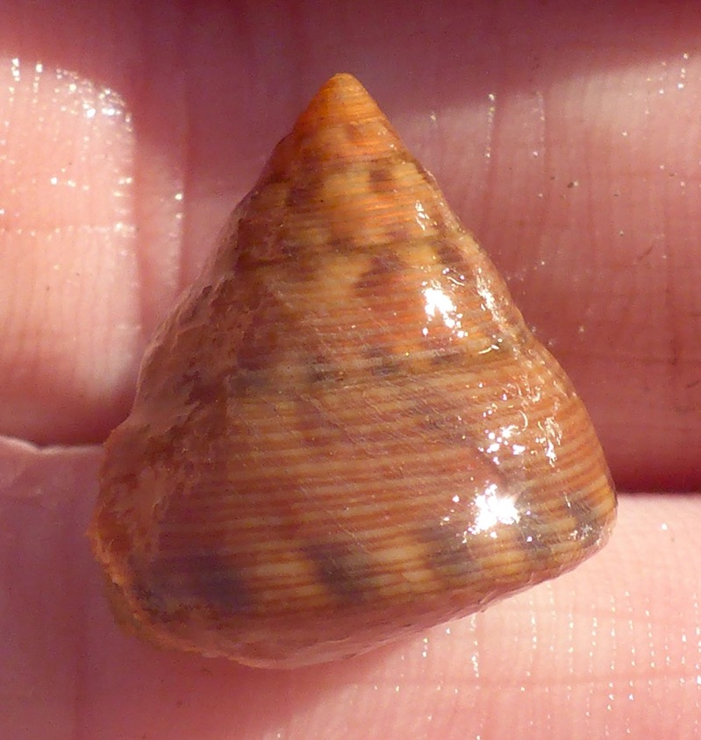
Fringed-hood Spaghetti Worm (Pista pacifica)
Glorious Topsnail (Calliostoma gloriosum)

Slide 21
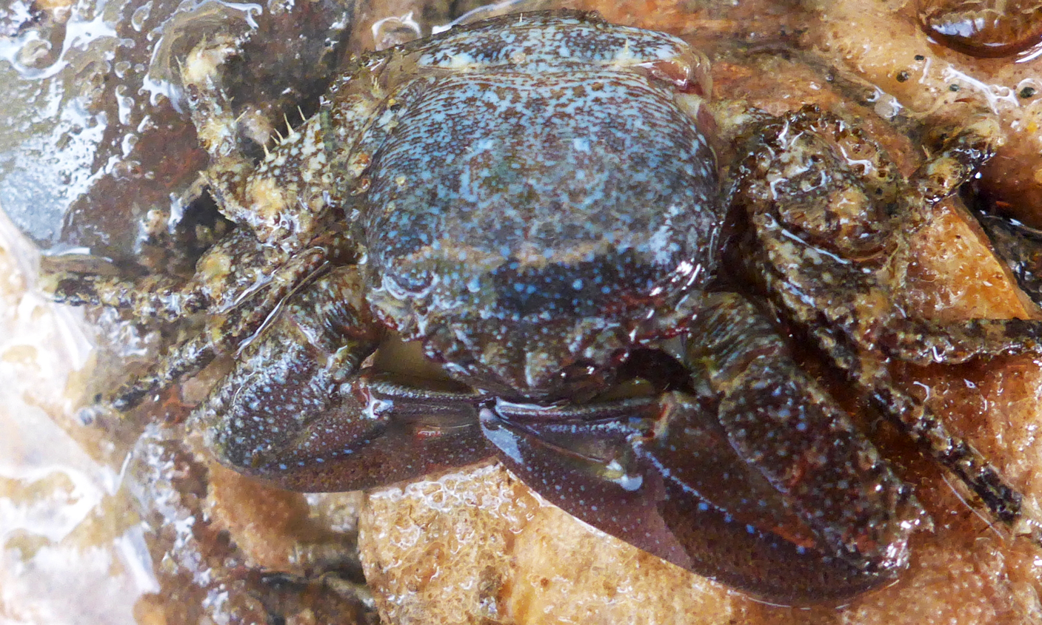
Chocolate Porcelain Crab (Petrolisthes manimaculis)

Slide 22
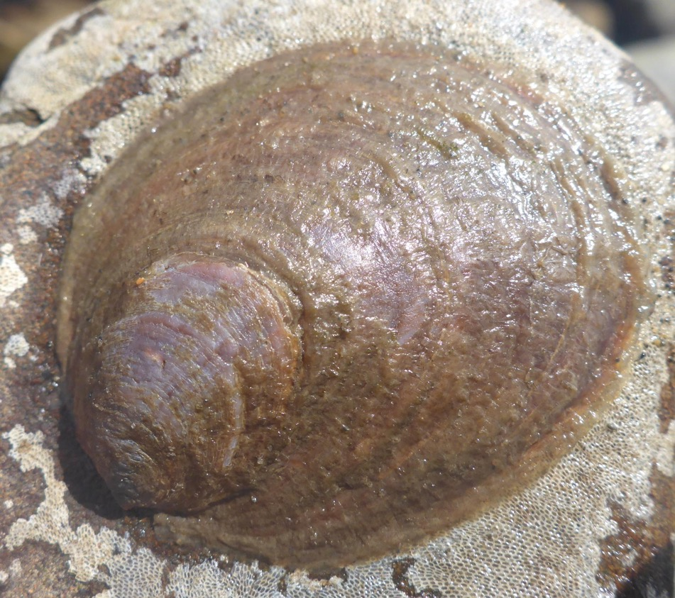
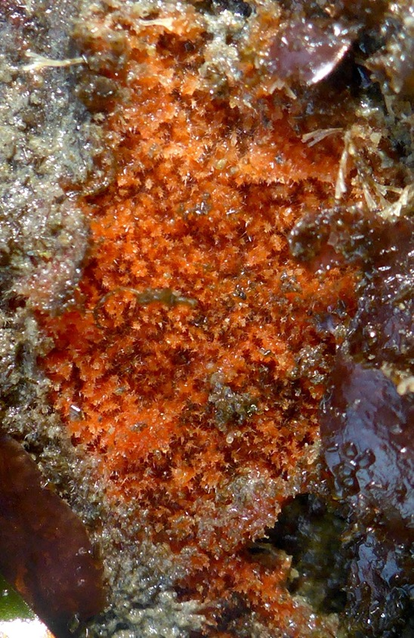
Onyx Slippersnail (Crepidula onyx)
Sponge (Raspailiidae sp.)

Slide 23
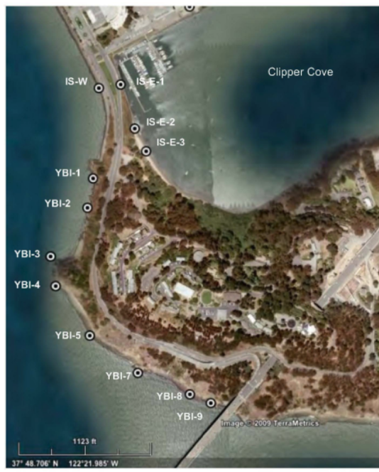
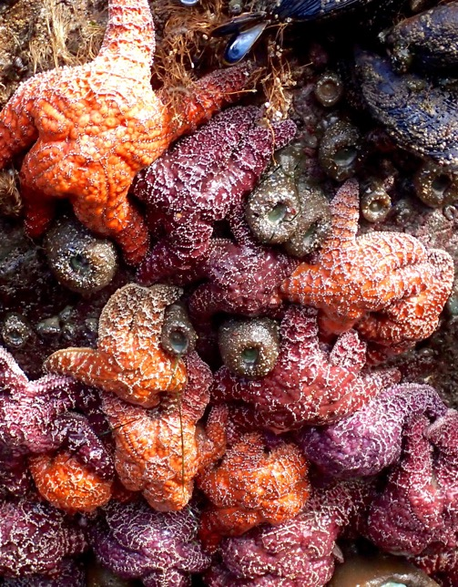
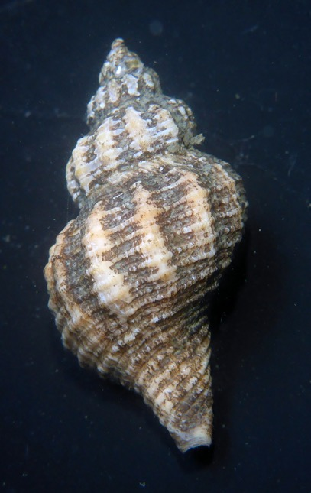
Yerba Buena Island intertidal biodiversity:
comparison to 2009 study
Eastern Oyster Drill
(Urosalpinx cinerea)
Ochre Star (Pisaster ochraceus)
Notes:
In 2009, Applied Marine Sciences conducted a rapid, one-day assessment of the Western Yerba Buena Intertidal, via surveys at nine sites along the shoreline, as part of a larger study to characterize the intertidal of Treasure Island and Western Yerba Buena Island.
Found Pisaster ochraceus at four of their sites and it was listed as “present” (on a spectrum of rare–present–common–abundant) in either the mid or low intertidal at those sites. SSWD in 2013-2014 led to a dramatic decrease in sea star abundance along the west coast of North America, especially for Pisaster ochraceus. Along the outer coast of north central California, P. ochraceus suffered 81% mortality. Closer to Yerba Buena Island, P. ochraceus at Alcatraz and at Point Bonita suffered more than 99% mortality. It’s very likely that sea stars at Yerba Buena were met with a similar fate from SSWD, and have not yet recovered.
Eastern Oyster Drill Urosalpinx cinerea is a predatory snail that was introduced to San Francisco Bay in the 1870s with Eastern Oyster (Crassotrea virginica) spat transported from the Atlantic coast. 2009 survey of Western Yerba Buena Island intertidal regions found U. cinerea at three of their sites and listed them as either “present” or “common” in both the mid- and low-intertidal at the three sites. One possibility is that U. cinerea was present on Western Yerba Buena Island in 2009 but has since disappeared. Other possibility is that the Eastern Oyster Drill was not actually present on Yerba Buena Island in 2009 and was a misidentification of another species.

Slide 24
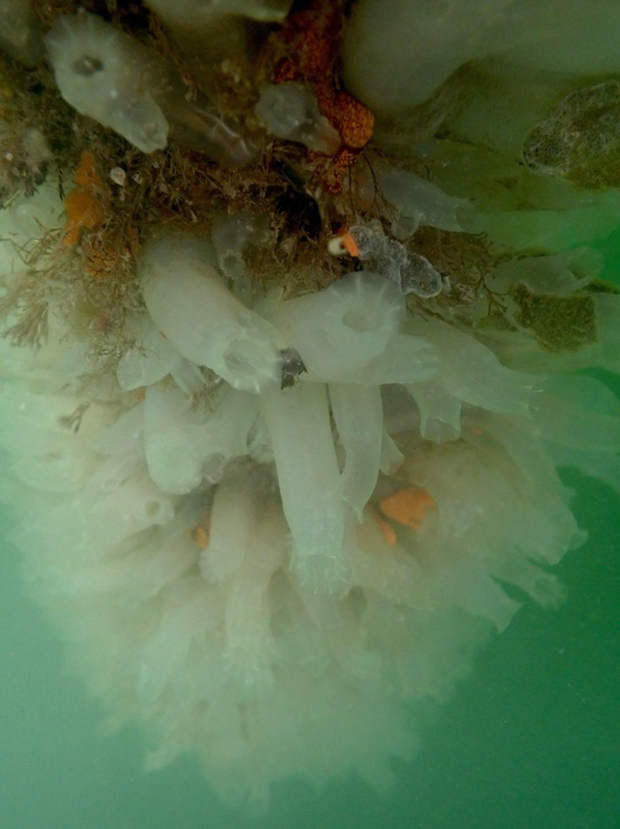
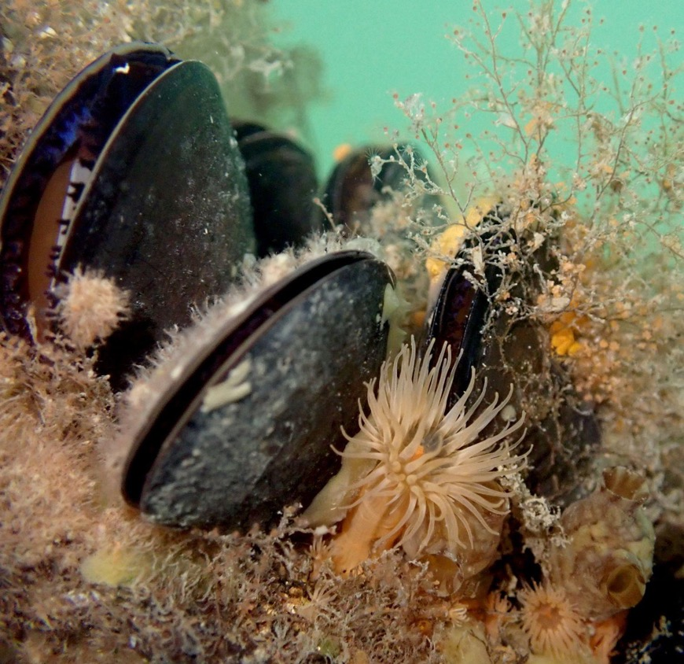
Introduced Species
27 introduced species found
18 along Clipper Cove/Eastern YBI (16.7% of species)
10 along Western YBI (8.7% of species)
17 on TI Marina docks (40.5% of species)
2 offshore Eastern TI (13.3% of species)
Hydroids (Ectopleura sp.)
Mussels (Mytilus spp.)
Plumose anemone (Metridium senile)
Tunicates (Ciona spp.)
Notes:
2009 study by the California Department of Fish and Wildlife of introduced species in the Bay found similar results to this study when surveying the subtidal fouling community of the Treasure Island marina and the rocky intertidal rip-rap of the Treasure Island/Yerba Buena Island causeway. The CDFW study found 40.4% of all species found at the Treasure Island marina were non-native, and 18.9% of the species found in the rocky intertidal rip-rap of the causeway were non-native.

Slide 25
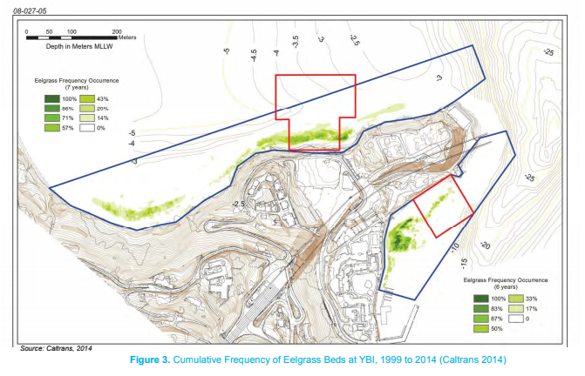
Eelgrass Surveys: Clipper Cove
Notes:
Clipper Cove has historically harbored a small (<1 ha) eelgrass bed, confined to a narrow fringe along the southern shoreline
Walking surveys: 2 in winter 2019-2020, 1 in summer 2020, 2 ROV surveys in winter & summer 2021 – no eelgrass
Eelgrass at Clipper Cove has been declining over the past fifteen years, from 0.2 ha in 2007 to less than 0.1 ha in 2013, and no eelgrass was detected in Clipper Cove in the 2015-18 survey

Slide 26
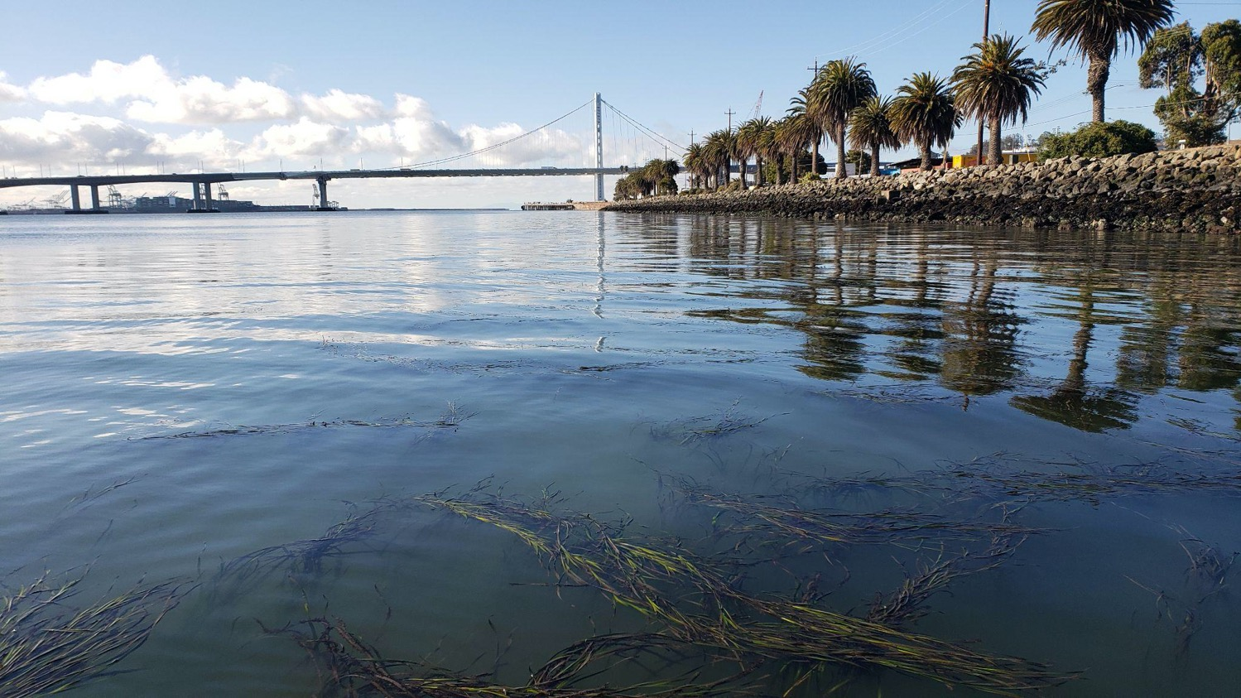
Eelgrass Surveys: Eastern Treasure Island
Notes:
In contrast to Clipper Cove, the eelgrass bed offshore of eastern Treasure Island is quite extensive. This study was not designed to survey the extent of the bed, however, visually, the eastern Treasure Island bed appeared to be of similar size to what was found in previous studies, extending along almost the entire length of the eastern shoreline (offshore from 3rd Street to 13th Street)
Eastern Treasure Island eelgrass bed could be an important source for reintroduction of eelgrass into Clipper Cove

Slide 27
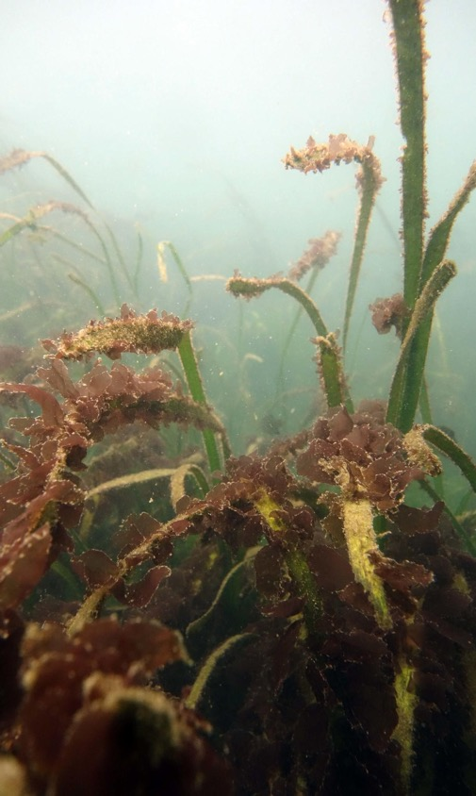
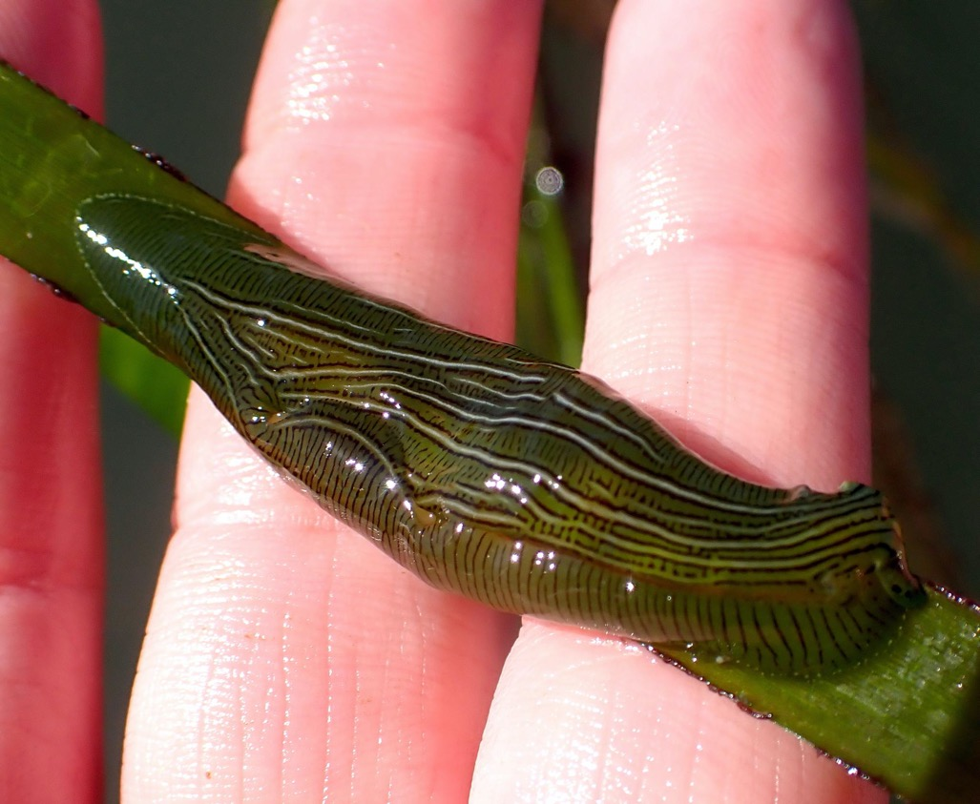
Eelgrass Surveys: Eastern Treasure Island
Sea Grass Laver (Smithora nadum)
Taylor’s Seahare (Phyllaplysia taylori)
Karolle Wall
Notes:
All eelgrass found around TI and YBI usually accounts for about 2% of all eelgrass in the Bay annually
Sea Grass Laver (Smithora nadum) documented – first record in SF Bay
Eelgrass associated species, like the Taylor’s Sea Hare
Across the entire Bay eelgrass extent fluctuates greatly year to year, with no indication of an overall increase or decrease over the past two decades
Large fluctuations across eelgrass beds throughout San Francisco Bay are hypothesized to be driven primarily by large-scale episodic events that influence sedimentation in the Bay: high flow events in wet years substantially increase sediment loading and thus sediment suspension in the water, which is slowly removed from the Bay by tidal exchange. Eelgrass is extirpated from sites of high suspended sediment and low sediment export for several years following these high-flow events. During drought conditions, sediment loading is reduced, increasing water clarity and improving conditions that support eelgrass

Slide 28
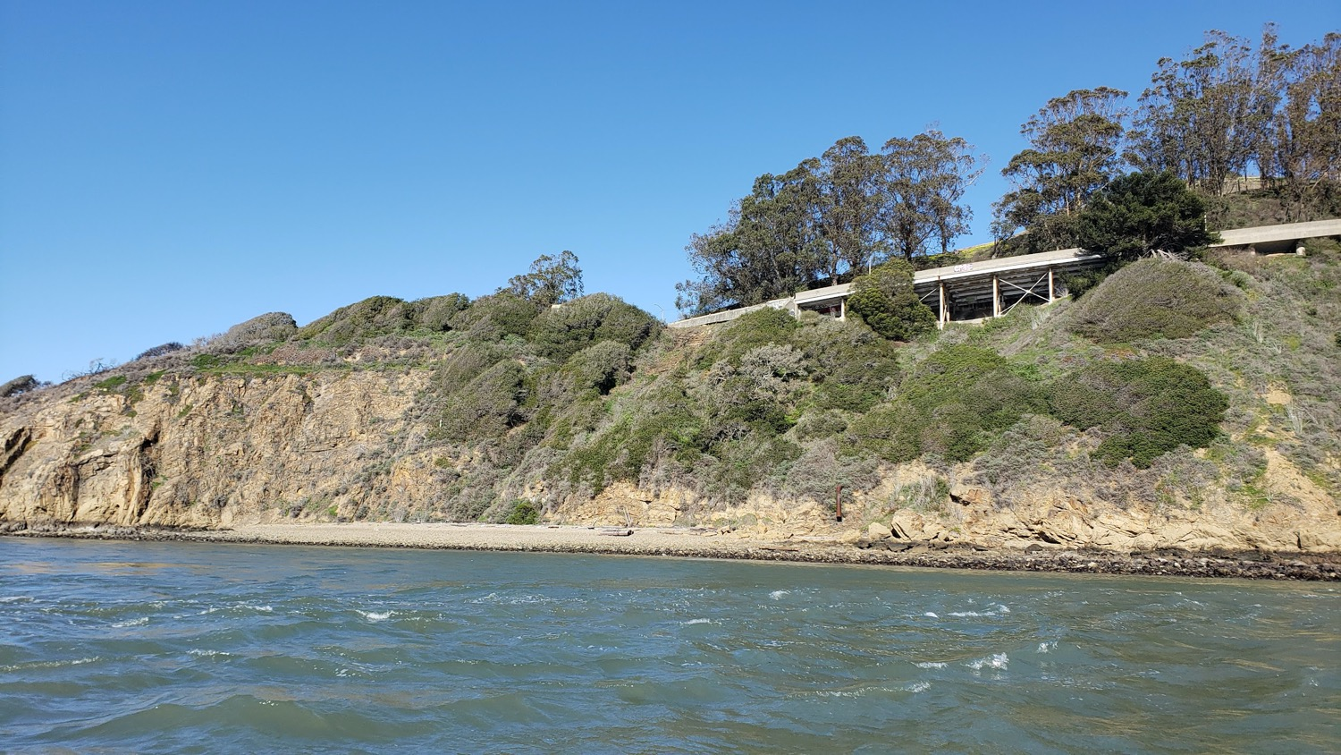
Recommendations
Notes:
RJ
Intertidal habitats of Yerba Buena Island are home to hundreds of species. The diversity of the interidal matches or supasses that of any other rocky interidal site in the San Francisco Bay. Overall the species composition of the YBI intertidal is similar to that of the rest of the bay, but YBI is unique in that it has not only a suite of habitats including cobble beaches, natural rock outcrops, sandy beaches, a sheltered bay, and a marina with human-made hard substrates, but it also has a strong marine influence along its western shores and more protected conditions on the eastern side of the island. This combination of habitat types and different salinities, currents and wave action, creates a mosaic that supports many species on YBI.
Yerba Buena Island is an important part of the San Francisco Bay ecosystem and its diverse habitats should be protected and celebrated.

Slide 29
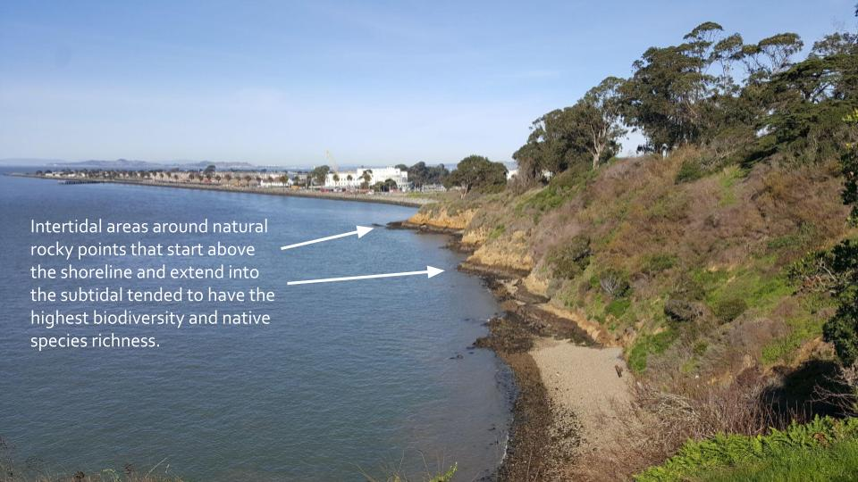
Recommendation: rocky points

Slide 30
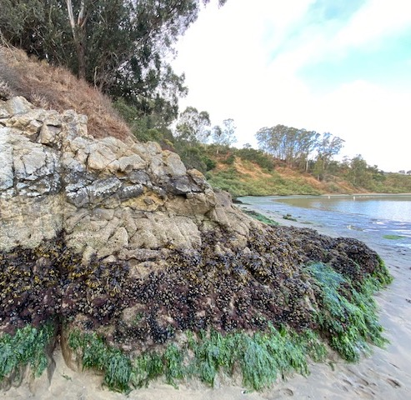
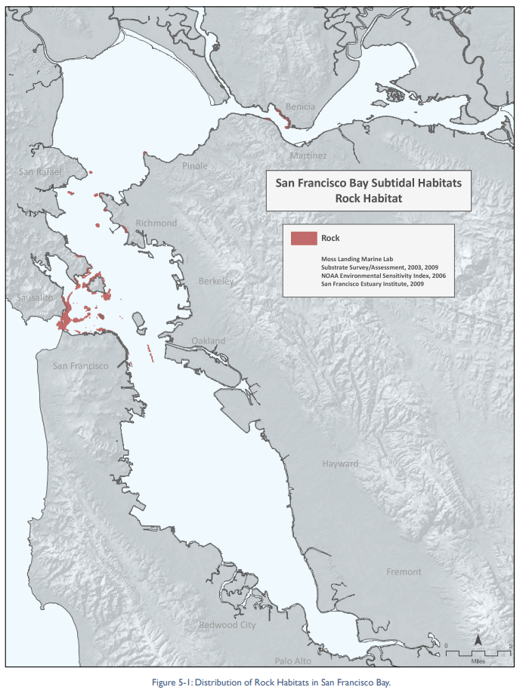
Recommendation: rocky points

Slide 31
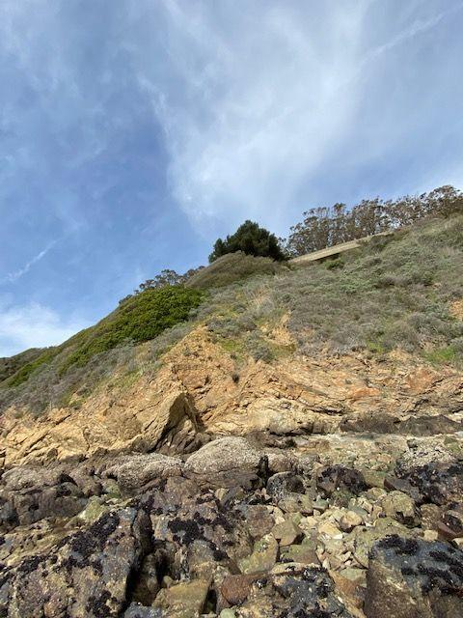
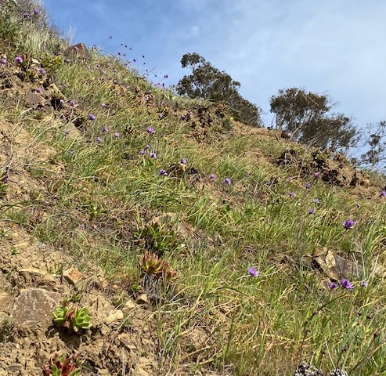
Recommendation: rocky points
Notes:
Recommendation: protect these points & the upland areas

Slide 32
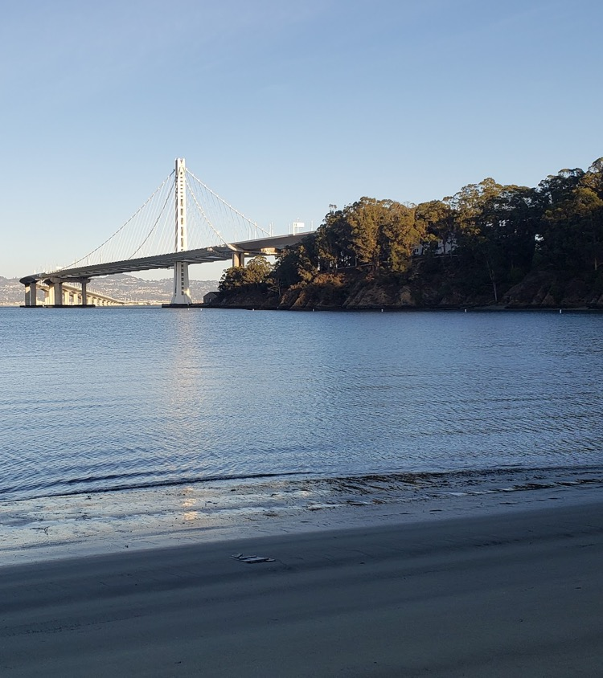
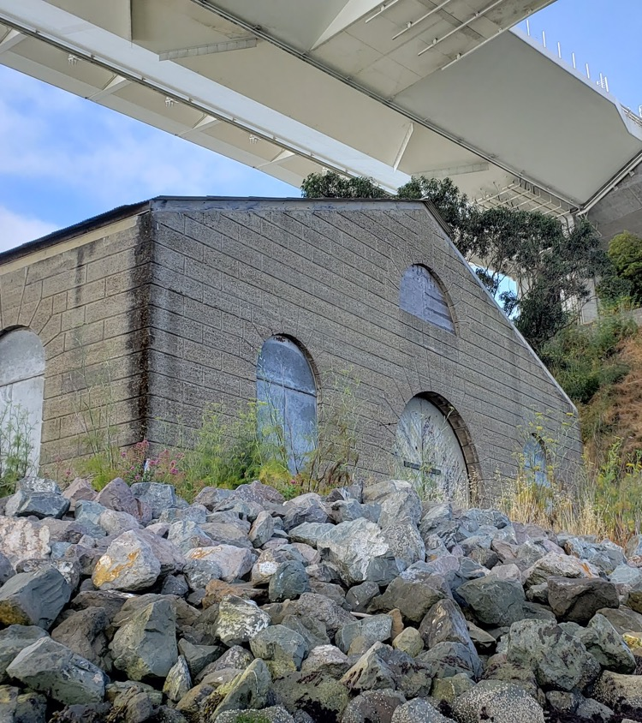
Recommendation: interpretive signage
Notes:
Recommendation: Clipper Cove / Torpedo House signage

Slide 33
Recommendation: eelgrass surveys
Notes:
Recommendation: Continue to survey eelgrass, decide on/if restoration

Slide 34
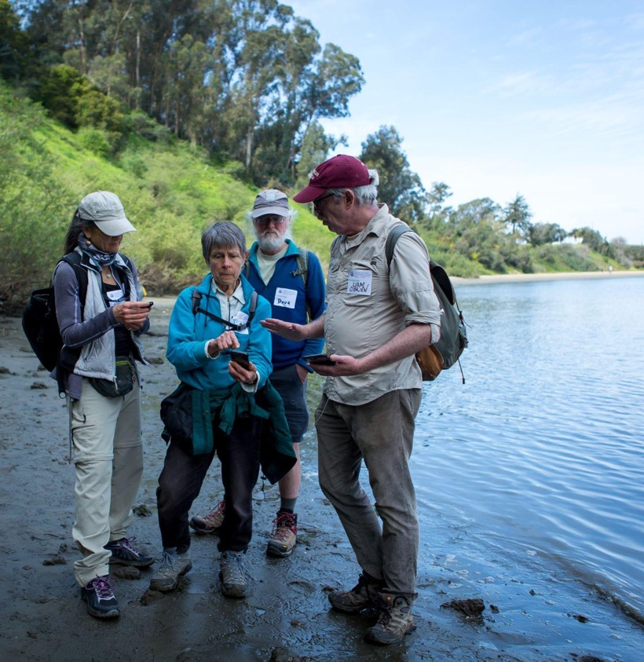
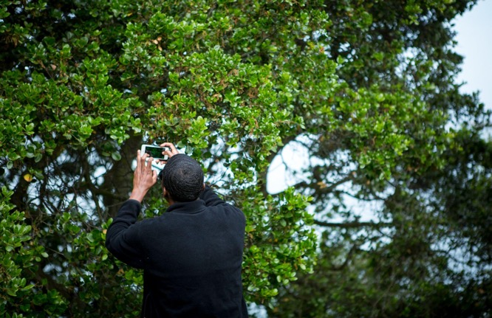
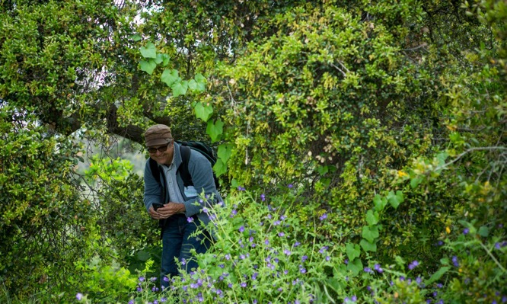
Recommendation: continued bioblitzes
Notes:
Recommendation: Continued bioblitzes

Slide 35
Alison Young and Dr. Rebecca Johnson
Center for Biodiversity & Community Science
California Academy of Sciences

