Slide 1
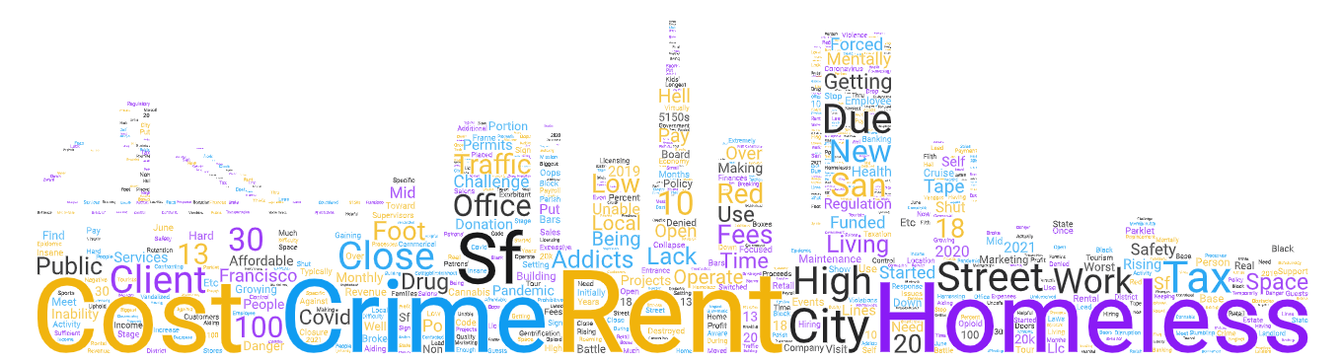


Recovery Challenges of Small Businesses in SF:
Results from the 2022 Survey
Feb 27, 2023

Slide 2

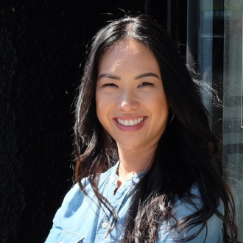

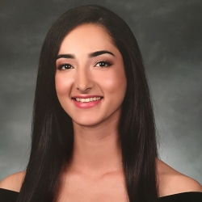
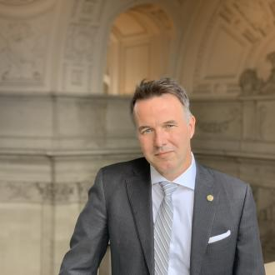
Our Team:
Anoshua Chaudhuri, Ph.D., Professor of Economics, SFSU
Tannaz Haghi, MS Quantitative Economics Student, SFSU
Cynthia Huie, President, SF Small Business Commission
Kerry Birnbach, Senior Policy Analyst/Commission Secretary, SF Small Business Commission
Sharky Laguana, Former President, SF Small Business Commission

Slide 3
Acknowledgments
Grateful for the SFSU and SFSBC Partnership that started in 2020.
Thanks to Lam Family College of Business for the Lam-Larsen Community Engagement Award that was used to fund a research assistant for this study.
Thanks to graduate students Kelsey Brown, Justin Chau and Marco Ruffinelli for their service learning contributions.
Thanks for a wonderful Community-based Participatory Research partnership.

Slide 4
Outline
Motivation
Methodology
Sample Description
Main Findings
Recommendations

Slide 5
Motivation for this Study
A follow-up study to the 2020-21 survey efforts to determine the impact of COVID-19 on small businesses
The current focus is the state of recovery of small businesses and remaining challenges
Projected 5 years for recovery (McKinsey study, July 2020), due to lower resiliency, has been uneven across the US due to policy complexities and disparities.

Slide 6
Small Business Voices
“Downtown San Francisco has been one of the slowest metropolitan areas in the country to recover since the onset of the pandemic, yet one of the most expensive cities to operate a business in. The dirty streets and homeless situation is still prevalent. Business levels are still down by more than 50% at this point and no longer sustainable if the situation does not improve.”
“Cutting through the red tape is very difficult. We are more of a micro business and it doesn’t feel like there are many programs or support for that type of business.”
“Between the crime and overall lack of cleanliness and safety this city is a nightmare to survive in. The cost of doing business keeps going up and support from local government and legislature is a joke.”

Slide 7
Methodology
Mixed methods with Interviews & Survey
Interviews: May – Aug, 2022.
Internet-based sample survey: Sept - Oct 2022
  Modified version of the 2021 COVID Impact survey
  Added questions of local policy interest
  Used Qualtrics to collect data
  Data collection period: Sept 7, 2022 - Oct 15, 2022
  Data collected in 8 most spoken languages in SF

Slide 8
Outline
Motivation
Methodology
Sample Description
Main Findings
Recommendations

Slide 9
2022 Data
Recognition
of CE
    Number of responses: 802
    719 English surveys
    33 in Spanish, 26 in Chinese, 15 in Vietnamese, 4 in Japanese, 3 in Arabic and 2 in Russian
    65% completed all questions
Notes:
Still a very high completion rate and valuable data.

Slide 10
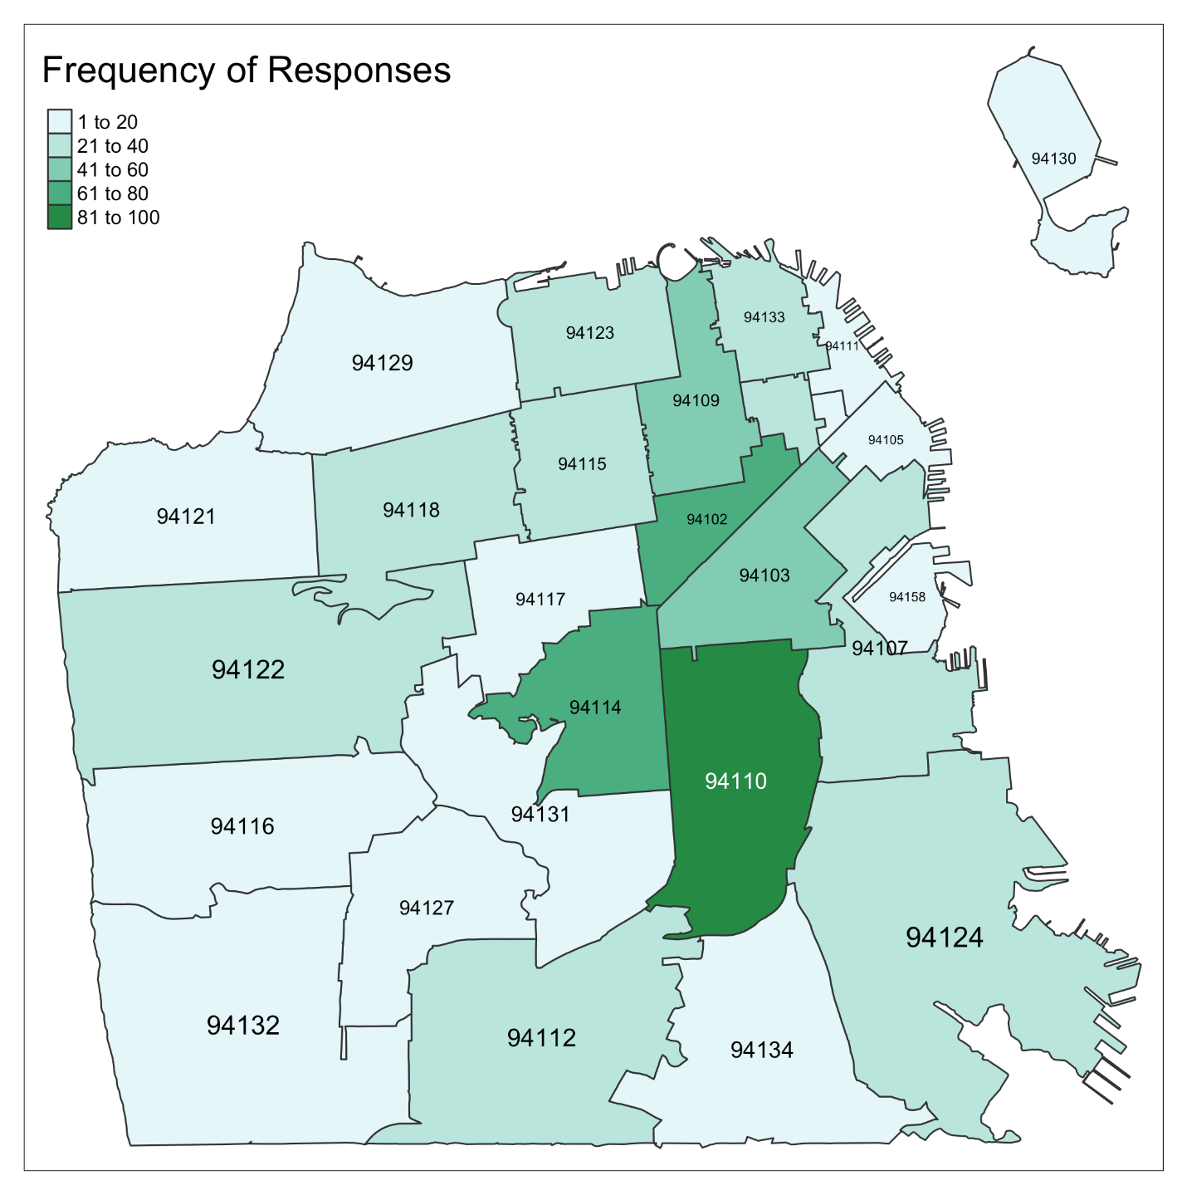
94110- Mission/Bernal
94114-Noe Valley/Castro
94102- Civic Center/Hayes Valley
94103-SoMa
94109- Russian Hill/Nob Hill
We have captured a reasonable representation from across the city and major commercial corridors.

Slide 11
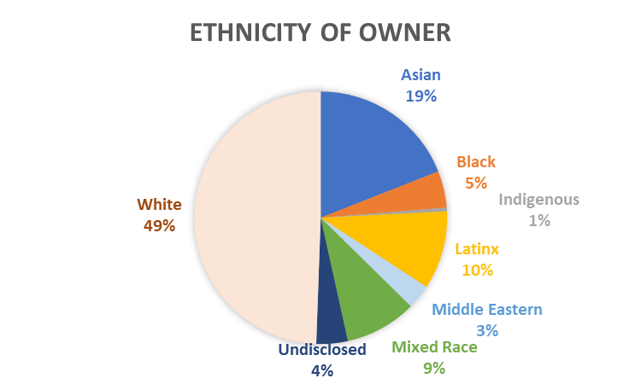
Demographic Description (% of businesses)
# respondents =498
# respondents=502
# respondents =447

Slide 12
Description of Business Operations
Where is this business located?
When did it start?
Clients
Recognition
of CE
Recognition
of CE
Recognition
of CE
    33% depend on tourists
    62% depend on SF residents
    44% depend on neighborhood residents
    25% depend on office workers

Slide 13
Outline
Motivation
Methodology
Sample Description
Main Findings
Recommendations

Slide 14
Main Findings
Current Impact of the pandemic on small business
Current Assistance needed by businesses to recover
Challenges faced during this recovery phase
Feedback on Policy suggestions

Slide 15

Current Impact of the pandemic on small businesses

Slide 16
87% of businesses have experienced a moderate to large negative impact

Slide 17
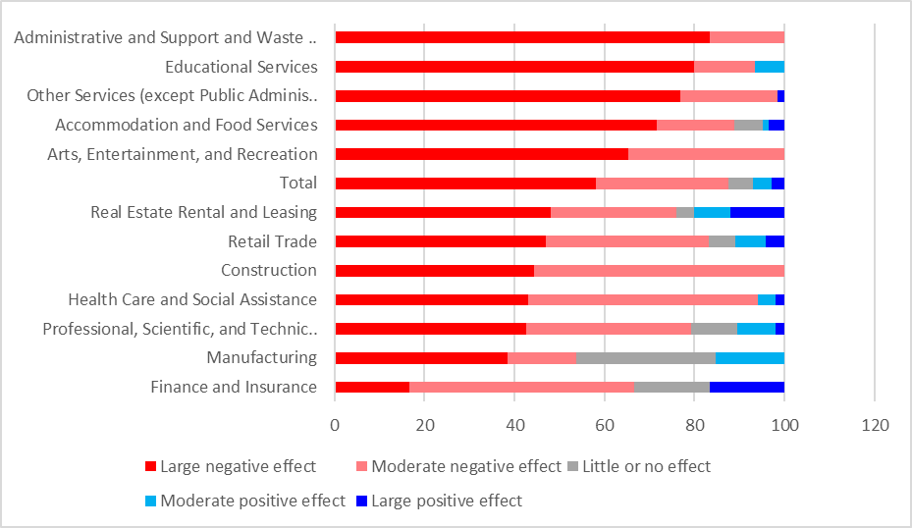
Impact across sectors still mostly negative
Notes:
Admin and Waste management, NAICS 56 The establishments in this sector specialize in one or more of these support activities and provide these services to clients in a variety of industries and, in some cases, to households. Activities performed include: office administration, hiring and placing of personnel, document preparation and similar clerical services, solicitation, collection, security and surveillance services, cleaning, and waste disposal services.

Slide 18
Impact by sector
Businesses that continue to experience a moderate to large negative impact
Arts & Entertainment
Administrative and Support
Construction
Some Businesses (less than 10%) posting moderate to large positive impact
Real Estate Rental and Leasing
Retail
Finance and Insurance
Professional, Scientific
Accommodation & Food Services

Slide 19
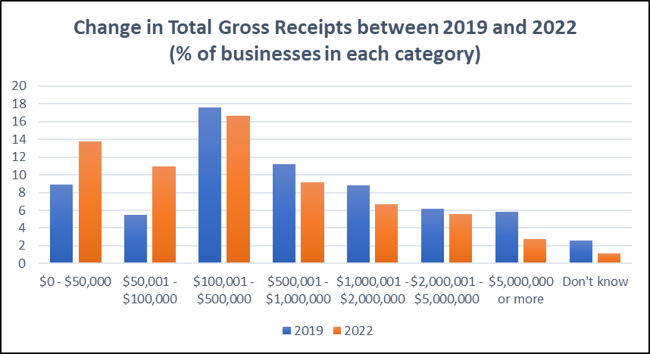
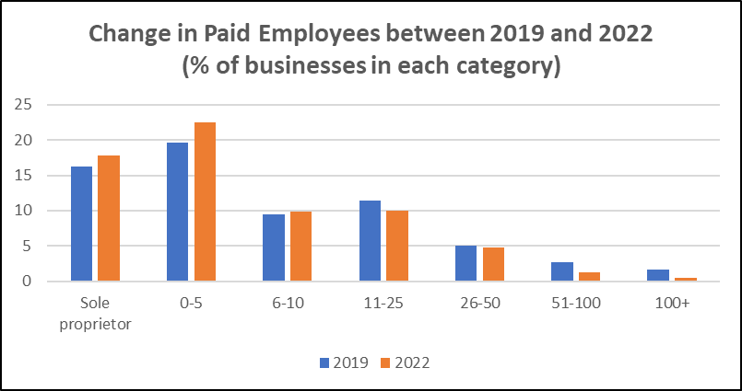
Current Impact on Operations
Business receipts have shrunk.
More micro-businesses (with less than 10 employees) in 2022 compared to their status in 2019.

Slide 20
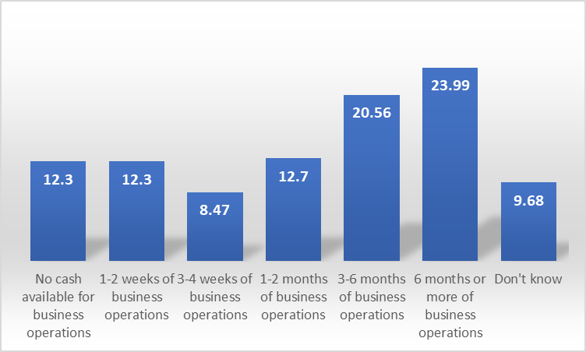
Current Cash on hand (% of businesses)
Notes:
A quarter of the sample reported either no cash or only 1-2 weeks of cash for business operations. Only a quarter have 6 months or more of cash for their business.

Slide 21
Current Assistance needed by businesses to recover

Slide 22
What have the businesses done to recover?
Financial Assistance from federal, local, friends and self
Pivoted business operations: More than 25% resorted to curbside pick-up, online services, online sales, outdoor operations. It worked extremely well for about a third of the businesses who moved to online or outdoor operations.

Slide 23
Financial Assistance
Gaps in funding requested and received
Most popular were federal loans and local grants
ERTC and Federal tax credits largely underused
58 businesses (7.2%) have not received any financial assistance

Slide 24
Barriers to accessing finances
Notes:
Businesses who did not apply

Slide 25
Assistance Needed with Lease
Notes:
Lease with legal advice

Slide 26
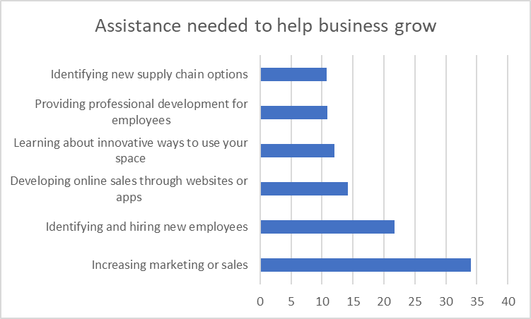
Assistance Needed for business operations
Notes:
Lease with legal advice

Slide 27
Challenges faced during this recovery phase

Slide 28
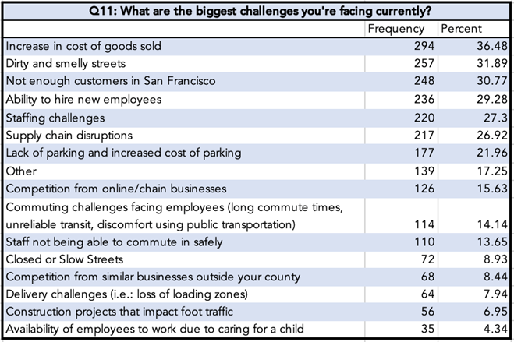
Businesses identified their Top 3, out of a range of Challenges

Slide 29
Top 3 Challenges by sector
Accommodation & Food Service
Supply chain disruptions
Staffing challenges
Increase in cost of goods sold
Arts & Entertainment
Staffing Challenges
Not enough customers
Dirty Streets
Retail
Lack of Parking
Supply chain disruptions
Increase in cost of goods sold
Health, Education & Others
Parking
Hire new employees
Dirty streets

Slide 30
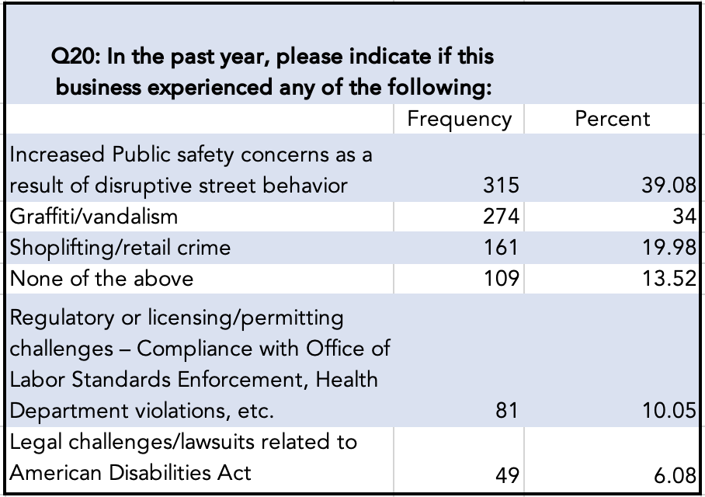
Challenges with safety, crime, legal

Slide 31
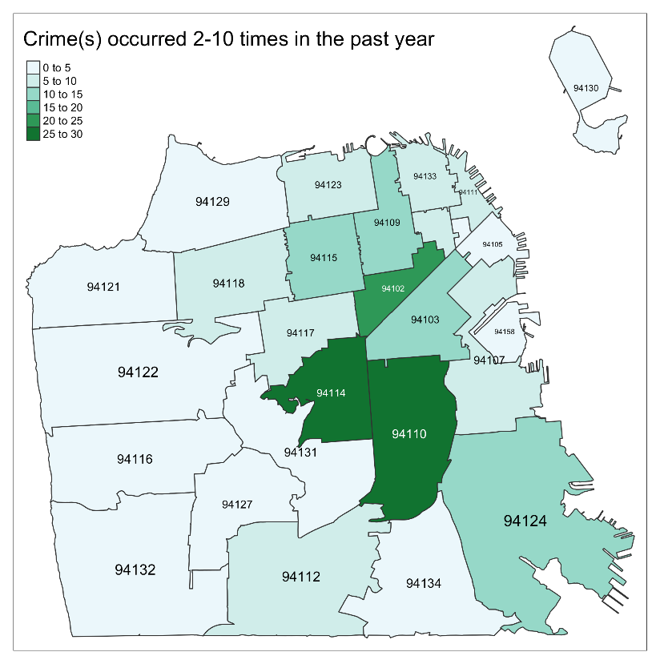
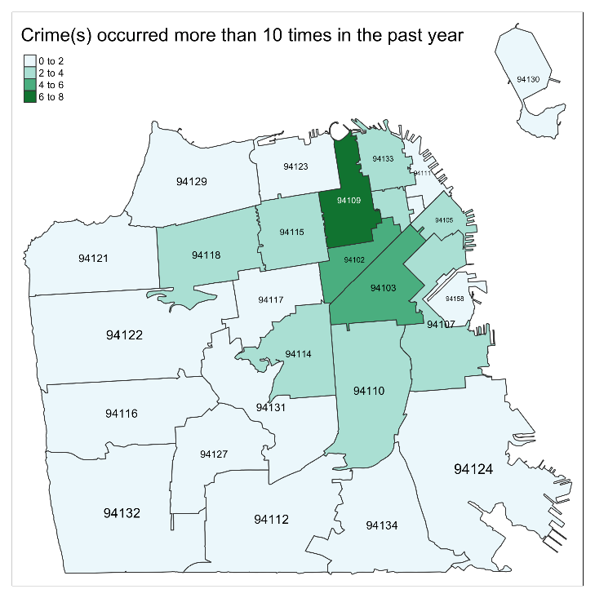
Crime, break-in, vandalism
94110- Mission/Bernal
94114-Noe Valley/Castro
94102- Civic Center/Hayes Valley
94103-SoMa
94109- Russian Hill/Nob Hill
Notes:
A related question that we asked was whether the businesses called for help and 7 out 10 businesses had called for help for each instance.

Slide 32
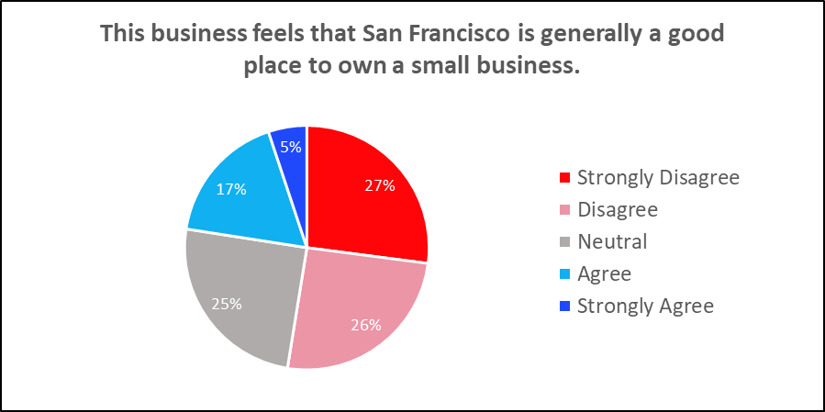
Only 22% agree that San Francisco is generally a good place to own a small business.

Slide 33
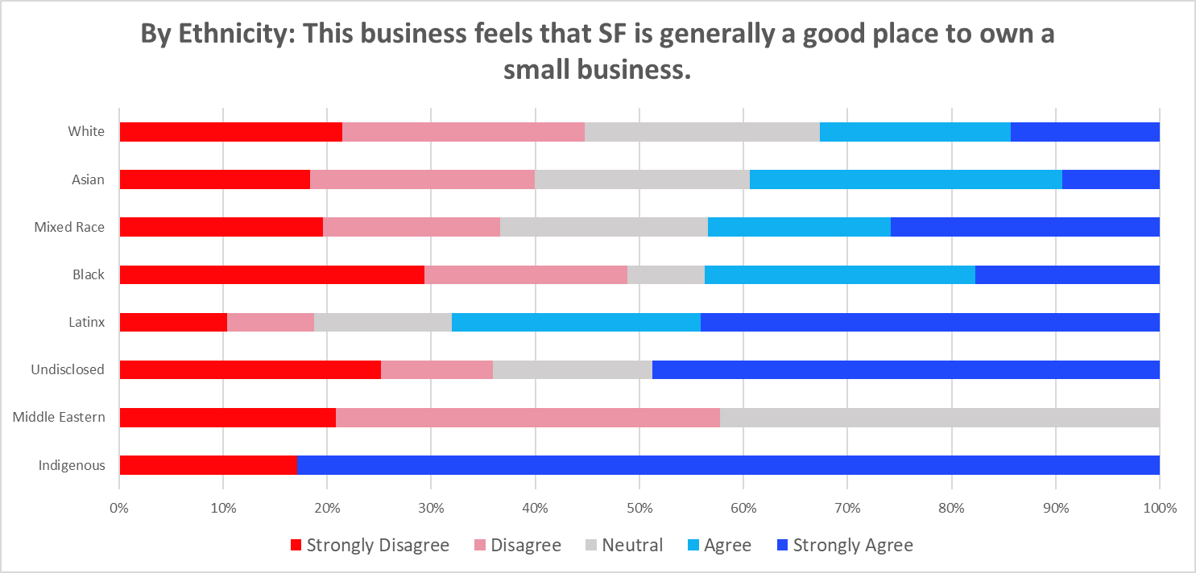
Majority (68%) of Latinx businesses find SF a good place to own a small business

Slide 34
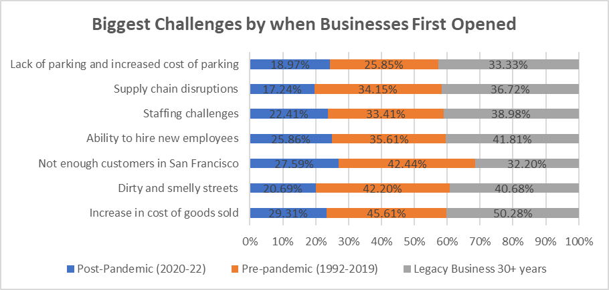
Challenges by when business started
Legacy businesses were disproportionately challenged. Pre-pandemic businesses most effected by unclean streets and not enough customers.

Slide 35
Feedback on Policy suggestions

Slide 36
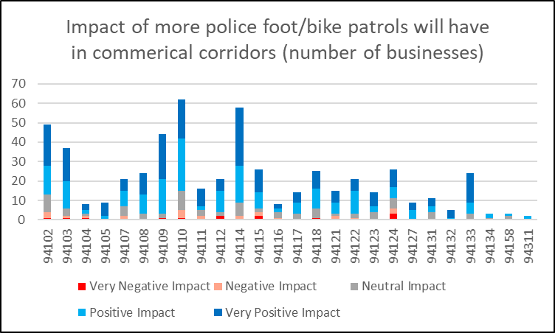
More Police patrols in commercial corridors
94110- Mission/Bernal
94114-Noe Valley/Castro
94102- Civic Center/Hayes Valley
94103-SoMa
94109- Russian Hill/Nob Hill
94124- Bayview
94115- Pac Heights/Western Add.

Slide 37
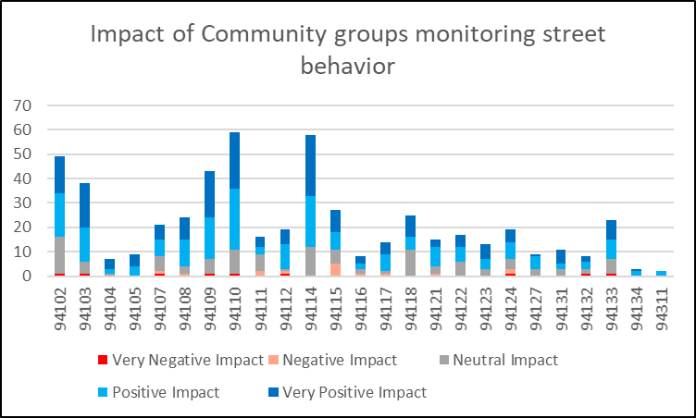
More Community-led monitoring of street behavior in commercial corridors
94110- Mission/Bernal
94114-Noe Valley/Castro
94102- Civic Center/Hayes Valley
94103-SoMa
94109- Russian Hill/Nob Hill
94115- Pac Heights/Western Add
94118- Presidio Heights
94133- North Beach

Slide 38
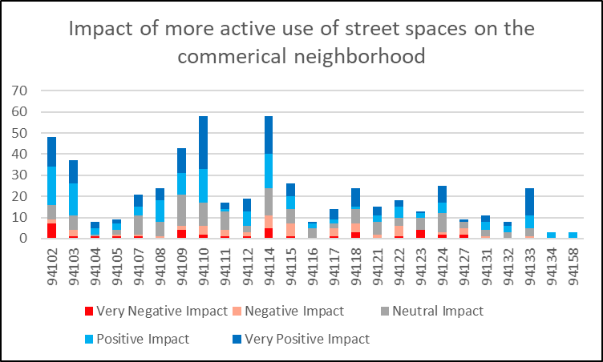
More active use of street spaces in commercial neighborhoods
94110- Mission/Bernal
94114-Noe Valley/Castro
94102- Civic Center/Hayes Valley
94103-SoMa
94109- Russian Hill/Nob Hill
94115- Pac Heights/Western Add
94118- Presidio Heights
94133- North Beach
94124- Bayview

Slide 39
Top 4 Needs Identified by small businesses

Slide 40
Top 4 needs by Business type
Accommodation and Food Services and Real Estate asked for improved street conditions
Arts & Entertainment and Retail asked for more marketing and messaging to increase customers
Education, Health Care and Manufacturing asked for increased security
Professional, technical and other services asked for more grants and loans

Slide 41
Top 4 needs by ethnicity
Asian and Middle-Eastern owners asked for increased security
Black, Latinx, Mixed Race owners asked for more loans and grants
White owners asked for improved street conditions

Slide 42
Summary of Findings
State of Recovery
Recognition
of CE
Recognition
of CE
    “I have refinanced my personal home and sold some assets to generate cash to pay landlords but still this was not enough for some”
    “Taxes and the HCSO ordinance really hurt our ability to offer higher levels of compensation and recruit and retain staff.”
    “Our landlord never gave our business a
    break, even though we were closed for
    fifteen months. How are we supposed
    to pay rent, insurance, utilities,
    etc...when we could not make a
    sale??????”
    Businesses are making less money and employing fewer people since 2019
    25% businesses have no cash or less than 2 weeks of cash
    20% businesses used their own savings, federal tax credits underused
    More than a third of businesses did not know or did not think programs were made for them

Slide 43
Summary of Findings
Current Challenges
Recognition
of CE
Recognition
of CE
“The cost of operating a business in this city is endangering small business.”
“Availability of qualified employees willing to commute into, or living within SF VERY limited. Combination of time and commute costs into SF is a major determent to obtain needed staff.”
“We are profitable, but the mental illness on the streets has hurt our ability to keep staff, we don't get prompt response from police, and we are consistently boldly shoplifted which hurts morale.”
    Increased cost of goods sold
    Deteriorating street conditions
    Shrinking customer base
    Inability to hire new employees, staffing challenges
    Supply chain issues
    Lack of parking, higher cost of parking
    Public safety concerns, retail crime

Slide 44
Summary of Findings
Recognition
of CE
Top Needs Identified
“Programs barred my ethnicity from applying OR were not for a single sole prop business”
“All of the advantages of being in San Francisco (tourists,
conventions, lots of residents who like going out) virtually
disappeared during the pandemic and are slow to return. Out of control drug use and violence on our streets is hurting all of the above, with the city seeming to encourage drug use and the rights of people to be on the street over the concerns of the safety of its other citizens.”
“We been broken into 3 times. One time cost us almost $20k. We've had numerous windows broken.”
Recognition
of CE
    Access to grants and 0% loans
    Improved Street conditions
    Greater messaging to support local small businesses.
    Increased security systems/cameras

Slide 45
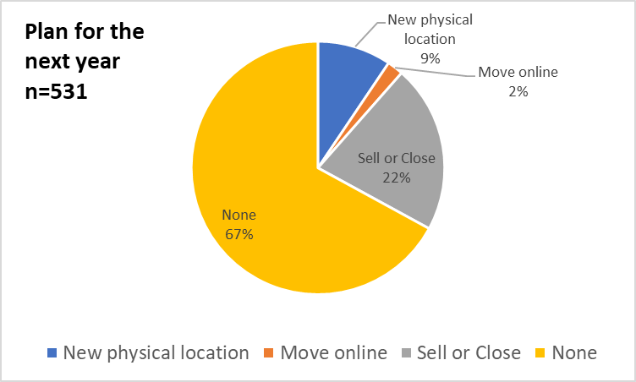
Future Plans
“As a small business owner, I'm broken hearted by San Francisco. Rents are high, we are paying pre-covid rent and I have lost over 50% of my clients, clients that lived in surrounding areas were scared to come into the city due to crime, homeless(ness), dirty (streets). I think about closing up and moving everyday.”

Slide 46
Recommendations
Invest in Safer streets
  Most businesses across zip codes think police patrols or community groups will bring a positive impact
Provide Technical Assistance around sources of financial help and business operations
  Businesses need assistance in applying for tax credits, setting up websites and apps for online sales, workforce recruitment and development
Messaging to increase sales, being Open is not enough
  Shop and Dine Local, Increased parking, Cleaner streets
Necessary Reforms
  HCSO Reform, Taxes & Fees Relief, Faster Licensing and permits

Slide 47
2022 Sample compared to 2021 Sample
Data 2022
Data 2021
Recognition
of CE
Recognition
of CE
    Number of responses: 802
    719 English surveys
    33 in Spanish, 26 in Chinese, 15 in Vietnamese, 4 in Japanese, 3 in Arabic and 2 in Russian
    65% completed all questions
    Number of responses: 579
    547 English surveys
    27 in Spanish, 3 in Chinese, 2 in Korean, 2 in Vietnamese, 1 in Japanese
    83% completed all questions
Notes:
Still a very high completion rate and valuable data, many in-language surveys that highlights the importance of continuing to collect data in other languages

Slide 48
Business Description 2021 vs 2022
Sample Description 2021
Sample Description 2022
Recognition
of CE
Recognition
of CE
    Sectors most responded: Accommodation and Food Services, Other services such as salons, massage and Retail
    14% legacy
    English is primary language for 87%
    46% female owners
    13% owners older than 65 years
    53% White, 22% Asian, 12% Latinx, 3% Black
    61% under $1 million in annual receipt, 23% in $1-$5 million
    32% more than 10 employees
    25% less than 2 weeks cash, 5% with 6 months
    Sectors most responded: Accommodation and Food Services, Retail, Other services such as salons, massage and Professional/Technical
    27% legacy
    English is primary language for 88%
    43% female owners
    20% owners older than 65 years
    49% White, 19% Asian, 10% Latinx, 5% Black
    74% under $1 million in annual receipts, 18% in $1-5 million
    25% more than 10 employees
    25% less than 2 weeks cash, 24% with 6 months

Slide 49
Findings 2021 vs 2022
Businesses still need access to grants and loans, greater messaging and marketing to bring in customers. In 2022, Businesses have expanded their needs from cleaner streets to safer streets and more cameras and security
Businesses continue to need technical assistance in finding appropriate grants and loans and other business operation support and training
Most businesses prefer consistent communication through the sf.gov website and emails from the Commission and OEWD

Slide 50
Q&A
Contact Us
Professor Anoshua Chaudhuri and Commissioner Cynthia Huie
Email
anoshua@sfsu.edu
Cynthiahuie@gmail.com

