Slide 1
What is Community Forward SF (CFSF)
Community Forward SF is a collection of vital programs that ensures our neighbors experiencing homelessness have effective services designed for their unique needs. Whether one needs housing, medical respite, a safe place to become sober, or calm in the face of domestic violence-we care for those most vulnerable in our community.
We are not just one program. We are a network of programs designed to work together to meet every stage of need.

Slide 2
How We Help
Focus on working with Cis and Transgender women
Providing support during a medical crisis
Offer support and programming when dealing with a substance abuse disorder
Supporting and being there for our older adult population
Services Provided
Emergency, Medical & Transitional Shelter
Supportive Housing
Wrap-Around services

Slide 3
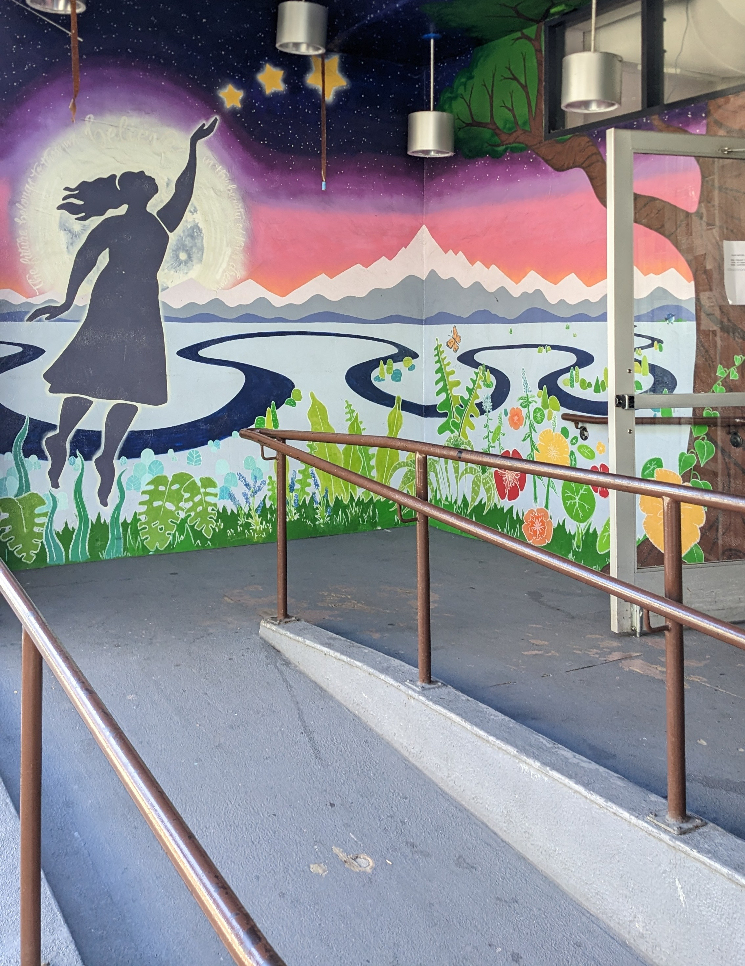
A Women’s Place Shelter (AWP)
A Woman’s Place is the only 24-hour supportive residential service in San Francisco that offers both emergency shelter and long-term treatment to all women, no matter their special needs. A Woman’s Place offers support to women who have mental health issues, HIV+/AIDS, a history of mental illness, and/or who are victims of sexual or domestic violence. It offers support including health care, mental health counseling, case management, and money management, to help at-risk women of all ethnicities and orientations attain permanent housing, gainful employment, stability, and independence.

Slide 4
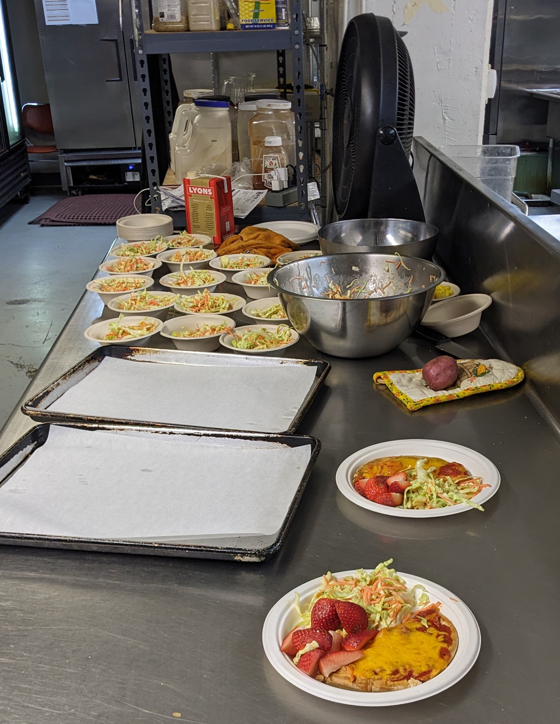
What We Provide On-Site

Slide 5
Notes:
The goal of our strategic planning process is to answer this question.
What should we stop doing to make room for these pathways?

Slide 7
Notes:
No data for 2022

Slide 10
Thank you Anna Kelleher, MSW, ASW Vice President of Women’s Services anna.kelleher@communityforwardsf.org
Notes:
The goal of our strategic planning process is to answer this question.
What should we stop doing to make room for these pathways?

