Slide 1
Recreation & Park Department
Golden Gate Park Accessibility Commitment Implementation
Update to Mayor’s Disability Council
Friday, January 20, 2023
Inspire, Connect, Play!

Slide 2
Agenda
Introductions
MDC resolution + general accessibility commitments
Where we are now
What have we accomplished
In the works
Projects that have started or are starting soon
Still to come
Projects that are on the horizon but need more planning, $ etc.
Notes:
Lucas go over agenda
Explain that we will address all of their items as well as some others that may not have been included in the resolution
We will cover all the items from the MDC resolution
We will also cover some accessibility items that were not included in the resolution
There are many items to cover, but we want to be sure we provide the information you need

Slide 3
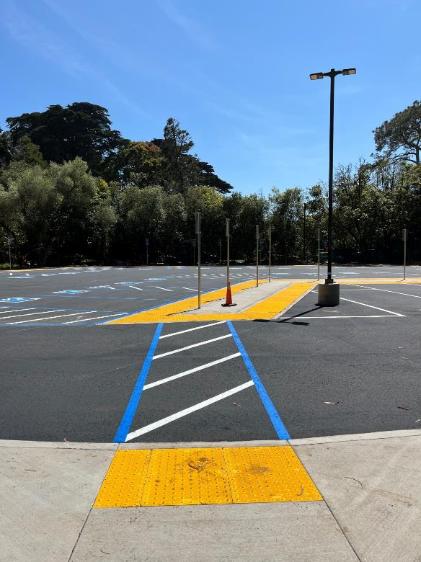
Accessible Parking
Notes:
Brian
New lot
Do we have any tracking? I have seen it well-used but not full many times on weekdays. I have also heard very positive feedback from many people, especially for adaptive bike program
Other blue zones
More than before
(show chart with distances)

Slide 4
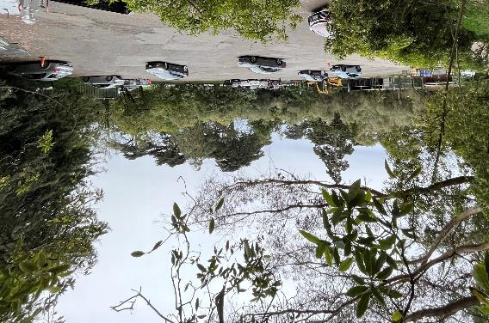
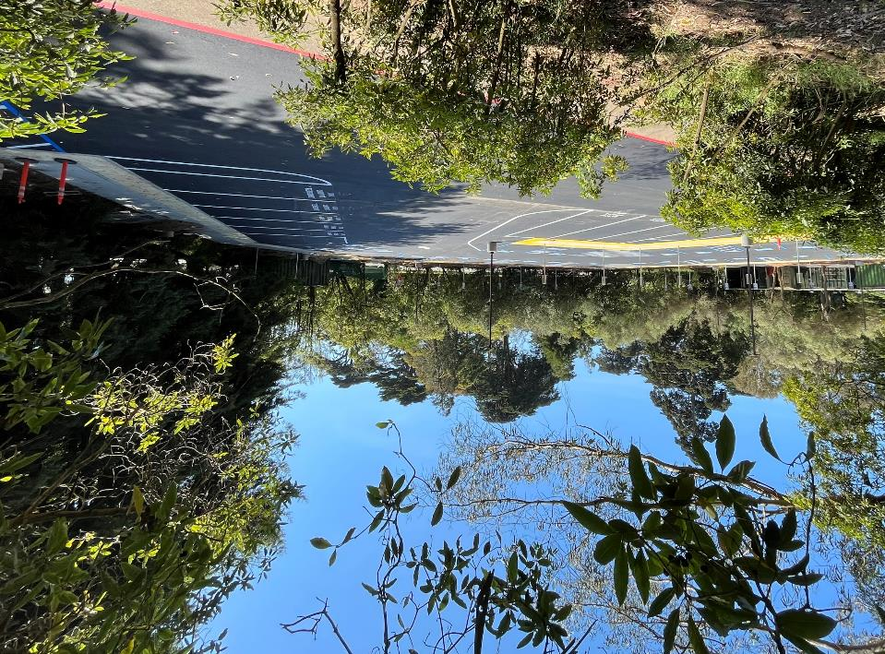
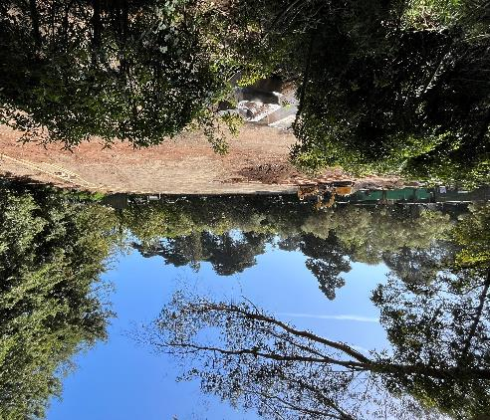
Where We are Now: New Accessible Parking Lot
Built in Spring 2022
Notes:
Brian

Slide 5
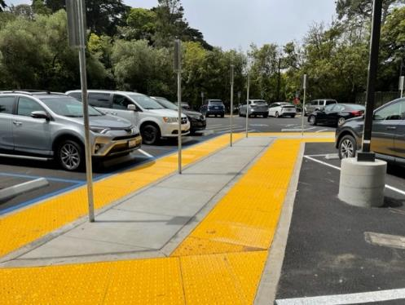
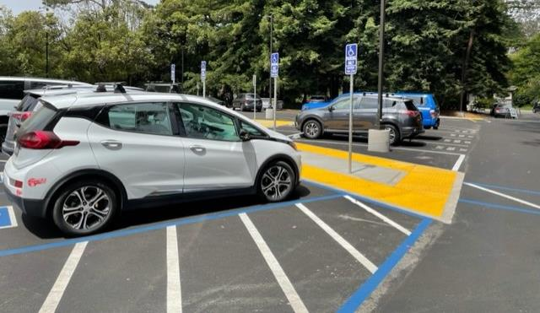
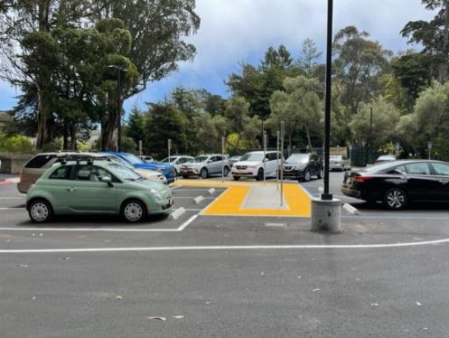
Where We are Now: New Accessible Parking Lot
20 spaces accessible parking lot
8 on-street accessible spaces along MLK & Nancy Pelosi
Shuttle Stop at parking lot
Notes:
Brian
You can mention that we have heard positive feedback from adaptive cycling participants

Slide 6
Music Concourse Garage Management
Notes:
Brian

Slide 7
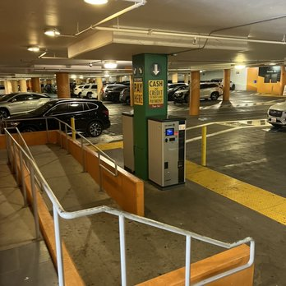
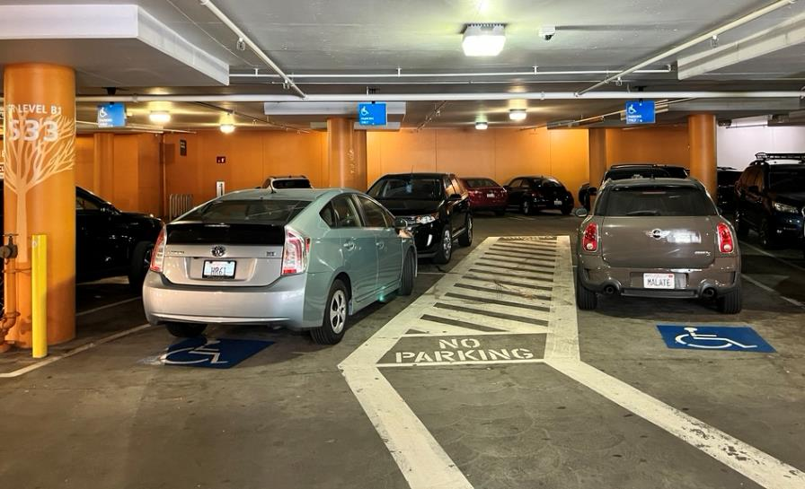
Where We are Now: Music Concourse Garage
Proposition N Passes—November 2022
Greater flexibility for the city to manage the existing privately owned Golden Gate Park Underground Parking Facility
Notes:
Brian

Slide 8
Shuttle Service and Paratransit
Notes:
Brian
Extended/expanded service for events
Piloting "on-call" service
Marked Paratransit vans can enter at 8th Avenue
Marked Paratransit vans can drive on JFK and other closed roads to provide curb-curb service
Paratransit taxis are not currently permitted on closed roads
Low-floor shuttles are on order and should be available sometime this year
In design phase for code compliant shuttle stops
We do not have plans for sheltered shuttle stops yet

Slide 9
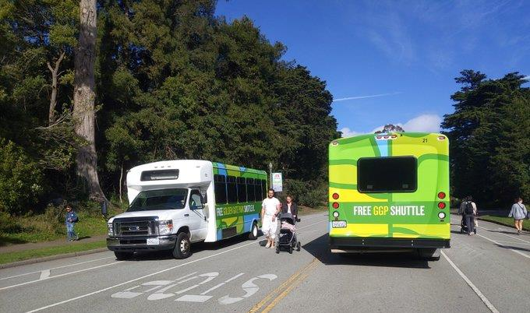
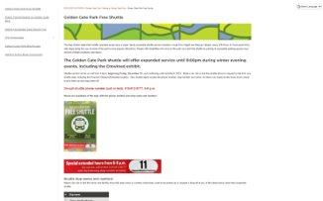
Where We are Now: Shuttle Service
Shuttle service 7-days/week since March 2022
Accessible with lift
3 shuttles Sat/Sun + holidays
2 shuttles Mon-Fri

Slide 10
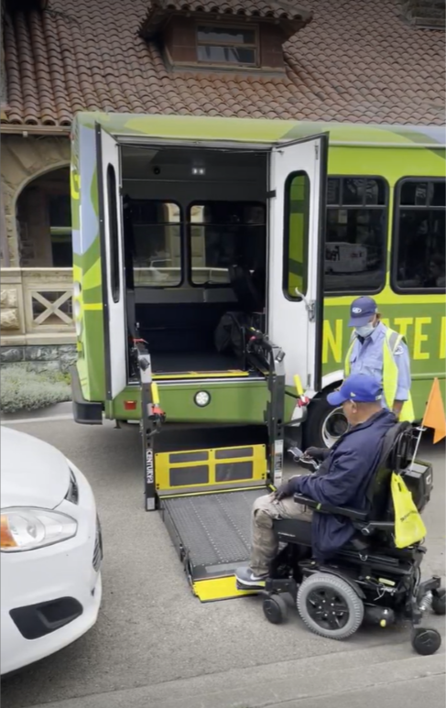
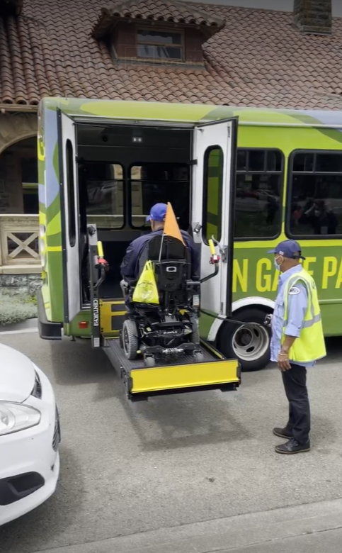
Where We are Now: Shuttle Accessibility

Slide 11
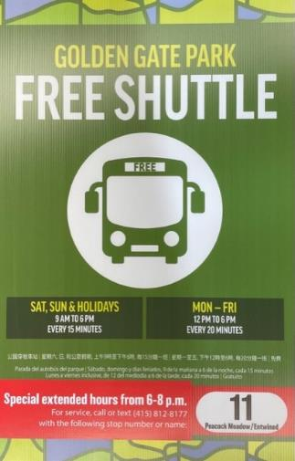
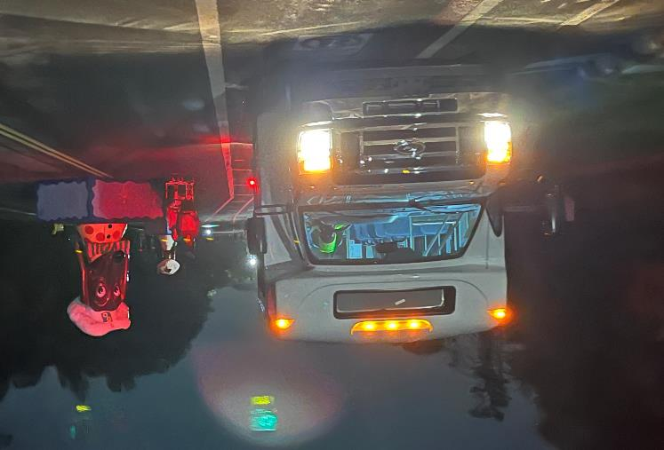
Where We are Now: Shuttle Hours
Shuttle extended evening service to 8pm
On-call service during Winter Lights to March 2023
Notes:
Brian
To service Entwined and other special winter events through mid-March
Mention that we would like their feedback on how well the on-call shuttle works as well as suggestions

Slide 12
Where We are Now: Paratransit Vehicles
Marked Paratransit vehicles allowed on JFK Promenade and other closed roads
Notes:
Lucas
The only vehicles allowed on JFK are RPD maintenance and deliveries for the deYoung, etc.
The best option is taking the shuttle
We are looking at how we can accommodate people with arranging for the shuttle to meet their group at a predetermined time, maybe having multiple shuttles there if it is a larger group, etc.

Slide 13
Information and Communication
Notes:
Lucas
The MDC resolution discussed several different modes of sharing information and providing communication access
Website
Calling & E-mail

Slide 14
Where We are Now: Website
WCAG 2.0 compliant
Content is updated for accessibility
Updated training for content contributors by fall of 2023
Notes:
Lucas

Slide 15
Where We are Now: Website text directions

Slide 16
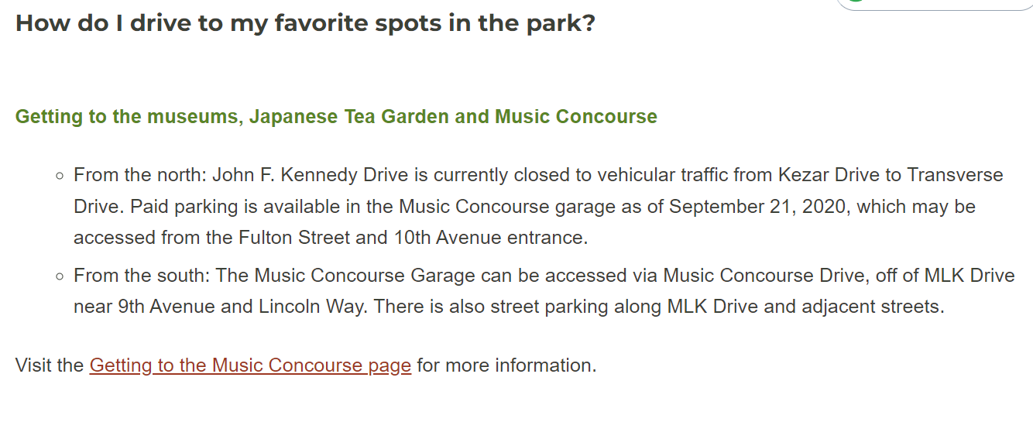
Sample Text Directions RPD Website
Where We are Now: Website text directions
Notes:
Lucas
This is a sample of the

Slide 17
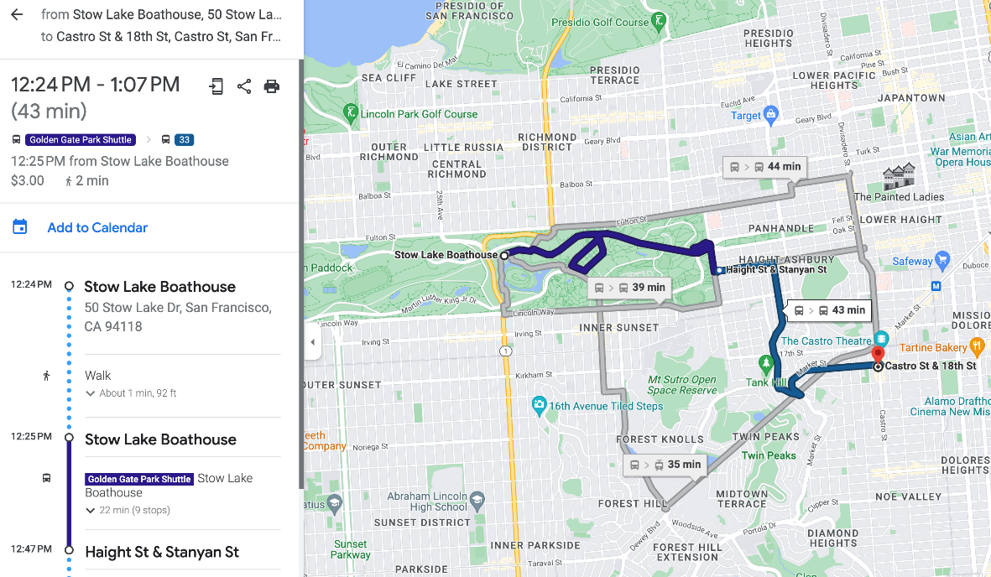
Where We are Now: Website
Google, Apple Maps, and Transit App have been updated
Notes:
Lucas

Slide 18
Where We are Now: Email and Phone Information
RPDAccess@sfgov.org
Phone: 415-831-6834
RPDInfo@sfgov.org
SF311.org
Phone: 311
Notes:
Lucas

Slide 19
Outreach to the Disability Community
Notes:
Lucas

Slide 20
Where We are Now: Outreach
Quarterly meetings with MOD
Updates to MDC as needed
Most current and upcoming GGP projects informed by disability and senior communities' input and feedback
Ongoing outreach to disability and Deaf communities about programs and events
Ongoing collaboration with other agencies
Support for Families, SFUSD SPED, BORP, CIC
Notes:
Lucas

Slide 21
Adaptive Bike Program
Notes:
Lucas
Vision to make more permanent

Slide 22
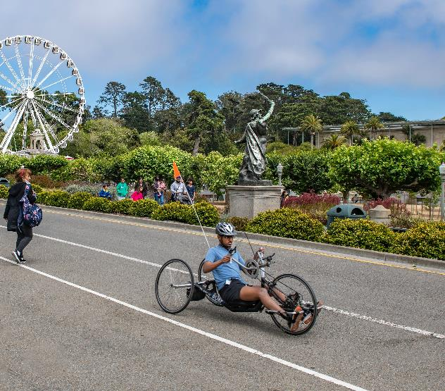
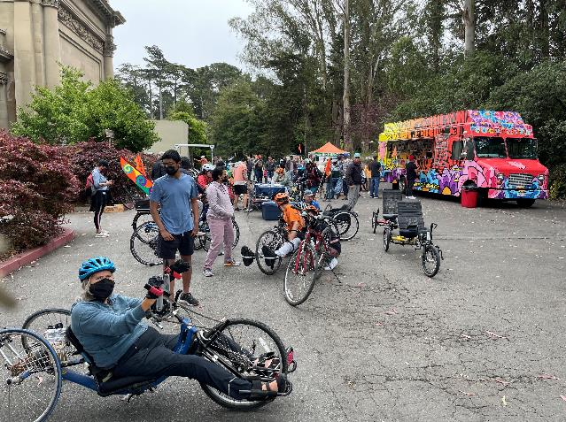
Where We are Now: Adaptive Bike Program
Notes:
Lucas
Bonus of the new location is it's right in the mix, so people are constantly stopping to ask questions and it's not like people with disabilities are being relegated to some unused area. It's right there where it all happens!

Slide 23
GGP Event Access
Notes:
Lucas

Slide 24
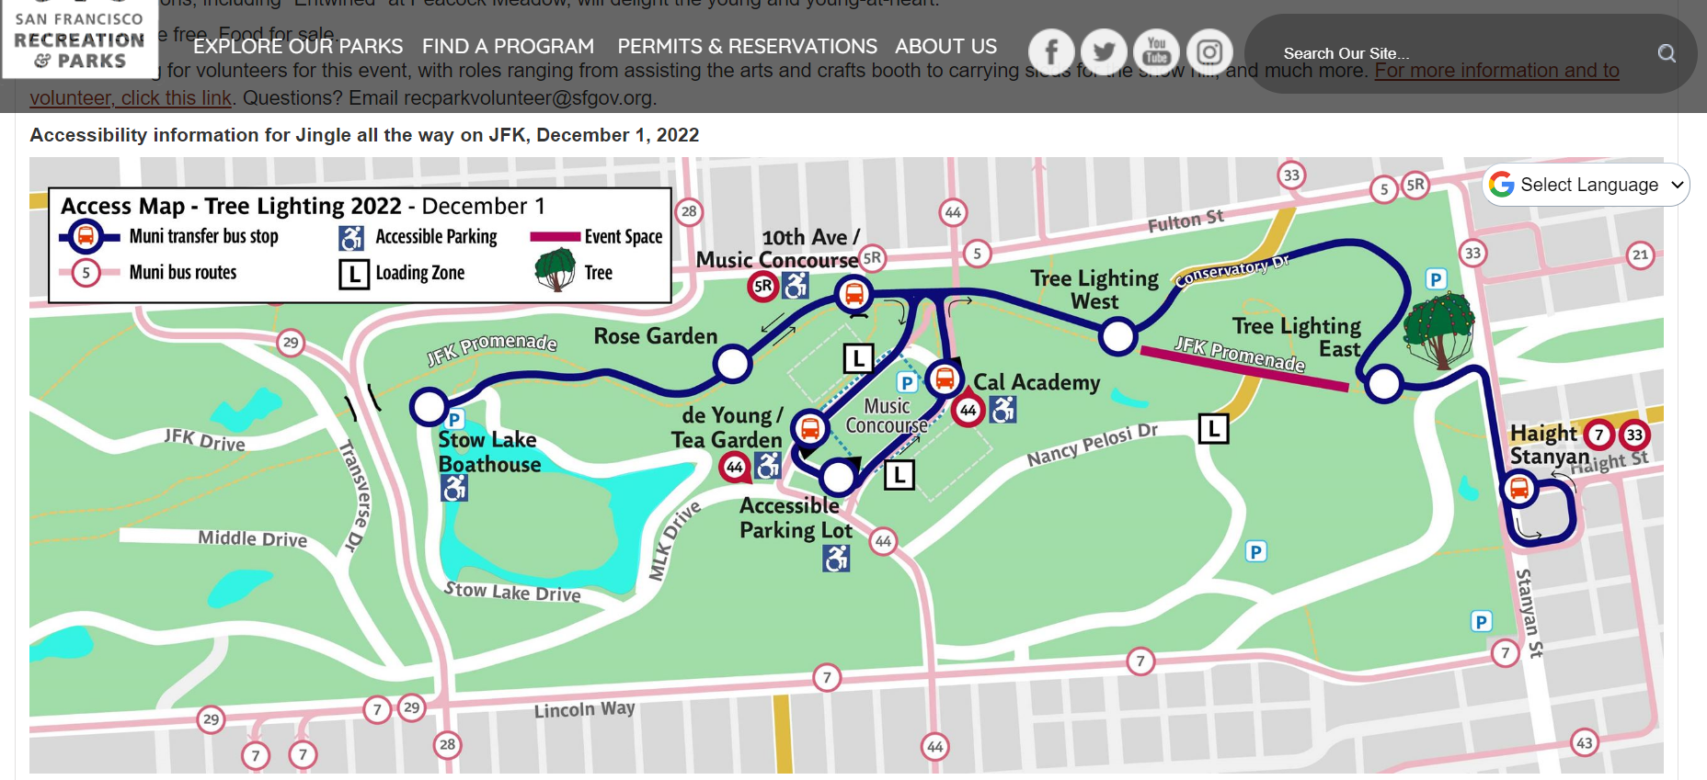
Where We are Now: Event Access Plan example—map

Slide 25
Where We are Now: Event Access Plan example—text
Driving to the event
Traffic will be heavy in and around Golden Gate Park during this event. If you drive, we recommend arriving early. Following is information about parking and passenger drop-off.
General information about driving to Golden Gate Park
You can find general information about driving to Golden Gate Park by visiting the Getting to Golden Gate Park by Car page on our website.
General and Accessible Parking
Information about general and accessible parking can be found on the Getting to Golden Gate Park by car page on our website. Following is information about accessible parking that may be helpful for the Tree Lighting event:
Accessible parking near Tree Lighting event—described below and shown on the Accessing Jingle all the way on JFK event map on this page
Accessible parking is available in the following locations. The location name/cross streets are followed by the number of spaces at that location. Be sure to consider how far you may have to travel from a parking space to your destination, and whether there is a shuttle stop near the parking location. We also recommend arriving early to avoid traffic and find parking.

Slide 26
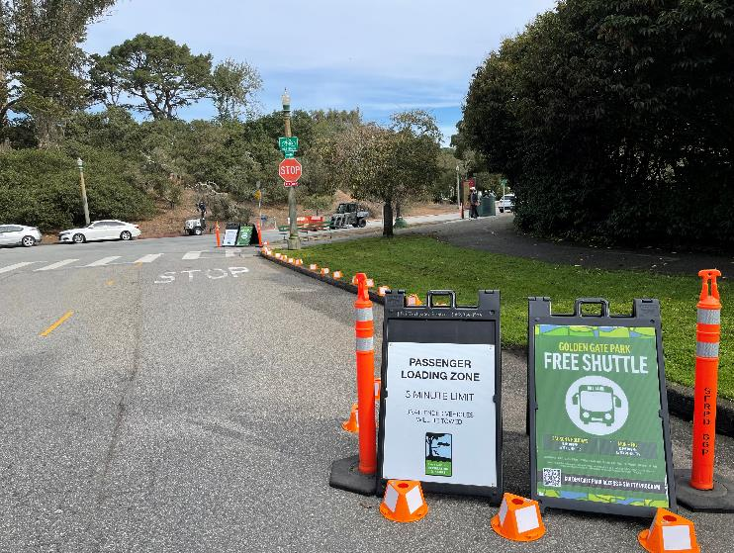
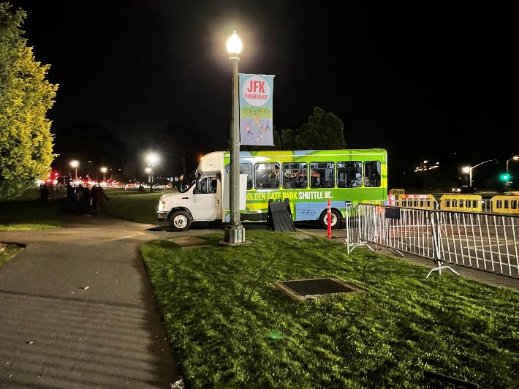
Where We are Now: Event Access
Notes:
Access plan examples

Slide 27
GGP Community Shuttle Program
Notes:
Lucas

Slide 28
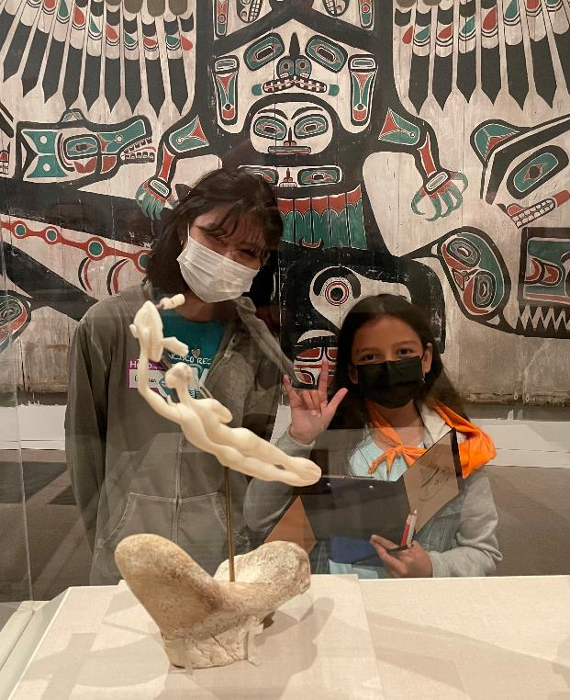
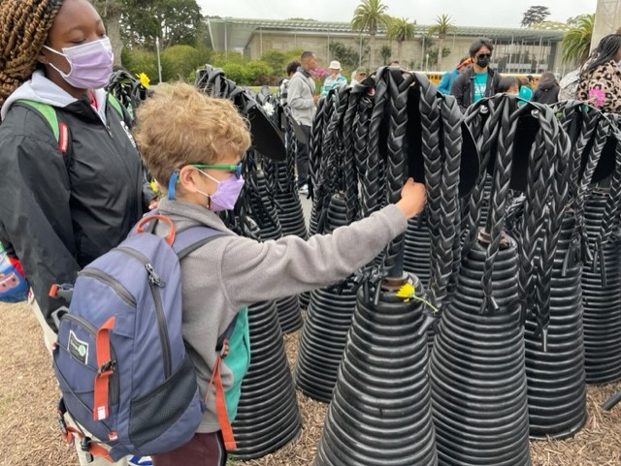
Where We are Now: GGP Community Shuttle Program
Notes:
Lucas

Slide 29
In the works

Slide 30
In the Works: More Shuttle Improvements
Shuttle Stop Improvements
Accessible landing pads
Benches
Stop Poles with information
Shuttle In-Vehicle
Maps
Audio Announcements
Visual destination signs
Shuttle Scheduling
Real-time Passenger information (knowing when shuttle will arrive)
Notes:
Brian
You can mention that the resolution mentioned shelters but we do not have plans for that. We are focusing on accessibility features such as landing pads and benches.

Slide 31
In the Works: Outreach & Input from the Disability Community
Working with MOD to identify key projects
Working with ADF SF on outreach for wayfinding projects
Outreach to the disability community for capital projects
Notes:
Lucas

Slide 32
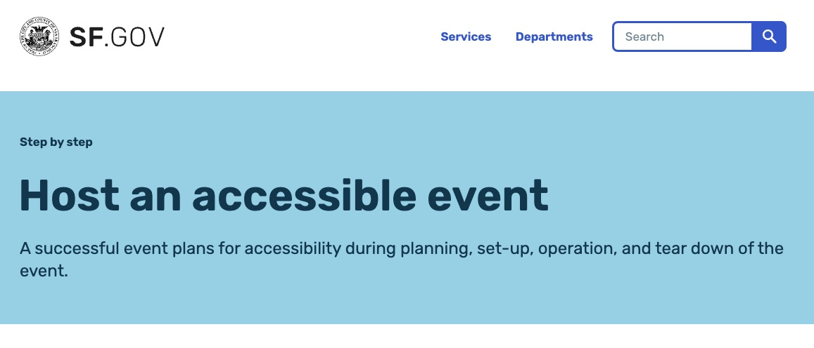
In the Works: Event Accessibility Toolkit—Phase II
Notes:
Lucas
SFSU intern to complete Event Accessibility Toolkit—Phase II
Resource toolkit and checklist to help ensure citywide events are accessible
Will be helpful city-wide to make sure event organizers are following correct accessibility guidelines, and especially in GGP
Collaborative project between RPD and MOD

Slide 33
In the Works: Wayfinding and Signage
Misleading signs have been removed
Proposed project for pathway assessment would inform wayfinding and signage and include training and input from people with disabilities
SFSU student "Know Before you go" project
Notes:
Lucas
With input from people with disabilities
Also may inform locations for wheelchair charging stations

Slide 34
In the Works: Disability Access Coordinator
Alexis Ward, ADA Coordinator-Physical Access
Lucas Tobin, ADA Coordinator-Programmatic Access
Disability Access Coordinator
Notes:
Lucas
Position has been approved and we are moving forward. We hope to be announcing the position in the coming months and begin the recruitment

Slide 35
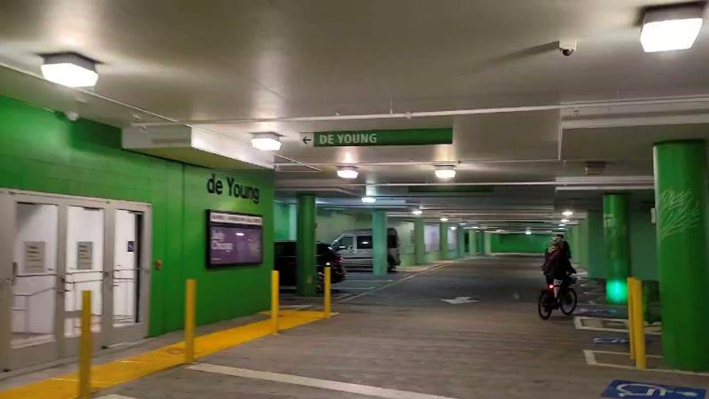
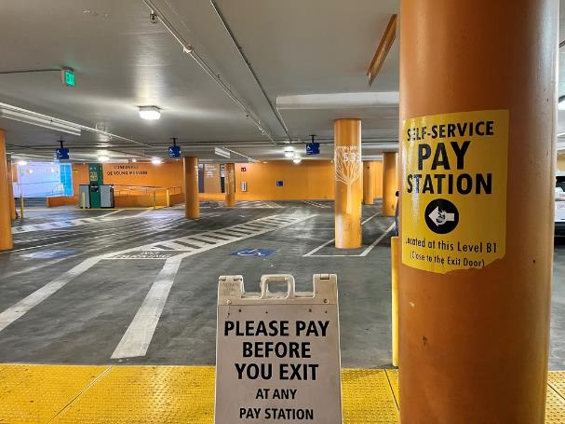
Music Concourse Garage Hours & Management
Notes:
Brian

Slide 36
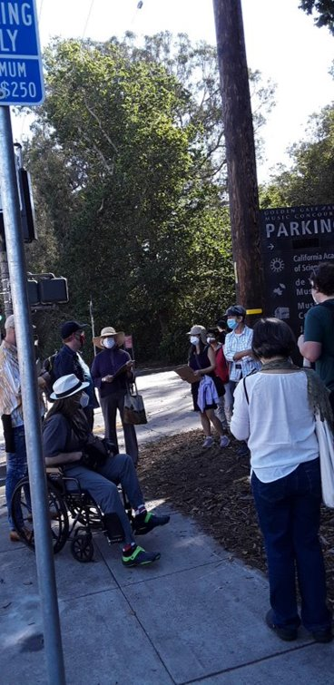
In the Works: Outreach
Invitations to interested members of the disability community to participate/provide input for specific projects
Notes:
Lucas
Wayfinding projects
On-call shuttle feedback
We are working with MOD on identifying other projects that lend themselves to input
We are focusing on the model of inviting people to come out to the park (virtually or in-person) and provide feedback

Slide 37
In the Works: Botanical Garden Bookstore Barrier Removal
Notes:
Lucas
Just mentioning that this project is also in the works. It was result of feedback from a member of the public
Programmatic solutions until ramp can be built

Slide 38
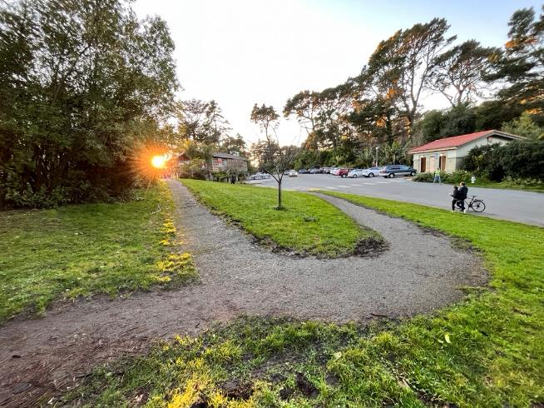
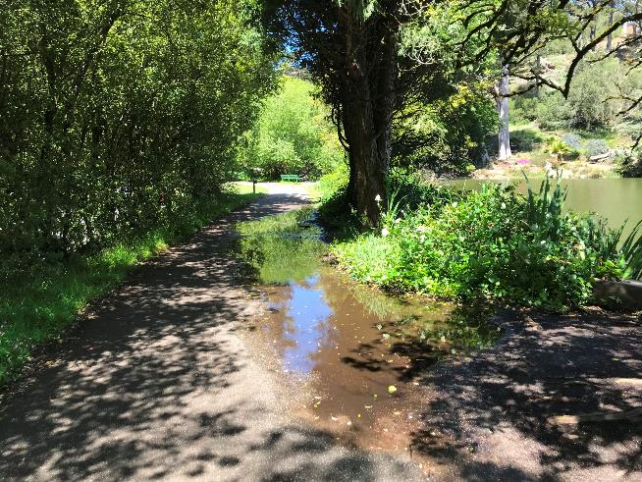
In the Works: Stow Lake Barrier Removal Project
Stow Lake Perimeter Path Renovation
Notes:
Brian

Slide 39
Path of travel improvements
Existing curb ramps up to current code, new curb ramps where needed, crosswalks

Slide 40
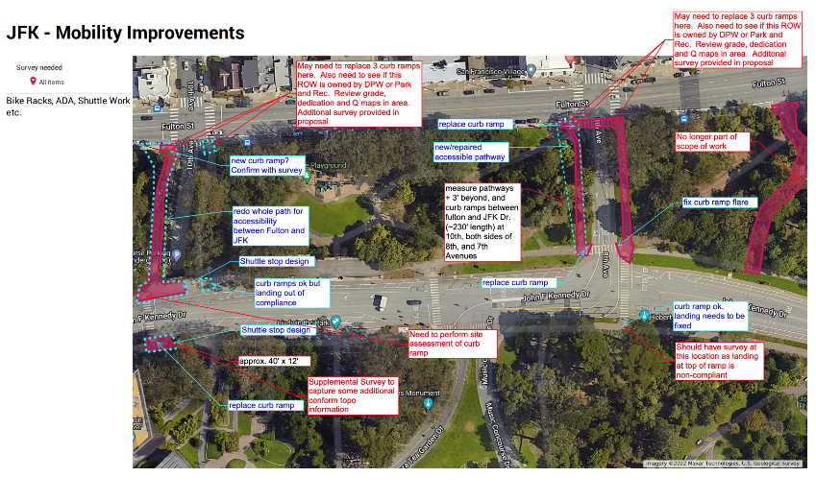
In the Works: Curb Ramps and Crosswalks
Replace curb ramps along JFK Promenade
From Stanyan to 10th Ave
Fulton to JFK Promenade
Stanyan frontage near McLaren Lodge
Improve crosswalks
Conservatory East
Pompeii Circle near Dahlia Dell
Notes:
Brian

Slide 41
Still to come

Slide 42
Still to Come
Conservatory access
More blue zones in center of park
Maps and brochures with accessibility information and in accessible formats
Audio description for website videos
Information on website in ASL for Deaf people—We provide visual information, text information, and captioning for videos. This is a great idea. We are looking into using videos for wayfinding and information, and could consider ASL videos

Slide 43
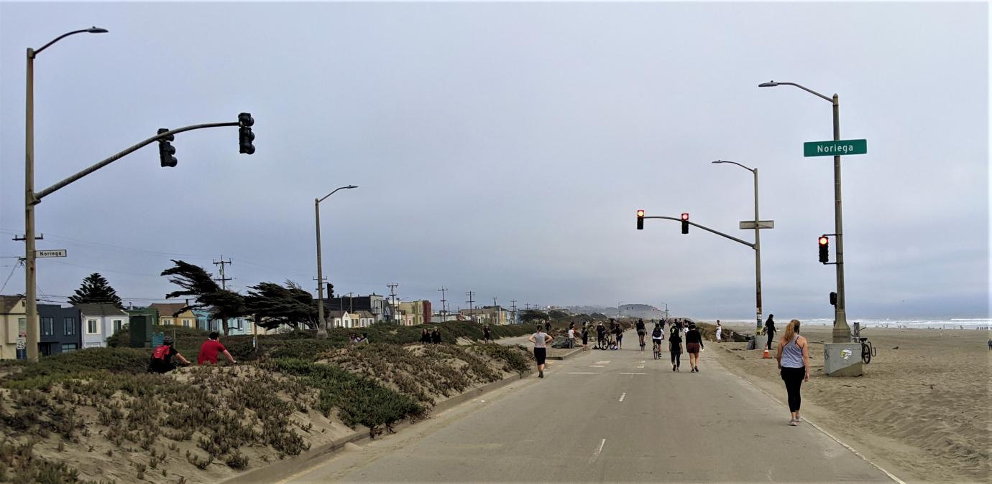
Recreation & Park Department
Great Highway Update
Update to Mayor’s Disability Council
Friday, January 20, 2023
Inspire, Connect, Play!

Slide 44
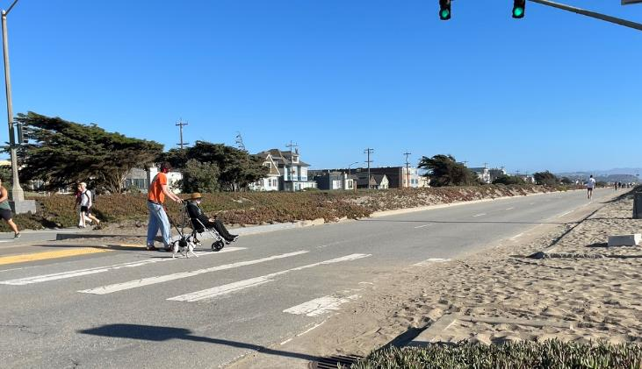
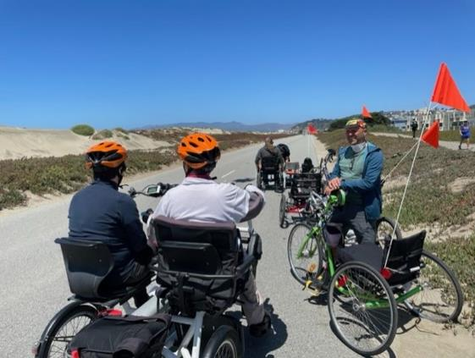
Great Highway Update: Data Collection and Outreach
Ramp up data collection/outreach--surveys, public meetings
What would MDC like included in data study so we can budget in request
Mayor's Disability Council
January 20, 2023
Brian Stokle, Planner RPD

Slide 45
Thank You
Inspire, Connect, Play!

