Slide 1
The Food Secuity Task Force Website Transition
October 5, 2022
Presented by:
DeJanelle Bovell, Equity Program Planner
DPH, Office of Anti-Racism and Equity/PHD
La Rhonda Reddic, Health Worker
DPH, Office of Anti-Racism and Equity/PHD

Slide 2
New website moving to sf.gov Questions to answer:
What aspects of the current FSTF website do you want to keep?
What do you find most helpful?

Slide 3
Notes:
Current website
https://www.sfdph.org/dph/comupg/knowlcol/FSTF/default.asp

Slide 4
Notes:
People- logo representation
Resources – Go into previously shared

Slide 5
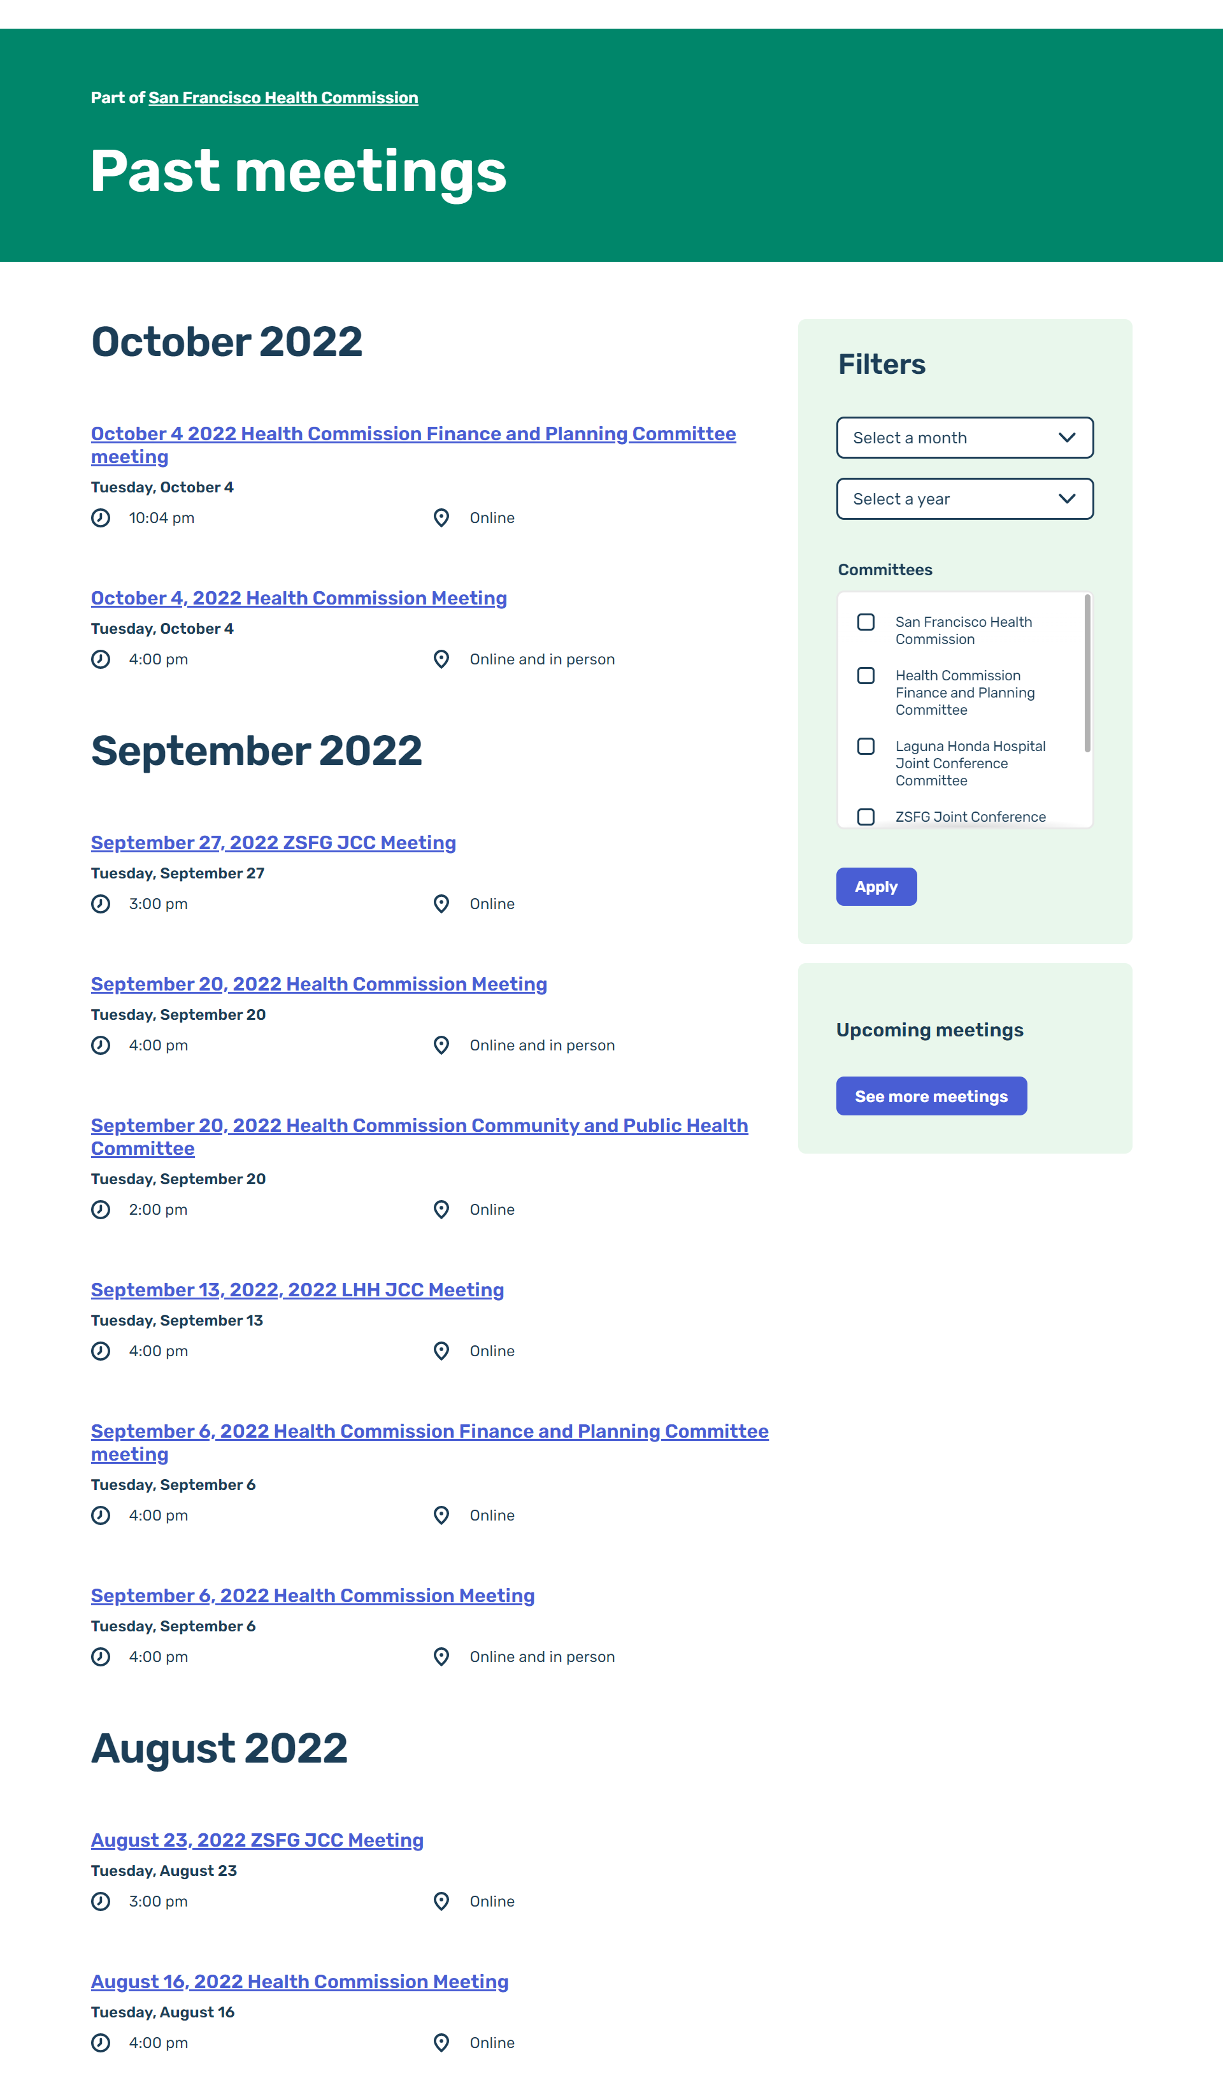

Slide 6
Timeline
Oct. 5: Request Feedback
Nov. 2: Share progress
Dec. 7: Share progress
Anticipating completion by January 2023
Oct. 19: Feedback Due

Slide 7
Next Steps
Please provide feedback by October 19, 2022
Contact us via email:
Larhonda.reddic@sfdph.org
Dejanelle.bovell@sfdph.org
Quick Links
Current FSTF site: www.sfdph.org/dph/comupg/knowlcol/FSTF/default.asp
Health commission new site: https://sf.gov/meeting/october-4-2022/october-4-2022-health-commission-meeting
Sugary drinks new site: https://sf.gov/public-body/sugary-drinks-distributor-tax-advisory-committee

Slide 8
Jamboard Discussion
Link to Jamboard found here:
https://jamboard.google.com/d/1GAhpNhc35Qr42X4WXaBCZhRR2opPxGnKlmm3-OsnKfo/edit?usp=sharing
Directions:
Utilize sticky notes on page to add your questions and insights for the new FSTF Website

