Slide 1
San Francisco Board of Supervisors Shelter Monitor Committee Proposal
Presented by committee members Muasau and Clark.

Slide 2
According to the Brain Donor Project, and the Anxiety and Depression Association of America:
1 in 5 people suffer from some kind of mental health issue. Depression, alone, is reported to affect nearly 300 million people, globally.

Slide 3
In San Francisco, our homeless population, conservatively, is estimated at 10,000 individuals and according to the UCSF Chair of Psychiatry, Dr. Matt State, MD PhD, 40% of that population suffers from mental illness and substance abuse disorders.

Slide 4
3 Step Proposal – Robust Recovery Resolutions (For addressing the mental health crisis of San Francisco shelter clients)

Slide 5
Step #1
Onsite Mental Healthcare Providers.
Consistent presence to promote trust and familiarity with clients.
Building relationships, moving toward transparency and assessing mental health needs of shelter clients that are signature and targeted to that individual.
Create more accurate, hands on data for the city of San Francisco and globally.

Slide 6
Step #2
Alcoholics & Narcotics Anonymous, H & I.

Slide 7
Step #3
Spiritual Counseling.

Slide 10
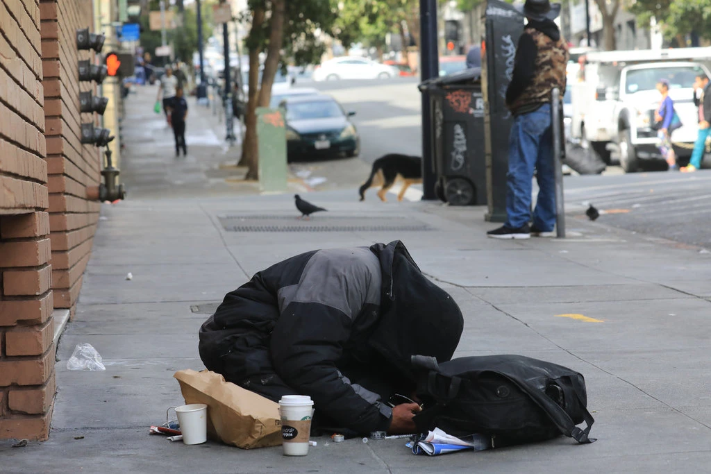

Slide 11
Projection and Possible Barriers:
Funding – The positions, proposed, require accredited mental healthcare professional salaries.
2. These positions must be filled by mental healthcare professionals that have a heart and a desire for the positive advancement of our homeless community in San Francisco.
3. The data/statistics, created, will be priceless and landmark toward care and treatment of mental health, globally.

Slide 13
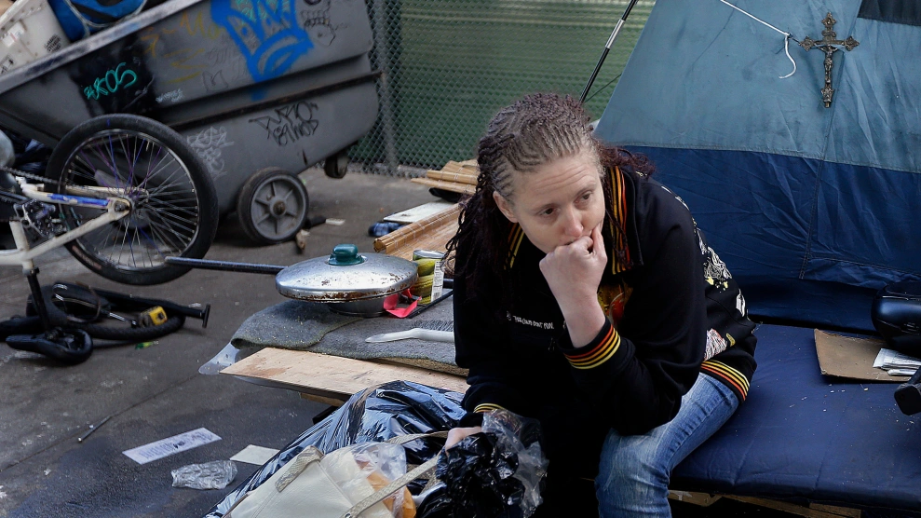

Slide 14
Conclusion:
As San Franciscans we do not need the aforementioned statistics, as we live and walk daily in the reality of the mental health crisis. Onsite mental health care professionals and their consistent presence at our shelters will forge relationships between providers & clients, where before there was mistrust yielding inaccurate data & ineffective care plans. With this proposal we hope to create vital data, formulate solutions and hopefully promote 'word of mouth' accounting from those who have 'been assisted' to those needing assistance. The shelter system is a great place to start this form of care and the Shelter Monitor Committee is the vehicle to bring this to the forefront.

