Slide 1
Policy Subcommittee
AFRICAN AMERICAN REPARATIONS
TASK FORCE ADVISORY
Update Report for
September 12, 2022
Subcommittee Members:
Daniel Landry (Subcommittee Lead), Nicole Cunningham, Omerede
‘Rico’ Hamilton, Yolanda Harris, James Lance Taylor, and Gwen Brown..

Slide 2
PURPOSE:
Our intention is to develop policy and legislative priorities
centering reparations for African Americans that can be
implemented as part of the San Francisco City Charter.

Slide 3
OBJECTIVES
We will choose current enforceable laws that disproportionately affect Black people.
We will unpack and review the current laws that have negatively impact Black people.
We will partner and work closely with the education Subcommittee and the Economic Empowerment Subcommittee to collaborate to ensure policies are concise and synchronized.
We will begin to research how to make legislation with teenth from previous recommendations put before the city i.e., African American Out Migration Report, Unfinished Agenda, and the War on Drugs Report.
We will review other African American Task Force Committee Subcommittee initial proposed recommendations policies prior to final submission to the BOS and the Mayor.
Who is impacted? Entire Black population in San Francisco Specific Populations: Infants, children, adults, and seniors. In all San Francisco Neighborhoods, Zip codes, and impacted citywide.

Slide 4
OUTCOMES
• All reparation legislation policies proposed to the City of San
Francisco will become law.
• Each Black/African American individual, born and raised and who
has lived in San Francisco since the incorporation of the City and
County of San Francisco will receives reparations.

Slide 5
HISTORY of SAN FRANCISCO
• Originally known as Yerba Buena and land of the Ohlone
People.
• San Francisco was founded in 1779 and named after
Saint Francis Drake.
• On April 15, 1850 the City and County of San Francisco
was incorporated.

Slide 6
How policy laws are established in San Francisco?
• Governmental policies or laws can be established
either by the Board of Supervisors, the Mayor, or by the
people through a ballot initiative approved by the majority
vote of San Francisciscan.
• Any laws can be challenged here locally, on a state level,
and/or in federal court.

Slide 7
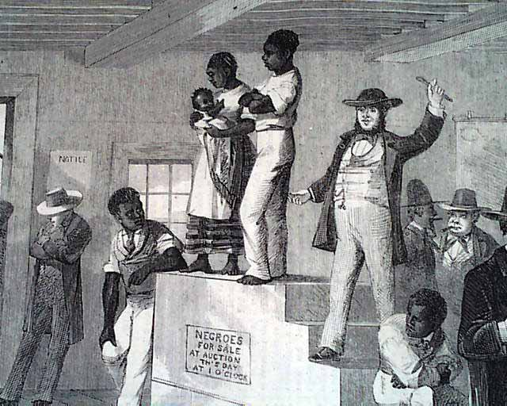
• 13th amendment
• Black codes/slave codes
• Debt servitude & debt bondage.
• Pig Laws.
• Sharecropping.
• Article 34.
• Jim Crow.
• Eminent Domain.
• Redling.
• Welfare aka AFDC.
• War on Drugs.
• Racial profiling.
PAST
HARMS:

Slide 8
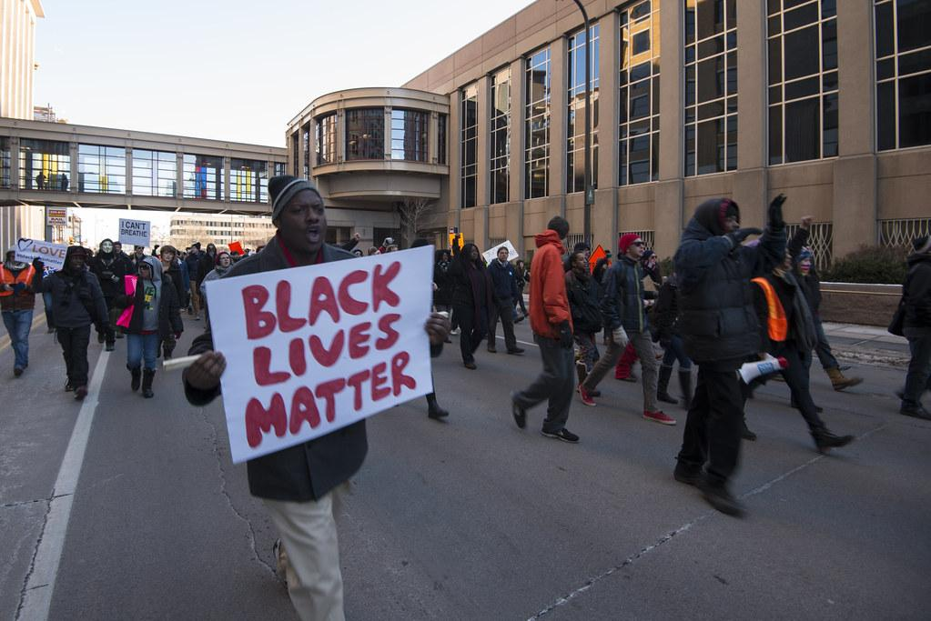
• Prop. 209.
• Housing evictions.
• Student loans & child support laws.
• Zoning laws restrictions.
• 3 Strikes & mandatory sentencing.
• Non-oversight for community benefits.
• Youth and young adults resources.
• Educational policies.
• Failed redevelopment projects.
• Health disparities.
• Environmental Injustice.
• Income wages gap.
• Bank loans & credit discrimnation.
• Black owned businesses decline
• Black Population in SF decline.
Continuing
HARM:

Slide 9
IMPLEMENTATION OF REPARATIONS LEGISLATION:
Identify specific policies to change or amend to mandate reparations through city ordinances and through again the city charter.
Research previous and current city tax codes to help craft a Reparations Tax.
Implement past recommendations of reports, and studies by rewriting the language to meet city policy standards.

Slide 10
AREAS OF FOCUS:
Systemic Disparities: In the legal system, the health institutions, In the area of housing, education, and the criminal system.
In the Institutional areas: That have legally hindered Black people in San Francisco from establish generational wealth.

Slide 11
Past Recommendations for consideration:
Unfinished Agenda of 1993:
• There was 23 Recommendations Actions in the report. Recommendation 1 and 2
talked about creating policy to increase African Americans income, and Recomm
- endation 3 talked about establishing a voluntary fund “Tax” to develop an African
American foundation.
Out Migration Report of 2009:
• The Out Migration Report overall recommendations covered housing, education/
economic development, cultural & social life, along with Public Safety & QOL issues.

Slide 12
War on Drugs Report of 2015:
• The community urged 12 recommendations to the SF Human Rights commission.
Here’s some that can immediately be implemented:
1. Lifs the lifetime ban on Calfresh assistance for people with low-levels drug convictions. 2. Expands post-conviction dismissal and provides that individuals who receive local sentences under the new realignment laws have an opportunity to petition
for “set aside and dismissal” under Penal Code 1203.4 (also known as “expungement”).
African American Historic Context Statement of 2016:
• Explore the Federal Rehabilitation Tax Incentive.
• Explore the Transient Occupancy Tax.

Slide 13
Reparations Tax:
We have identified two options:
Increasing the User Sales Tax to 9.5 %. San Francisco.
2. Establish a Special Tax on the bank institutions and insurance companies
who admitted to playing a role in slavery.

Slide 14
Additional Policy subcommittee proposed areas for Reparations:
• Fillmore Heritage Center should be given as an asset to the Black community, and
A cooperative entity must be structure for shareholder ownership.
• City of San Francisco should payoff all Mortgages for housing cooperatives.
• Creation of BlackCARD which Anieties’ Economic Subcommittee is working on.
• City of San Francisco needs to look into land acquisition illegally acquired
by eminent domain and redistributed to the Black community.
• Creating something like a Reparations Commission that will have more teeth.
• A form of land own by the City and County of San Francisco.

Slide 15
Getting around Prop 209:
Obstacle:
• Proposition 209 is a California ballot proposition which, upon amended the
State Constitution to prohibit state governmental institutions from
considering Race, Sex, or ethnicity, specifically in the areas of public
employment, pubic contractings, and education.
A Possible Solution:
• Create an ELIGIBILITY CLASS CRITERIA. Design a eligibility group based on
lineage and ancestry of those who are descenants from US Slavery and Jim
Crow.

Slide 16
Research, Outreach, and Consulting Advice:
N'COBRA
Evaniston. IL Reparations policy reviewed.
Community At-large: Elder Sammie Broadnax, & Ken Johnson
De'Anthony Jones, CCSF
Ira Mosely, IRS Tax Expert
Chris Lodgson, & CJEC team
AFRICAN
AMERICAN REPARATIONS
TASKFORCE
ADVISORY
COMMITTEE

Slide 17
MILESTONES
June 1, Dec. 1 Dec. 1 June 1, Jan. 18,
2021 2021 2022 2023 2024
First Meeting
First Report
Submit Draft
Report
Submit Final
Plan
Sunset of
AARAC

Slide 18
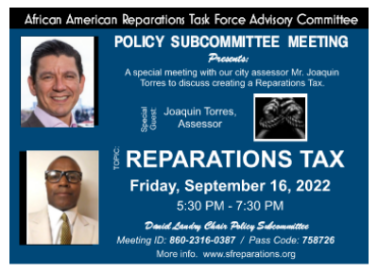

Slide 19
For more Info.
Daniel Landry, Policy Subcommittee Lead
E-mail: danielb.landry@yahoo.com
San Francisco Human Rights Commission
www.sfreparations.org / reparations@sfgov.org
Thank You!

