Slide 1
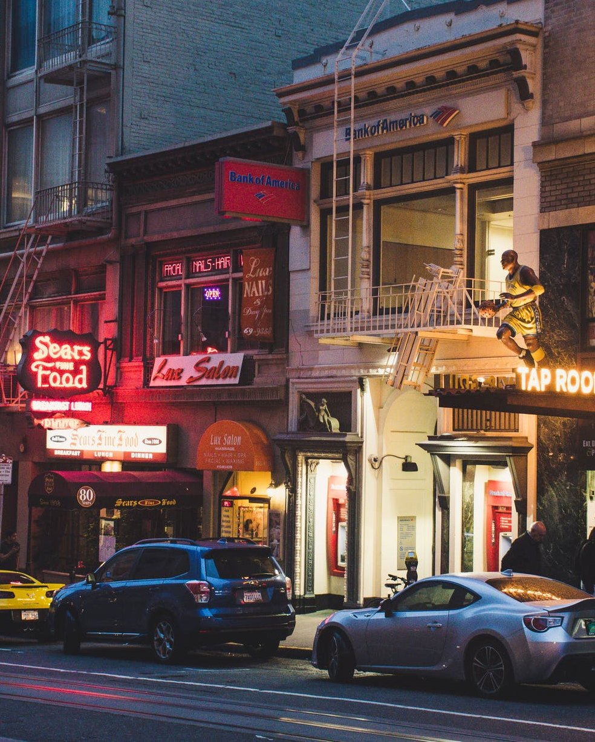
First Year Free
Supporting and Reviving Small Businesses by Waiving Fees for New Storefronts
September 12, 2022

Slide 2
First Year Free
November 1, 2021- July 31, 2022
1173 First Year Free Enrollments
Total Waived: $377,868.86
864
TTX
211
DPH
35
DBI
(incl. those collected for other Depts.)
9
ENT
5
DPW
14
CPC
6
POL
30% of Businesses in Food Industry

Slide 3
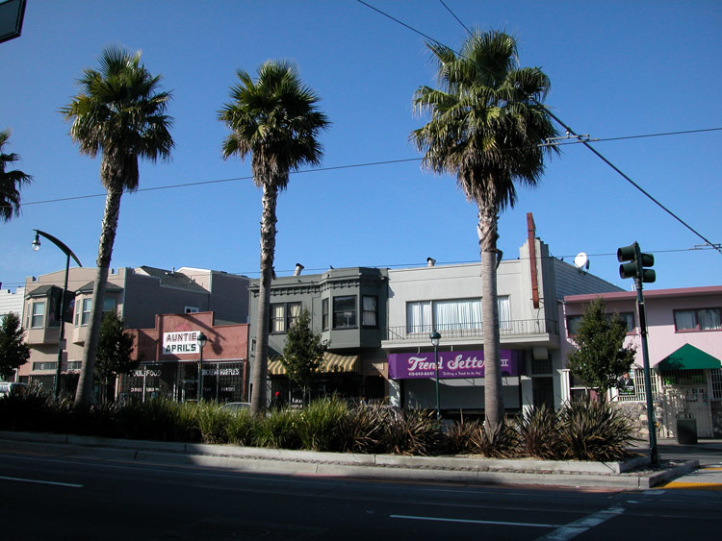
Automatic Enrollment
No Extra Forms or Applications to Fill Out
Register as a new business (or new location) and we will screen you for eligibility into First Year Free.
If you are eligible, we will share more about the program, and ask you if you want to sign up.

Slide 4
What are qualified businesses saying?
Thank you so much! I am switching entities and it was a huge help to me to not have to pay for both structures at the same time. Thank you!!
We can not survive without City & County Support under Covid-19 pandemic. Thank you supporting for small business. I appreciate that.
So far it has been great! As a non-profit operating our office and community space in a commercial space this helps us a lot with fees and costs.
It’s important to support small businesses in the city because we are suffering
This is an amazing benefit for opening a new business in San Francisco. It helps me a great deal as I have other areas of start up cost. Thank you.

Slide 5
Proposed Changes
(Retroactive to November 1, 2021)
Extend the program through June 30, 2023
Increase the maximum gross receipts to qualify for from $2 million to $5 million
Extend to all commercial use locations (currently only ground floor)

Slide 6
Projected Increase in Number of Eligible Businesses Based on GR
 | 11/1/21 to 6/30/22 | 7/1/22 to 6/30/22
Less than $2m GR
Ground Floor Commercial | 1,085 (actual) | 1,627 (projected)
$2m to $5m GR
Ground Floor Commercial | 398 (projected) | 597 (projected)

Slide 7
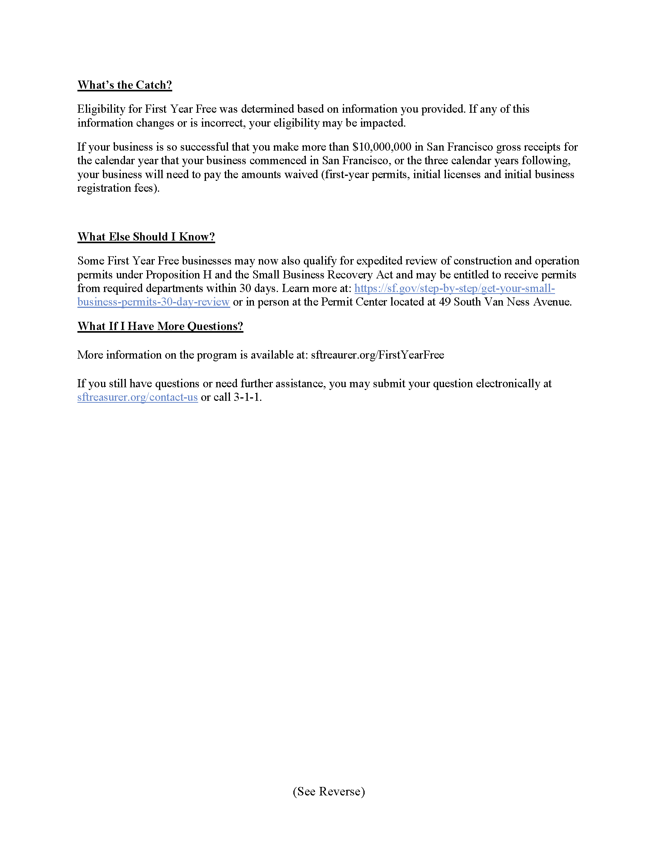
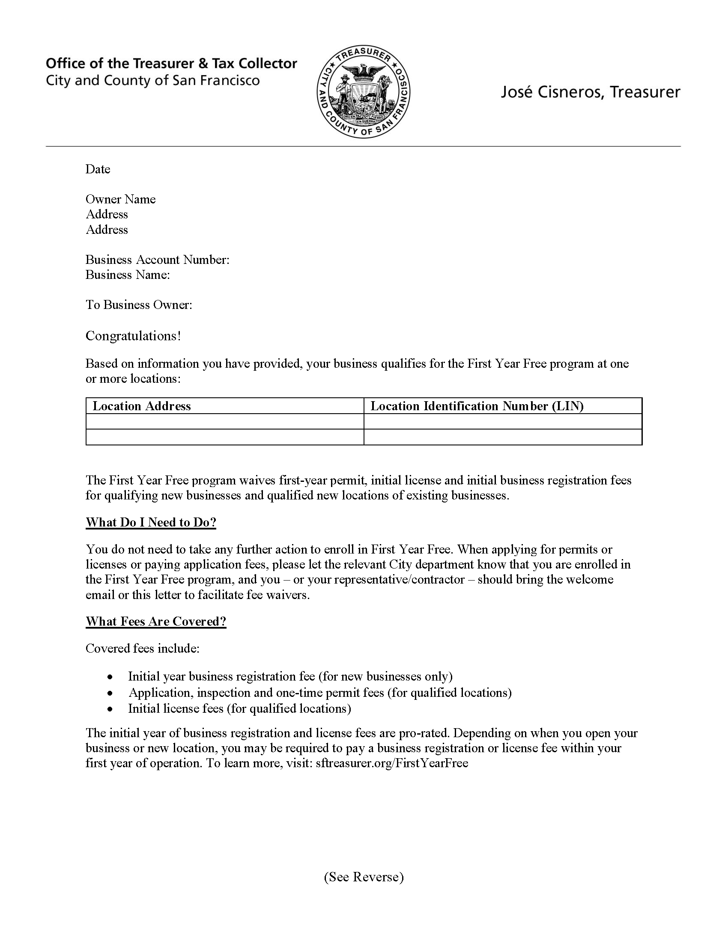
How will these changes impact departments?
FYF Verification will remain same
Some manual work
Increase in refund requests

Slide 8
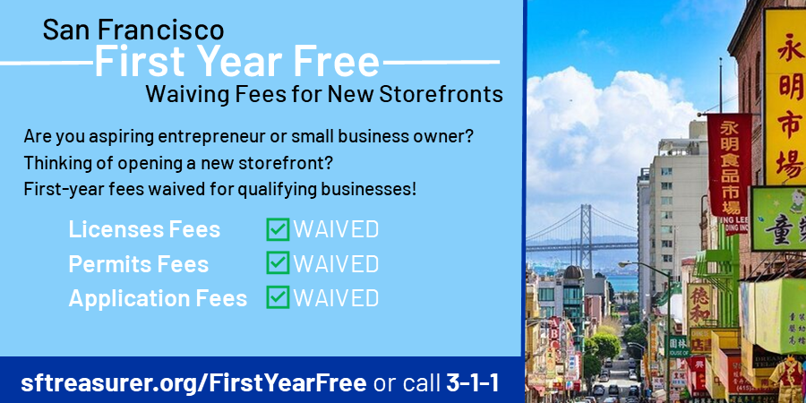
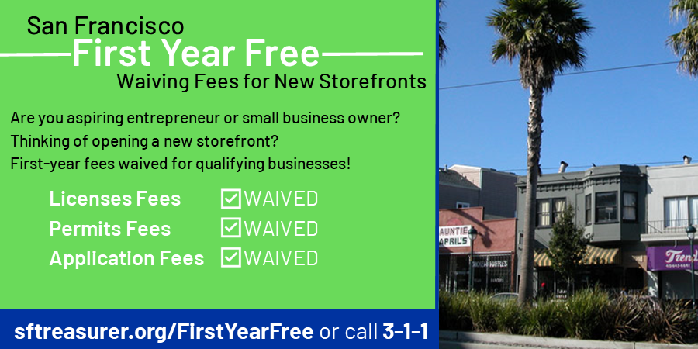
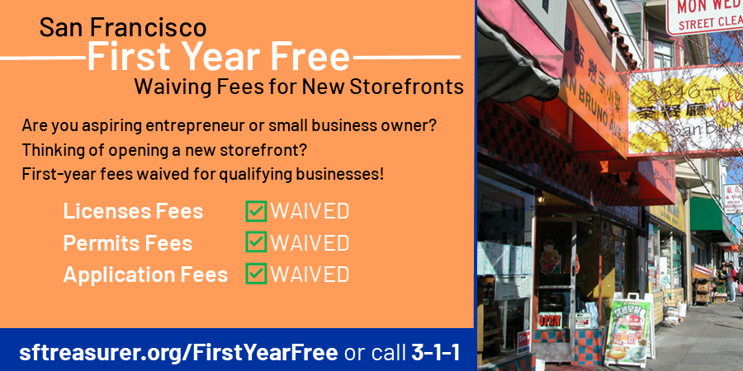
Outreach Plan
Set up meetings with all departments for refresher trainings and provide update to legislative changes
Contacting eligible businesses based on GR
Updating website, social media, fliers

Slide 9
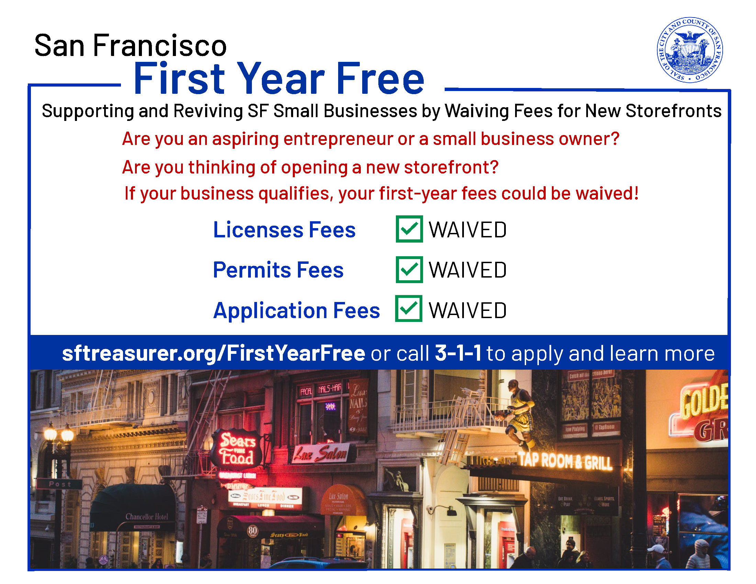
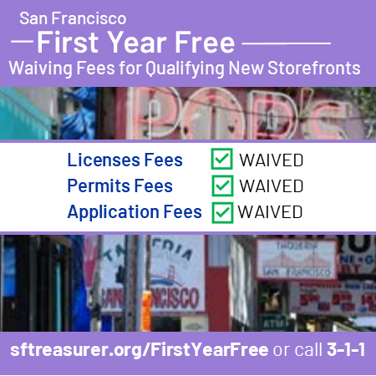
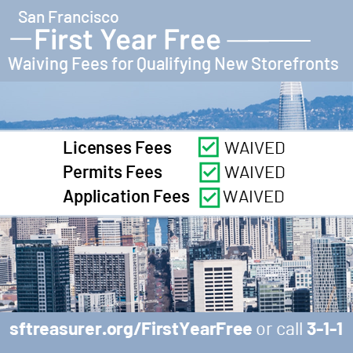
More Outreach Materials…
You can also refer people to sftreaurer.org/FirstYearFree or 3-1-1

Slide 10
Thank You and Questions!
Thank you for your partnership and help! Reach out any time with questions or comments!
Amanda.Fried@sfgov.org
Hafiza.Salehbhai@sfgov.org

