Slide 1
Navigation Centers and Standards of Care
Shelter Monitoring Committee
July 20, 2022

Slide 2
Navigation Center Model
Pets, partners and possessions
Case Management and Housing Navigation
Connection to HSA Benefits
DPH Shelter Health and Behavioral Health
24/7 staffing
Unsheltered Adults
High staff to client ratio
Encampments
Housing Referral Status
Harm reduction
No curfew or set meal times
Safety staff
High Staffing
Service Rich Environment
Welcoming
Target Population
Notes:
Welcoming, Privacy - No bunk beds, partitions

Slide 3
Current Navigation Centers
Site | Capacity
Bayshore | 128
Bayview SAFE | 186
Central Waterfront | 64
Division Circle | 186
Embarcadero SAFE | 200
Lower Polk TAY | 75
Taimon Booten | 84

Slide 4
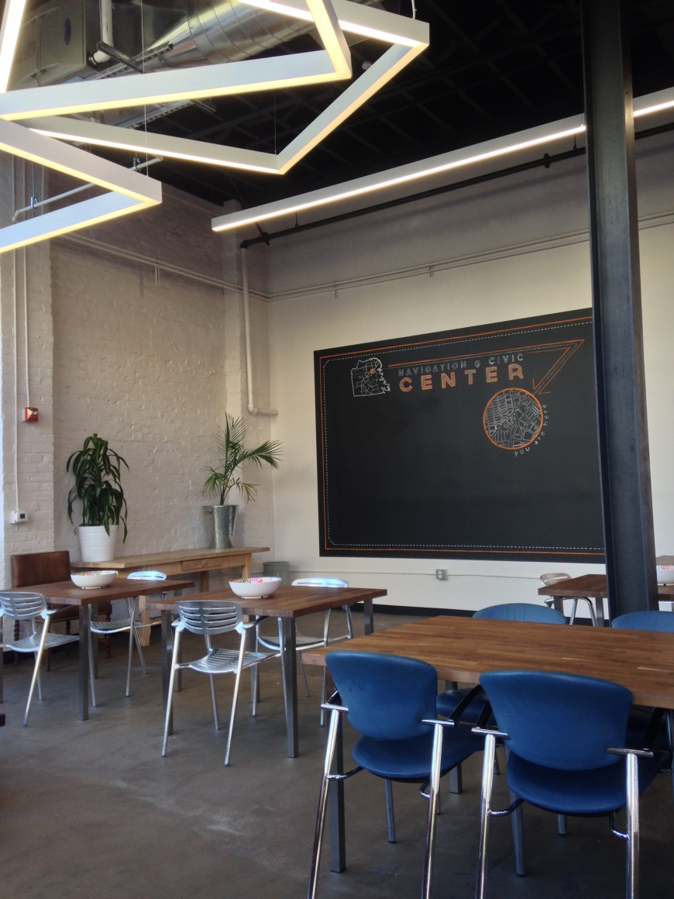
Navigation Center Sites
Notes:
Central Waterfront
Civic Center Hotel

Slide 5
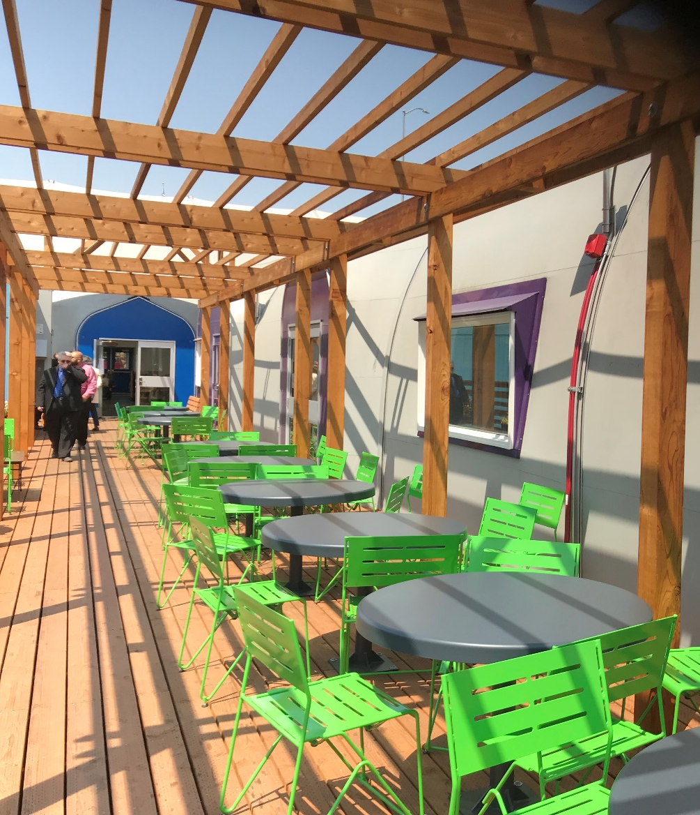
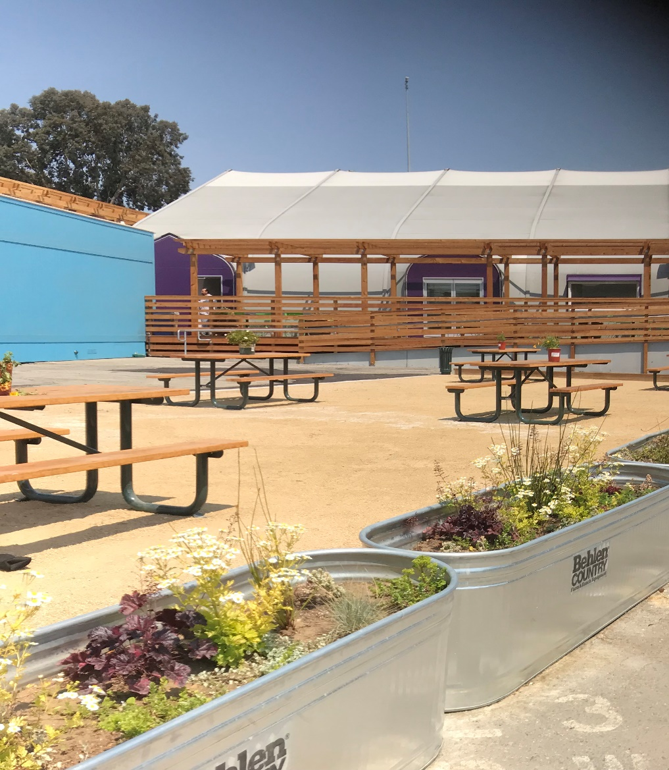
Navigation Center Sites
Notes:
Division Circle

Slide 6
Standards of Care at Nav Centers
Standards that may not align with existing operations:
Engage a nutritionist, who shall develop all meal plans, including meal plans for children and pregnant women; and post menus on a daily basis.
Provide a minimum of 22 inches between the sides of sleeping units, excluding the designated ADA-accessible sleeping units and sleeping units separated by a wall
To the extent not inconsistent with Proposition N, passed by the voters on November 5, 2002, ensure all single adult shelter reservations be for a minimum of 7 nights.
Maximize the space for sleeping in the shelter to the fullest extent possible.
Notes:
Nutritionist standard changing – review instead of develop
Partitions were allowed to be considered walls for this standard.
Prop N is Care Not Case legislation. Homeward Bound beds are less than 7 days.
No bunk beds

Slide 7
Nav Centers Implementation
Proposal for moving towards implementation:
Navigation Center tours – 2 sites had tours in July
Join Quarterly Shelter Provider Meeting
Email introduction
One Pilot Inspection at each site in 2022
Begin to take complaints
Roll out regular inspections once member capacity is available
Notes:
Nutritionist standard changing – review instead of develop
Partitions
Homeward Bound beds
No bunk beds

