Slide 1

MD-APP
New Online Application
Implementation for
Credentialed/Non-Credentialed Staff & Avatar Users
Felicia Davis
Carla Love
San Francisco Health Network
Behavioral Health Services
San Francisco Department of Public Health

Slide 2
What is MD-App?
MD-App is a secure online application platform that is part of our New MD-Staff credentialing system
  Applicants can login, modify, and submit applications online from anywhere using the web browser on their computer/laptop, iPhone, iPad, or Android phone/tablet
  MD-App includes built-in lookup tables and reference addresses minimizing the time needed to fill out the application, while expediting the application process and reducing errors
  Documents can be uploaded and signed electronically using DocuSign

Slide 3
Implementation Date
Starting January 1, 2020
MD-App will replace the following paper applications:
  Certification and Verification for Avatar Staff ID (Attestation for Non-Licensed Staff)
  Certification and Verification for Avatar Staff ID (Licensed/Waivered/Registered/Certified Staff)

Slide 4
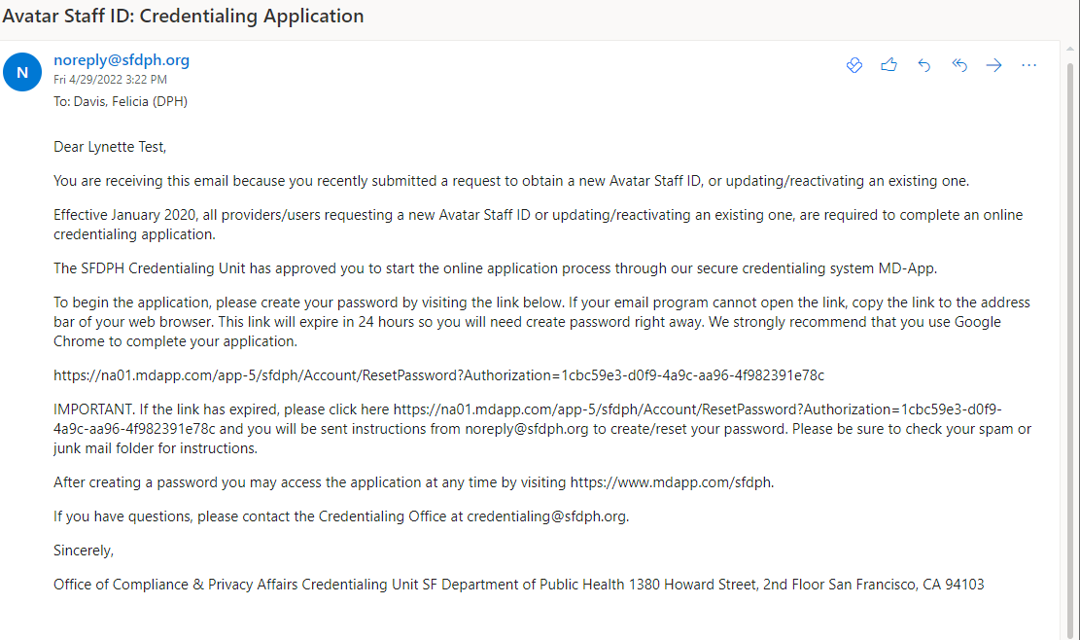
How does MD-APP work?
You will receive an email with link from the Compliance Department (noreply@sfdph.org.com) with the appropriate application template

Slide 5
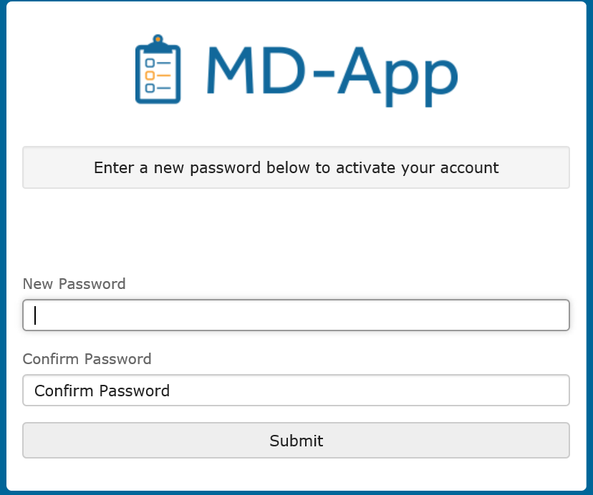
Set up Password
”

Slide 6
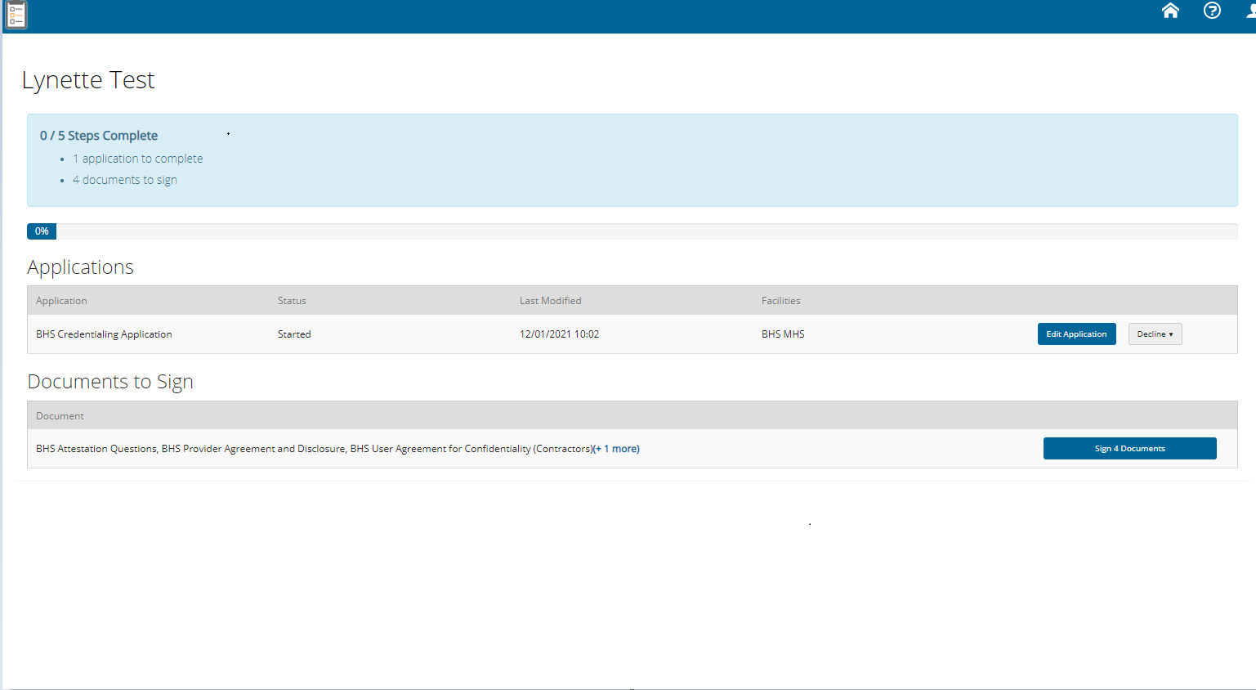
Application Home Page
*To began the Application, click “Edit Application”

Slide 7
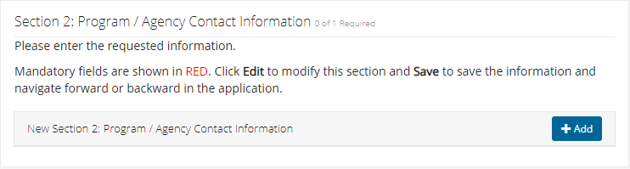
Personal Information

Slide 8
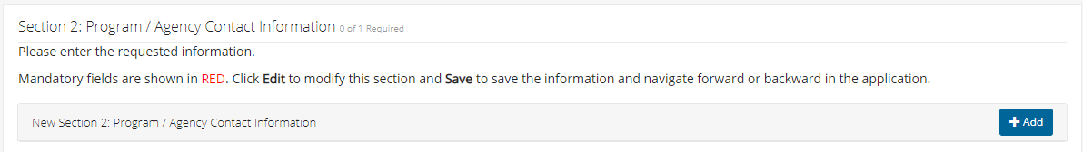
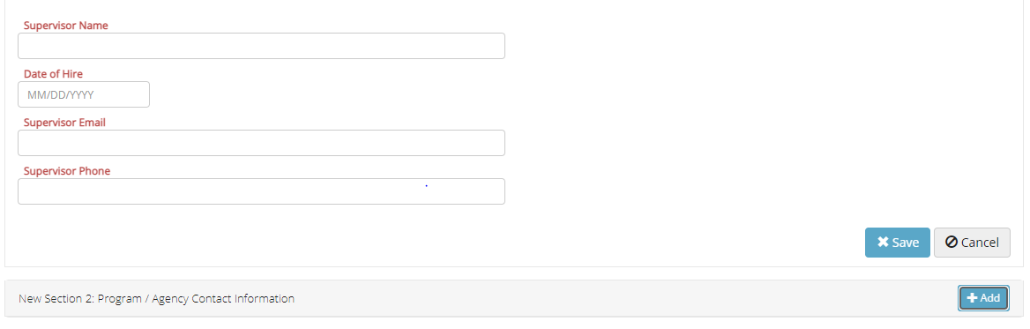
Program/Agency Information
Notes:
Use Timely Access if you do not open an episode
Use CSI Assessment if you do open the case

Slide 9
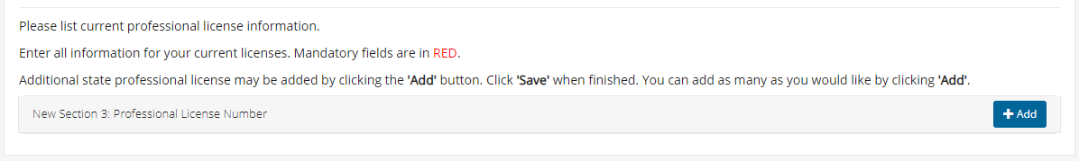
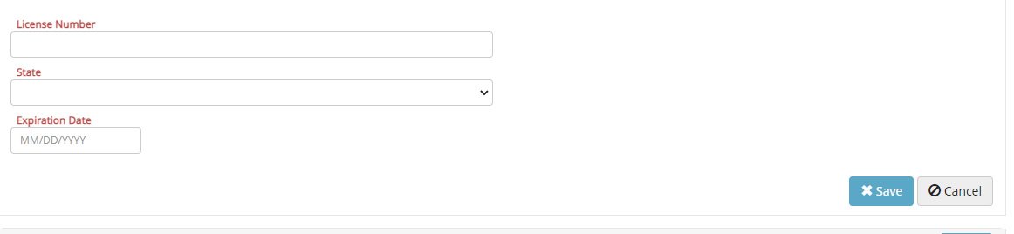
License/Registration Information
Notes:
Use Timely Access if you do not open an episode
Use CSI Assessment if you do open the case

Slide 10
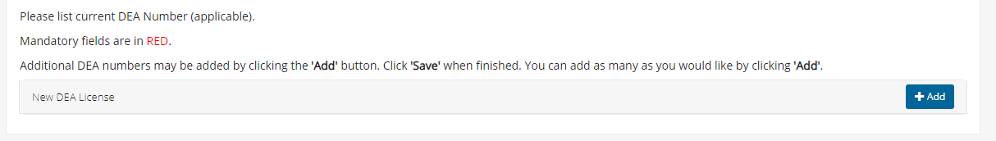
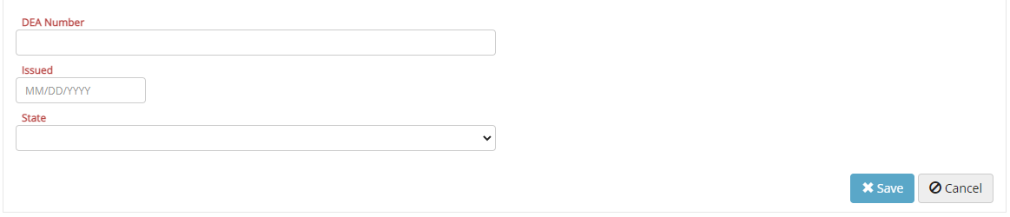
DEA Information
(MD and NP ONLY)

Slide 11
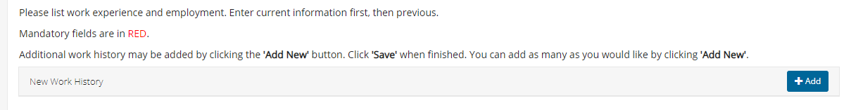
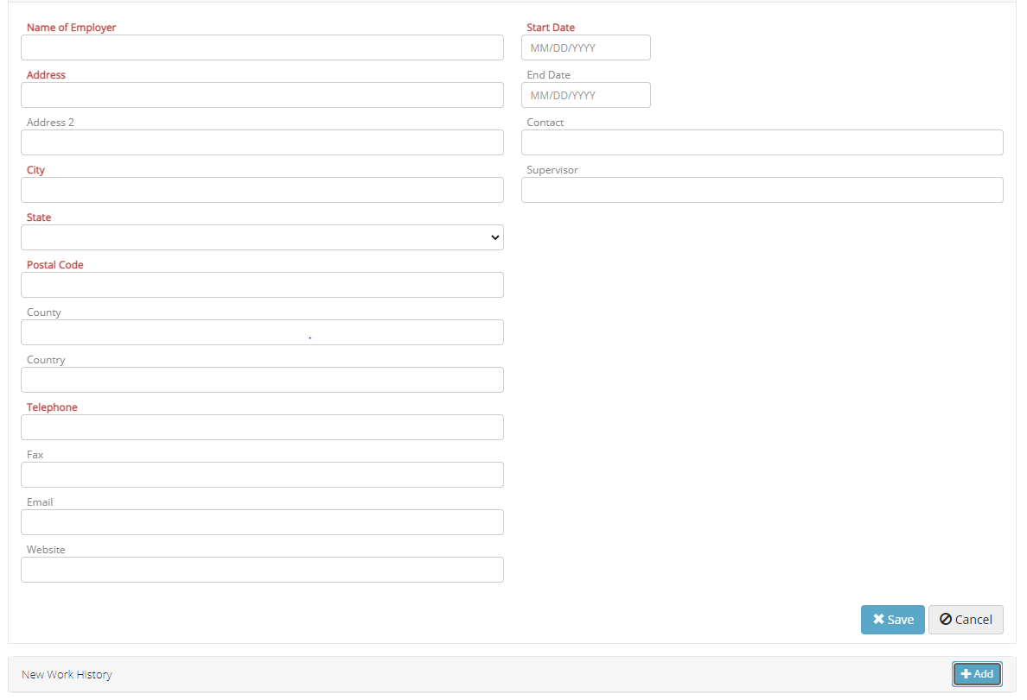
Employment Information
(LPHA’s Only)
Notes:
Use Timely Access if you do not open an episode
Use CSI Assessment if you do open the case

Slide 12
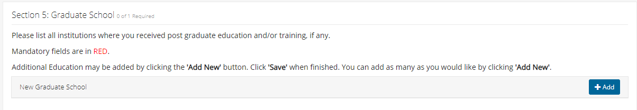
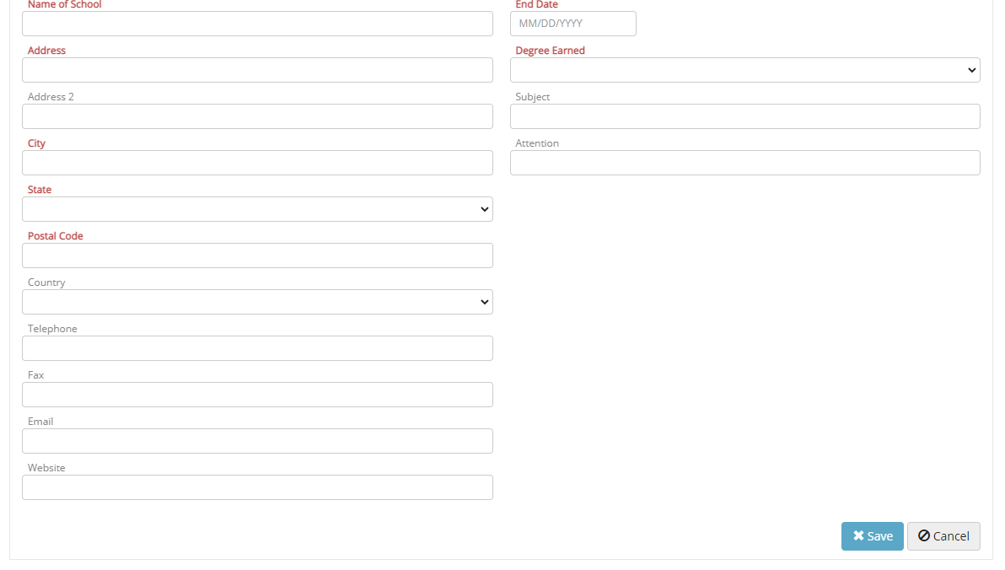
Education
(LPHA’s Only)
Notes:
Use Timely Access if you do not open an episode
Use CSI Assessment if you do open the case

Slide 13
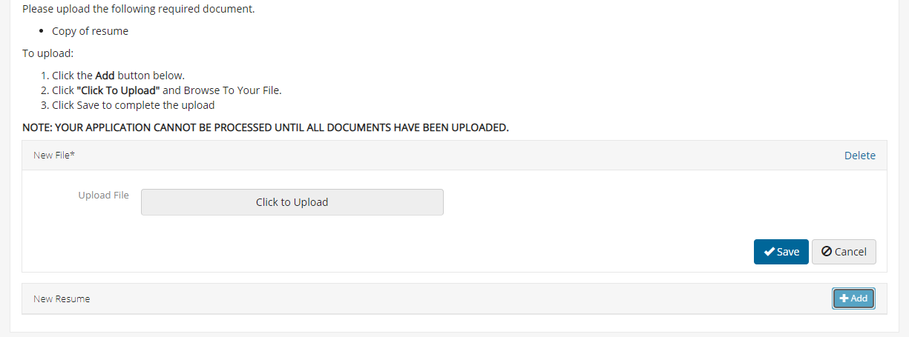
Upload Documents
Notes:
What do they enter as “expiration date”
What do they enter as “file description”
It needs a button to say “see file”

Slide 14
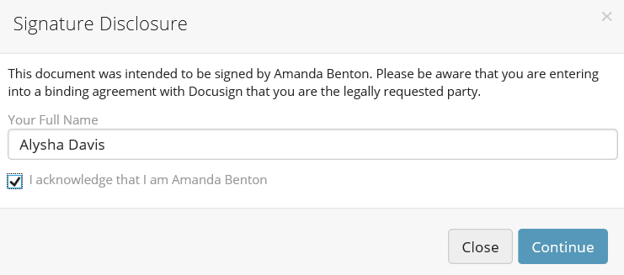
DocuSign

Slide 15
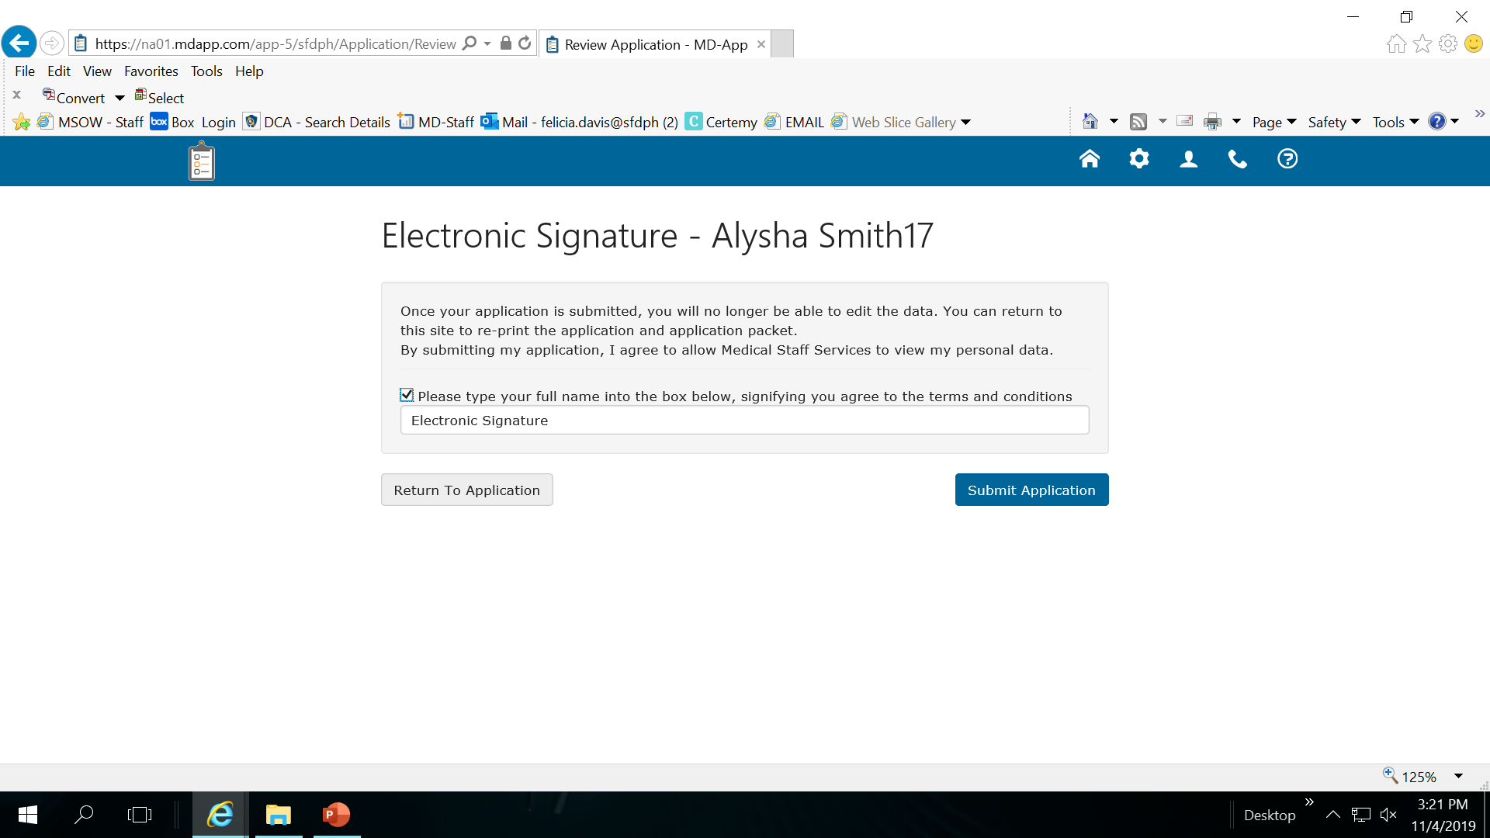
Si
Signature Page

Slide 16
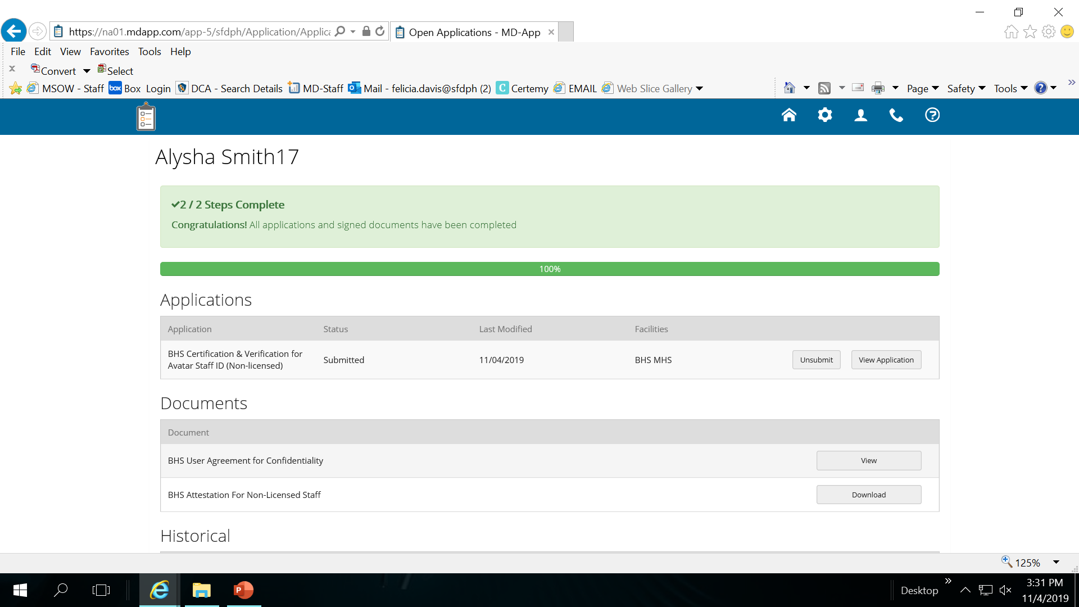
Application Completed

Slide 17
FAQs for MD-App
1) How do I login into MD-App?
You should of received an email with a link to create your password. If not, contact the facility you are applying to and they will resend the email.
2) How do I upload scanned documents or files?
When logged into MD-App / Edit Application there is a section called Files or Upload Files (or similar) on the navigation bar (left hand side). Click on that and you can begin to upload files.
3) How Do I Use DocuSign?
Go to the section called “Documents to Sign” on the application page. Click on the sign button and type in full name select the “I acknowledge checkbox”. Click CONTINUE to begin the signing process.
4) How do I submit my application?
After you enter and upload the proper information there will be a formal submission button on bottom of the application - click that to complete the submission process.
5) Why can’t I submit my application/Submit button won’t click?
Confirm all fields have been filled in look for red items in the menu on the left, etc.

