Slide 1
Justice-Involved Youth
Demographics and other Data stories for those engaged in behavioral health services
Ritchie Rubio PhD Farahnaz Farahmand PhD Mona Tahsini MFT Laura Moyé
Behavioral Health Services | Children, Youth, and Families System of Care
Close Juvenile Hall Full Working Group Meeting | October 21, 2020

Slide 2
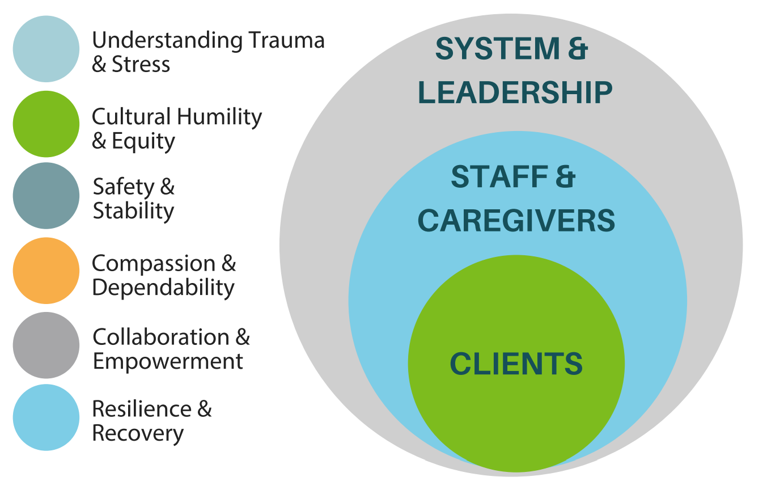
CYF Mission, Vision, & Values
Triple Aim
Racial Equity
Trauma Informed Systems
Reflective Leadership, Supervision, & Practice
Notes:
Farah/Chris
I wanted to start with the frame through which CYF strives to lead our work (including data analytic work).
As you know, trauma is a pervasive, long-lasting, public health issue that not only impacts the clients we serve but also affects our public health workforce and system. TIS promotes a paradigm shift in our organizational culture, to a create responsive relationships and a healing environment.
Racial equity is a deep dive on the “cultural humility and equity” principle of TIS with explicit focus on race. And for us it includes crucial conversations between staff and a race equity lens in terms of our system (such as hiring practices & access/engagement in clinical services).
& Reflective leadership promotes and supports the development of a relationship-based organization.
We apply this lens to an Equity and Organizational Healing Work Plan where we’ve done work for the last several years on: Respectful Culture (workforce) & Access & Engagement (client/family care)

Slide 3
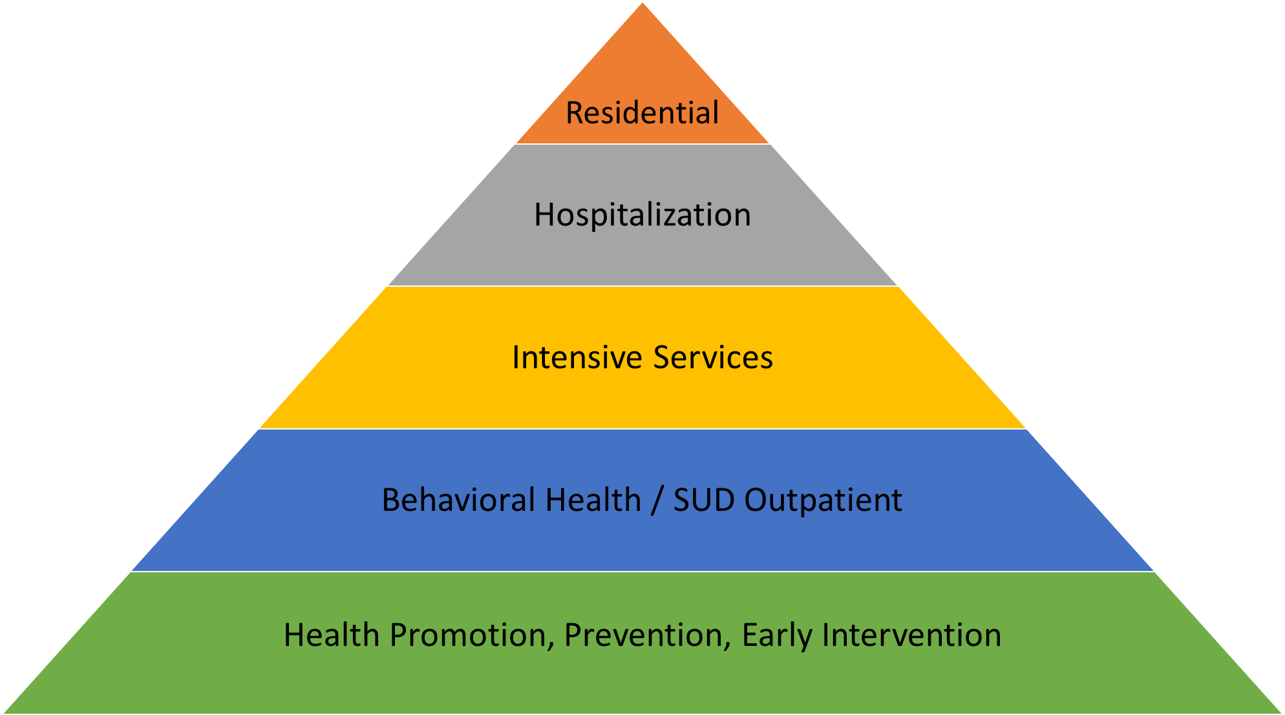
Children Youth & Families Services System of Care Overview
Self
Community Providers
Systems Providers, e.g. Schools, Juvenile Probation & Child Welfare
Primary Care
Level of Intensity
Points of Entries for Children, Youth & Families to Access System of Care
Notes:
Farah/Chris
You’ll see in the presentation today the integrated programming we have with the school district, child welfare, and juvenile justice systems. Many our youth access services through these partnerships. In addition, primary care is a big point of entry and folks also come through by self or community referral.
We have programs that span from prevention all the way through residential placements. Some examples of programming:
Health Promotion; Prevention; Early Intervention
ECMHCI; Wellness Centers-HS; PTI; SUD Prevention; FUERTE
Mental Health Outpatient & SUD Outpatient Services
Includes School-Based; ERMHS; SOAR
Intensive Services
Forensic (ISCS); CEEP; ISS, WRAP, ICC/IHBS, TBS; Linkage & Referral (FCMH, AIIM Higher)
Hospitalization
5585 through Comp Crisis; CSU; HD; 24/7 MRT
Residential Placements
Placements made by system partners (SFUSD, JPD, Child Welfare)
Note gaps/areas for growth (SUD treatment both outpatient & intensive services; Psychiatric hospitalization beds)
We also always strive for access and better understanding of how families can navigate our system. We are partnering on clinical research with UCSF to develop a system navigation function for our system

Slide 4
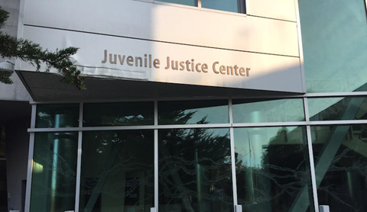
Juvenile Justice Services
Special Programs for Youth (SPY)
Structured interface between behavioral health service system and juvenile justice system
Intensive Supervision & Clinical Services (ISCS) Providers
AIIM Higher
Youth & Families involved in JJ System
WRAP Providers
TRACK
Outpatient Therapy Providers
FIRST
Notes:
Farah/Chris
Lots of focus on JPD services. We had representation on Mayor’s Blue Ribbon Panel and also have two staff two of the BOS Close Juvenile Hall Workgroups (Reinvestment & Mental Health). Goal is to ensure behavioral and medical needs of youth are met wherever that setting is after Dec 2021.
SPY is staffed by a multi-disciplinary team who is dedicated to providing trauma informed, culturally-relevant and accessible health services to all youth at JJC. SPY offers primary medical care, behavioral health services, dental care, and health education, as well as coordination of subspecialty services and screening for sexually transmitted infections (STI). Services are provided in accordance with Title 15 of the California Correctional Standards Authority for juvenile detainees.
AIIM Higher (Assess, Identify, Integrate, Match): range of services including consultation, referral, linkage assistance, and treatment.
WRAP is an intensive Care Coordinator and Case Manager model. Clinicians work to draw upon the strengths of individual, family, and community supports to address the needs of the youth. WRAP is a community based service.
FIRST is a family focused treatment service. Clinicians primarily provide family therapy and aim to improve family dynamics and strengthen the family’s ability to manage and support the youth’s behavioral and mental health needs. Clinicians can work with the youth in placement or within the community.
TRACK provides substance use and behavioral health treatment services for youth with co-occurring substance use and behavioral health needs. TRACK is a community and clinic based service.
Youth Transition Service helps youth transition to adulthood and build life skills. YTS focuses on educational, vocational, recreational, and legal domains, in addition to improving the overall well-being of the youth.
ART is a curriculum focused group intervention aimed at helping youth gain skills to better manage and cope with emotions related to anger. Sessions are at the Juvenile Justice Center.
Competency Attainment Program is a curriculum based individual intervention providing legal education for youth who have been determined incompetent by the court.
ISCS: The Intensive Supervision and Clinical Services Program combines the monitoring and structure of intensive supervision with an array of clinical services and evidence-based practices targeted to address critical needs and increase the strengths of youth, their families/caregivers. This combination of services has shown to be more effective for this population of youth than intensive supervision alone.
Clinical services offered by CYC, Instituto, YMCA Urban Services:
· Collaborative probation-therapeutic planning
· Comprehensive assessment
· 3 face to face weekly visits @ home, school or clinic-based
· Case management
· Individual, group, family therapy as needed
· Medication management
· Trauma-focused CBT

Slide 5
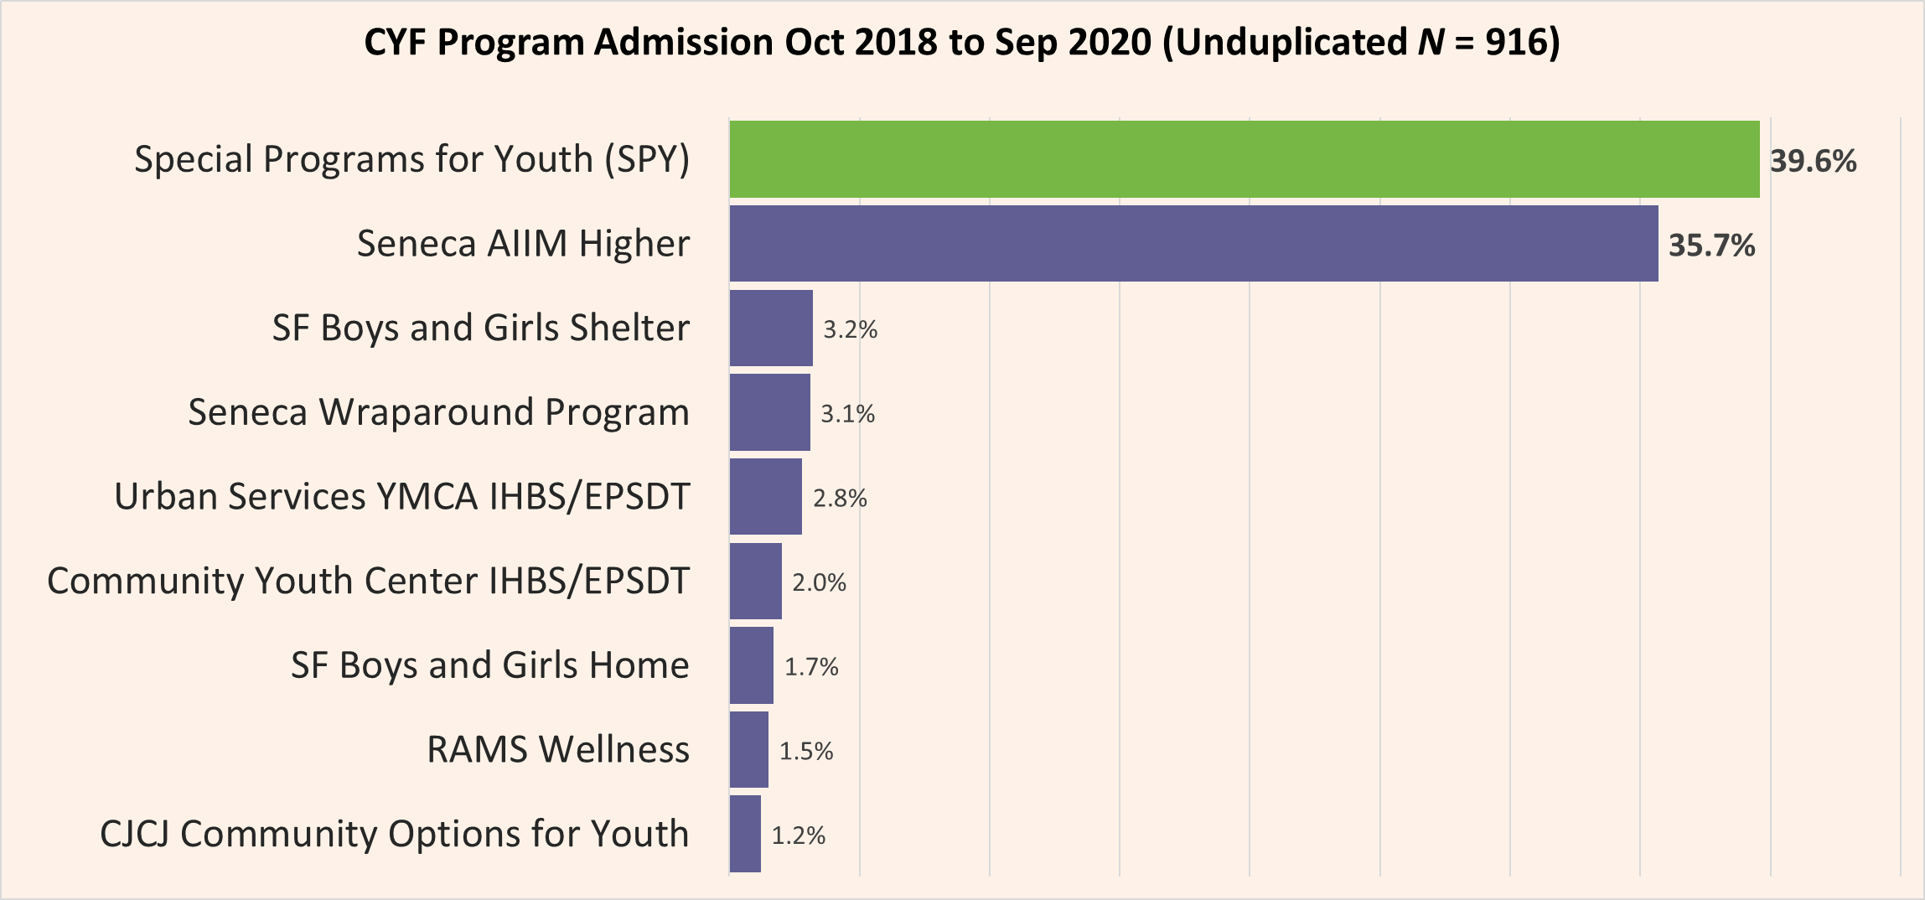
Where do Justice-Involved Youth receive Behavioral Health Services?
Note: Other programs with less than 1% include Alternative Family Services (AFS), Child and Adolescent Support Advocacy and Resource Center (CASARC), Chinatown Child Development Center (CCDC), CJCJ IHBS/EPSDT, Edgewood Residential, Edgewood Wrap, Family Mosaic Project, Foster Care Mental Health Services, Homeless Children’s Network Ma'at Program, Instituto Familiar dela Raza Families First, Semillas and ISCS, Occupational Therapy Training Program (OTTP-SF) ISCS and OP, Southeast Child and Family Therapy Center (SECFTC), Seneca Connections, Seneca DBT, Seneca YTS, St Vincent, St Vincent Wrap, Unity Care SF, and Urban Services YMCA
Notes:
Ritchie

Slide 6
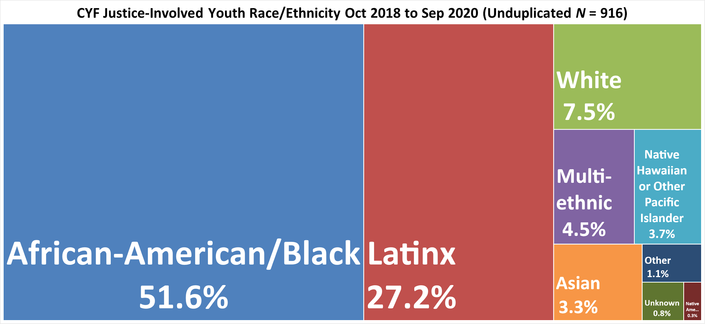
What’s the race/ethnicity of
CYF Justice-Involved youth?
Notes:
Ritchie

Slide 7
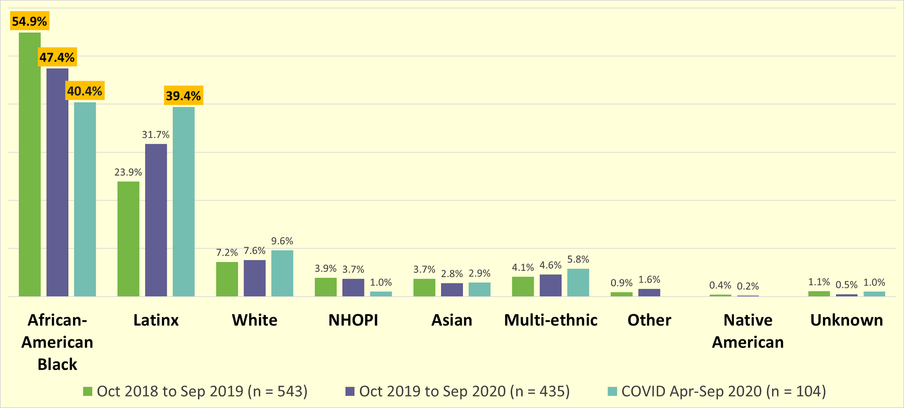
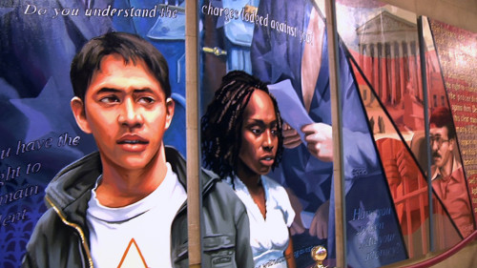
Has the race/ethnicity breakdown changed through time?
Notes:
Ritchie

Slide 8
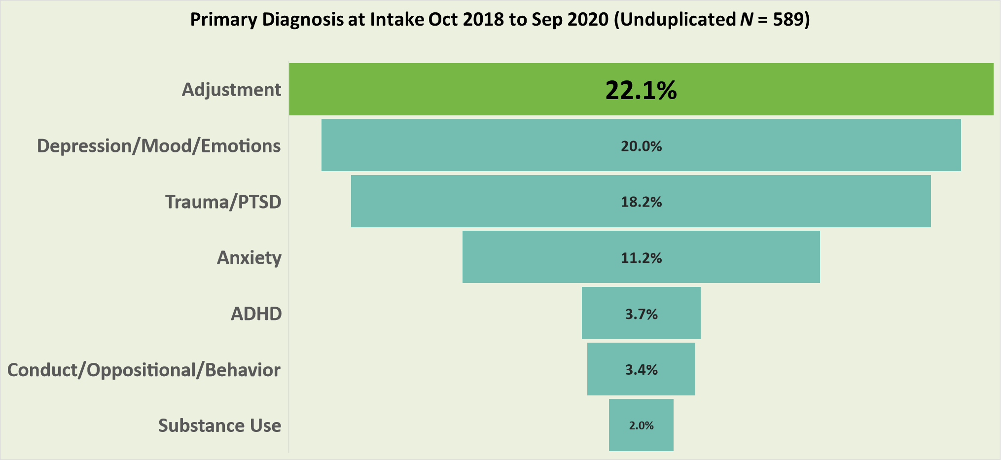
What are the behavioral health needs of Justice-Involved youth?
Notes:
Not included are most of AIIM Higher clients not in Avatar.
Chart does not include diagnosis with lesser frequency (e.g. eating disorders, sleep disorders, schizophrenia)
Notes:
Ritchie

Slide 9
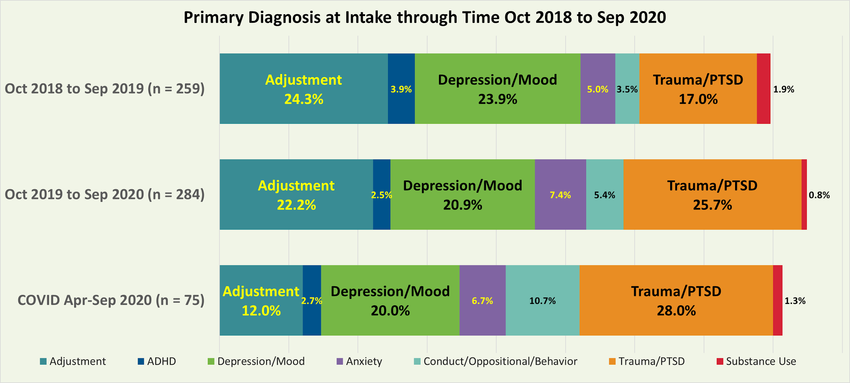
What are the behavioral health needs of Justice-Involved youth?
Notes:
Ritchie

Slide 10
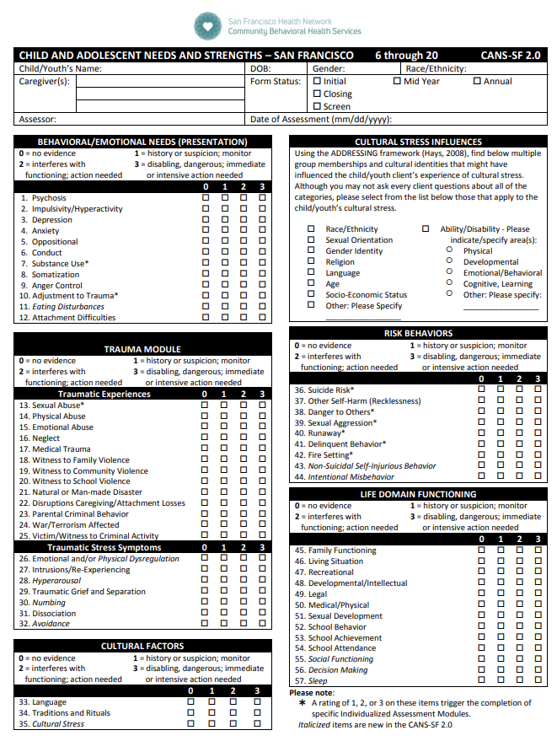
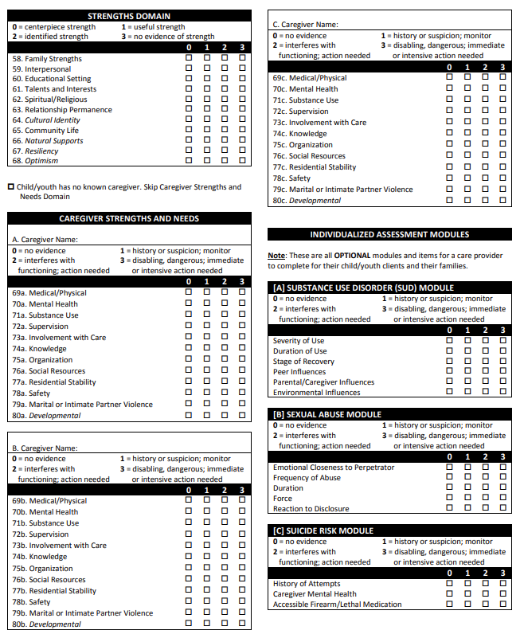
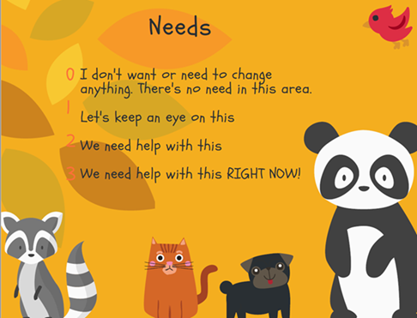
The Child and Adolescent Needs and Strengths (CANS) Assessment Tool
Notes:
Ritchie

Slide 11
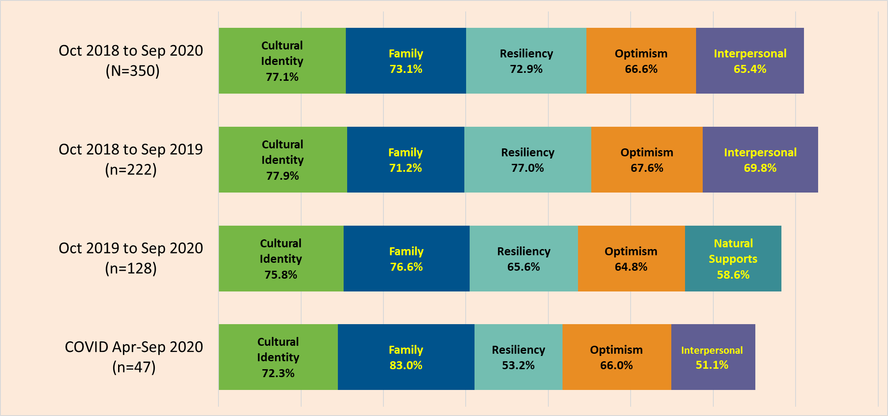
What are the top 5 CANS Strengths of Justice-Involved youth?
Note: % is the proportion of clients who have a useful or centerpiece strength
Notes:
Ritchie

Slide 12
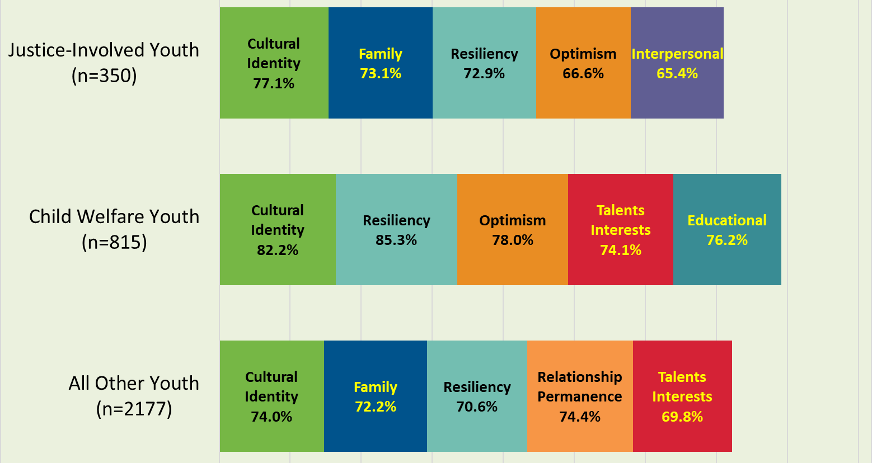
What are the CANS Strengths of Justice-Involved youth compared to other youth?
Family and Interpersonal Strengths are prominent
Notes:
% is the proportion of clients who have a useful or centerpiece strength
Only includes Initial and/or Screenings assessments. Total CANS assessments for these 2 years = 10, 451.
Notes:
Ritchie

Slide 13
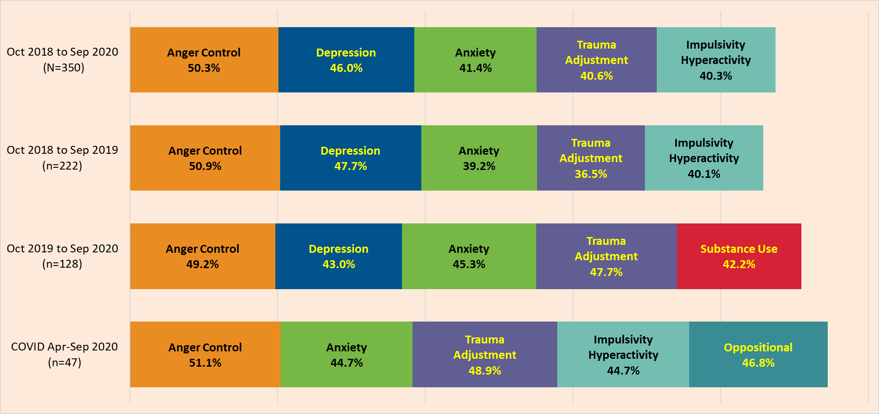
What are the top 5 CANS Needs of Justice-Involved youth?
Note: % is the proportion of clients who need intervention or intensive action
Notes:
Ritchie

Slide 14
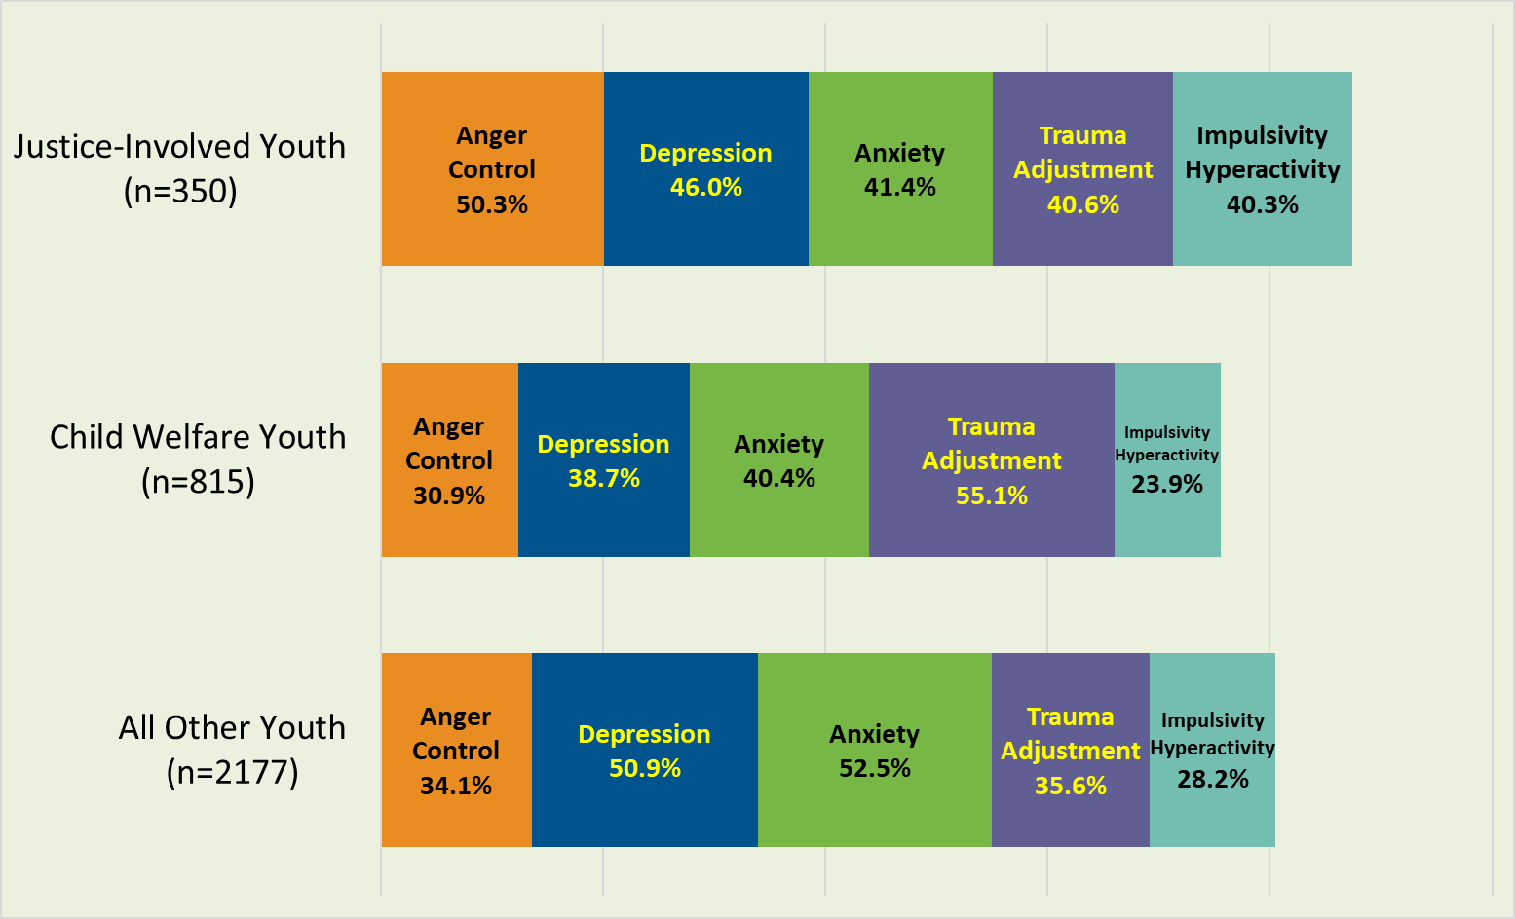
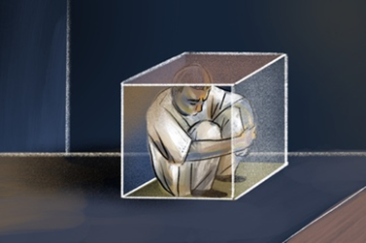
What are the CANS Needs of Justice-Involved youth compared to other youth?
Anger Control and Impulsivity Hyperactivity are prevalent needs
Note: % is the proportion of clients who need intervention or intensive action
Notes:
Ritchie

Slide 15
Client’s mother reports that he witnessed domestic violence when he was younger and was removed from the home by CPS at the age of one. Mother states youth experienced abuse while in the foster care system such as having hot sauce put on his tongue and having food withheld. Client denies having memories of any early trauma. Both client and his mother confirm having witnessed community violence. She reports that the family was robbed at gun point once and client reports witnessing shootings in the community many times.

Slide 16
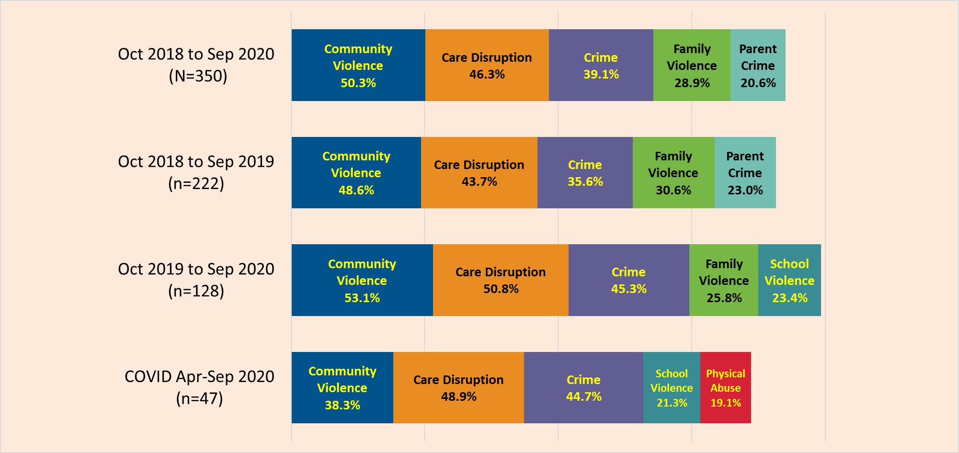
What are the Top 5 ACEs or Trauma Experiences of Justice-Involved youth?
Note: % is the proportion of clients who have experienced multiple, chronic, repeated, ongoing, and/or severe trauma.
Notes:
Ritchie

Slide 17
Client witnessed domestic violence in early childhood, observing his father being physically and emotionally abusive towards his mother. Client's father has also physically abused him. There was a period of homelessness due to his mother's substance abuse and her being incarcerated briefly. Client also reported that his mother physically hit him and his brother. Client’s father was incarcerated for most of his childhood. Client has witnessed many incidents of community violence and clearly recalls finding a friend dead after being shot. He has also lost many other friends and family due to gang related or community violence throughout his life. Client and his family experienced homelessness during which client became involved with the juvenile probation department.

Slide 18
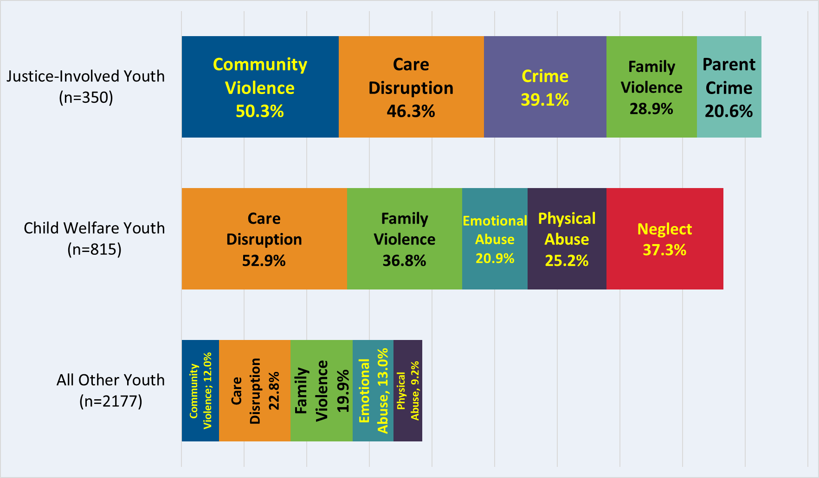
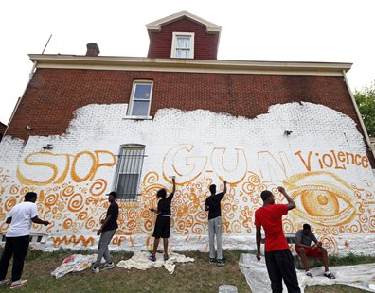
What are the ACEs of Justice-Involved youth compared to other youth?
Likelihood of Complex Trauma is higher than other youth
Note: % is the proportion of clients who have experienced multiple, chronic, repeated, ongoing, and/or severe trauma.
Notes:
Ritchie

Slide 19
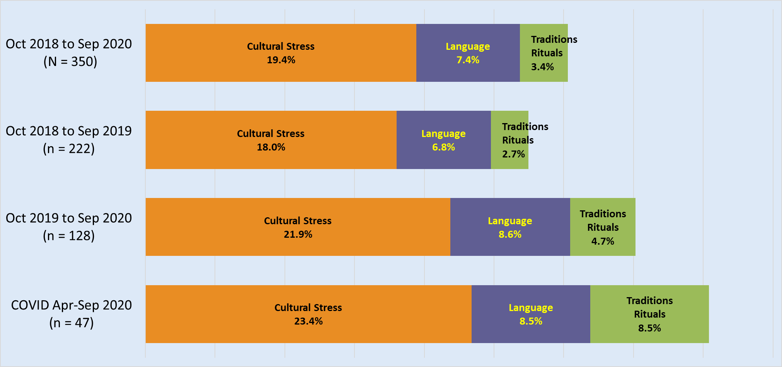
What are the Cultural Needs of
CYF Justice-Involved youth?
Note: % is the proportion of clients who need intervention or intensive action
Notes:
Ritchie

Slide 20
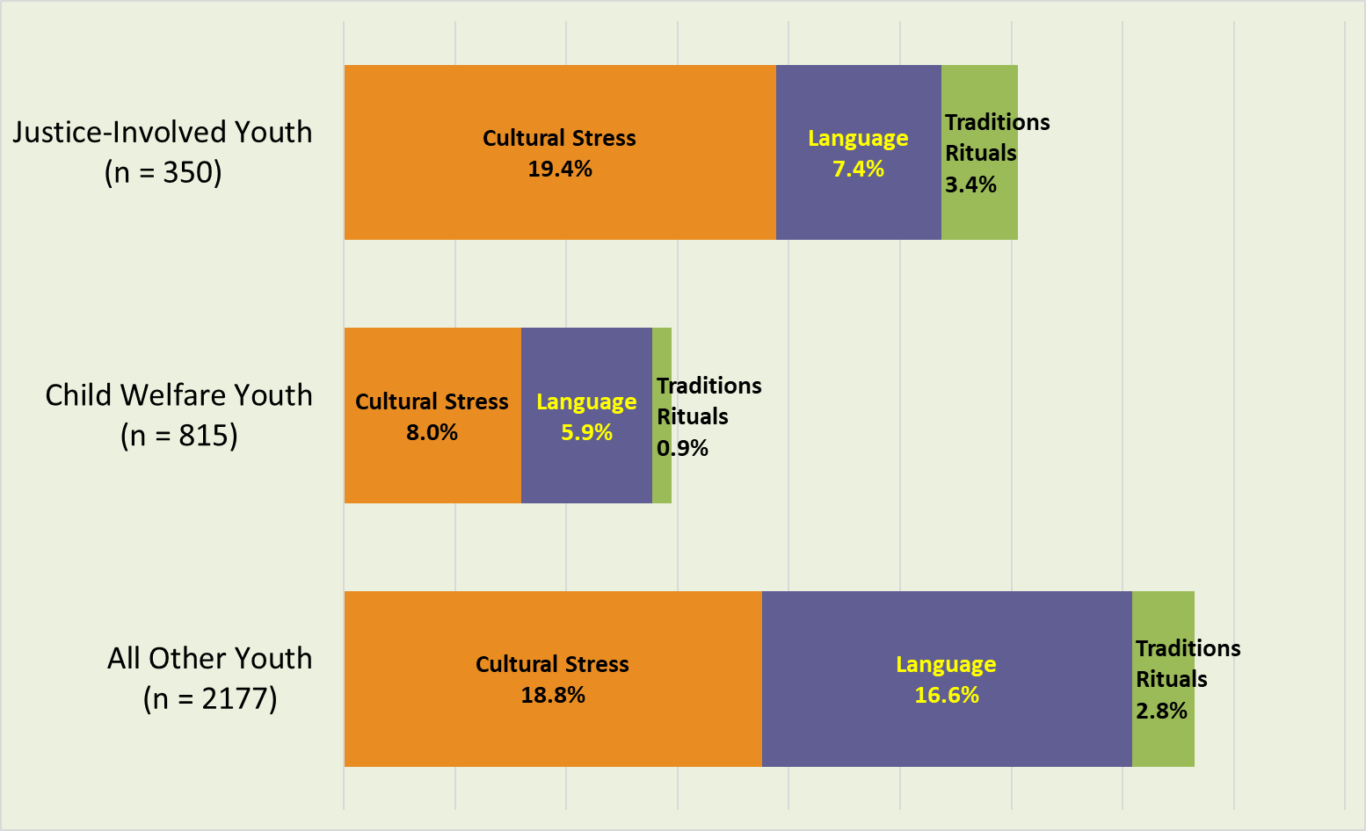
What Cultural Needs do Justice-Involved youth have compared to other youth?
Experience cultural stress slightly higher than other youth
Note: % is the proportion of clients who need intervention or intensive action
Notes:
Ritchie

Slide 21
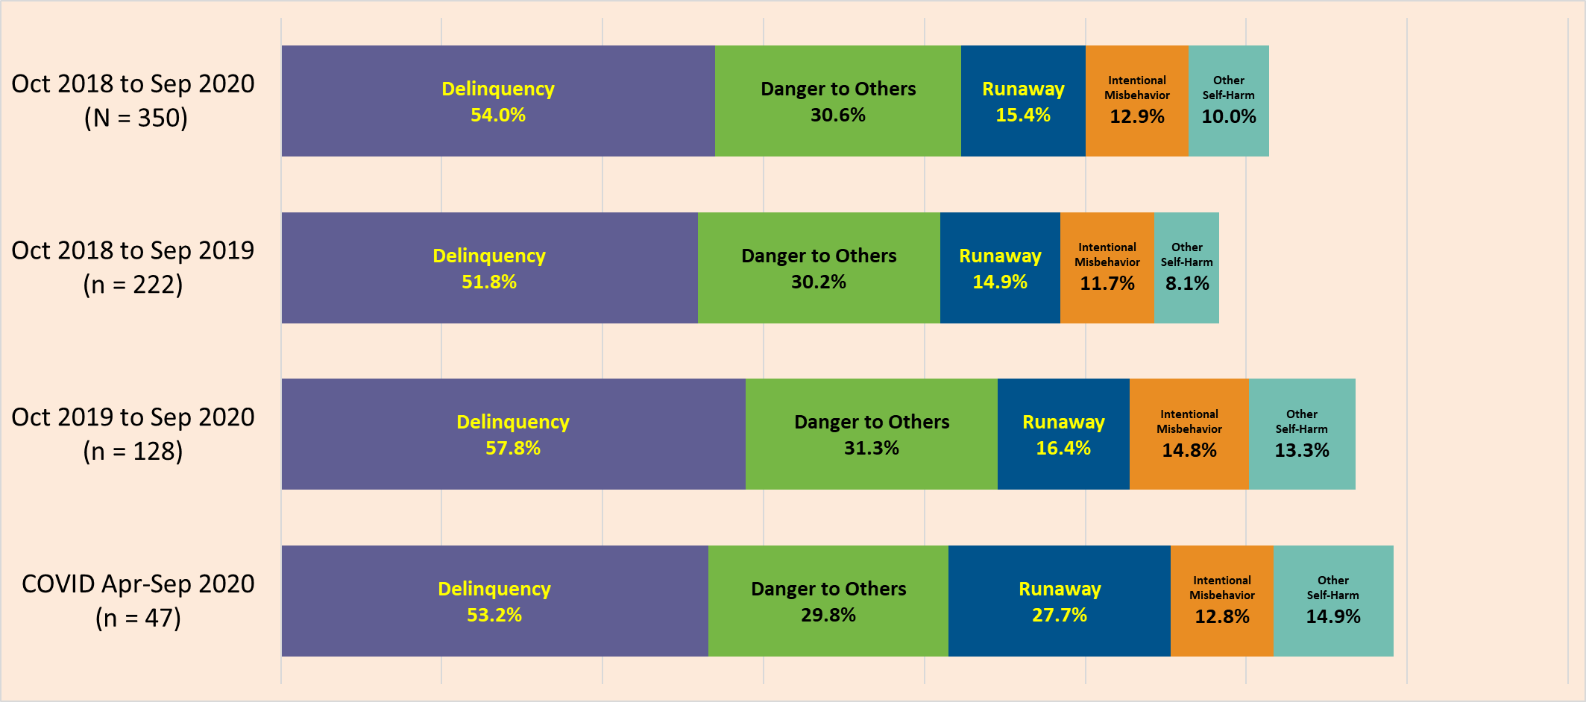
What are the Top 5 Risk Behaviors of Justice-Involved youth?
Note: % is the proportion of clients who need intervention or intensive action
Notes:
Ritchie

Slide 22
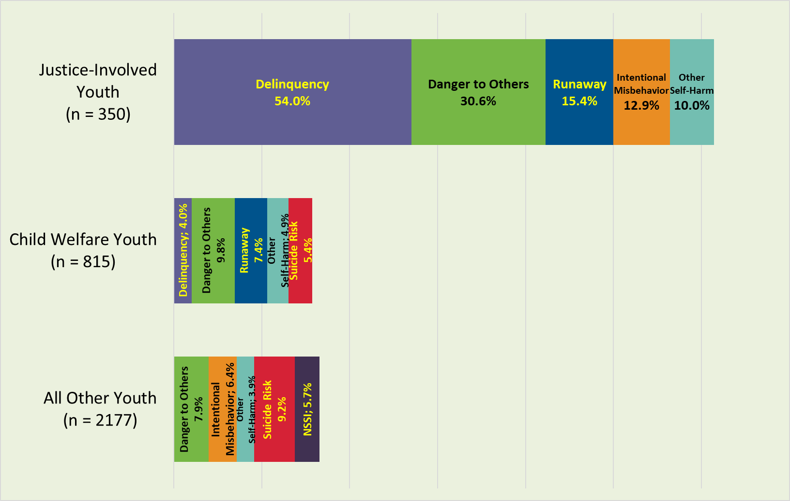
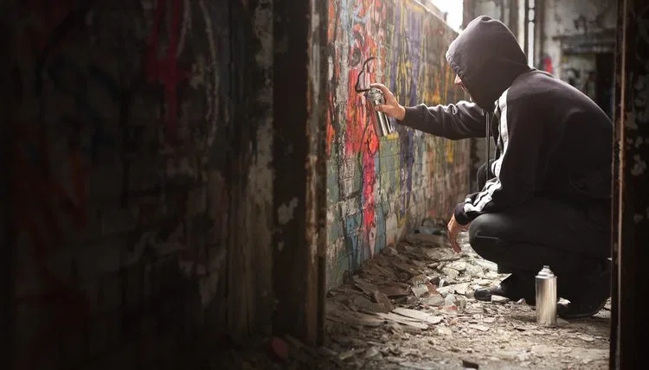
What are the Risk Behaviors of Justice-Involved youth compared to other youth?
Risk behaviors needing intervention are higher than other groups
Note: % is the proportion of clients who need intervention or intensive action
Notes:
Ritchie

Slide 23
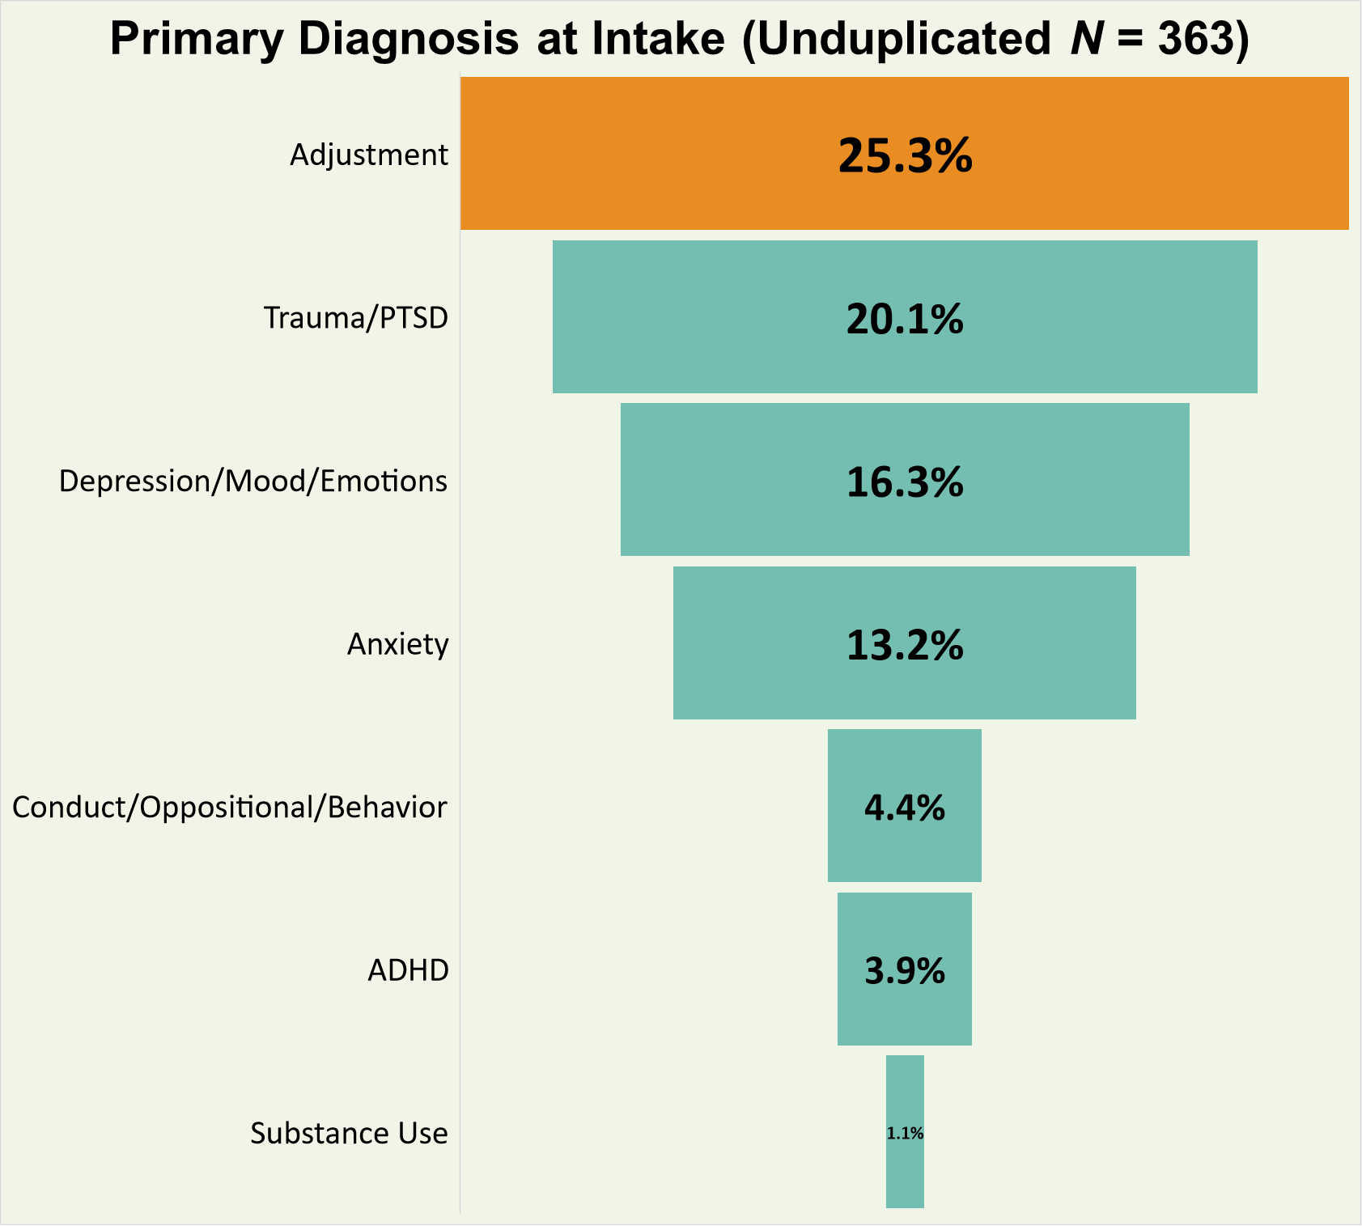
Special Programs for Youth (SPY)
A two-year snapshot
(Oct 2018 to Sep 2020)
500 = Number of Episodes Opened in Avatar (BHS electronic health record)
363 = Number of Unduplicated clients
353 in-custody clients involved in the Youth Guidance Center (YGC)
10 out-of-custody clients involved in outpatient CAP and JSR
Race/Ethnicity: 53% Black/African-American, 28% Latinx, 9% White
Notes:
Ritchie/Mona

Slide 24
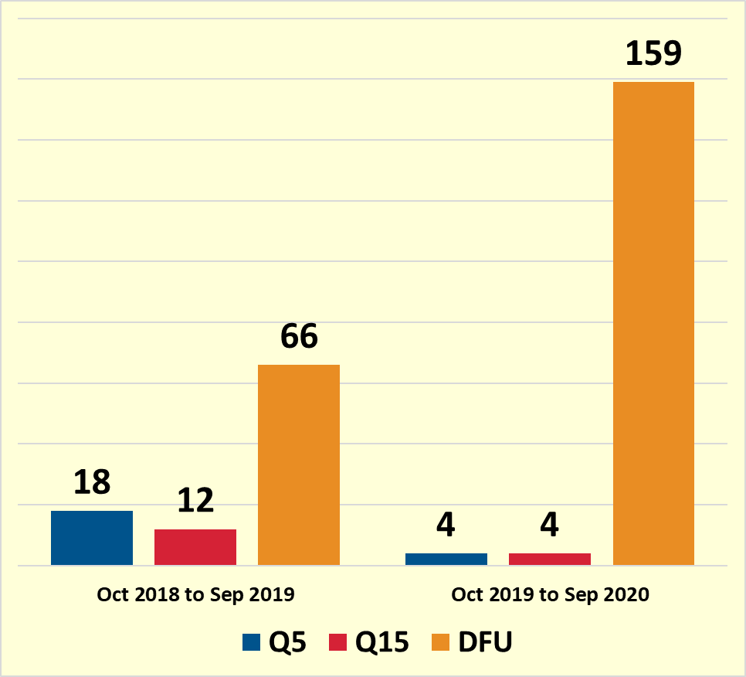
Special Programs for Youth (SPY)
Safety Watches (Oct 2018 to Sep 2020)
Daily Follow Up (DFU)
Youth who are experiencing distress and would benefit from daily BH support may be placed on daily follow up and receive daily BH contact 1 to 2 times a day.
Q15 (High Acuity Watch)
Youth is placed on Q15 to alert unit staff that youth has acute behavioral health needs and would benefit from increased supervision/support.
Youth placed on Q15 receive BH support 2x’s daily.
Q5 Watch (Safety Watch)
Can be initiated by BH staff for suicidality, danger to self or others, agitation, unusual behavior or other acute medical/behavioral health needs.
Detention staff must check on youth every 5 minutes, even when sleeping.
Youth is assessed at a minimum twice daily by BH staff and a Safety Plan is developed/updated daily.
Notes:
Ritchie/Mona

Slide 25
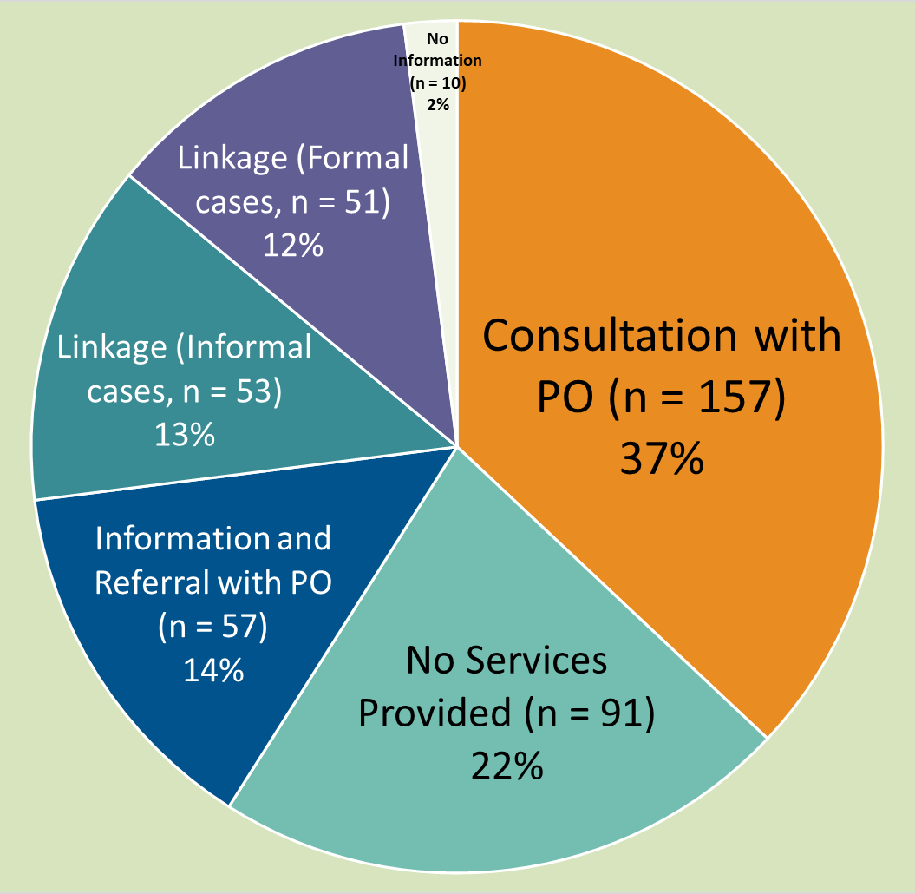
AIIM Higher (Assess, Identify Needs, Integrate Information, and Match to Services)
A two-year snapshot
(Oct 2018 to Sep 2020)
419 = Number of Episodes Opened in DCAR (Data Collection, Analysis, and Reporting) database. See pie chart for proportion of services provided.
327 = Number of Unduplicated clients
Race/Ethnicity:
54% Black/African-American,
26% Latinx, 6% Multi-Ethnic
Notes:
Ritchie
Consultation
The triage clinician meets with the assigned probation officer to provide CAT information, and consult and make suggestions for linkages.
For example: MDT or when AIIM talks with a current provider to determine if the current service is appropriate. Linkage clinicians often provide consultation to PO’s regarding services.
Info and Referral
After the consultation with the PO, the triage clinician offers the recommended service to the PO, and provides the information to the PO to move forward with their own linking of that youth
For example: Clinicians helping the PO fill out a MAST referral or providing the PO with the name of an agency and a referral form for a Tier 1 service.
Linkage (Informal cases ONLY)
Utilizing the CAT and consultation, the triage clinician offers the recommended service to the PO and then facilitates that linkage by doing the legwork of completing the referral, proving information to the subsequent provider, and gathering information from the provider regarding face to face contacts
For example: direct referral to ISCS where AIIM is tracking 3 face to face
APLE (Formal open cases)
A CANS Screen is completed. After the CANS is completed, the Clinician makes the appropriate referral and then fills out the Linkages Form to document 3 face to face contacts.
None- Youth is eligible but no services are provided.

Slide 26
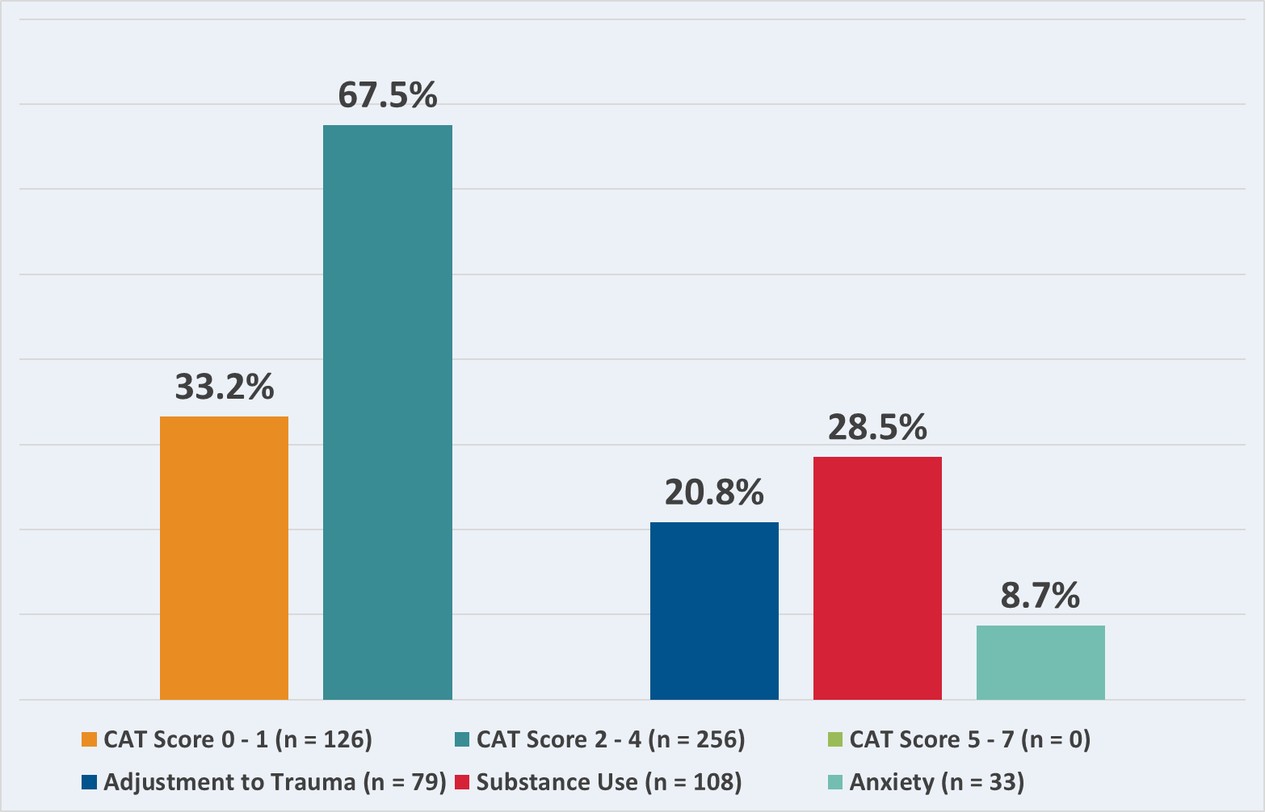
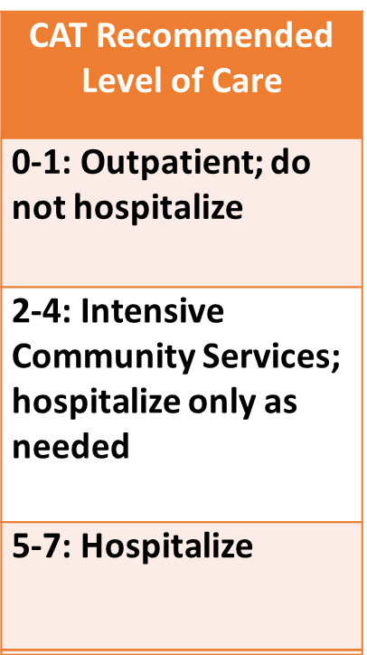
AIIM Higher Client Behavioral Health Needs Crisis Assessment Tool (CAT)
N = 379 Oct 2018 to Sep 2020, Data from DCAR

Slide 27
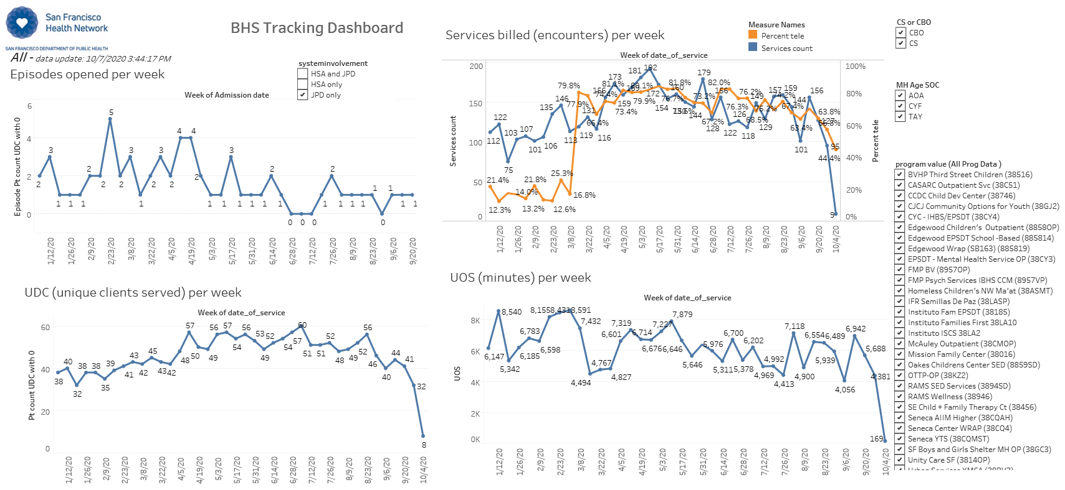
Access and Engagement of Justice-Involved Youth during the COVID-19 Crisis
Tableau Dashboards were created by
Dr. Tom Bleecker, Assistant Director of our BHS Research and Evaluation Unit, in collaboration with our IT department
Notes:
Ritchie

Slide 28
Justice-Involved Youth
Episodes Opened
First 3 months after SIP
6% drop
Next 3 months after SIP
64% drop
Notes:
Ritchie

Slide 29
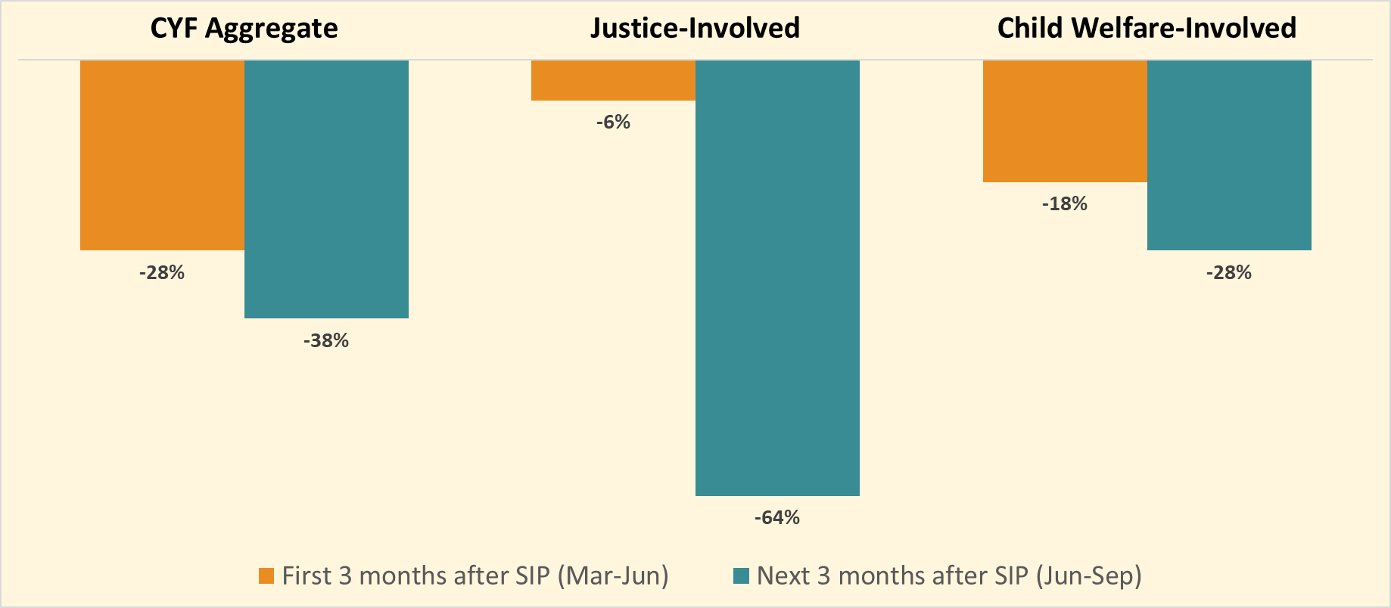
Episodes Opened Comparison
Notes:
Ritchie

Slide 30
Justice-Involved Youth Encounters (Services Billed)
First 3 months after SIP
29% increase
Next 3 months after SIP
20% increase
Notes:
Ritchie

Slide 31
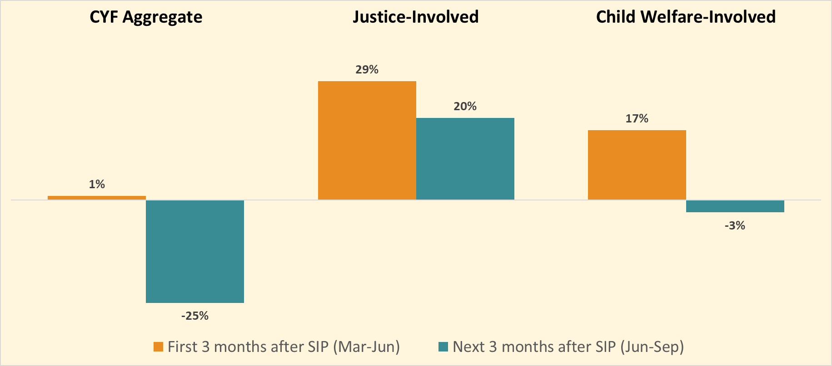
Encounters Comparison
Notes:
Ritchie

Slide 32
Justice-Involved Youth
Units of Service (UoS, in minutes)
First 3 months after SIP
13% drop
Next 3 months after SIP
19% drop
Notes:
Ritchie

Slide 33
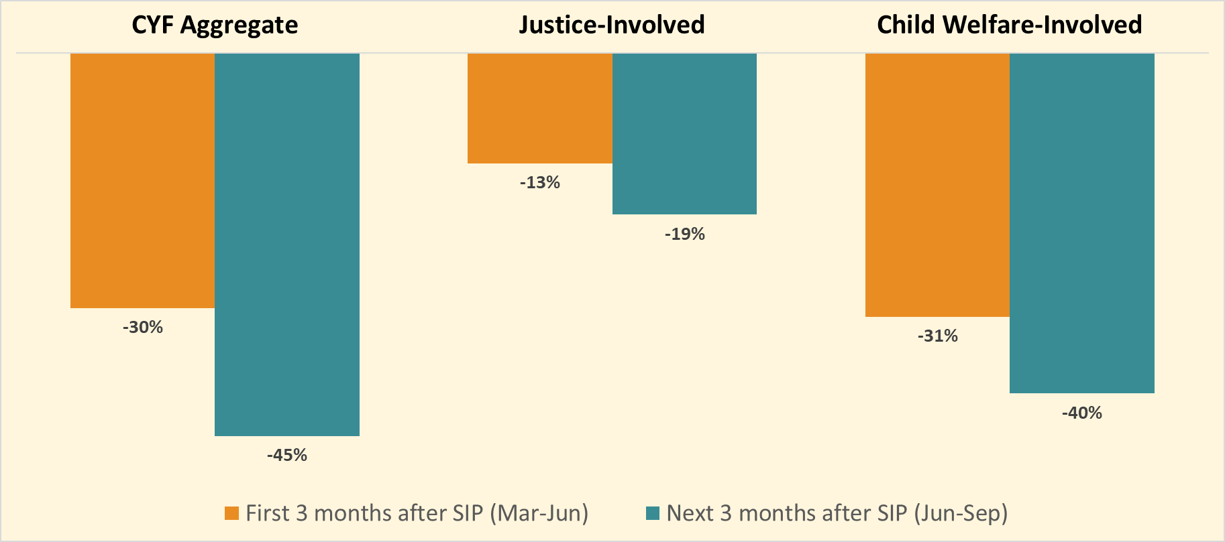
Units of Service Comparison
Notes:
Ritchie

Slide 34
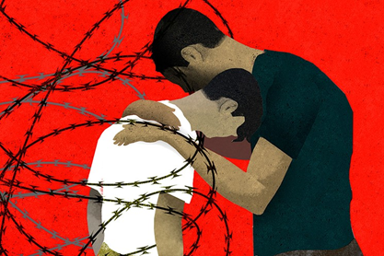
Implications of Data Stories
Programs that respond to the behavioral health needs of justice-involved youth should:
Integrate strengths of cultural identity and family in interventions.
Integrate a trauma-informed lens in choosing interventions and evidence-based practices
Integrate race equity and cultural issues in working with primarily Black/African-American, and Latinx youth and their families
Notes:
Ritchie

