Slide 1
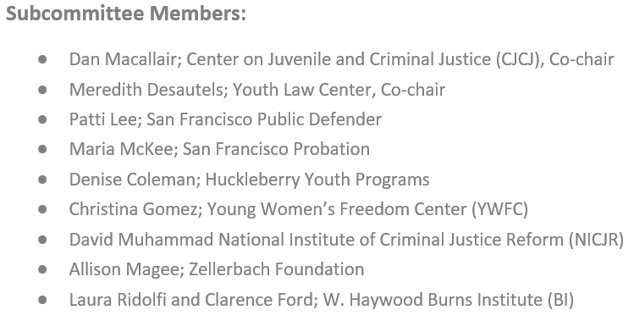
Data and Needs Assessment Report #1: Juvenile Hall Overview
Submitted June 2020 Brief Overview: CJHWG Meeting July 15, 2020

Slide 2
Data and Needs Assessment Subcommittee Assignment from CJHWG
Assignment →
Population profile over the last 6-12 months that enumerates the numbers, including but not limited to youth detained for 707b offenses, specific offenses, gender identity, race/ethnicity, age and zip code.
Report Content →
San Francisco Juvenile Hall Population Profile .
Majority of Youth are Detained for Technical Violations, Warrants and Non-Violent Offenses
Greatest Proportion of Detention for “Technical Violations or Warrants” are “Warrant 602”
Despite Numeric Reductions, Significant Racial and Ethnic Disparity Persists
Population Breakdowns: Gender; Age; Residence Zip Code
San Francisco Juvenile Hall Annual Trends .
Major Decrease in Incarcerated Youth
Despite Significant Reductions in Detention Rates, Racial and Ethnic Disparities are Increasing
Odds of Detention in Juvenile Hall, Once Referred to Probation, are Increasing
Proportionally, Youth Detained for Less Serious Reasons, Has Increased
Costs of Incarceration per Youth Increasing

Slide 3
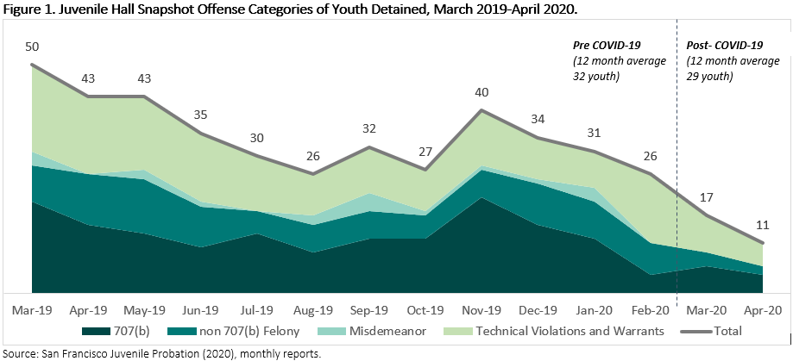
Majority of Youth are Detained for Technical Violations, Warrants and Non-Violent Offenses
On average, youth with warrants or accused of technical violations, misdemeanors or non-violent felonies account for 63 percent of youth detained.
Notes:
Policies and practices instituted in response to the COVID-19 pandemic have affected the number of youth in juvenile hall in recent months, but prior to COVID-19, the number of youth detained in juvenile hall was already declining. The average number of youth in juvenile hall during the twelve months prior to COVID-19 was 32 youth. On average, youth with warrants or accused of technical violations, misdemeanors or non-violent felonies account for 63 percent of youth detained. Youth accused of crimes listed in Welfare and Institutions Code (W.I.C.) 707(b) account for 37 percent of youth detained (an average of 12 youth in the 12 months prior to COVID-19).
Law requires that probation hold a youth in custody prior judicial review if the youth is fourteen years of age and has been accused of an offense listed in Welfare and Institutions Code (W.I.C.) 707(b).

Slide 4
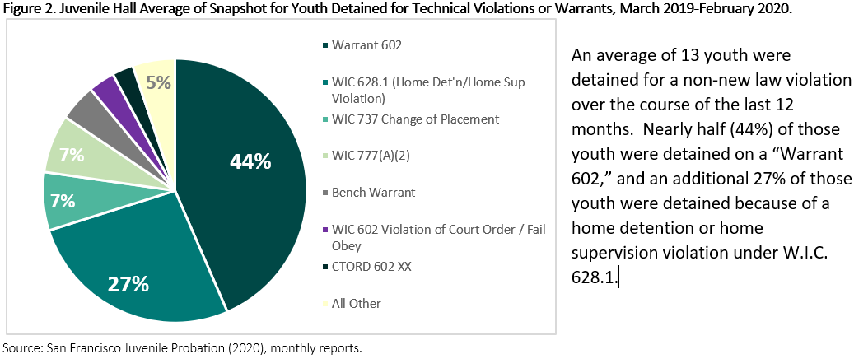
Greatest Proportion of Detention for “Technical Violations or Warrants” are “Warrant 602”

Slide 5
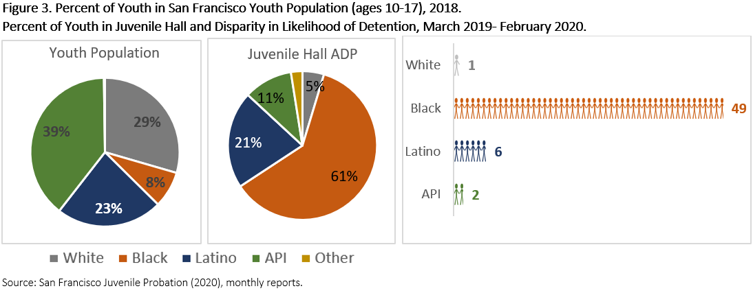
Despite Numeric Reductions, Significant Racial and Ethnic Disparity Persists

Slide 6
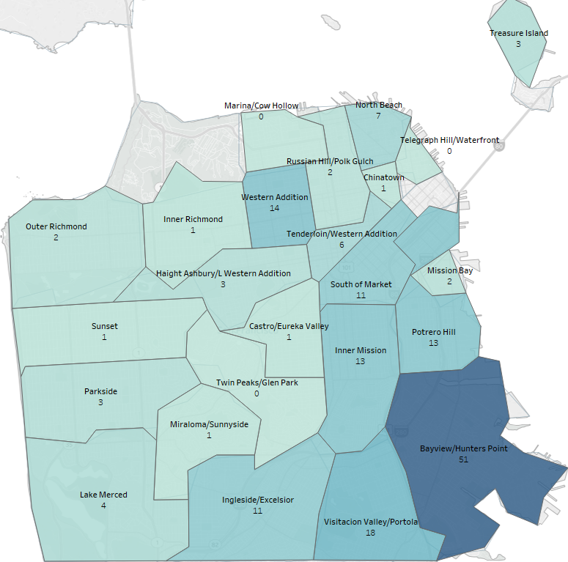
Residence Zip Code
Figure 6. Resident Zip Codes of Youth Booked into Juvenile Hall, 2019.
In 2019:
More than 1/3 of youth booked into Juvenile Hall were not San Francisco residents or had unavailable zip code information.
For youth in San Francisco, top zip codes are:
94124 (Bayview /Hunter’s Point)
94134 (Visitacion Valley/Portola)
94110 (Inner Mission)

