Slide 1
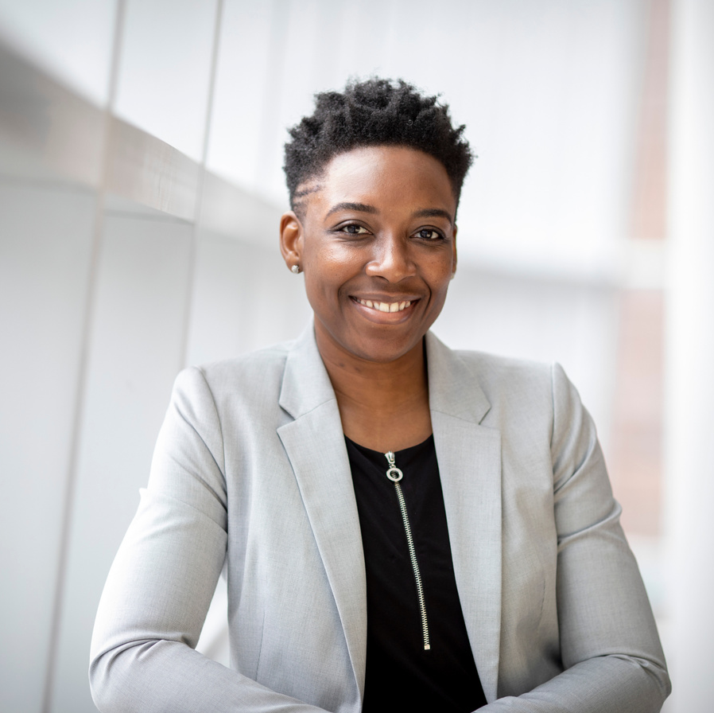



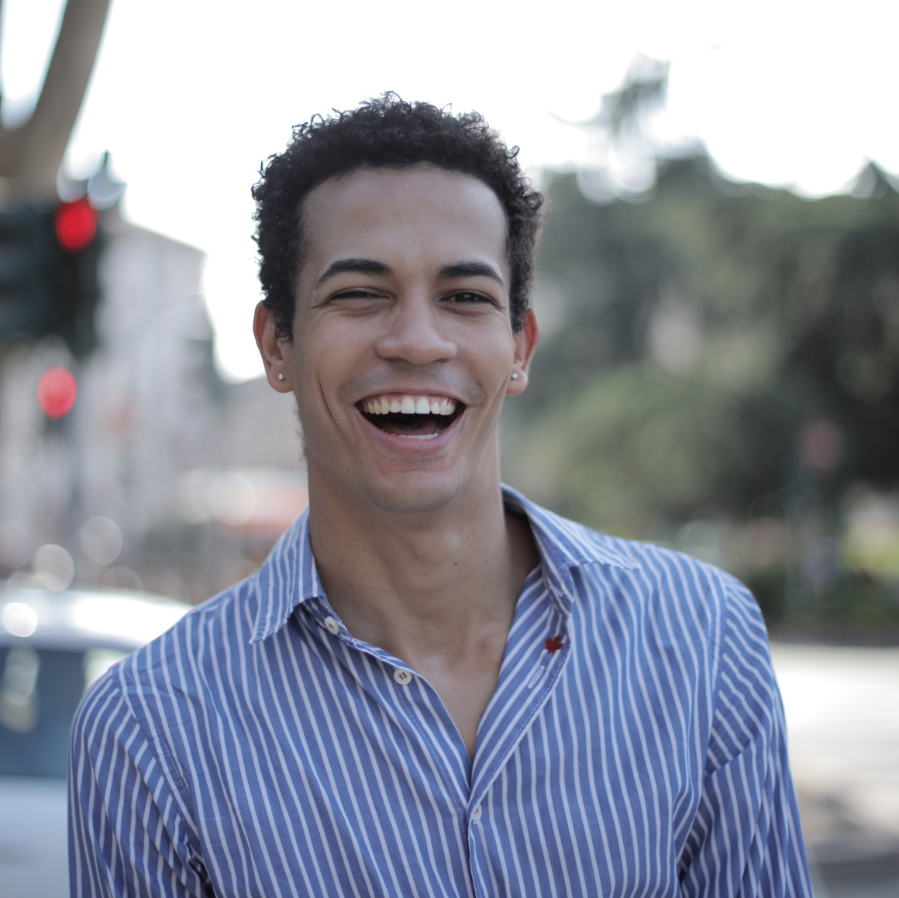



SAN FRANCISCO DEPARTMENT OF PUBLIC HEALTH
ANTI-RACISM, EQUITABLE, & INCLUSIVE LEADERS FELLOWSHIP
SPONSORED BY THE OFFICE OF
HEALTH EQUITY – WORKFORCE
EQUITY STRATEGIES
AND PROGRAMS

Slide 2

Program Review
The Health & Racial Equity Fellowship
is a 5-month cohort-based learning community.
This program is designed to support leaders with more than 5 years of management experience – who are committed to and want to learn what it means to create anti-racism organizational change. This is an advanced leadership program that will provide hands-on support in the implementation of the Department of Public Health's Racial Equity Action Plan (a requirement of the Racial Equity Ordinance). Participants should have some knowledge of the concepts of equity, racial equity, race, racism, anti-racism, color, and colorism; as well as demonstrated awareness and willingness to learn about advancing equity, anti-racism, and inclusion at SFDPH. The program will provide a comprehensive set of skills, tools, action-items, and best practices that leaders will utilize throughout the program and beyond.

Slide 3
Examine racial sanctioning rooted in colorism
Identify and understand racism
Create and enhance anti-racist, and equitable processes
Program
Objectives
as a psychological, sociological, legal, and cultural as the main property and function of government/governance.
and the reasons racism was established and embedded into the legal, institutional, social, economic, and hierarchical fabric of U.S. culture.
policies, and programs to lead actionably and effectively.
Build skills to combat explicit and implicit biases
Highlight racial inequalities
Focus on inclusivity and enhanced support
Develop anti-racist strategies
and inequities through the realm of anti-Blackness, the experiences of non-White people, and White people, to examine the ways in which racial power and privilege, as well as racial powerlessness and dis-privilege, impact the humanity of all individuals in a racialized society.
and practices at both the individual and organizational levels.
stemming from racist perceptions, stigmas, and stereotypes to develop empathy for people who have different backgrounds and experiences.
of Black, Indigenous, Latinx, Asian-Pacific Islander, and people from impacted groups referred to as People of Color (BIPOC).

Slide 4



Certification
Performance Review
Those who complete the program will be awarded a certification, also placed in their employee file.
Completing the program will be positively reflected in each fellows' performance review!
Program
Benefits
Advise, Educate, Implement
Fellows will be qualified to support and make changes that advances the work of their area toward anti-racism, equity, and inclusion.

Slide 5
Fellowship Structure & Curriculum
Phase 1: June & July
Phase 2: August – October
June-July
August
September
October
  Understanding & Addressing the Roots and Forms of Racism, Bias, Power, and Privilege
  Anti-Racism and Equity in Organizational Change (AEOC) Overview
  Workforce Data Review, Strategic Planning, Implementation and Application
  AEOC Strategy and Program Implementation
  AEOC Leaders Progress Report
  AEOC in Community Engagement, Power-Sharing, and Combatting the Tenets of White Supremacy
  AEOC Leaders Progress Report

Slide 6

Additional Background
The concept of implementing anti-racism and racial equity practices into organizations is relatively new. More recently, institutions are seeking to:
  leverage diverse talents
  focus on differences beyond race, sex, and gender
  integrate inclusion into their culture and diversity into core mission
  measure organizational performance and leadership based on maintaining diverse representation
Despite these efforts, recent events in this country, and here in San Francisco, have highlighted the need for additional efforts focused on creating not just diverse organizations, but those focused on being actively anti-racist and pursuing deliberate and intentional racial equity strategies. This program is designed to meet that goal.
"focused on being actively anti-racist and pursuing deliberate and intentional racial equity strategies"

Slide 7
Virtual Tuesday Cohort Gatherings
Total Time Commitment: 60-70 hours
This includes pre-session reading materials, cohort gatherings, and post-session practices.
For June and July, we will meet the first 4 Tuesdays of June, and July.
  6/1, 6/8, 6/15, 6/22, 7/6, 7/13, 7/20, 7/27
For August through October, we will meet for 2-3 hours every other week.
  8/3, 8/17, 8/31, 9/14, 9/28, 10/12, 10/26

Slide 8
Nominations from 11 departments
Sections | Total
ZSFG | 15
LHH | 7
BHS | 7
PC | 7
PHD | 3
MCAH | 1
JHS | 1
HR/Finance | 1
Finance | 1
IT | 1
Central Admin | 4
This table projects the number of fellows per area by rough proportion. This is an initial maximum. Additional names should be shared as waitlist candidates. Unused seats will be assigned to names on the waiting list.
Managers at any level may enroll in the fellowship but must be nominated by their department executive or designee. The names of nominees can be shared via email from the leader or designee.

Slide 9
Nominations
Please click here to access nomination application
Please include the following information:
DPH Branch/Section
Name of Nominee
Nominee Job Classification
Nominee Job Title
Nominee Race/Ethnicity
Why are you nominating this person to be an Equity Fellow?
How or why is this person positioned to implement effective anti-racism and equity-related change in your unit/branch/section?
Name of Nominator
Nominator Job Classification
Nominator Job Title
Nominator Race/Ethnicity

Slide 10
Congratulations to Our First Cohort of Participants in the
DPH-Anti-Racism, Equitable, and Inclusive Leaders Fellowship
Summer 2021
Sharon Keyes
Ritchie Rubio
Alex Jackson
Maya Vasquez
Basil Price
Nicole Joe
Melissa Friedman
Heather Weisbrod
Shilu Ramchand
Jenny Lopez
Tanvi Bhakta
Stephen Wu
Alice Moughamian
Herbert Mariano
Christina Bloom
Amanda Eckels
Vishal Kumar
Ameerah Thomas
Elaine Lee
Daisy Aguallo
David Lawlor
Linda Sims
Mark Wilson
Loretta Gordon
David Snyder
Katherine Merriman
Valerie Williams
Mary Eugenio-Allen
Terry Saltz
Amie Fishman
Margie Groeninger
Lisa Ender
Janet Gillen
Chauncey Jackson
Susan Duong
Shannon Bevett
Joseph Pace
Sunny Pak
Keith Seidel
Philippa Doyle
Carol Taniguchi
Maria Beaza
Royce Lin
Wayne Enanoria
Tracey Packer
Alonn Ilan
Diane Prentiss
Karen Hill
Byron Decuire
Garrett Chatfield
Tess Marstaller
Michael Phillips
Christian Kitchin

Slide 11
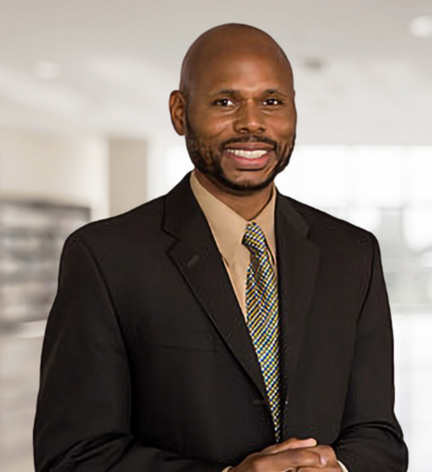
Program Host/Facilitator
I am excited to announce the launch of DPH’s Anti-Racism, Equity, and Inclusive Leaders Fellowship. This fellowship is designed to educate, motivate, and influence DPH leadership at mid-to-senior levels of the organization. It is especially crafted to build and enhance awareness, emotional intelligence, anti-racism leadership competencies and practices, aligning with our mission and the City’s goal of establishing an organizational culture of inclusion and belonging.
The more we lead by example with anti-racism, equity, and inclusion at the center of our practices and approach, the more our employees will follow in how they treat each other – and our patients. This type of critical and vital leadership will enable us to remain a premier healthcare provider of health equity services.
Leading with anti-racism and equity must be at the core of everything we do.
Dante King
DPH Director of Workforce Strategies and Programs and Equity Fellowship Program Lead
Thank you for taking time to consider this transformative and life-changing endeavor. My goal is to educate, liberate, activate, empower, and inspire you to become a premier leader, while challenging you to grow and expand your leadership capabilities. I look forward to engaging and growing with you on this journey of growth, endurance, and change.​

